Slide 1
Networking: TCP/IP

Slide 2
Origins
TCP/IP’s design is a result of its historical role as the protocol system for what was to become the Internet
The Internet grew from research originally performed by the United States Department of Defence

Slide 3
Important features of decentralized TCP/IP
End-node verification: The two computers that are actually communicating (the end nodes) are responsible for acknowledging and verifying the transmission
All computers basically operate as equals, and there is no central scheme for overseeing communications
Dynamic routing: Nodes are connected through multiple paths, and the routers choose a path for the data based on present conditions

Slide 4
TCP/IP features
Logical addressing
Routing
Name resolution
Error control and flow control
Application support

Slide 5
Logical Addressing
A network adapter has a unique physical address
In the case of ethernet, the physical address is typically assigned to the adapter at the factory
The physical address is also known as Media Access Control [MAC] address

Slide 6
ICANN
If your network will be part of the Internet, then ICANN (Internet Corporation for Assigned Names and Numbers) will assign a network ID to your network
This network ID will form the first part of the IP address

Slide 7
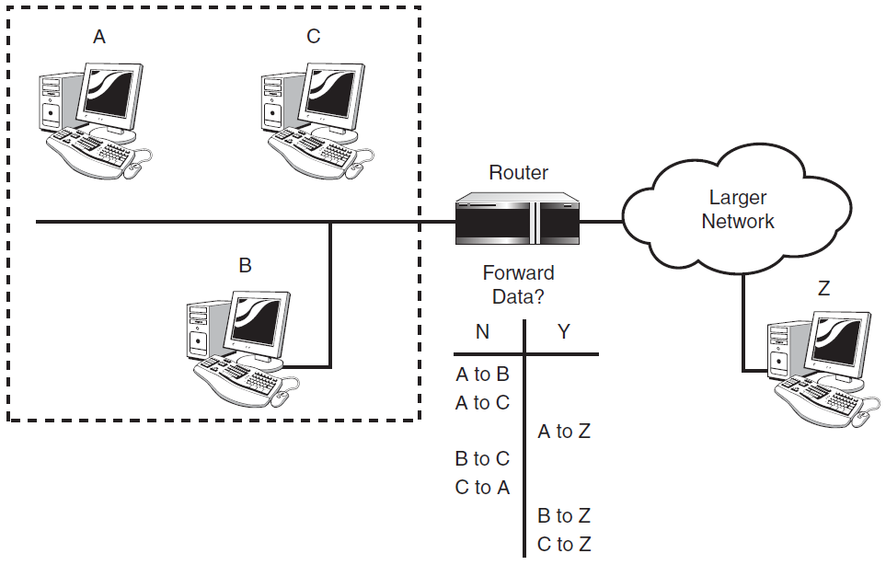
Routing

Slide 8
Name Resolution
DNS is the name resolution system for the Internet and is the most common name resolution method
TCP/IP’s name service system provides for a hierarchy of name servers that supply domain name/IP address mappings for DNS-registered computers on the network
This means that the everyday user rarely has to enter or decipher an actual IP address

Slide 9
Some TCP/IP Utilities
ftp
ping
telnet
traceroute

Slide 10
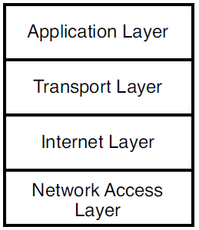
The TCP/IP stack

Slide 11
Network Access layer
Provides an interface with the physical network
Formats the data for the transmission medium and addresses data for the subnet based on physical hardware addresses. Provides error control for data delivered on the physical network

Slide 12
Internet layer
Provides logical, hardware-independent addressing so that data can pass among subnets with different physical architectures
Provides routing to reduce traffic and support delivery across the internetwork
The term internetwork refers to an interconnected, greater network of local area networks (LANs), such as what you find in a large company or on the Internet
Relates physical addresses (used at the Network Access layer) to logical addresses

Slide 13
Transport layer
Provides flow-control, error-control, and acknowledgment services for the internetwork
Serves as an interface for network applications

Slide 14
Application layer
Provides applications for network troubleshooting, file transfer, remote control, and Internet activities
Also supports the network application programming interfaces (APIs) that enable programs written for a particular operating environment to access the network

Slide 15
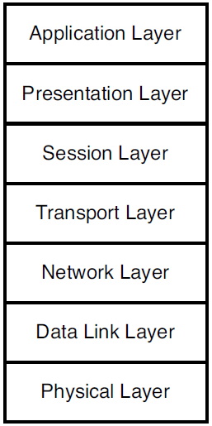
Open Systems Interconnection (OSI) model

Slide 16
OSI Layers
Physical layer: Converts the data into the stream of electric or analog pulses that will actually cross the transmission medium and oversees the transmission of the data
Data Link layer: Provides an interface with the network adapter; maintains logical links for the subnet
Network layer: Supports logical addressing and routing
Transport layer: Provides error control and flow control for the internetwork
Session layer: Establishes sessions between communicating applications on the communicating computers
Presentation layer: Translates data to a standard format; manages encryption and data compression
Application layer: Provides a network interface for applications; supports network applications for file transfer, communications, and so forth

Slide 17
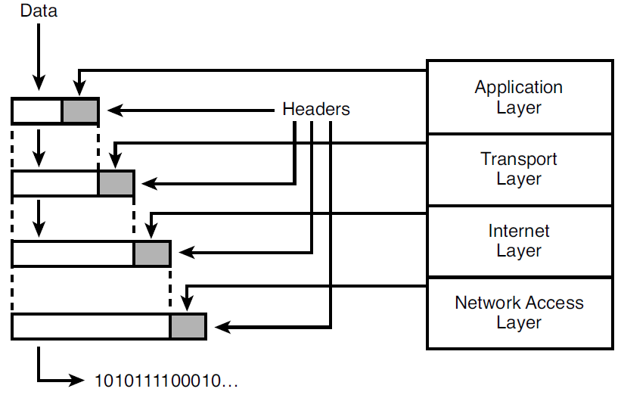
Data Packages

Slide 18
Names for the data packages
The data package created at the Application layer is called a message
The data package created at the Transport layer, which encapsulates the Application layer message, is called a segment if it comes from the Transport layer’s TCP protocol
If the data package comes from the Transport layer’s User Datagram Protocol (UDP) protocol, it is called a datagram
The data package at the Internet layer, which encapsulates the Transport layer segment, is called a datagram
The data package at the Network Access layer, which encapsulates and may subdivide the datagram, is called a frame
This frame is then turned into a bitstream at the lowest sublayer of the Network Access layer

