Slide 1
Java, Web and Design
Toby Dussek
2017

Slide 2
Technical Training: 19 days
Part 1: Java
Part 2: Web
Part 3: Design
Also:
Testing
Networks, servers and clients
Performance and efficiency
Writing plenty of code
Project work

Slide 3
What we cover
Java
HTML
CSS
JavaScript
Also
Web servers
Databases
Security, performance, testing, optimizing, conventions and best practices

Slide 4
Java
Very popular robust language
Strongly typed, so it's harder to write it incorrectly
Object Oriented, so it mirrors reality
Compiles to low level bytecode so it runs really fast
Java Virtual Machine (JVM) can run on any hardware
Open source
currently licensed from Oracle
There is a flavour of Java used in Android devices

Slide 5
HTML
Hyper Text Markup Language
Currently HTML5
Defines the structure of web content
Declarative
Tags and Attributes
Makes up the Document Object Model (DOM)

Slide 6
CSS
Cascading Style Sheets
Declares the style applied to HTML
e.g. colours, fonts, sizes and layout
Also essential to provide alternative styling for different screen sizes

Slide 7
JavaScript (no relation to Java)
The programming language for web content
Much less strict than Java
Any idiot can make a web page
Officially called ECMAScript
ES3, ES5, ES6...
Now becoming popular even outside web content

Slide 8
Web Servers
Just a place to keep web content
Includes loads of security measures
Only publicly accessible using HTTP
Hypertext Transfer Protocol
Often the place to run Java
Alternatively PHP, .NET
Apache is a hugely popular open source server
Microsift have IIS (Internet information Server)

Slide 9
Databases
Extremely efficient place to store and retrieve data
Usually on a Database Server
Usually made up of indexed tables with links between indexes
Most commonly uses SQL
Structured Query Language
CRUD
Create, Read, Update, Delete
Recently small flat-file databases exist on browsers
Also recently NoSQL databases are gaining popularity

Slide 10
Other Languages
C C++ C#
Still a popular choice, but harder to learn and use than Java
A version of C called Objective-C runs Apple devices
Python
Extremely fast, great for science and big data
PHP
Ruby
Go
etc.

Slide 11
What we cover when
One week of Java
Four days of Web Technologies (HTML5, CSS, JavaScript)
Project Work
One week of web design
Most likely a presentation at the end

Slide 12
Exercises, Reviews and Projects
Work through code together
Consolidate with exercises
Most days: after lunch review exercise
Individually or in groups
Use any and all resources
Project work
Meaningful project to implement course content
This is the only part of the Technical Training that is in any way ‘assessed’
i.e. demonstrate progress through course and evidence of assimilation
Will likely overlap with the review exercises

Slide 13
Computers

Slide 14
Machine Language
All computers understand instructions in binary format
A sequence of 0s and 1s
Called machine language or machine code
A computer has a fixed set of basic instructions that it understands, and each computer system has its own set of instructions
For example, 0010 may be an instruction to add two numbers on one computer and 0101 is an instruction to add two numbers on another computer
Programs written in machine language are machine-dependent
Sometimes machine code is referred to as native code as it is native to the machine for which it is written

Slide 15
Add two numbers
The program to add two numbers in machine language will look similar to this:
0010010010 10010100000100110
0001000100 01010010001001010

Slide 16
Assembly Language
An assembly language provides different notations to write instructions
An assembly language uses mnemonics to represent instructions as opposed to the binary 0s and 1s used in machine language
A program written in an assembly language to add two numbers looks similar to the following:
li $t1, 15
add $t0, $t1, 12

Slide 17
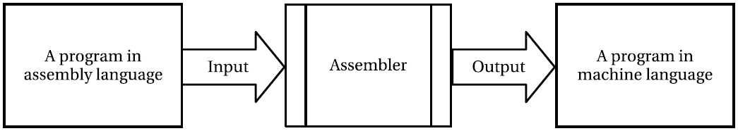
The relationship between assembly code, assembler, and machine code

Slide 18
High Level Languages
COBOL, Pascal, FORTRAN, C, C++, Java, C#, etc.
The high-level programming languages use English-like words, mathematical notation, and punctuation to write programs
A program written in a high-level programming language is also called source code
Java source code looks like this:
int x = 15 + 27;

Slide 19
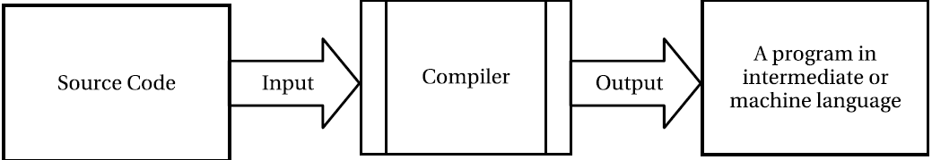
The relationship between source code, a compiler, and machine code

Slide 20
Components of a Programming Language
A programming language is a system of notations that are used to write instructions for computers
Syntax
Valid programming statements
Semantics
The meaning of the programming statements
Pragmatics
The use of the programming language in practice

Slide 21
Common Programming approaches
Imperative – immediate result
Procedural – steps to result (mutate variables)
Declarative – ‘what’ not ‘how’ e.g. SQL
Functional – steps to result (without mutating variables)
Logic – follow axioms to a logical result
Object-Oriented – encapsulate data in object states

Slide 22
Week 1: Java

Slide 23
Overview of Java course content
Set up a development environment
Create classes with modifiers and members
Organize code into packages
Java syntax and structure
Data types and scope
Object-Oriented Programming with Java
Properties, methods and events
Accessing data
Common Java design patterns
Code management: modules and version control

Slide 24
Where to write code
Any text editor will do
Usually use a dedicated Integrated Development environment (IDE)
NetBeans
IntelliJ
Eclipse

Slide 25
Where to run Java code
Most IDEs have a run command
Uses Java Virtual Machine (JVM) behind the scenes
Can also run at a command prompt
Invoke java and pass in parameters (uses javac compiler)

Slide 26
What Is Java?
Java is a general purpose programming language
Supports object-oriented, procedural, and functional programming
Java has features for concurrent applications
A concurrent application has multiple interacting threads of execution running in parallel

Slide 27
What is bytecode?
The Java Virtual Machine (JVM) is a computer inside a computer
Bytecode is code for this virtual computer
Bytecode is not like machine code that would run on a real hardware processor
Computer scientists would call bytecode an intermediate representation, part way between source code and machine code
The whole aim of bytecode is to be a format that can be executed efficiently by the JVM’s interpreter on ANY hardware

Slide 28
Why is it called bytecode?
The instruction code is just a single byte
There are only 256 possible instructions
In practice, some are unused
About 200 are in use
Some of them aren’t used by recent versions of the Java Compiler (javac)

Slide 29
Interpreted versus Compiled Code
The JVM is basically an interpreter, with Just-In-Time (JIT) compilation to give it a big performance boost
Most interpreted languages (e.g. PHP, Perl, Ruby, and Python) directly interpret programs from source form
The JVM interpreter requires class files which require a separate source code compilation step with javac

Slide 31
How Java code is compiled and loaded

Slide 32
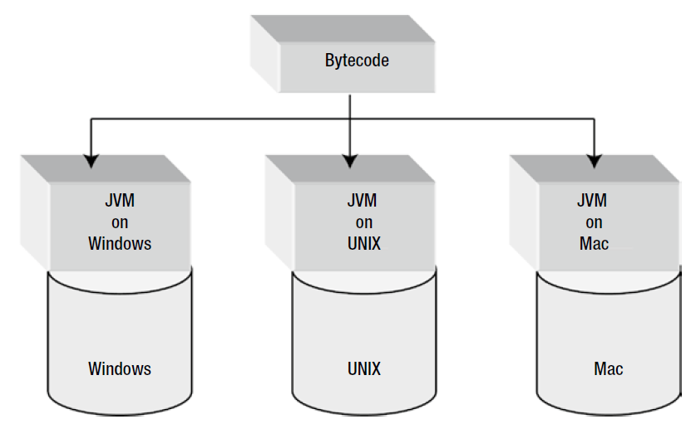
A JVM as a translator between bytecode and an operating system

Slide 33
A Java Object (i.e. a Class)
package com.jdojo.concepts;
public class Person {
private String name;
private String gender;
public Person(String initialName, String initialGender) {
name = initialName;
gender = initialGender;
}
public String getName() {
return name;
}
public void setName(String newName) {
name = newName;
}
public String getGender() {
return gender;
}
}

Slide 34
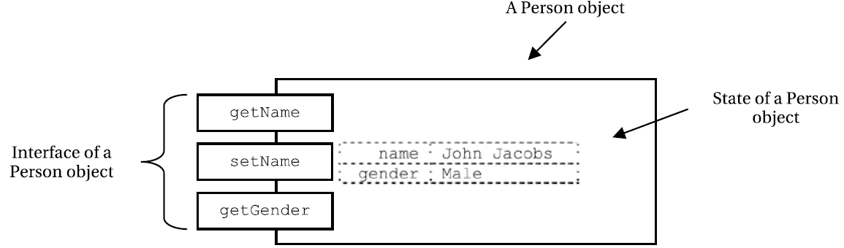
The state and the interface for a Person object

Slide 35
Errors that may occur
Compile-time errors (also known as syntax errors)
Runtime errors
Logic errors

Slide 36
Debugging
The process of finding and fixing bugs in a program
All modern integrated development environments (IDEs) provide a debugger
Can run the program step-by-step to inspect the program’s state at every step

Slide 37
Four Principles of Object-Oriented Java
Abstraction
Encapsulation
Inheritance
Polymorphism

Slide 39
Java Programming
Writing the source code
Compiling the source code
Running the compiled code

Slide 40
Some Terms
Namespace
com.example
Class Library
Useful pre-compiled programs

Slide 41
System Requirements are simple
Java Development Kit
Currently at version 9
Some way to write code
Eclipse
IntelliJ IDEA
NetBeans
Any text editor

Slide 42
Java source code
consists of three parts
Zero or one package declaration
Zero, one, or more import declarations
Zero, one, or more type declarations such as class or interface

Slide 43
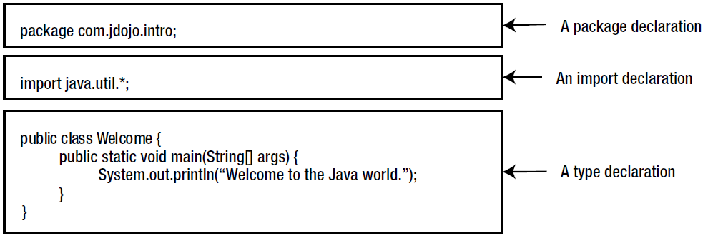
Parts of a Java program

Slide 44
A package collects Java types together
Java source code is case sensitive
class
Interface
Packages provide groupings for related Java types
Packages are optional
If omitted, code will be in an un-named package
Packages are a big help for name-spacing code
avoiding code collisions

Slide 45
Import Declarations
Whenever a type (a class or interface) is used in Java source code it is referred to by its fully qualified name
Import declarations tell the Java compiler that you might use one or more classes from a particular package
So using an import declaration for a type lets you refer to a type using its simple name
import com.jdojo.intro.Account;
import com.jdojo.util.*;
Import declarations are optional

Slide 46
Package Declaration
A package declaration starts with the keyword package followed with a package name
package <your-package-name>;
E.g.
package intro;
package com.wibble.intro.common;
package ie.galway.west;
package com.jdojo.adgr;

Slide 47
Class Declaration
In the simplest form, a class declaration looks like this:
class Welcome {
// Code for the class body goes here
};
The body of a class consists of four parts
All parts are optional, may appear in any order, and can be split into multiple sections
Field Declarations
Initializers: Static initializers and instance initializers
Constructors
Method Declarations

Slide 48
Comments in code
// This is a single-line comment
/*
This is a multi-line comment.
It can span more than one line.
*/
/**
* This is a documentation comment. javadoc generates
* documentation from such comments.
*/

Slide 49
Method Declaration
The first thing you specify is the type of value that a method will return to its caller
If a method does not return anything you must mention that fact in the beginning of the method declaration
The ‘void’ keyword indicates a method does not return anything
The name of the method follows the return type of the method, and left and right parentheses follow the method name
<<MethodReturnType>> <<MethodName>> (<<arguments>>) {
// Body of the method goes here
}

Slide 50
example of a method declaration:
void main() {
// Empty body of the main method
}
This method declaration contains four things:
The method does not return anything as indicated by the keyword void
The name of the method is main
The method requires no arguments
The method does not do anything as its body is empty

Slide 51
Passing values to the method
You need to specify two things about the values you want to pass to the method:
The type of the value you want to pass, e.g. to pass an integer use ‘int’
The identifier, which will hold the value you pass to the method
Identifier is a user-defined name, called a parameter name
If you want the main method to accept one integer value from its caller, its declaration will look like this:
void main(int num) {
//
}

Slide 52
Passing large amounts of parameters
Here num is an identifier of the type int and it can hold one integer value
int num
If you use square brackets it means that num is an array of int and it can hold as many integer values as you want
int[] num
to pass many names to the method main, you can change its declaration as follows:
void main(String[] name) {
}

Slide 53
Main constructor method
The JVM requires that the name of the method must be main
// Welcome.java
package com.jdojo.intro;
class Welcome {
public static void main(String[] args) {
System.out.println("Welcome to the Java world.");
}
}
public and/or static keywords must be present to declare the main method

Slide 54
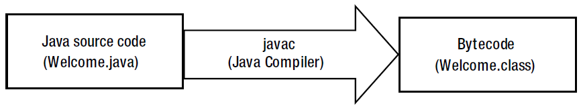
compiling a Java source code into bytecode

Slide 55
Using javac
Supply the source code (Welcome.java) as input to the Java compiler and it generates a new file (or a set of files) with extension .class
The file with extension .class is called a class file
A class file is in a special format called bytecode
Bytecode is a machine language for Java virtual machine (JVM)
At a command prompt, enter
javac Welcome.java
NB may need to add the JAVA_HOME\bin directory to the PATH environment variable

Slide 56
Multiple Classes in One File
You can declare as many classes as you want in one Java source code
The compiler scans the whole source code file
It creates one class file for each class declared in the source code
If the Welcome.java file had three classes, Welcome, Thanks and Bye, the compiler would have generated three class files, Welcome.class, Thanks.class, and Bye.class

Slide 57
Running the compiled code
At a command prompt, enter
java com.intro.Welcome
The JVM tries to locate the bytecode (here, Welcome.class file) for the com.jdojo.intro.Welcome class on your machine
JVM replaces every dot in the fully qualified name of the class with the file-separator character on the host system

Slide 58
Variables and Memory
A variable has three properties:
A memory location to hold the value
The type of the data stored at the memory location
A name (also called identifier) to refer to the memory location

Slide 59
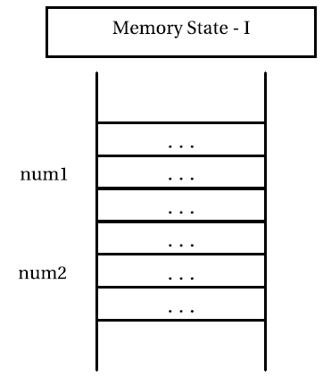
Memory States
The following two lines in a Java program indicate the fact that there are two integers, num1 and num2
int num1;
int num2;

Slide 60
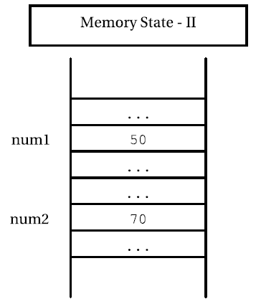
Memory States
This code stores 50 in num1 and 70 in num2
num1 = 50;
num2 = 70;

Slide 61
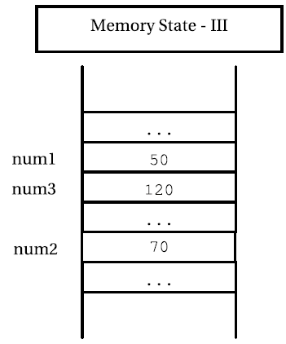
Memory States
This code adds the two numbers and stores the result in another memory location
int num3 = num1 + num2;

Slide 62
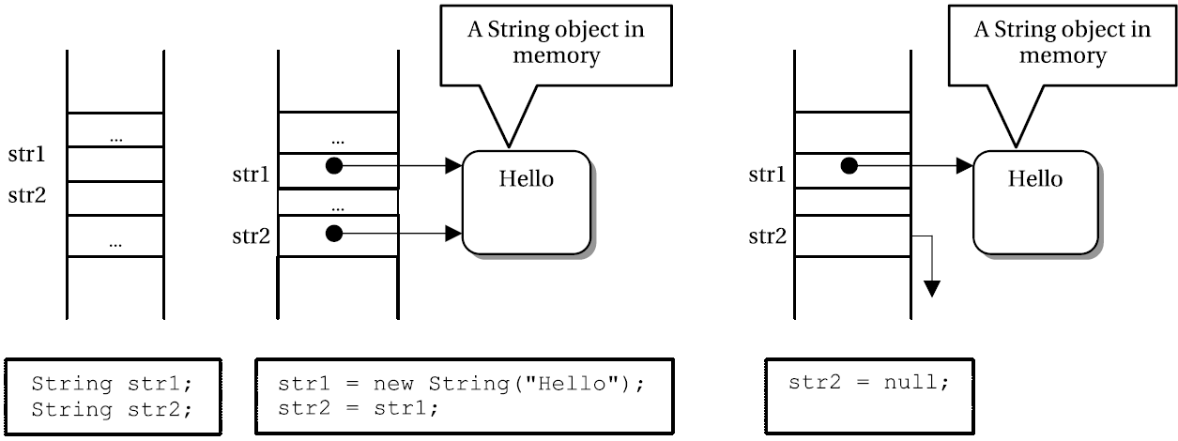
Memory States using null

Slide 63
Java Data Types

Slide 64
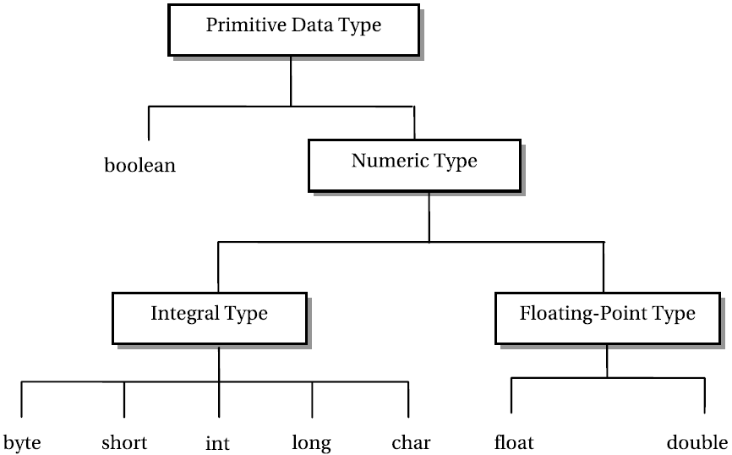
Primitive Data Types in Java

Slide 65
Defining Data Types
Data types are defined in terms of:
A set of values (or data objects)
An int data type consists of a set of all integers between -2,147,483,648 and 2,147,483,647.
A set of operations that can be applied to all values in the set
Operations such as addition, subtraction, multiplication, division, comparison, and many more are defined for the int data type.
A data representation, which determines how the values are stored
A value of the int data type is represented in 32-bit memory in 2’s compliment form

Slide 66
Identifiers
There is no limit on the number of characters used in an identifier
An identifier can be as small as one character long or as big as you want
Identifiers are case sensitive
num and Num are two different identifiers
Use letters, numbers and underscore
E.g. i, x1, theCurrent_Time, 獺
Cannot start with a number
Cannot use hyphen or most punctuation marks

Slide 67
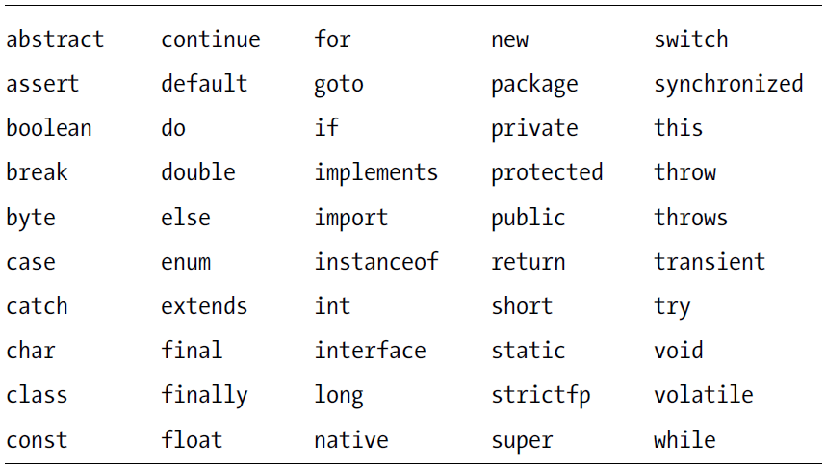
Keywords and Reserved Words in Java

Slide 68
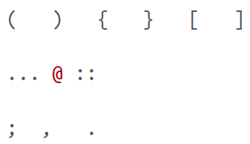
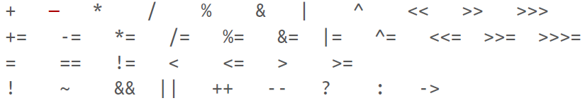
Punctuation
← Separators
Operators →

Slide 69
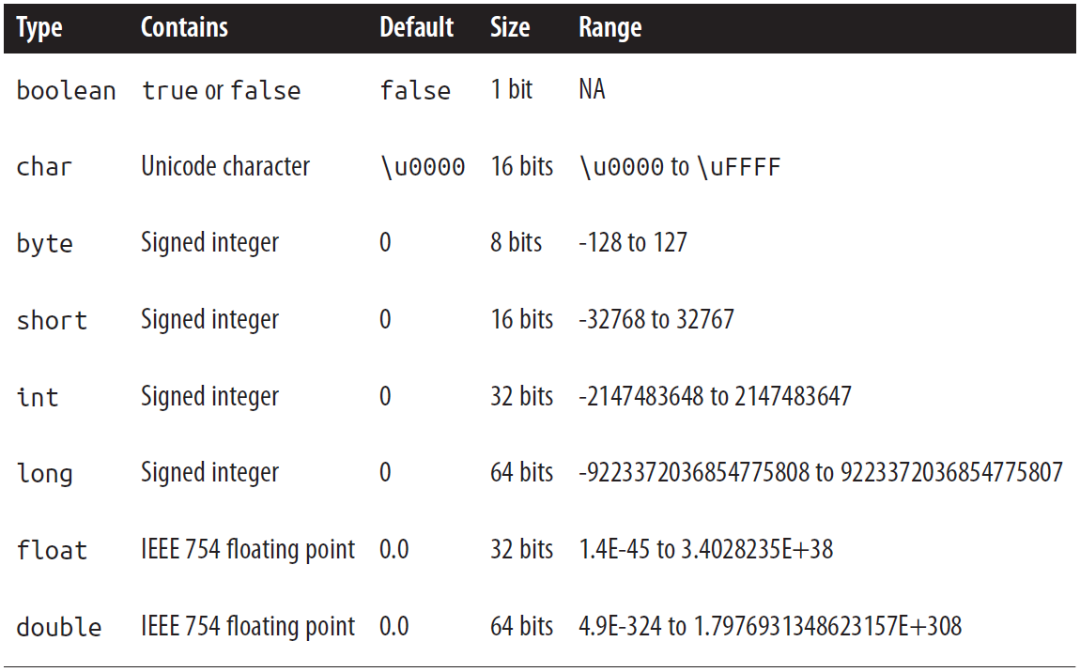
Java primitive data types

Slide 70
Boolean
Things do not default to truthy or falsy
So must explicitly store true or false

Slide 71
Char
To include a character literal in a Java program, simply place it between single quotes
char c = 'A';
char tab = '\t', nul = '\000', aleph = '\u05D0', slash = '\\';

Slide 72
String literals
The String type is a class and is not one of the primitive types of the language
Because strings are so commonly used Java does have a syntax for including string values literally
A string literal consists of arbitrary text within double quotes
"Hello, world"
"'This' is a string
String is a reference type

Slide 73
Integer Types and Wrapper Classes
The integer types in Java are byte, short, int, and long
These types differ only in the number of bits and therefore in the range of numbers each type can represent
1234 // An int value
1234l // A long value
0xffL // Another long value
Each integer type has a wrapper class: Byte, Short, Integer, and Long
These define MIN_VALUE and MAX_VALUE constants
They also define useful static methods, such as Byte.parseByte() and Integer.parseInt(), for converting strings to integer values

Slide 74
Floating-Point Types
Real numbers are represented by the float and double data types
Float is a 32-bit, single-precision floating-point value
Decimals up to 38 digits
Double is a 64-bit, double-precision floating-point value
Decimals up to 300 digits
Floating-point literals can also use exponential notation
1.2345E02 // 1.2345 * 10^2 or 123.45
1e-6 // 1 * 10^-6 or 0.000001
6.02e23 // Avogadro's Number: 6.02 * 10^23
Floating-point literals are double values by default
To include a float value literally follow the number with f or F
double d = 6.02E23;
float f = 6.02e23f;

Slide 75
Real Numbers
Most real numbers, by their very nature, cannot be represented exactly in any finite number of bits
It is important to remember that float and double values are only approximations of the numbers they are meant to represent
Float is a 32-bit approximation, which results in at least six significant decimal digits
Double is a 64-bit approximation, which results in at least 15 significant digits

Slide 76
Float and Double Special Values
In addition to representing ordinary numbers, the float and double types can also represent four special values
positive and negative infinity, zero, and NaN
The Java floating-point types make a distinction between positive zero and negative zero, depending on the direction from which the underflow occurred
Statements that result in these special values:
double inf = 1.0/0.0; // Infinity
double neginf = -1.0/0.0; // Negative Infinity
double negzero = -1.0/inf; // Negative zero
double NaN = 0.0/0.0; // Not-a-number

Slide 77
Integer, float and Decimal Behaviours
Integer arithmetic in Java never produces an overflow or an underflow when you exceed the range of a given integer type
Instead, numbers just wrap around
byte b1 = 127, b2 = 1; // Largest byte is 127
byte sum = (byte)(b1 + b2); // Sum wraps to -128, the smallest byte
Floating-point arithmetic never throws exceptions, even when performing illegal operations, like dividing zero by zero or taking the square root of a negative number
NaN is not a number so the == operator says that it is not equal to any other number, including itself
To check if a float or double value is NaN use Float.isNaN() and Double.isNaN()

Slide 78
Primitive Type Casts
Force a narrowing conversion using a cast
Perform a cast by placing the name of the desired type in parentheses before the value to be converted
int i = 13;
byte b = (byte) i; // Force the int to be converted to a byte
i = (int) 13.456; // Force this double literal to the int 13
The fractional part of the floating-point value is truncated so the floating-point value is rounded toward zero, not toward the nearest integer
Use Math.round(), Math.floor(), and Math.ceil() for other types of rounding

Slide 79
Side Effects
Often an expression has side effects
a[i++] += 2;
a[i++] = a[i++] + 2;
Can be really useful

Slide 80
The Conditional Operator
The conditional operator evaluates the first operand
If true, evaluate and returns the second operand
If false evaluate and returns the third operand
int max = (x > y) ? x : y;
String name = (name != null) ? name : "unknown";

Slide 81
The instanceof Operator
Use only with reference types and objects, not primitive types and values
"string" instanceof String // True: all strings are instances of String
"" instanceof Object // True: strings are also instances of Object
null instanceof String // False: null is never an instance of anything
Object o = new int[] {1,2,3};
o instanceof int[] // True: the array value is an int array
o instanceof byte[] // False: the array value is not a byte array
o instanceof Object // True: all arrays are instances of Object
Use instanceof to make sure that it is safe to cast an object
if (object instanceof Point) {
Point p = (Point) object;
}

Slide 82
Labelled Statements
A statement that has been given a name
Labels are used by the break and continue statements
rowLoop: for(int r = 0; r < rows.length; r++) { // Labelled loop
colLoop: for(int c = 0; c < columns.length; c++) { // Another one
break rowLoop; // Use a label
}
}

Slide 83
Method Signature
The method signature specifies the following
The name of the method
The number, order, type, and name of the parameters used by the method
The type of the value returned by the method
The checked exceptions that the method can throw
Various method modifiers that provide additional information about the method
A method signature defines everything you need to know about a method before calling it
It is the method specification and defines the API for the method

Slide 84
Method Signature Details
modifiers type name ( paramlist ) [ throws exceptions ]
modifiers
zero or more special modifier keywords, separated by spaces
E.g. public and static
type
the return type of the method
If the method does not return a value, type must be void
Otherwise it must include a return statement that returns a value of the declared type
name
May contain letters in any language represented by the Unicode character set
Method Overloading
Can define more than one method with the same name
Each version of the method has a different parameter list

Slide 85
Example Method Definitions
This method is passed an array of strings and has no return value
All Java programs have an entry point with this name and signature
public static void main(String[] args) {
if (args.length > 0) System.out.println("Hello " + args[0]);
else System.out.println("Hello world");
}
This method is passed two double arguments and returns a double
static double distanceFromOrigin(double x, double y) {
return Math.sqrt(x*x + y*y);
}

Slide 86
Constructor
A constructor is a block of code, similar to a method
Used to initialize newly created objects
Constructors are defined in a very similar way to methods, except that their signatures do not include a type specification

Slide 87
Classes and Objects
Classes define new data types
Important to distinguish between the data type itself and the values the data type represents
char is a data type: it represents Unicode characters
a char value represents a single specific character
a class is a data type
a class value is called an object
Each class defines a type or kind, or species, or class of objects
The Java platform includes thousands of predefined classes that are guaranteed to be available on every computer that runs Java

Slide 88
Classes
A class in Java may consist of five components:
Fields
Methods
Constructors
Static initializers
Instance initializers
Fields and methods are also known as members of the class

Slide 89
Class Variables and Instance Variables
// Human.java
package com.jdojo.cls;
class Human {
String name; // An instance variable
String gender; // An instance variable
static long count; // A class variable because of the static modifier
}

Slide 90
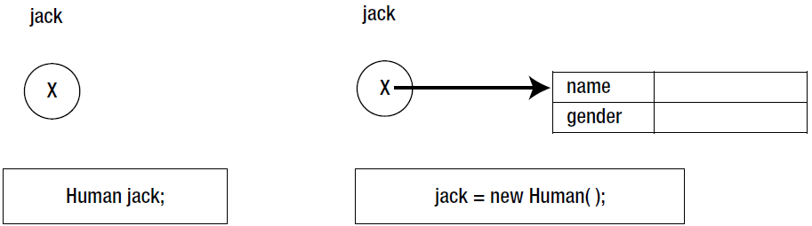
Memory states when a reference variable is declared and assigned

Slide 91
Using Dot Notation to Access Fields of a Class
Dot notation is used to refer to instance variables
jack.name = "Jack Parker";
The following statement assigns the value of the name instance variable to a String variable aName
String aName = jack.name;
Both of the following refer to the count class variable of the Human class
Human.count = 101;
jack.count = 101;

Slide 92
Default Initialization of Fields
All fields of a class, static as well as non-static, are initialized to a default value
The default value of a field depends on its data type
A numeric field (byte, short, char, int, long, float, and double) is initialized to zero.
A boolean field is initialized to false.
A reference type field is initialized to null.

Slide 93
Definition of a Lambda Expression
A lambda expression is essentially a function that does not have a name, and can be treated as a value in the language
In Java, this means that a lambda is an anonymous method that is defined on some class
The syntax for a lambda expression looks like this:
( paramlist ) -> { statements }
Simple example
Runnable r = () -> System.out.println("Hello World");

Slide 94
Java Files
Each file can contain at most one top-level class that is declared public
A public class is one that is designed for use by other classes in other packages
A class can contain any number of nested or inner classes that are public
If a Java file contains a public class, the name of the file must be the same as the name of the class, with the extension .java appended
Regardless of whether your classes are public or not, it is good programming practice to define only one per file and to give the file the same name as the class
When a Java file is compiled, each of the classes it defines is compiled into a separate class file that contains Java byte codes to be interpreted by the Java Virtual Machine.

Slide 95
Development Environment Setup
Run Java SE Development Kit (JDK) accept all defaults
Notice the install location
Set JAVA_HOME to
C:\Progra~1\Java\jdk1.8.0_65 (or similar)
Also add Java bin folder to Path environment variable
Install IDE(s)
NetBeans (with optional servers and junit) – takes ages to install
Eclipse (just unzip it somewhere)
IntelliJ (currently the most polished)

Slide 96
Using Apache Derby as a Database
Derby is written and implemented completely in Java
It provides a small standards-based database engine
https://db.apache.org/derby/derby_downloads.html
Unzip anywhere
Add DERBY_HOME to Environment variables
e.g. <path>\db-derby-10.14.1.0-bin
Add %DERBY_HOME%/bin to PATH

Slide 97
Note on Environment Variables
Changing environment Variables usually means you need to close and re-open the process that uses them
E.g. a command prompt
You can view some system Information
sysinfo
or
systeminfo (windows 10)

Slide 98
The ij Tool
derbytools.jar provides the ij tool
A command line for the derby database
To invoke ij type this at a command prompt:
java org.apache.derby.tools.ij (or else just type ij)
Some sample ij statements:
Create a database (if doesn’t exist) and connect to it
ij> connect 'jdbc:derby:MyDbTest;create=true';
Connect as a client to a database
ij> connect 'jdbc:derby://localhost:1527/MyDbTest;create=true';

Slide 99
Connecting to a Derby Database from Java
At a command prompt, start the derby server
java -jar %DERBY_HOME%\lib\derbyrun.jar server start
Add derbyclient.jar as an external JAR for the project
File-> Project Structure -> Project Settings -> Libraries +
To shut down the derby server just type ctrl-c
or:
java -jar %DERBY_HOME%\lib\derbyrun.jar server shutdown

Slide 100
Simple App (provided with Apache Derby)
Start the derby network database
java -jar %DERBY_HOME%\lib\derbyrun.jar server start
Copy the file ‘SimpleApp.java’ from
<path>db-derby-10.14.1.0-bin\demo\programs\simple
Add a run-time argument (so the app runs as a client of the network database)
derbyclient
Run the ‘SimpleApp’ class

