Slide 1
Python programming
Project Topic: Effect of snow on soil erosion – Raster calculations
Theresa Blaich
Kilian Mouris

Slide 2
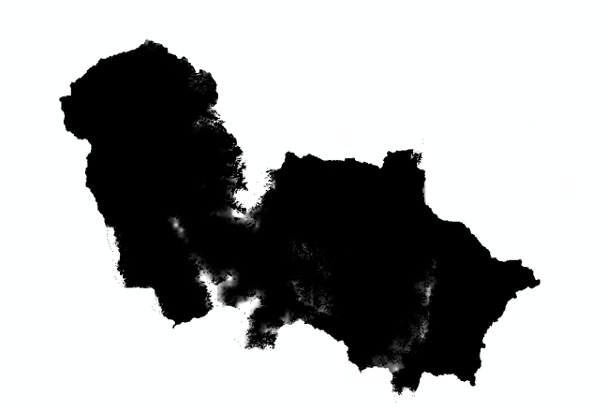
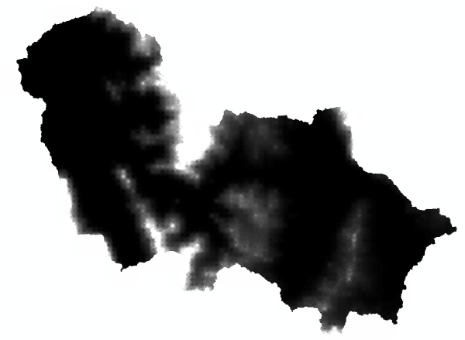
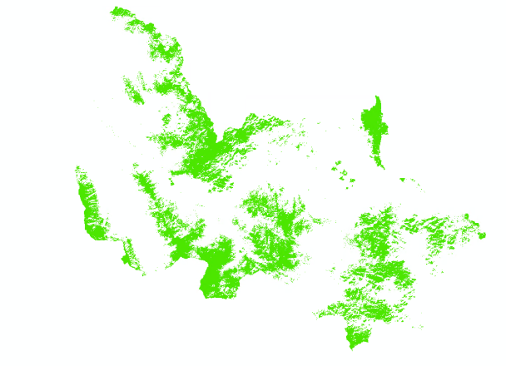
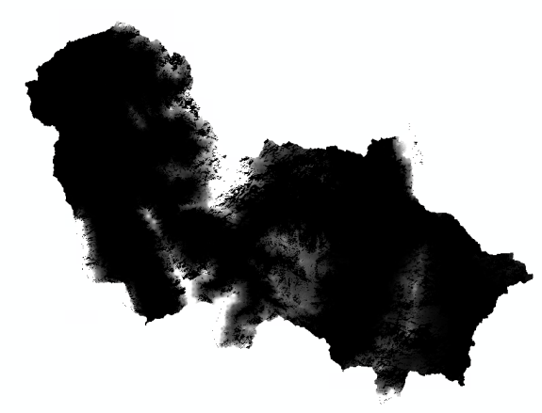

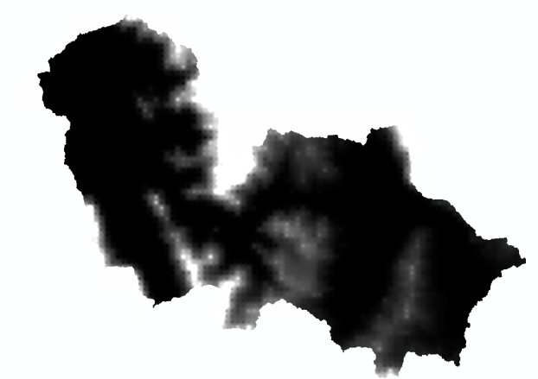
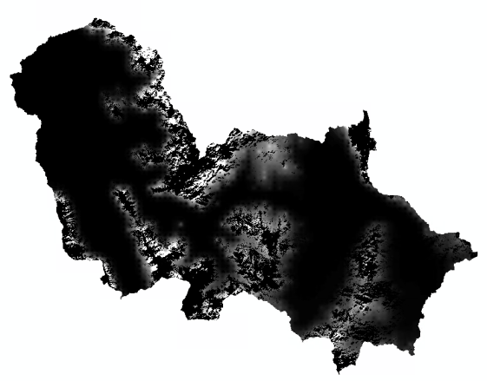
Project Idea
Calculations using December as an example
Snow end of November (mm)
Total snow December (mm)
Snow cover end of December
Snow (mm) end of December
New snow December (mm)
Transferred to January
Total snow December -Snow (mm) end of December
Snowmelt (mm) December
Extension of the RUSLE approach by including effects of snowfall and snowmelt
→ identify snowmelt to include its erosive forces
Erosive in December

Slide 3
Problems & Challenges
Arbitrary number of raster files as input data in a specified folder
Raster files are sorted and processed using a for loop and created functions
Get date from filenames
Function extracts month and year from filename (file ends with yy_mm)
Carry out raster calculations - considering projections, file formats, spatial resolution etc.
Extracted and checked before calculations
taking into account the temporal sequence (previous results affect the following months)
Considered in for loop and raster calculation functions
Write result files in raster format (accessible for all common GIS programs, e.g. .tiff)
Using a custom save raster function and geotransform, projection as input arguments

Slide 4
Functionality
General functionality of our code:
Creates result folders if they don‘t exist
Loads all the input raster files, gets their geodata, raster arrays, and dates
Checks the array shape, geodata and number of files before calculation
Calculates the snow depth (end of each month) and the snowmelt (per month)
Saves resulting raster arrays in .tiff-format and names them by date
Calculates statistics

Slide 5
Code diagram
geo_utils
raster_calculations.py
RasterCalculations
snow_at_end() snowmelt() snow_at_start()
snow_start_of_period snow_cover snow_measured
data_management.py
DataManagement
folder_creation() get_date() get_proj_data() save_raster()
path filename
check_functions.py
CheckInputData
compare_shape() number_of_items() compare_geotransform() compare projection()
array_one array_two raster_one_path raster_two_path
config.py
global libraries
Snow_mm_path SnowCover_path path_results
log.py
wrap() entering() exiting()
fun.py
check_input() raster2nested_list() compare_date calculate_snowmelt()
statistics.py
get_zon_statistics() coverage()
main.py
main()

Slide 6
Constituent elements
3 classes
Raster math operation (+shapefile attribute table)
Magic methods
Log file
Wrapper function

Slide 7
Timeline
28th Feb
Improve stability
Finish ReadMe, check & correct whole project
Last week
Next week
This week
check functionality & implement/improve missing components
Deadline

Slide 8
Resource allocation
Kilian:
Class Data Management
statistics.py
Theresa:
Class Raster Calculations
Class Check Functions
Together:
main.py, fun.py
Readme
Check & correct

Slide 9
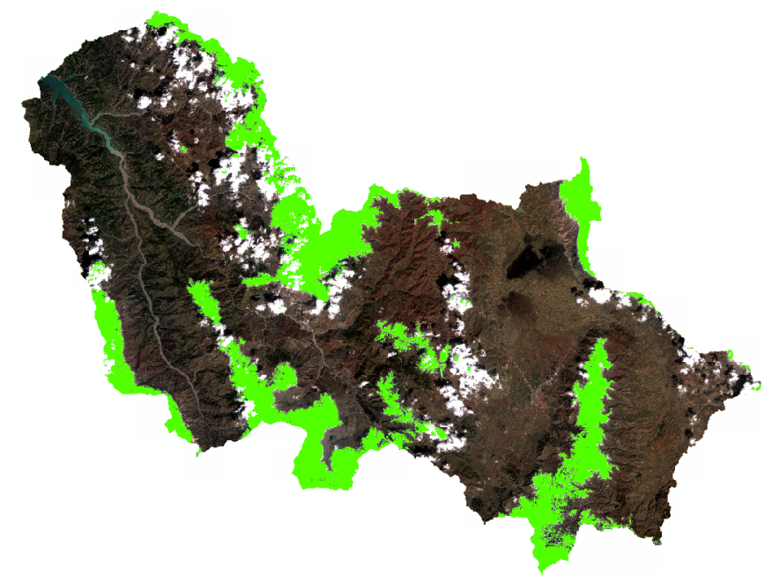
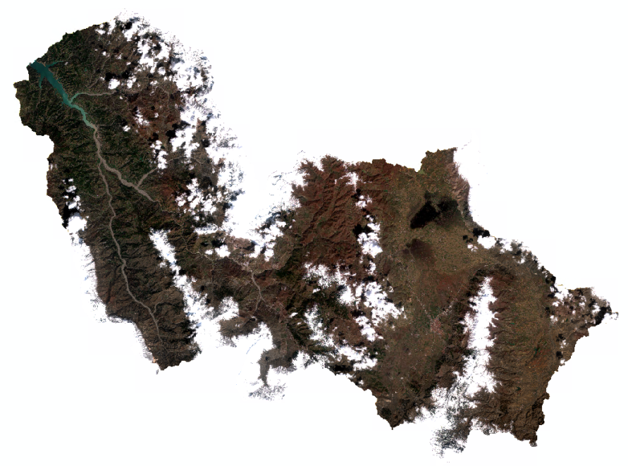
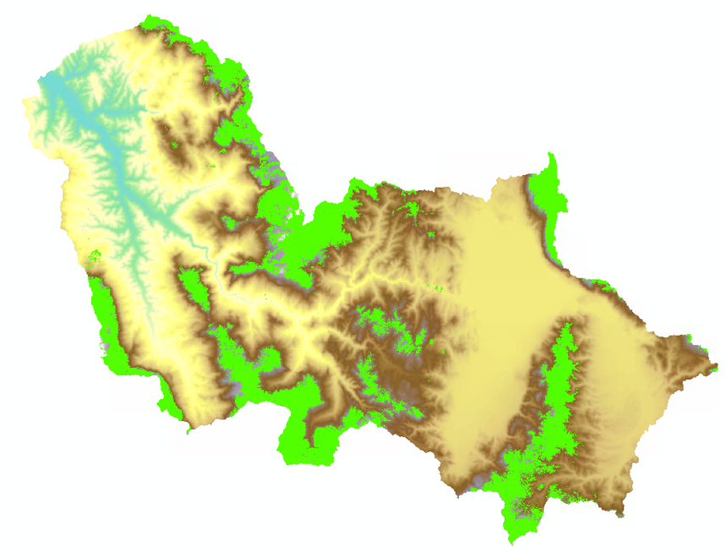
Additional

Slide 10
Project Idea
Overview
Extension of the RUSLE approach to estimate soil erosion by including the effects of snowfall and snowmelt → distinguish between precipitation in the form of rain (erosive) or snow (non-erosive), already done → identify snow cover from satellite images, already done → identify subsequent snowmelt to include its erosive forces, Project work
Snowfall (mm) per month
Snow at the end of each month (mm)
Project Code
Snow cover at the end of each month
Snowmelt per month (mm)

