Slide 1
Python Progamming
Exam Project: Snow Raster
Theresa Blaich
Kilian Mouris

Slide 2
Project Idea
Overview
Extension of the RUSLE approach to estimate soil erosion by including the effects of snowfall and snowmelt → distinguish between precipitation in the form of rain (erosive) or snow (non-erosive), already done → identify snow cover from satellite images, already done → identify and include the erosive forces of subsequent snowmelt, Project work
Snowfall (mm) per month
Snow at the end of each month (mm)
Project Code
Snow cover at the end of each month
Snowmelt per month (mm)

Slide 3
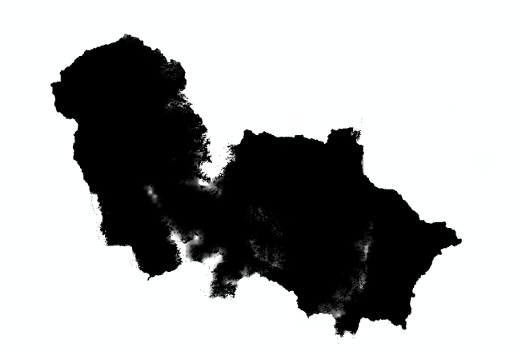
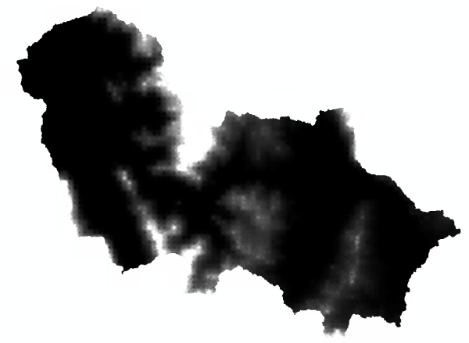
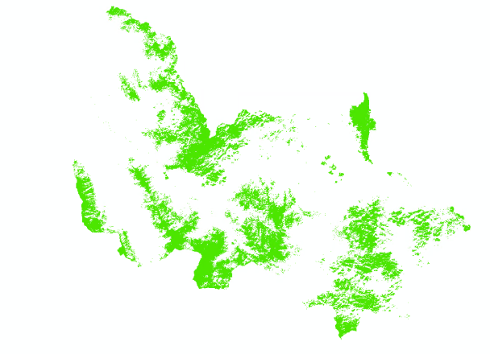
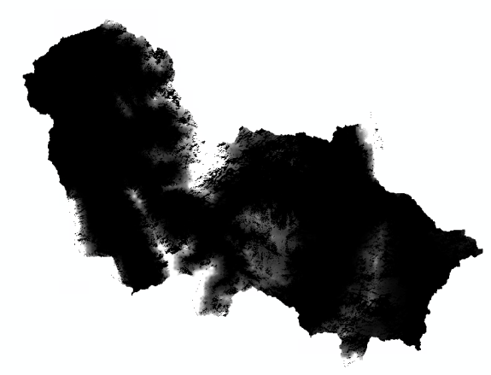

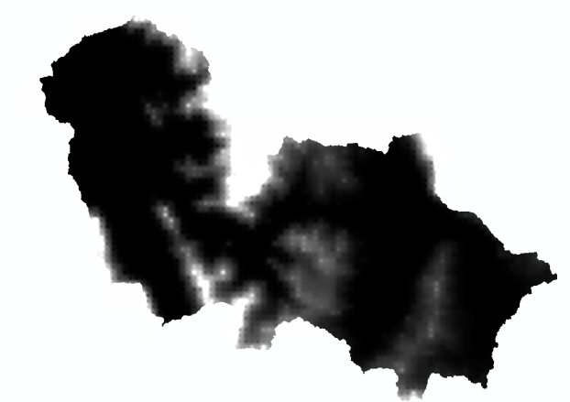
Project Idea
Calculations using December as an example
Snow end of November (mm)
Total snow December (mm)
Snow cover end of December
Snow (mm) end of December
New snow December (mm)

Slide 4
Problems & Challenges

Slide 5
Goal of the program
Class data management:
Create folders to save results
Load, read and write raster files (transform Raster to arrays; save arrays as raster)
Class check functions:
Check if raster formats are all equal
Get raster data
Class Raster Calculations:
Multiplying raster (to get actual snow at the end of the month and snowmelt)
Adding raster (to get new snow)
Calculate monthly snowmelt which acts as erosive force

Slide 6
Timeline
Week 1
Code design: classes and functions => diagram
Week 2
Week 3
Week 4
Week 5
Week 6
Week 7
10th Feb: Detailed project plan presentation
28th Feb: Deadline
Prepare presentation
Check, correct and improve code
Fundamental and optional components
Finish code + Readme
Problems, Questions
Write Classes + Main Script

Slide 7
Resource allocation
Kilian:
Class Data Management
Main Script
Theresa:
Class Raster Calculations
Class Check Functions
Together:
Design code
Readme
Presentation
Check & correct

Slide 8
e-mail
phone +49 (0) 711 685-
www.
University of Stuttgart

Slide 9
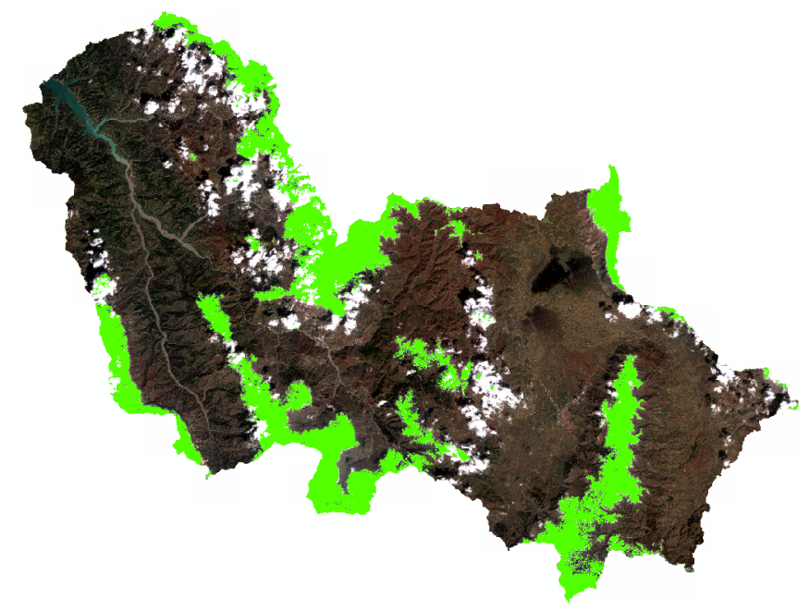
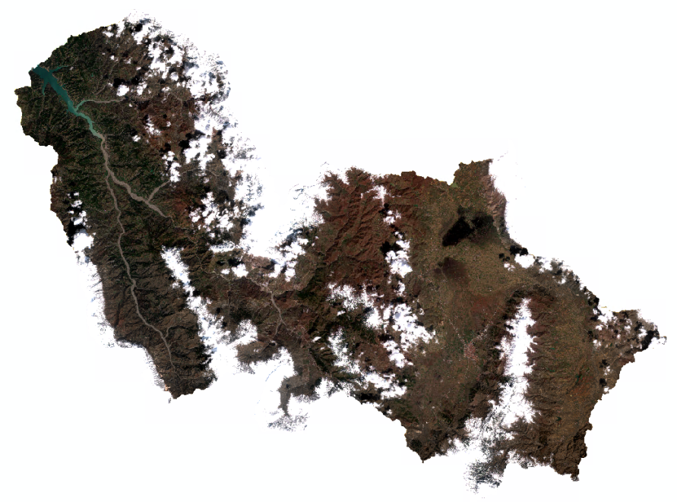
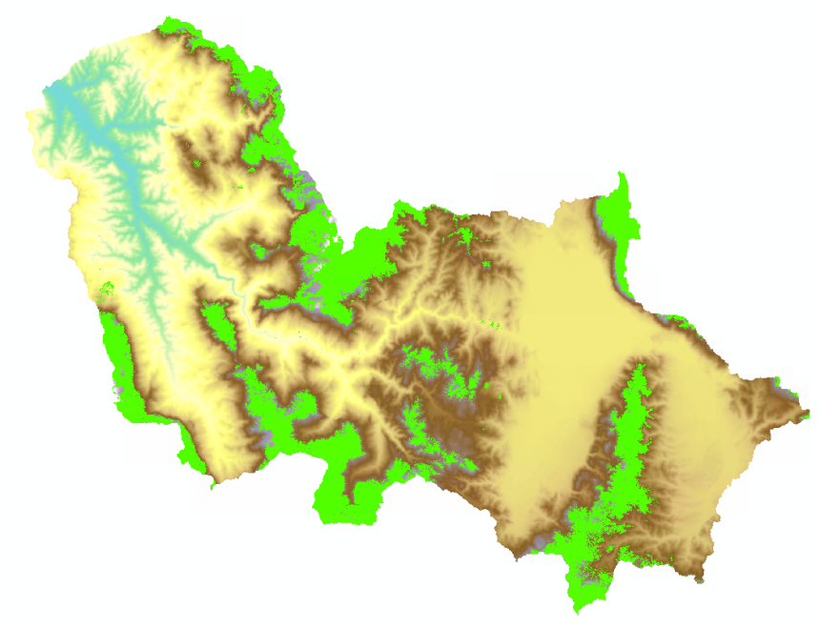
Additional

