Slide 1
IEEE ESEK SYMPOSIUM 2017
Engineering solutions to expand Kenya's self-reliance
‘AUTO-MA3 SYSTEM’

Slide 2
PRESENTERS:
KITHINJI A. MURIUNGI
MOI UNIVERSITY,
BEng.(Electrical and Electronics Engineering).
ROBERT NDUNG’U
MOI UNIVERSITY,
BEng.(Electrical and Telecommunications Engineering).

Slide 3
INSIGHT:
HOW MANY TIMES HAVE YOU BOOKED A MATATU AND THEN LEFT BEHIND BECAUSE OF WRONG TIMING???
HOW MANY CASES HAVE BEEN REPORTED MONTHLY WHERE ACCIDENT OCCURS AND THEN THE PASSENGERS ENDS UP NOT BEING NOTICED???
HOW MANY CASES HAVE BEEN REPORTED CONCERNING THE SECURITY OF THE PASSENGERS???
HOW MANY TIMES HAVE YOU LOST SOMETHING WHILE TRAVELLING AND YOU END UP NOT BEING ABLE TO TRACE IT BACK???
HOW MANY ARE SATISFIED WITH THE WAY MATATU SERVICES ARE BEING DELIVERED TO THE PASSENGERS???
HOW MANY FEEL THAT THE MATATU NEEDS TO BE “DIGITAL”???

Slide 4
INTRODUCTION:
STATEMENT OF PROBLEMS
INSECURITY: Public transport has been insecure in the recent times especially those travelling for long distances.
TIME: There has been a lot of time wastage especially in seasons where there is irregular availability of the passengers.
TECHNOLOGY: In the informal sector, these businesses (matatu) are seen as minial and lack the technological spur to grow.

Slide 5
SOLUTIONS OF THE PROBLEMS:
Time is saved for the passengers instead of waiting in the stage for the all day.
The powerful database provides all data concerning the passengers and the Saccos hence accountability and integrity guaranteed.
Security is guaranteed since all travelling passengers will have to provide their phone numbers, ID numbers, or any other form of identification i.e police tracking.
The system supports other analysis from the data collected hence helping the saccos to improve on their services.
Quality of services is guaranteed due to positive competition.
Receipts can be printed and produced for the passengers, drivers, and other parties concerned.

Slide 6
RELATION WITH THE ESEK THEME
Offers a Real Engineering solution
It’s an innovation hence encouraged by IEEE ESEK since none is available in the market.
Offers a better chance to link between the academia and industry.
Provides an Entrepreneurial solution in the market.
Broad benefits for both private and public sectors.

Slide 7
AUTO-MA3 SYSTEM
Web Application with the integration of USSD.
Manages Booking and other Services offered by the Matatus
Real-Time Automatic Alerts and Notifications
Receipts processing
Know your favorite vehicle timing
ADVANCED : GPS integration to locate location of the matatu (v2.0)

Slide 8
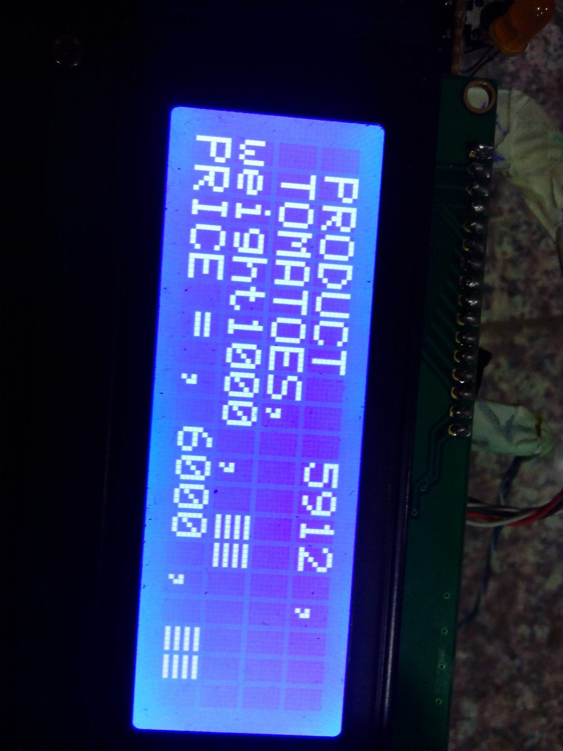
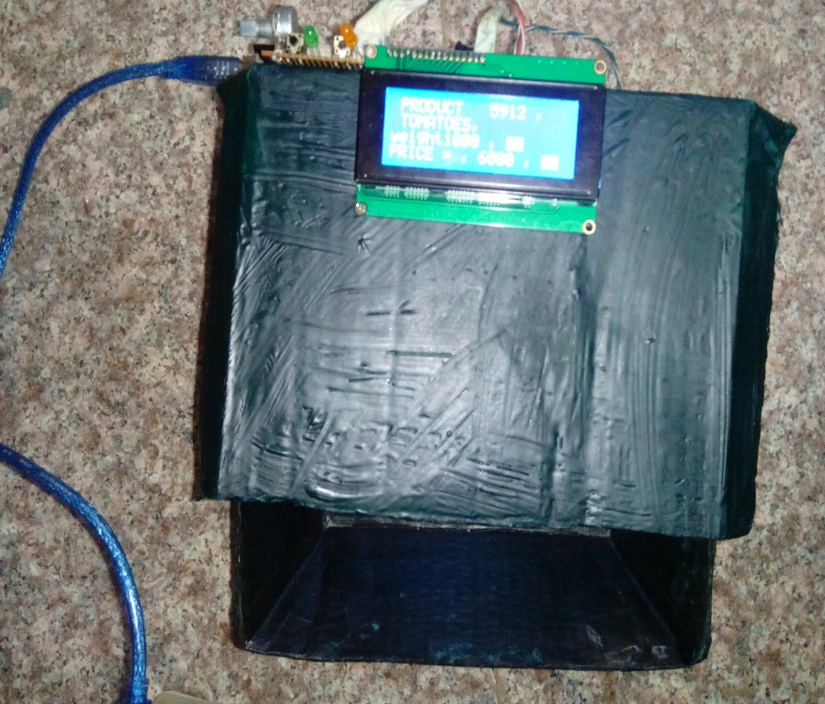

Slide 9
COMPETITOR IN THE MARKET:
BAR-CODE BASED POINT OF SALE SYSTEM
The system operates well where products are packed hence given a bar-code.
LIMITATION OF BAR-CODE BASED SYSTEM
No choice.
limited to buying the exact quantities.
Its expensive due to products packaging and labeling which requires more personnel and resources.

Slide 10
TARGET MARKET :
LARGE SCALE SELLERS i.e. SUPERMARKETS, AND HYPERMARKETS
30% market share
Big on customer experience
1 million first year profits
Exponential growth

Slide 11
THE BUSINESS MODEL
CAPITAL REQUIRED:-
The Approximate capital cost per unit is Kshs. 5000 reduces to 2000 with mass production
We target an expansive informal market and also supermarkets hence there is sure returns.
MARKET ENTRY STRATEGY:-
Starting with conventional self service stores and eventually going into the hundreds of informal businesses after proof of concept.
``

Slide 12
CALL FOR INVESTORS
The system offers advantages to both buyer and seller and has a broad market base making the project very viable and attractive.

