Slide 1
IEEE STUDENTS EXPO 2015
‘GREENTECH’
A SMART GREEN-GROCERY POINT OF SALE SYSTEM

Slide 2
PRESENTERS:
PETER NDUNG’U KAMAU
MOI UNIVERSITY,
BEng.(Electrical and Electronics Engineering).
KITHINJI A. MURIUNGI
MOI UNIVERSITY,
BEng.(Electrical and Electronics Engineering).

Slide 3
INTRODUCTION:
STATEMENT OF PROBLEMS
Green groceries are highly interpersonal businesses this is lost as scales of operation increase hence condemning them to remain small.
Prices are based majorly on owners’ judgment and not based on exact factual information this limits profits.
In the informal sector, these businesses(mama mboga) are seen as minial and lack technology investment to spur growth.

Slide 4
SOLUTIONS OF THE PROBLEMS:
The system standardizes service ensuring repeat customers and sure profits since the price is a mathematical result rather than a broad approximation.
It digitizes data and offers analytical information of the businesses making them attractive to financial market players.
Create a system that is able to alert the proprietor about the stock flow based on the stock flow rates and trends. This allows expansion of the business.

Slide 5
THE SMART GREEN-GROCERY POINT OF SALE SYSTEM,
Works by identifying the product in question using a colour sensor. Analysis of light spectrum tells products apart.
The weight and the product is measured and the system automatically calculates the cost of the product by the use of designed algorithm specifically meant for each products.

Slide 6
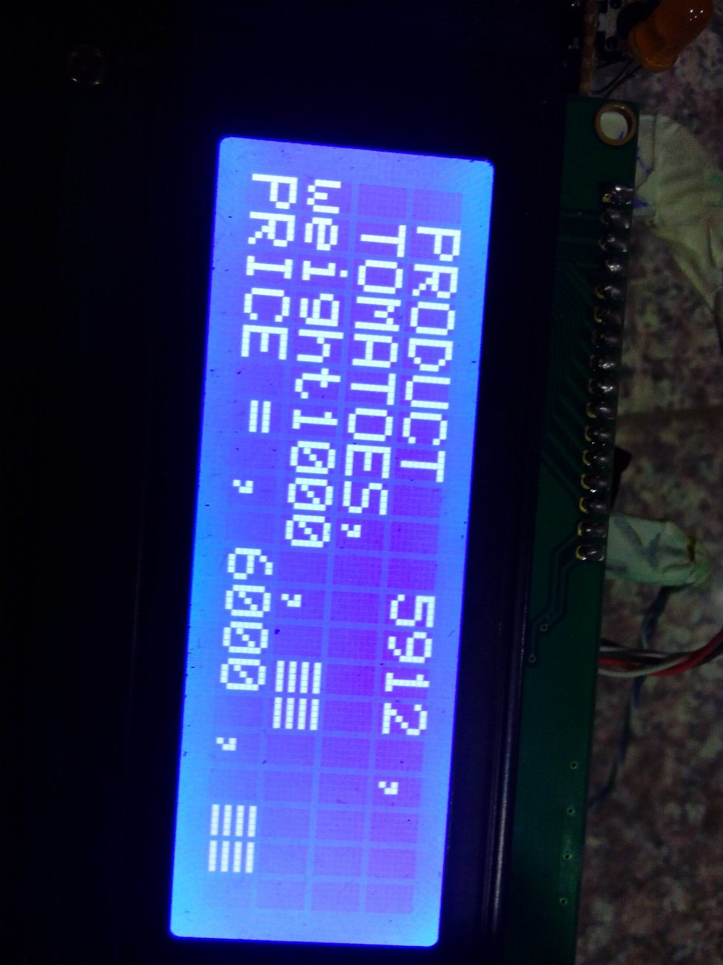
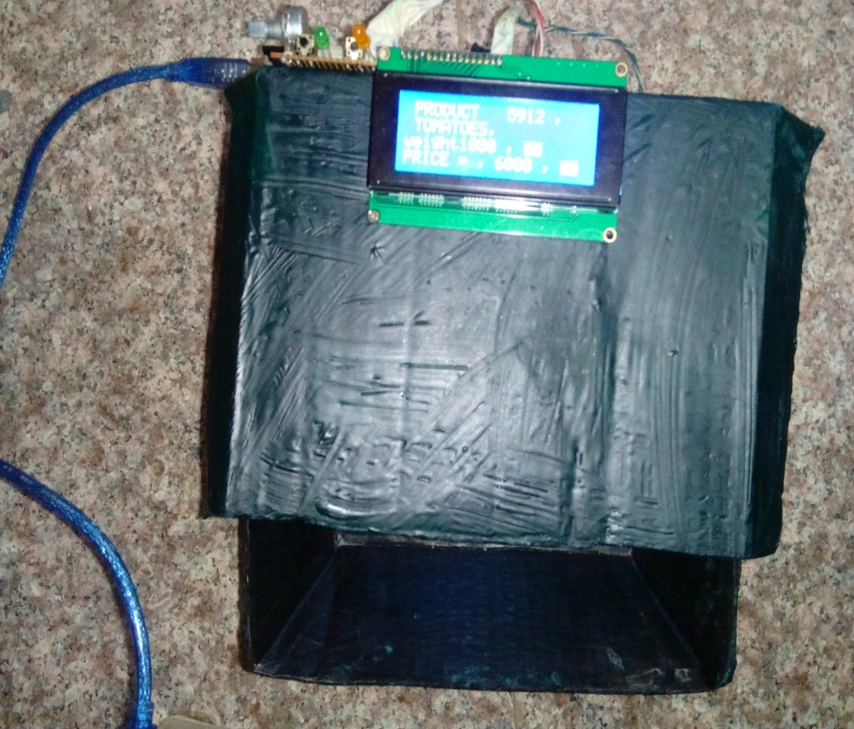

Slide 7
Competitor in the Market:
BAR-CODE BASED POINT OF SALE SYSTEM
The system operates well where products are packed hence given a bar-code.
LIMITATION OF BAR-CODE BASED SYSTEM
No choice.
limited to buying the exact quantities.
Its expensive due to products packaging and labeling which requires more personnel and resources.

Slide 8
COMPETITIVE ADVANTAGES:
Pricing system is wholly based on the stocked weight and intended profits.
Customer pays for exact amount purchased.
The proprietor can easily manage the stocks of all products even with an expanded business.
The system offers alerts when stocks are running out based on stock flow trends
Cloud services,

Slide 9
TARGET MARKET :
LARGE SCALE SELLERS i.e. SUPERMARKETS, AND HYPERMARKETS
30% market share
Big on customer experience
1 million first year profits
Exponential growth

Slide 10
TARGET MARKET :
TRADITIONAL AND INFORMAL SECTOR
70% market share
Thousands of small outlets
Profits from third year
Offer of cloud services , main attraction

Slide 11
THE BUSINESS MODEL
CAPITAL REQUIRED:-
The Approximate capital cost per unit is Kshs. 5000 reduces to 2000 with mass production
We target an expansive informal market and also supermarkets hence there is sure returns.
MARKET ENTRY STRATEGY:-
Starting with conventional self service stores and eventually going into the hundreds of informal businesses after proof of concept.
``

Slide 12
CALL TO INVESTORS
The system offers advantages to both buyer and seller and has a broad market base making the project very attractive.

