Slide 1

Movie Reviews
Analysis
Group 3
Nguyễn Minh Hoàng , Nguyễn Xuân Dương, Nguyễn Đăng Khôi, Vũ Trần Nam Khánh

Slide 2




Table Of Content
Preprocessing
Baseline model
Error analyss
Improvement
Nguyễn Đăng Khôi
Nguyễn Xuân Dương
Nguyễn Minh Hoàng
Vũ Trần Nam Khánh

Slide 3
Introduce Dataset
DATASET
MISSION
Name: IMDB Dataset of 50K Movie Reviews
Size: 50K row
2 column
Review
Sentiment
Input: Review (A raw text string)
Output
0: Negative
1: Positive

Slide 4
Preprocessing
Nguyễn Đăng Khôi

Slide 5
PREPROCESSING PIPELINE
HTML Cleaning
Special Character Removal
Lowercasing
Tokenization
Stopword Removal
Lemmatization

Slide 6
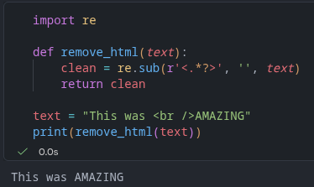
HTML Cleaning
Remove all HTML tags from raw review.

Slide 7
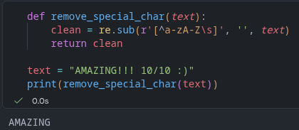
Special Character Removal
Remove special characters, keep only letters.

Slide 8
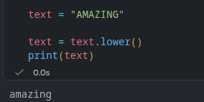
Lowercasing
Convert everything to lowercase.

Slide 9
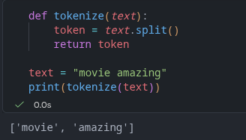
Tokenization
Break the sentence down into individual words.

Slide 10
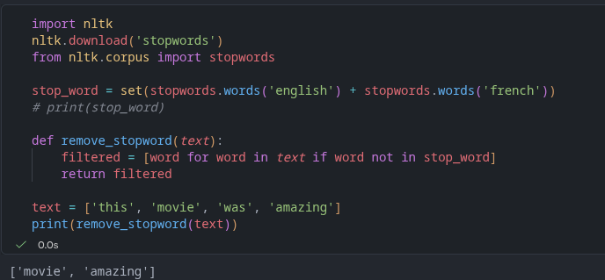
Stopword Removal
Removing meaningless words that doesn't help the model learn.

Slide 11
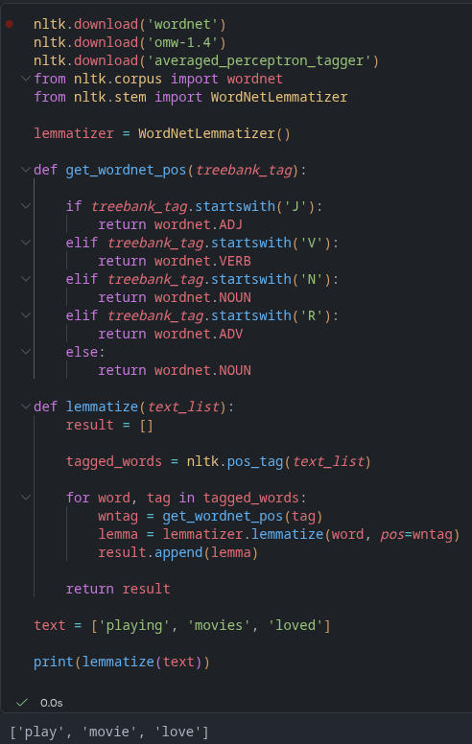
Lemmatization
Restore the word to its original form using a dictionary.

Slide 12
Apply to the real dataset (IMDb 50K Movie Reviews)
Here is the result
Before
After
I had the terrible misfortune of having to view this "b-movie" in it's entirety.<br /><br />All I have to say is--- save your time and money!!!
terrible misfortune view bmovie entirety all say save time money

Slide 13

Baseline model
Nguyễn Xuân Dương

Slide 14



Text representation
OneHotEncoding
Detects the presence of a word in a document
Bag of Words
Detects the occurence of a word in a document
TF - IDF
Detects the importance (weight) of a word in a document

Slide 15
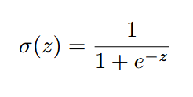


Classification Algorithm
Logistic Regression
Predicts based on the weight of the word
Naives Bayes
Predicts based on the probability of the word within a class

Slide 16
Results
Model Architecture | Training Score | Testing Score
One-hot-encoding + Naive Bayes | 84.52% | 84.33%
One-hot-encoding + Logistic Regression | 89.32% | 86.99%
Bag-of-words + Naive Bayes | 83.79% | 83.41%
Bag-of-words + Logistic Regression | 89.32% | 86.63%
TF-IDF + Naive Bayes | 84.77% | 84.29%
TF-IDF + Logistic Regression | 89.32% | 87.11%
Conclusion!
Logistic Regression is better at predicting than Naive Bayes
But why?

Slide 17
Error analysis
Nguyễn Minh Hoàng

Slide 18
Example 1
I admit creating great expectations before watching because some friends mentioned it (and they are not pervs!) as a must see. And it is a must see! Just don't expect to see something outbreaking. The Freudian psychoanalyzes are interesting in many parts of the film, but there's just too much perversion and it doesn't stick in the end. Some of the good things are the analyzes of Kieslowski's Blue, most of David Lynch's, some of Hitchcock's and perhaps a couple more I missed (I just remembered...), and I usually don't miss things unless they are too obvious or loose in the air. Other than being repetitive, which makes it too long, the documentary is enjoyable in the sense of noticing some perversions fed by our unconscious, hence the commercial success of most thrillers studied and used as basis for this theory. I really enjoyed the energetic tone of the narration and the effort of Mr. Zizek to revive Freud's theory, which has been numb for too long, specially in north America. Again, it's way over the top and I believe not to be a completely waste of time for I do believe most humans have a dark appreciation for death and blood.
True label: Negative
Model predict: Possitive
Why the model is wrong: Mix Review
The number of positive words that appear is higher than Negative words
“Not to be a completely waste of time “: The “Not” and “waste of time” is too far

Slide 19
Example 2
The story of the bride fair is an amusing and engaging one, and it is to the filmmaker's credit that he sets out to portray rural Minnesotans with the same respect ordinarily reserved for Coast-dwellers. It is weird, though, to find an independent movie, the brainchild of a single person, that is as unambitious and clichéd©-ridden as a committee-brewed Hollywood potboiler. The portrait of rural people is intended to be affectionate, I think, but these characters don't ring true to me--I have had quite a few meals in small-town diners, but never overheard a debate on the merits of different nineteenth-century English novelists. One might suggest that writer/director Seamans has no more experience with rural culture than the Coen brothers, and considerably less satiric verve.
True label: Negative
Model predict: Possitive
Why the model is wrong:
For me: They can’t understand The writting style of the human
User would like to praise a few aspects of the film ⟶ Talk about what they don’t like in the film
“Don't ring true to me”: The model only test 1, 2 words near ⟶ they can’t trully understand this part
For LLM: cannot understand Concession
Human critics often try to be polite. They start by praising the director's intentions before destroying the actual execution of the movie.

Slide 20
Example 3
Farrah Fawcett gives an award nominated performance as an attempted rape victim who turns the tables on her attacker. This movie not only makes you examine your own morals, it proves that Fawcett can excel as a serious actress both as a victim and victor.
True label: Positive
Model predict: Negative
Why the model is wrong: Lack of classification words
For me:
The reviews only talk about the actress and his movie, what it talk about?
The model is completly blind in context
LLM:
The model does not understand that these dark words are merely describing the plot of a thriller/drama movie. To the algorithm, "attacker" is pure negative noise that distracts from the praise of the actress.

Slide 21

Problems model can predict wrong
Sarcasm & Irony: Using positive words to express a negative thought
Negation: When a modifier flips the meaning of the word next to it
Mixed Sentiment/Long Reviews: The main point is hide in the long paragraph.
Out of Vocabulary: Slang, typos, or new words the mode never saw
Hypotheticals and Conditionals: The user describe their wish bit not happen
Domain-Specific Noise: Vocabulary that change the sentimenent depend on the movies types
Context-Dependent Words: Words that change their meaning depending on the subject

Slide 22
Improvement
Vũ Trần Nam Khánh

Slide 23
IMPROVEMENT
As we can see from the error analysis...

Slide 24
IMPROVEMENT
As we can see from the error analysis...
From what we have noted, that those baseline models we worked - are Frequency Based Word Embedding.

Slide 25
IMPROVEMENT
As we can see from the error analysis...
From what we have noted, that those baseline models we worked - are Frequency Based Word Embedding.
Our new “embedding” attempt we will cover is Prediction Based Word Embedding.

Slide 26
IMPROVEMENT - Word2Vec
We will use Word2Vec to work with (from Gensim pip library).

Slide 27
IMPROVEMENT - Word2Vec
We will use Word2Vec to work with (from Gensim pip library).
If you pay attention, there are two architectures that we can choose from : Continuous Bag Of Words (CBOW) and Skip-gram.
For the sake of simplicity of this presentation and for the project, we will only talk about CBOW.

Slide 28
IMPROVEMENT
Our code / program of the model : initialization with Word2Vec - CBOW

Slide 29
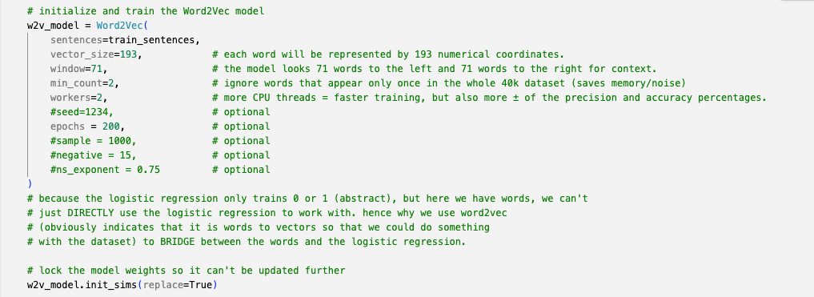
IMPROVEMENT
Our code / program of the model : initialization with Word2Vec - CBOW

Slide 30
IMPROVEMENT
Our code / program of the model : initialization with Word2Vec - CBOW
let’s just care the first 5 parameters because those would make an important difference.

Slide 31
IMPROVEMENT
Our code / program of the model : initialization with Word2Vec - CBOW
let’s just care the first 5 parameters because those would make an important difference.
that is, they are somewhat important and optimal for the best accuracy and precision score.

Slide 32
IMPROVEMENT
How would CBOW benefit more from this new data representation than the baselines ?

Slide 33
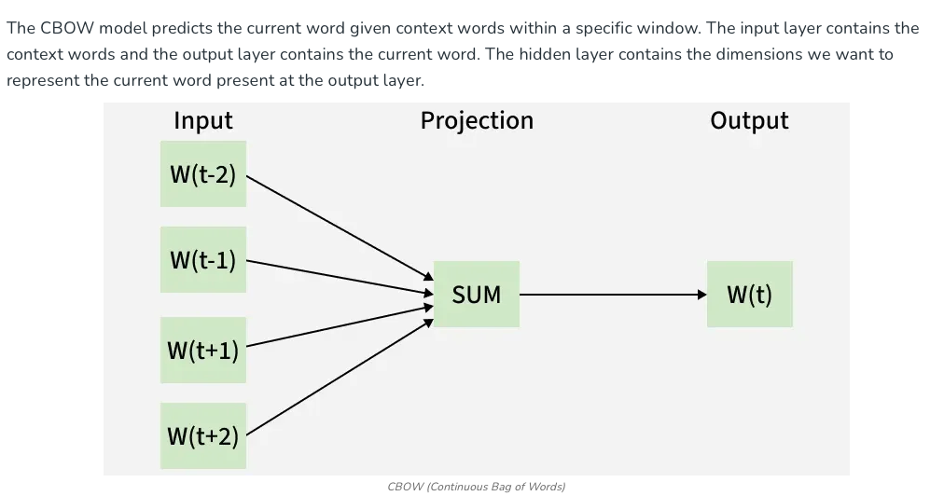
IMPROVEMENT
How would CBOW benefit more from this new data representation than the baselines ?

Slide 34
IMPROVEMENT
How would CBOW benefit more from this new data representation than the baselines ?

Slide 35
IMPROVEMENT
How would CBOW benefit more from this new data representation than the baselines ?
If we have n dimensions (or in our code, vector_size) and k windows and suppose that we are stopping at position t (we will call that position is center) then when running the program :

Slide 36
IMPROVEMENT
How would CBOW benefit more from this new data representation than the baselines ?
If we have n dimensions (or in our code, vector_size) and k windows and suppose that we are stopping at position t (we will call that position is center) then when running the program :
Firstly, the model will try to convert the words into vectors / numbers that could be placed inside that n dimensions. it could be any number.

Slide 37
IMPROVEMENT
How would CBOW benefit more from this new data representation than the baselines ?
If we have n dimensions (or in our code, vector_size) and k windows and suppose that we are stopping at position t (we will call that position is center) then when running the program :
Firstly, the model will try to convert the words into vectors / numbers that could be placed inside that n dimensions. it could be any number.
The model is now in the center - it is like saying that it is in the index t and is doing the prediction.

Slide 38
IMPROVEMENT
How would CBOW benefit more from this new data representation than the baselines ?
If we have n dimensions (or in our code, vector_size) and k windows and suppose that we are stopping at position t (we will call that position is center) then when running the program :
Firstly, the model will try to convert the words into vectors / numbers that could be placed inside that n dimensions. it could be any number.
The model is now in the center - it is like saying that it is in the index t and is doing the prediction.
Based on the k windows that we have defined, it will take the vector values of k words to the left and k words to the right then sum it up and it computes the average :

Slide 39

IMPROVEMENT
How would CBOW benefit more from this new data representation than the baselines ?
If we have n dimensions (or in our code, vector_size) and k windows and suppose that we are stopping at position t (we will call that position is center) then when running the program :
Firstly, the model will try to convert the words into vectors / numbers that could be placed inside that n dimensions. it could be any number.
The model is now in the center - it is like saying that it is in the index t and is doing the prediction.
Based on the k windows that we have defined, it will take the vector values of k words to the left and k words to the right then sum it up and it computes the average :

Slide 40
IMPROVEMENT
How would CBOW benefit more from this new data representation than the baselines ?
If we have n dimensions (or in our code, vector_size) and k windows and suppose that we are stopping at position t (we will call that position is center) then when running the program :
Firstly, the model will try to convert the words into vectors / numbers that could be placed inside that n dimensions. it could be any number.
The model is now in the center - it is like saying that it is in the index t and is doing the prediction.
Based on the k windows that we have defined, it will take the vector values of k words to the left and k words to the right then sum it up and it computes the average :
Then that the average vector value will be compared with other vector values. The closest value to the average vector will be the word that the model will choose from.

Slide 41
IMPROVEMENT
How would CBOW benefit more from this new data representation than the baselines ?
If we have n dimensions (or in our code, vector_size) and k windows and suppose that we are stopping at position t (we will call that position is center) then when running the program :
Firstly, the model will try to convert the words into vectors / numbers that could be placed inside that n dimensions. it could be any number.
The model is now in the center - it is like saying that it is in the index t and is doing the prediction.
Based on the k windows that we have defined, it will take the vector values of k words to the left and k words to the right then sum it up and it computes the average :
Then that the average vector value will be compared with other vector values. The closest value to the average vector will be the word that the model will choose from.
and continues the training loop with the new t + 1 until it is finished...

Slide 42
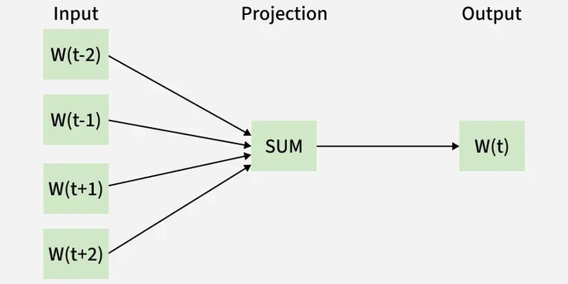
IMPROVEMENT
Suppose that we have :
[...,"this", "movie", "is", "bad", "which", "to", "be", "fair", "it", "is", "understandable",...]
with dimensions = 3, windows = 3 and the center is at “bad”

Slide 43
IMPROVEMENT
Suppose that we have :
[...,"this", "movie", "is", "bad", "which", "to", "be", "fair", "it", "is", "understandable",...]
with dimensions = 3, windows = 3 and the center is at “bad”
Firstly, the words should be converted into vector such as:
“this” → [0.5, -0.17, 1] “movie” → [0.36, 0.69, -0.67] “is” → [..., ..., ...]

Slide 44
IMPROVEMENT
Suppose that we have :
[...,"this", "movie", "is", "bad", "which", "to", "be", "fair", "it", "is", "understandable",...]
with dimensions = 3, windows = 3 and the center is at “bad”
Firstly, the words should be converted into vector such as:
“this” → [0.5, -0.17, 1] “movie” → [0.36, 0.69, -0.67] “is” → [..., ..., ...]
It is important to note that, at the index of “bad”, this is what the model is looking :
[“this”, “movie”, “is”, “___”, “which”, “to”, “be”]
Window to the left we have [“this”, “movie”, “is”]
Window to the right we have : [“which”, “to”, “be”]

Slide 45
IMPROVEMENT
Suppose that we have :
[...,"this", "movie", "is", "bad", "which", "to", "be", "fair", "it", "is", "understandable",...]
with dimensions = 3, windows = 3 and the center is at “bad”
Firstly, the words should be converted into vector such as:
“this” → [0.5, -0.17, 1] “movie” → [0.36, 0.69, -0.67] “is” → [..., ..., ...]
It is important to note that, at the index of “bad”, this is what the model is looking :
[“this”, “movie”, “is”, “___”, “which”, “to”, “be”]
Window to the left we have [“this”, “movie”, “is”]
Window to the right we have : [“which”, “to”, “be”]
The model will take the vector value for each of the words from those windows and compute the average and find the closest value.

Slide 46
IMPROVEMENT
Suppose that we have :
[...,"this", "movie", "is", "bad", "which", "to", "be", "fair", "it", "is", "understandable",...]
with dimensions = 3, windows = 3 and the center is at “bad”
Firstly, the words should be converted into vector such as:
“this” → [0.5, -0.17, 1] “movie” → [0.36, 0.69, -0.67] “is” → [..., ..., ...]
It is important to note that, at the index of “bad”, this is what the model is looking :
[“this”, “movie”, “is”, “___”, “which”, “to”, “be”]
Window to the left we have [“this”, “movie”, “is”]
Window to the right we have : [“which”, “to”, “be”]
The model will take the vector value for each of the words from those windows and compute the average and find the closest value.
...and that value will be the model prediction of the word. It could be “bad”, it could be “mediocre”, it could be “breathtaking”, or anything else..

Slide 47
IMPROVEMENT
As you can see... that is our important change...

Slide 48
IMPROVEMENT
Our code / program of the model : vectorization...

Slide 49
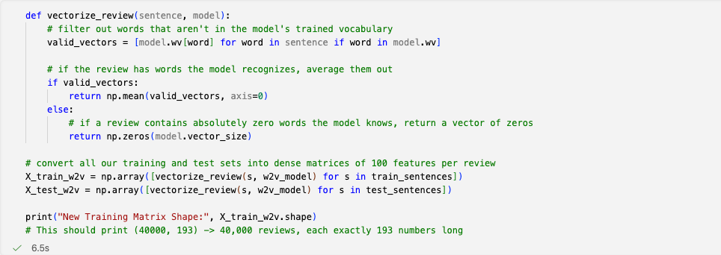
IMPROVEMENT
Our code / program of the model : vectorization...

Slide 50
IMPROVEMENT
Our code / program of the model : Logistic Regression and Bayes Classification...

Slide 51
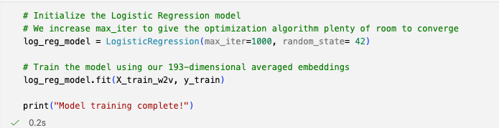
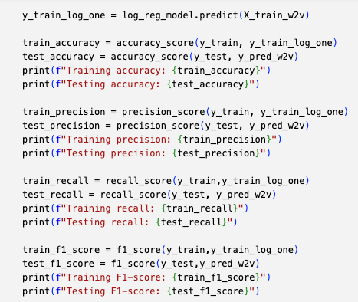
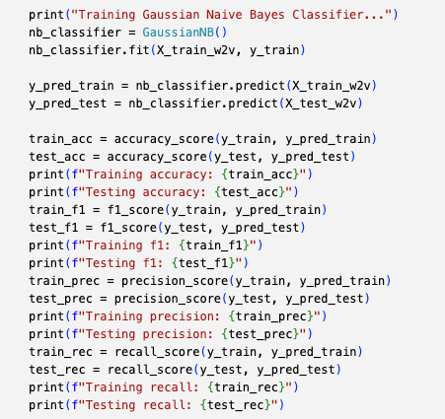
IMPROVEMENT
Our code / program of the model : Logistic Regression and Bayes Classification...
you get the idea...

Slide 52
IMPROVEMENT
scores of embedding go here....
New Architectures | Training Score | Testing Score
Word2Vec + Logistic Regression | 88.70% | 88.58%
Word2Vec + Naïve Bayes | 82.26% | 81.58%

Slide 53
IMPROVEMENT
scores of embedding go here....
New Architectures | Training Score | Testing Score
Word2Vec + Logistic Regression | 88.70% | 88.58%
Word2Vec + Naïve Bayes | 82.26% | 81.58%
remarks... some improvement! right?

Slide 54
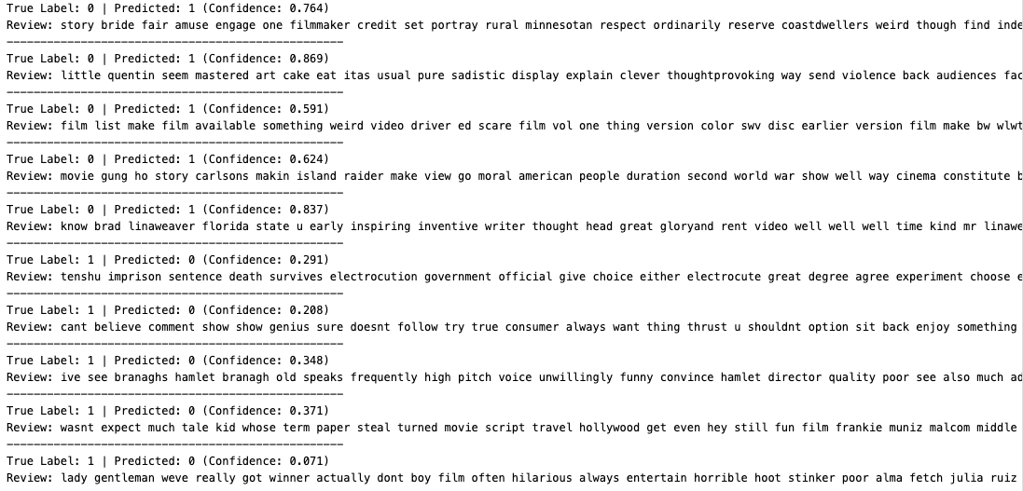
IMPROVEMENT
not really...
the newer model still fails to identify the mixed reviews, treating of the negative words and positive words...

Slide 55
The Role of the AI Assistant

Slide 56
Role
The AI acted as an educational collaborator
Architectural Engineering: Guided the transition from basic counting pipelines to dense semantic networks (Word2Vec).
Performance optimization: Analyze the accuracy and suggest improvements to get the best score in the final results
Deep Diagnostics: Helped categorize abstract model failures into concrete Natural language processing challenges

Slide 57
Thank You
ANY QUESTION?

