Slide 1
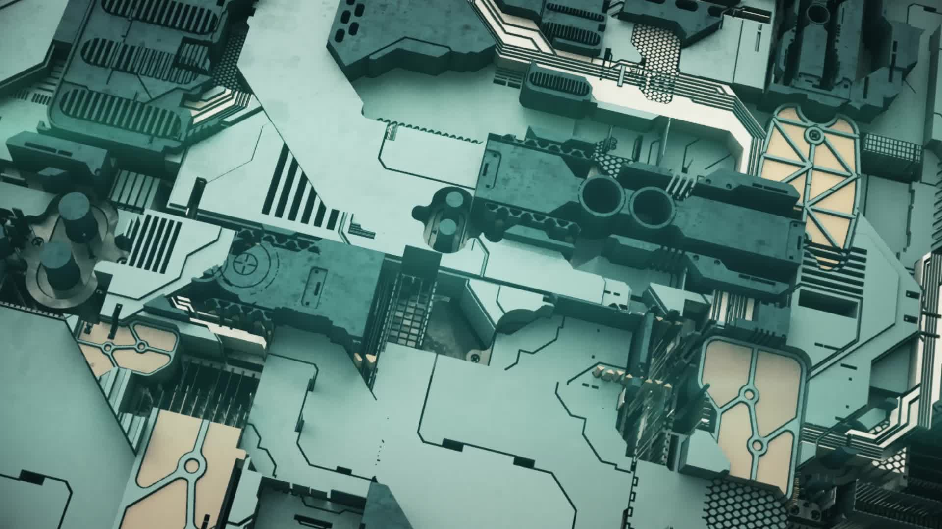
Transformer Drone Simulation
By Kaung Nyi Naing, Keeyan Canlas, and Troy Tadros

Slide 2
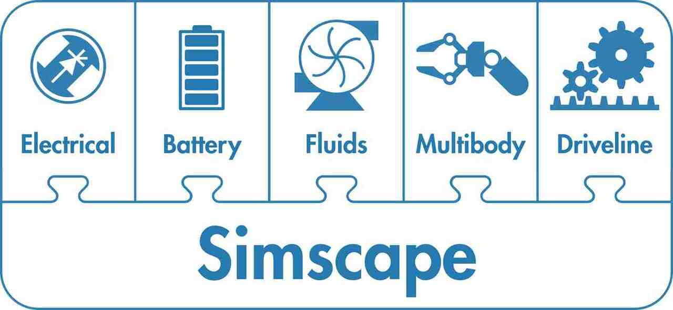
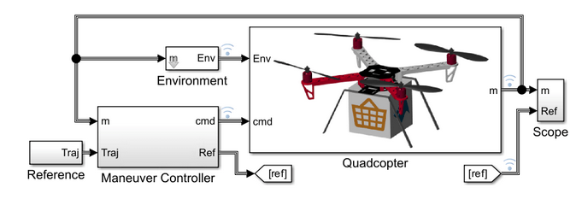
Goals & General Info
To simulate drone with accurate dimensions, weight and thrust values
To simulate midflight transformation with configurable arm angles
To simulate the effects of transformed flight on flight time, stability and power consumption.
Using MATLAB Simulink and Simscape Add-Ons
Based on Model Quadcopter Drone MATLAB example

Slide 3
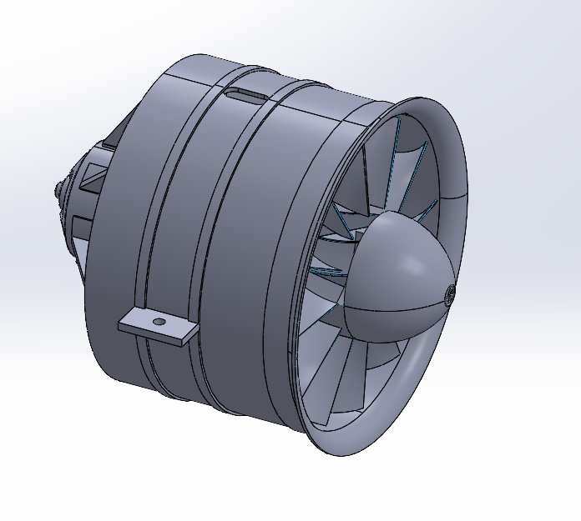
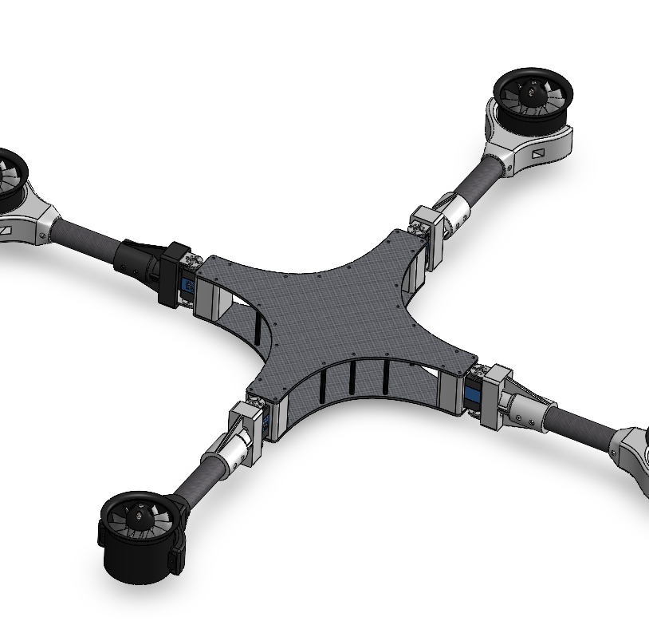
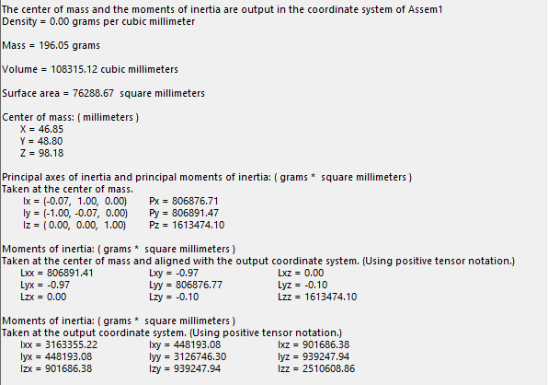
Swapping CAD Models
Replaced placeholder drone components with our real drone parts using SolidWorks assemblies.
Changed mass, intertia, and geometry in SimScape to create a realistic simulation.
Adjust connection frames and rigid offsets to attach parts in the same orientation.

Slide 4
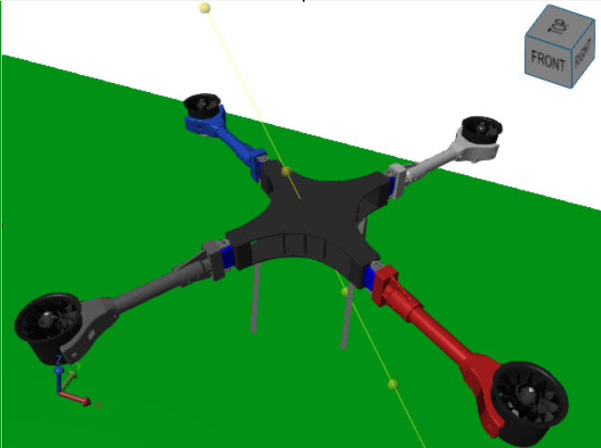
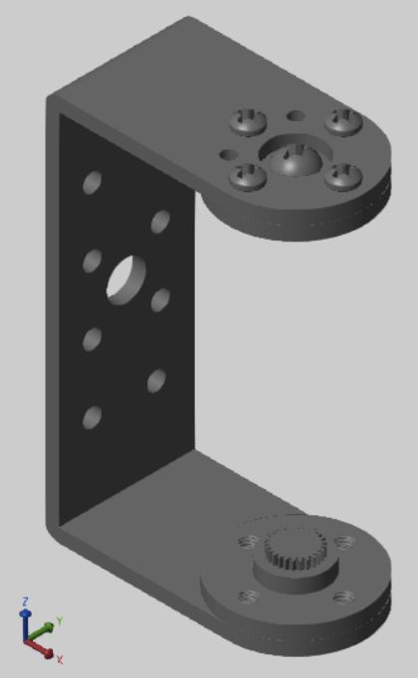
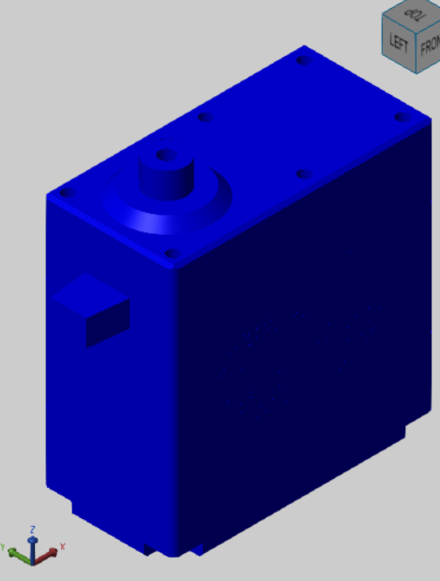
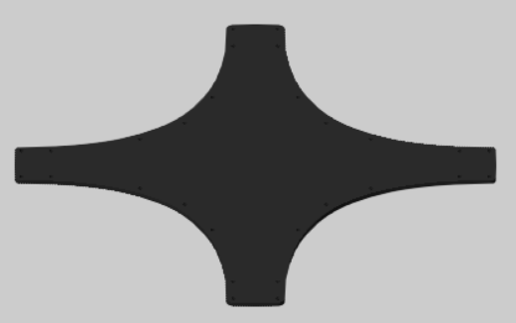
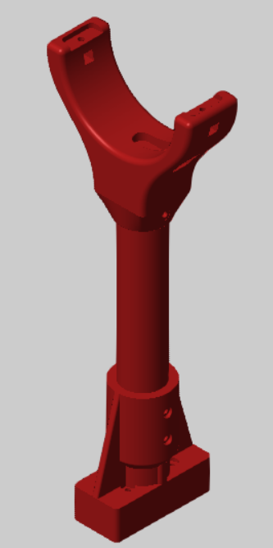
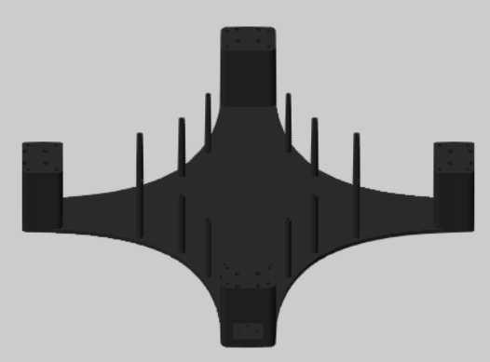
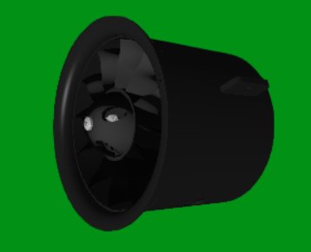
Current Simulated CAD Model

Slide 5
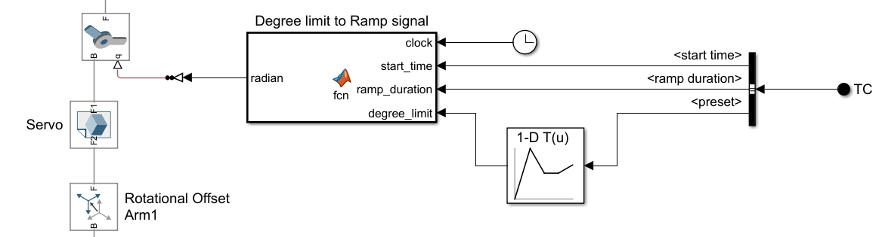
Transformation Control
Modeled a control block and bus for easy adjustability
Created angle preset table so we can change the drone’s shape with a single preset
Included start time to simulate midflight transformation
Included transform duration to simulate servo movement delay

Slide 6
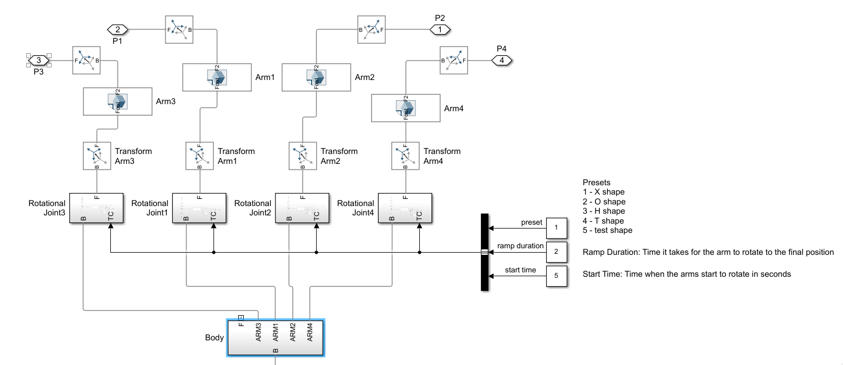
Transformation Model Showing Body to Arm Connection

Slide 7
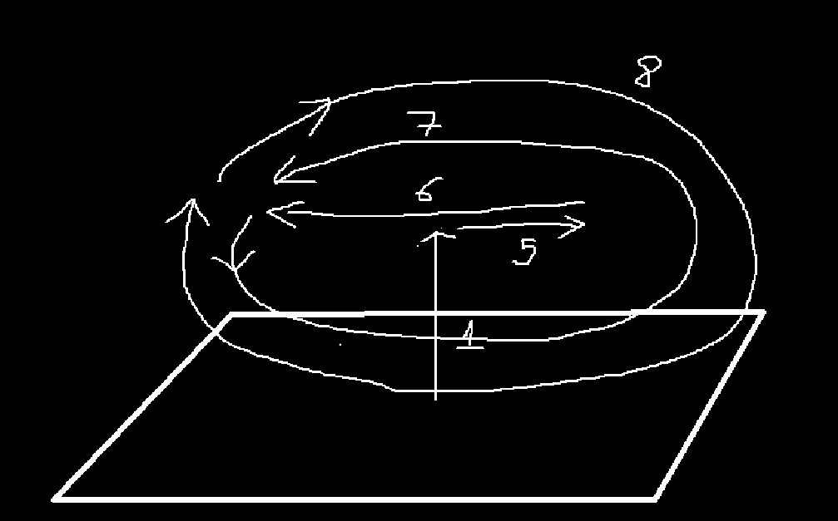
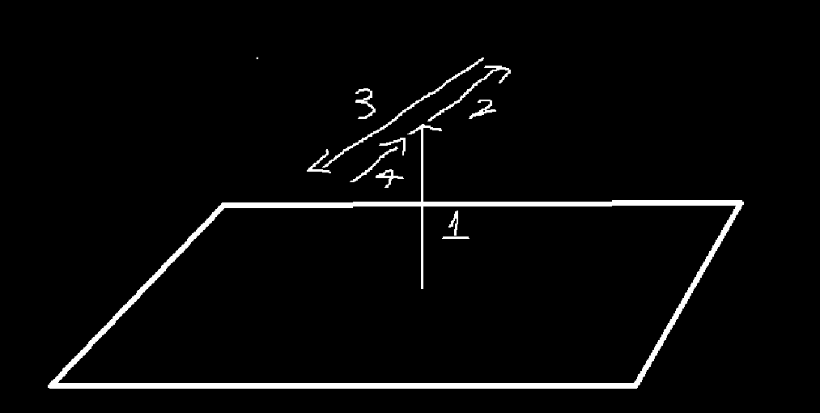
Custom Pathing
Test the drone for stability in simple linear and rotational paths
Includes 7 custom pathing options with return to home feature.
Coded a way to adjust rotational path smoothness

Slide 8
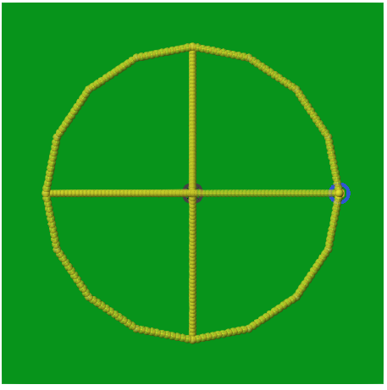
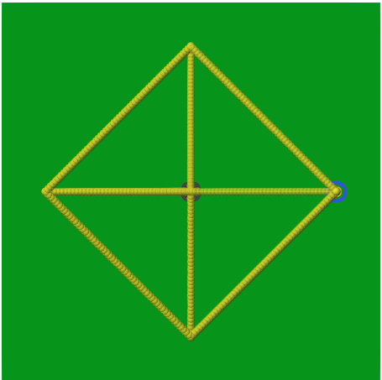
Simulation with Custom Path

Slide 9
Current and Future Work Items
Better servo/actuation simulation
Adjust Yaw/Pitch/Roll PID variables
Modify or Replace Flight Controller block to support other transformations
Adjust motor variables to better match the EDF power and behavior.
Adjust Power system variables so we can accurately simulate motor power consumption.

Slide 10
Live Demo
A live demo of the latest simulation build on MATLAB.

