Slide 1
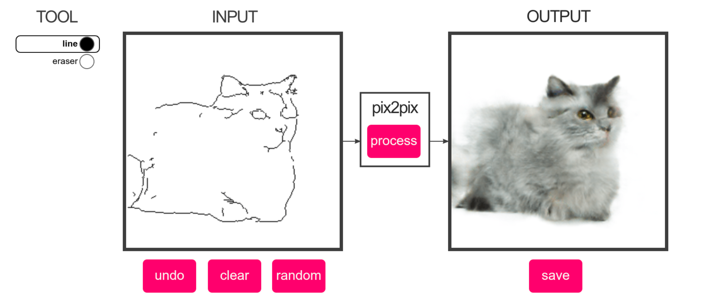
Generative Adversarial Networks
&
Autoencoders
‘16 Isola et al.
inż. Tomasz Szczepański

Slide 2
Plan
The purpose of the presentation – explanation
Questions issue
Autoencoders Intuition
Variational Autoencoders – to read at home
Generative Adversarial Networks
GAN & AE - Comparison and summary
Examples – 8 minutes of videos

Slide 3
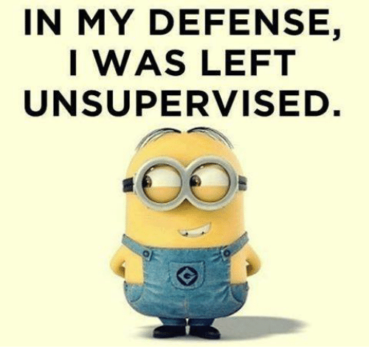
Machine learning
Supervised
Unsupervised – unlabeled data
Semi-supervised

Slide 4
Autoencoders
Applications of autoencoders include:
Anomaly detection
Data denoising (eg. images, audio)
Image inpainting
Information retrieval

Slide 5
Autoencoders
Feature Representation
Decoder
Encoder
Feed-back
Generative
Top-down
Feed-forward
Bottom-up
Input Image

Slide 6
Autoencoders
Feature Representation
Decoder
Encoder
Decoder filters
Linear func.
Encoder filters
Sigmoid func.(nonlinearity)*
Need additional constraints to avoid learning identity
Encoder and Decoder filters can be different
Input Image

Slide 7
“It is not what's outside, but what is inside that counts” - merchant, Alladin (Disney)

Slide 8
Undercomplete Representation
Hidden layers “compresses” input (dimensionality reduction)
Compresses well only for training distribution
Hidden units
  Good features for training distribution
  Not robust to other types of input

Slide 9
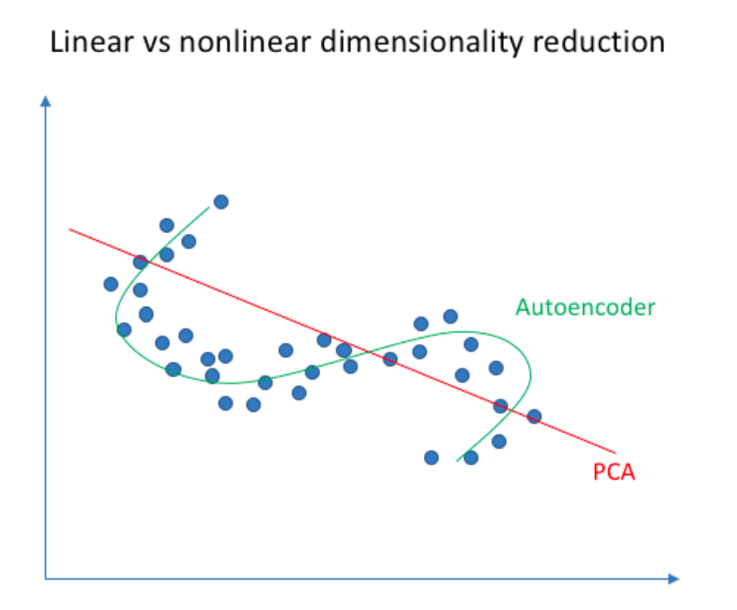
*PCA vs Autoencoder
Neural networks are
capable of learning
nonlinear relationships

Slide 10
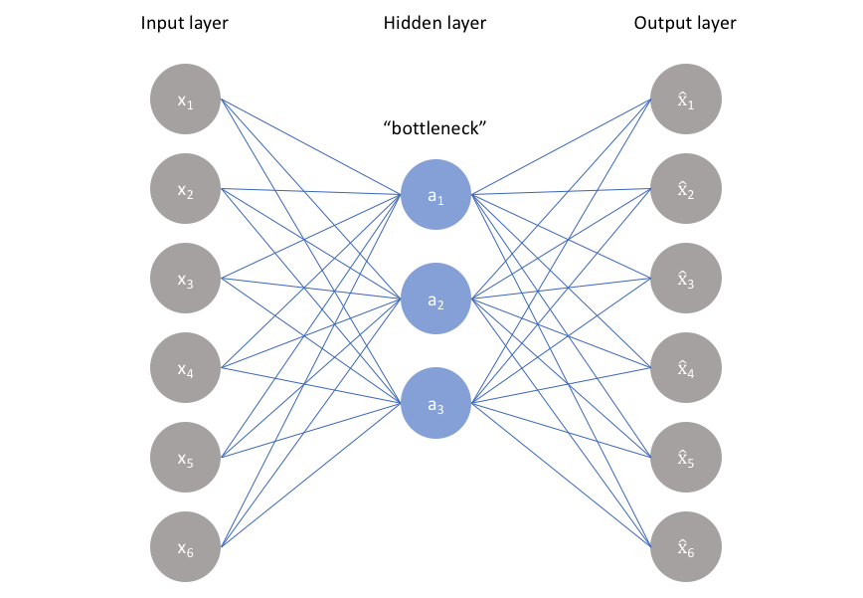
Bottleneck
Impose a bottleneck in the network which forces a compressed knowledge representation of the original input

Slide 11
Autoencoder balance
Sensitive to the inputs enough to accurately build a reconstruction.
Insensitive enough to the inputs that the model doesn't simply memorize or overfit the training data.

Slide 12
Deep autoencoder – risk of memorization
Bottleneck autoencoder
Sparse autoencoders
  penalize activations within a layer
  weights regularization analogy

Slide 13
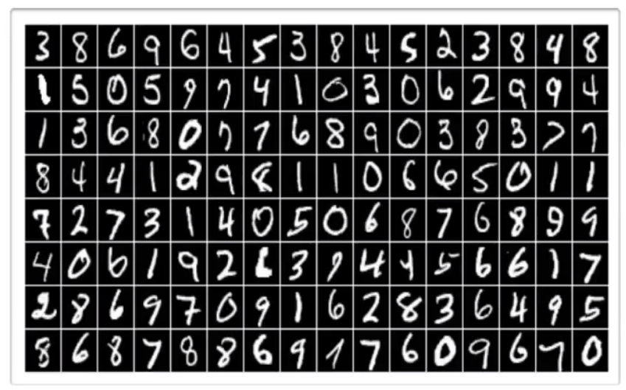
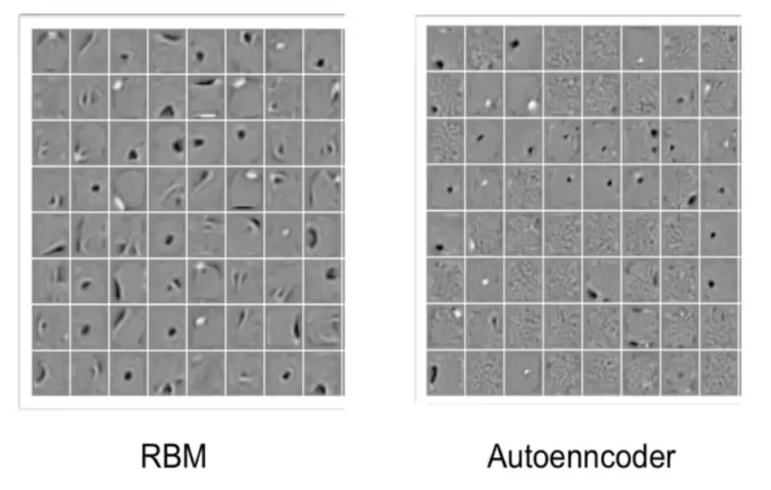
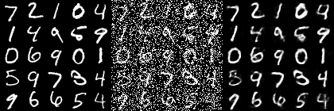
MNIST dataset
National Institute of Standards and Technology

Slide 14
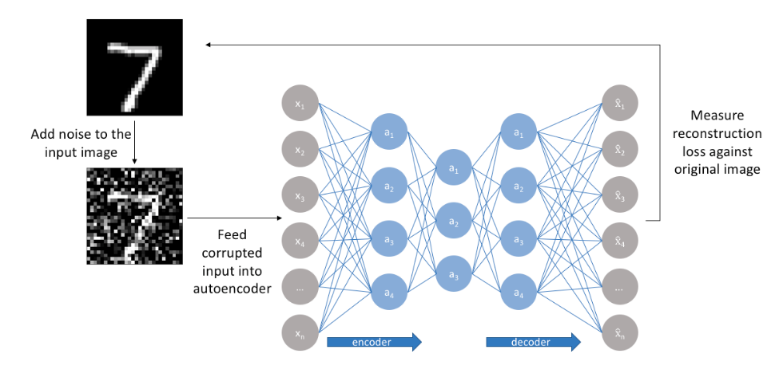
Denoising autoencoder
Robust to introduction of noise
  random assignment of subset of inputs to 0
  Gaussian additive noise

Slide 15
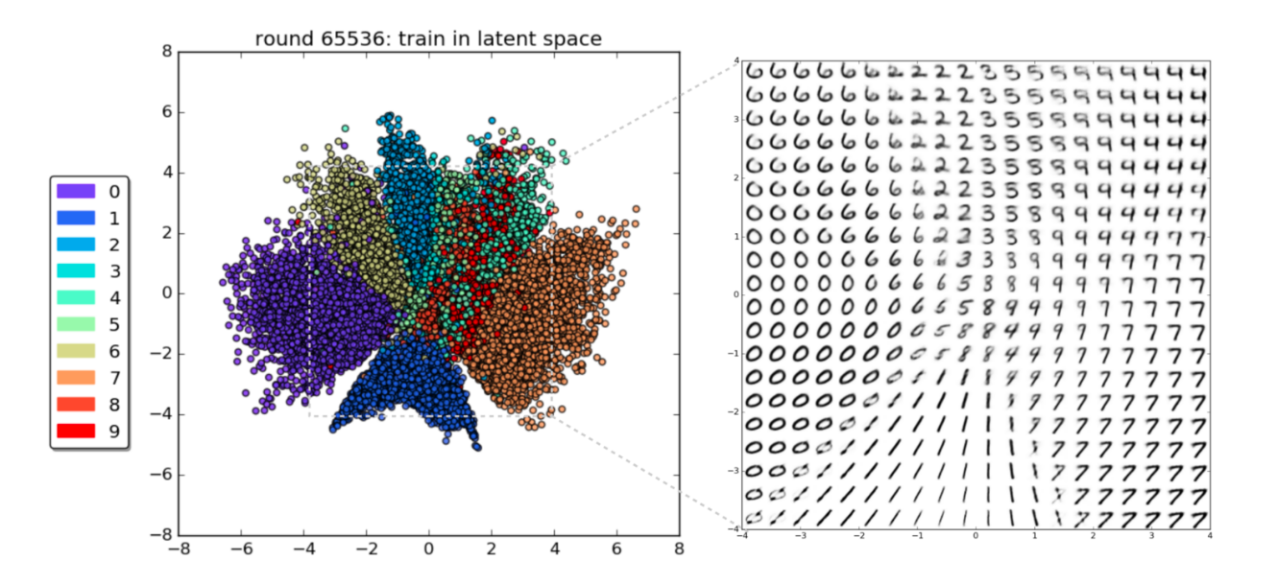
Variational autoencoder
We add a constraint on the encoding network, that forces it to generate latent vectors that roughly follow a unit gaussian distribution. It is this constraint that separates a variational autoencoder from a standard one.

Slide 16
Generating new images is now easy: all we need to do is sample a latent vector from the unit gaussian and pass it into the decoder.
In practice, there's a tradeoff between how accurate our network can be and how close its latent variables can match the unit gaussian distribution.

Slide 17
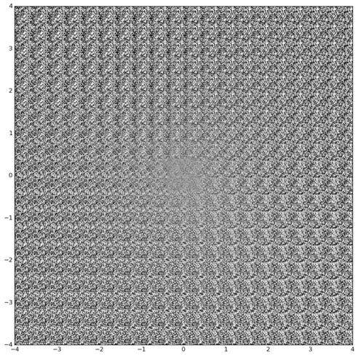

Slide 18
VAE – to read at home
Variational Autoencoders (VAEs) incorporate regularization by explicitly learning the joint distribution over data and a set of latent variables that is most compatible with observed datapoints and some designated prior distribution over latent space.
The prior informs the model by shaping the corresponding posterior, conditioned on a given observation, into a regularized distribution over latent space (the coordinate system spanned by the hidden representation).
As a result, VAEs are an excellent tool for manifold learning—recovering the “true” manifold in lower-dimensional space along which the observed data lives with high probability mass—and generative modeling of complex datasets like images, text, and audio—conjuring up brand new examples, consistent with the observed training set, that do not exist in nature.
Introducing Variational Autoencoders (in Prose and Code) – worth reading

Slide 19
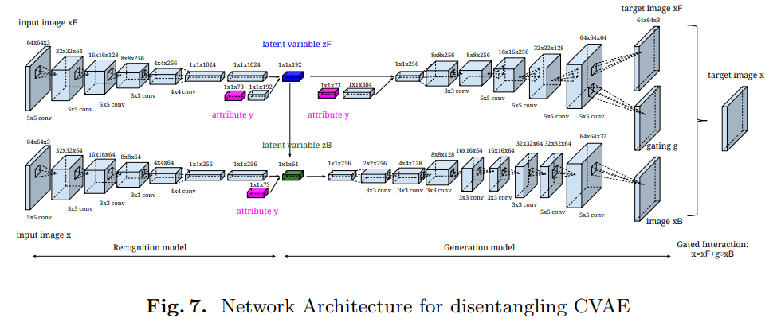

Slide 20
Latent ‘hidden’ space
Before you use a neural network for a task the usual architecture is to extract features through many layers.
The function (NN) maps your input to features in the latent space.
In other words, the latent space is the space where your features lie.

Slide 21
Generative Adversarial Network
Neural network as a classifier: cats vs dogs
Generation vs discrimination – difficult even for humans
Drawing – data, model, error

Slide 22
Adversarial training – focusing on weaknesses
“Neural networks don't have feelings, yet.…"
Adversary == Opponent, foe, enemy
Forger & Expert, Generator & Discriminator

Slide 23
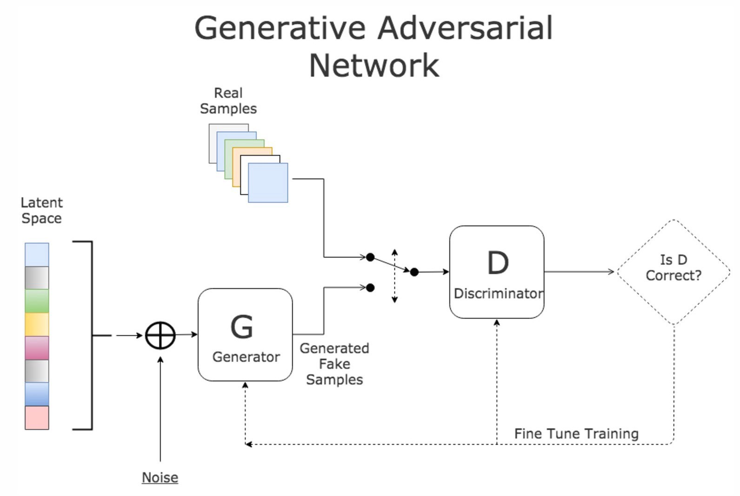

Slide 24
You can use gradient of discriminator to train generator – backpropagation issue
Adjust weigth to “move” towards/down the gradient
In learning process Generator is being moved up with the gradient to increase Discriminator error

Slide 25
Generation
Random noise feed – point in the input space
Mapping from latent space into output image
Smooth movement around latent space – directions of movement correspond to meaningful traits of image
Understandment of what creates object - structure
Adding and subtracting vectors results in meaningful changes in images
“Feature vectors”

Slide 26
Generative Adversarial Networks
GANs allow the model to learn that there are many correct answers (i.e. handling well on multimodal data)
Semi-supervised learning: features from the Discriminator or inference net could improve performance of classifiers when limited labeled data is available

Slide 27
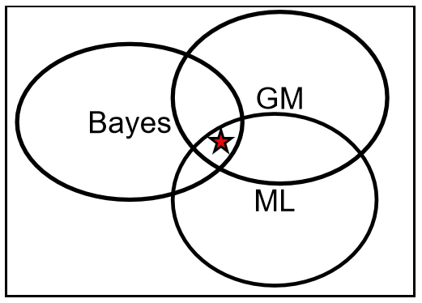
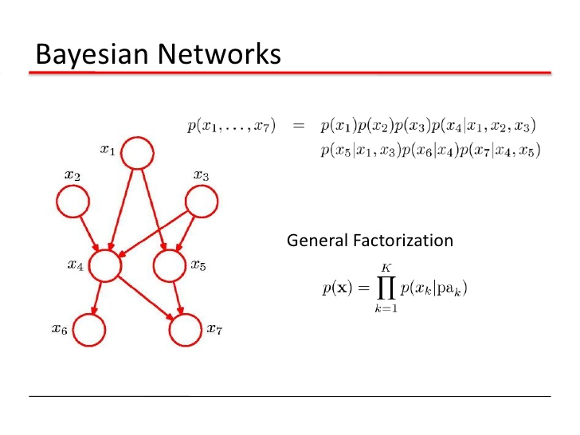
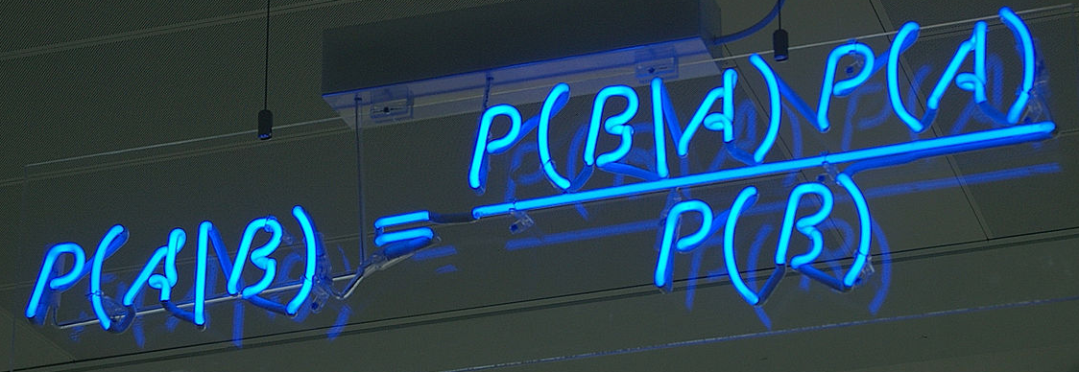
Graphical Models – Probabilistic Models
  Bayesian Network
  Generative Models
  Markov Random Fields
  Generative Topographic Mapping

Slide 28
GAN vs Autoencoder
Both GANs and Autoencoders are generative models,
They learn a given data distribution,
The key difference is how they do it.

Slide 29
Autoencoders
Autoencoders learn a given distribution comparing its input to its output – loss function.
This is good for learning hidden representations of data, but is pretty bad for generating new data.
Mainly because we learn an averaged representation of the data thus the output becomes pretty blurry.

Slide 30
GANs
Generative Adversarial Networks take an entirely different approach.
They use another network (Discriminator) to measure the distance between the generated and the real data.
It is distinguishing the real data from the generated.
It receives some data as an input and returns a number between 0 and 1. 0 meaning the data is fake and 1 meaning it is real.
The Generator’s goal then is learning to convince the Discriminator into believing it is generating real data.

Slide 31
Autoencoders are more suitable for compressing data to lower dimensions or generating semantic vectors from it.
Where GANs are more suitable for generating data.

Slide 32
What we can generate
Images
Video
Music
Text
Drugs
Molecule development

Slide 33
Image Domain

Slide 34
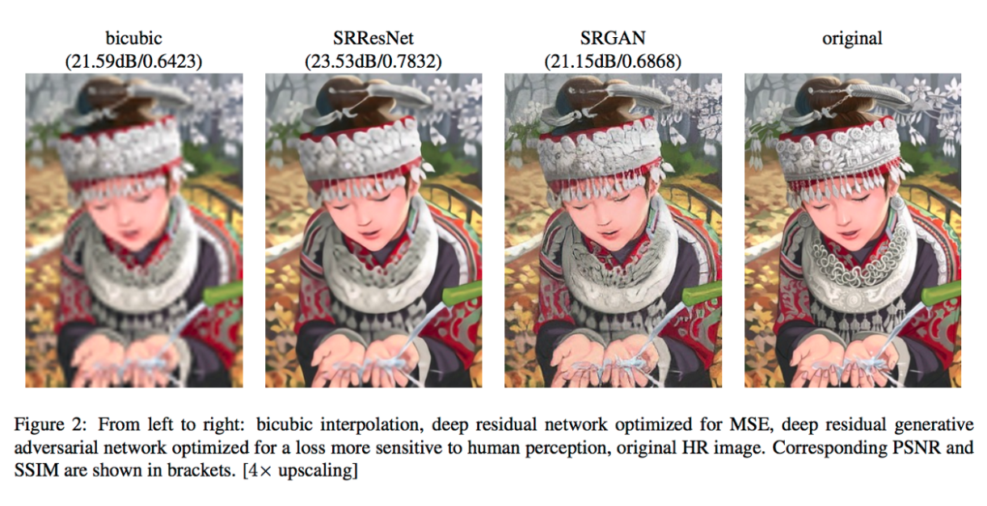
Super Resolution
‘16 C. Ledig et al.

Slide 35
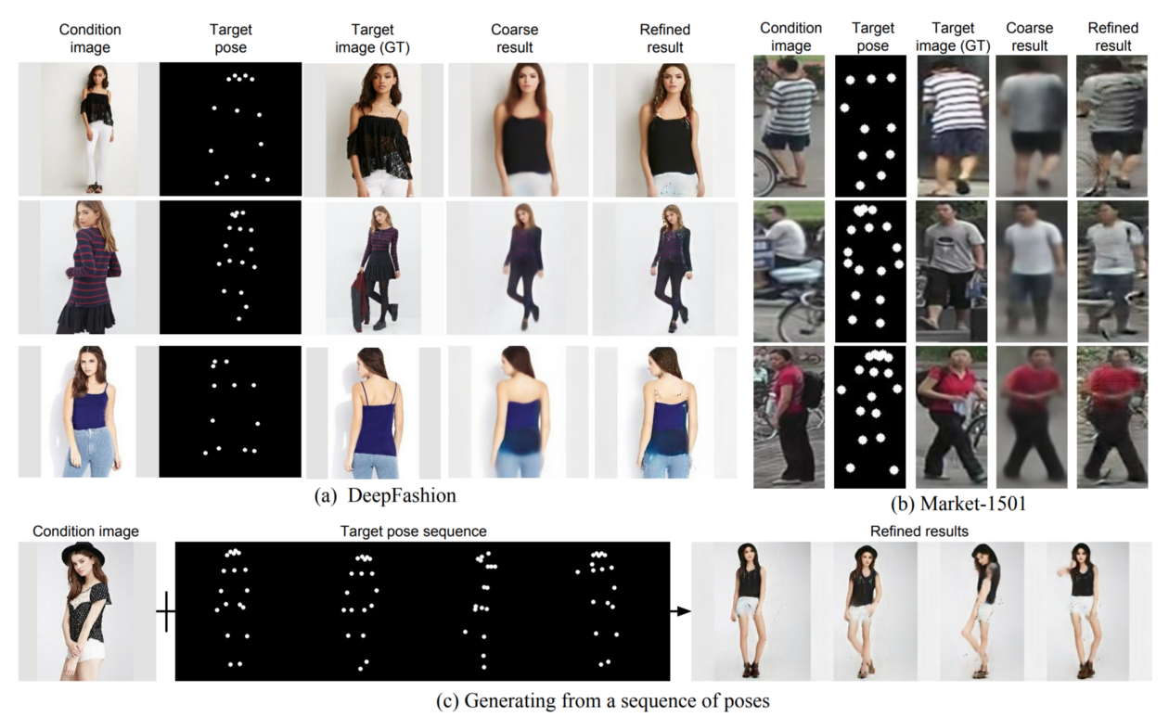
Pose generation
‘17 L.Ma et al.

Slide 36
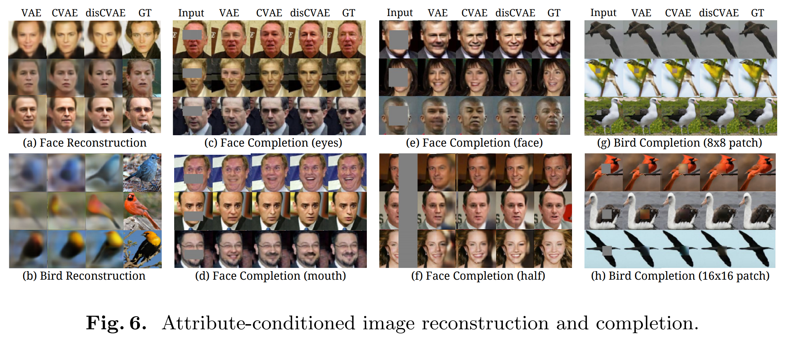
Attribute2Image
Conditional Image Generation from Visual Attributes - CVAE
Conditional Variational Auto-Encoder
2015
‘15 X.Yan et al.

Slide 37
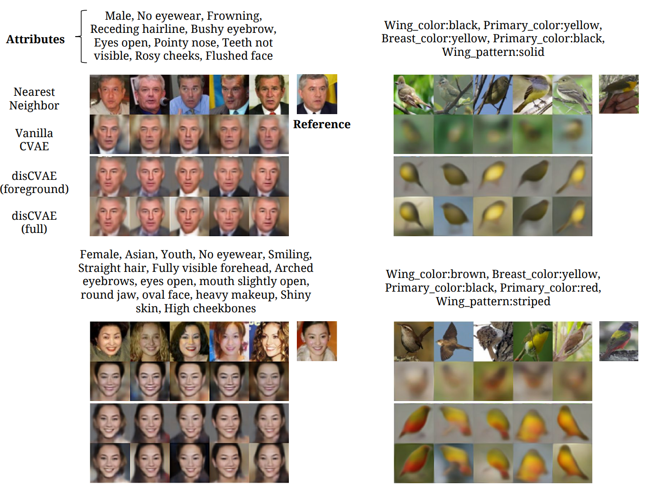
2015

Slide 38
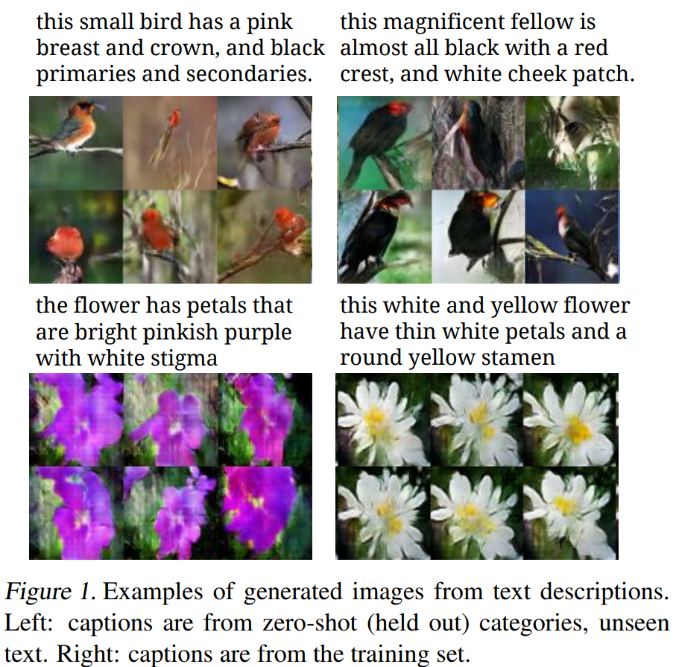
Text2Image
Generative Adversarial Text to Image Synthesis
2016
‘16 S. Reed et al.

Slide 39
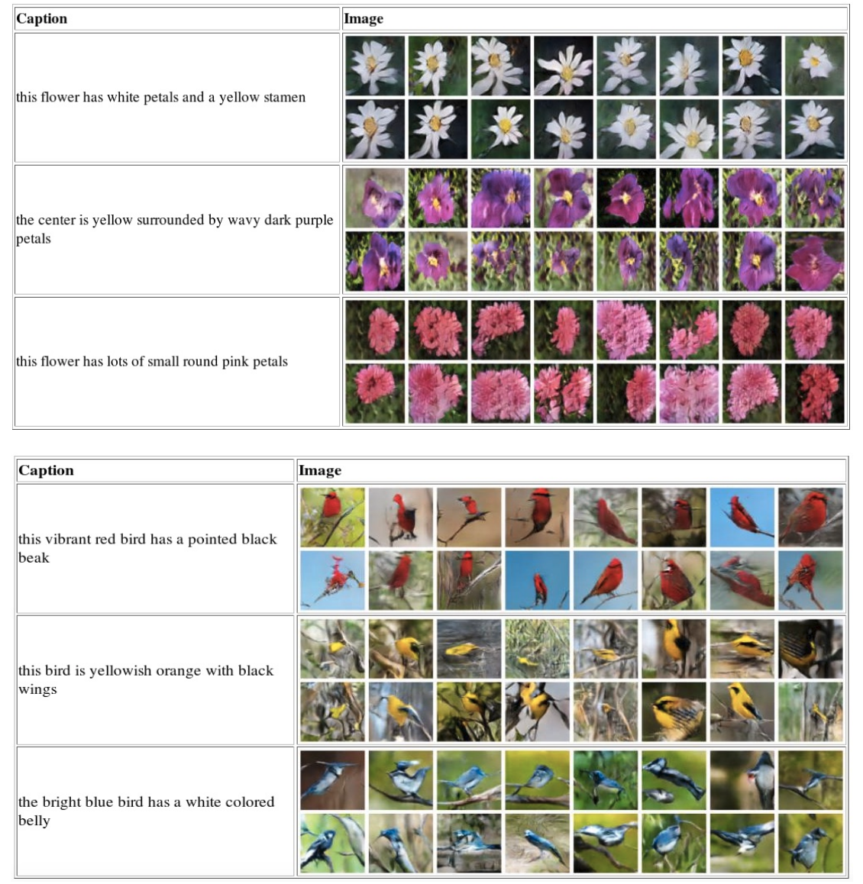
2016

Slide 40
3D GAN – 02:06
Learning a Probabilistic Latent Space of Object
Shapes via 3D Generative-Adversarial Modeling
2016/2017
‘16 J. Wu, C. Zhang et al.

Slide 41
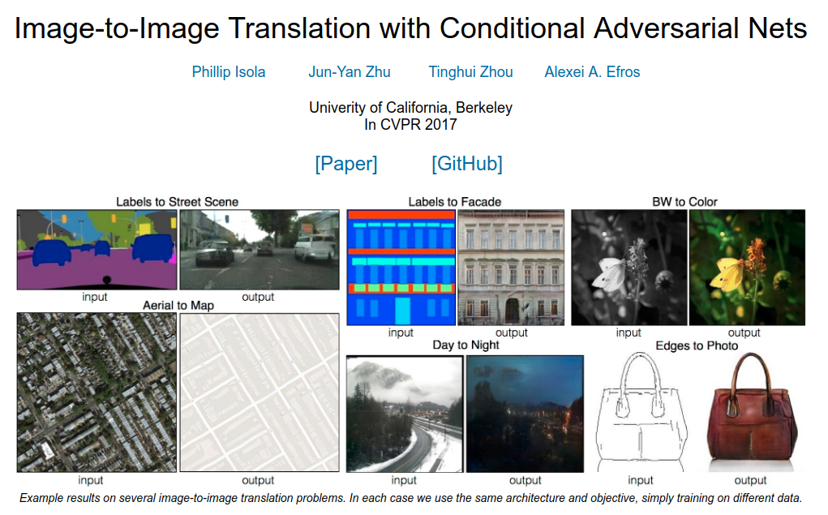
2016/2017
‘16 P. Isola et al.

Slide 42
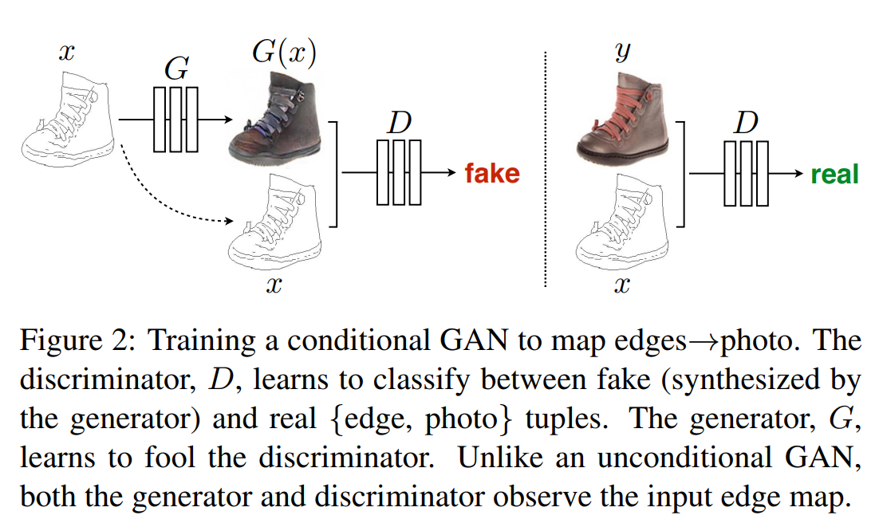
2016/2017

Slide 43
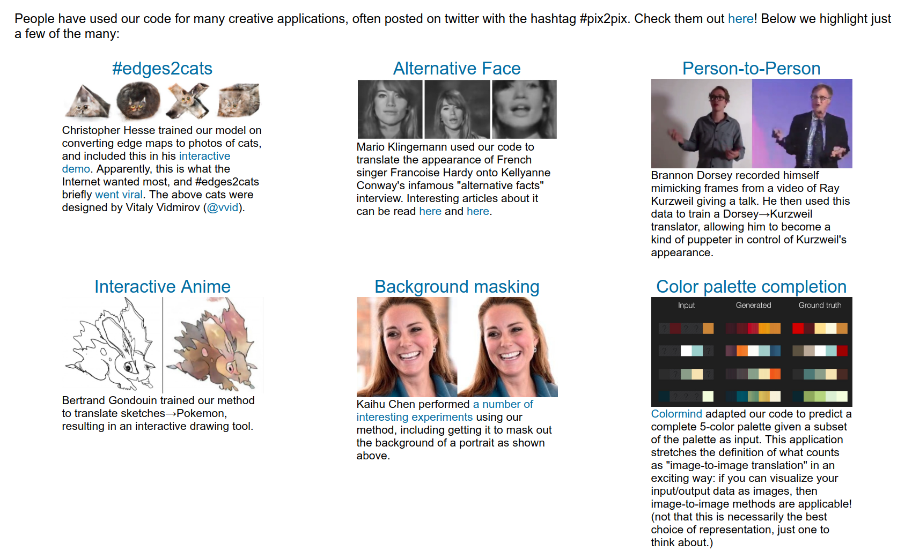
2016/2017

Slide 44
Pix2pix contrib - 01:07
2016/2017

Slide 45
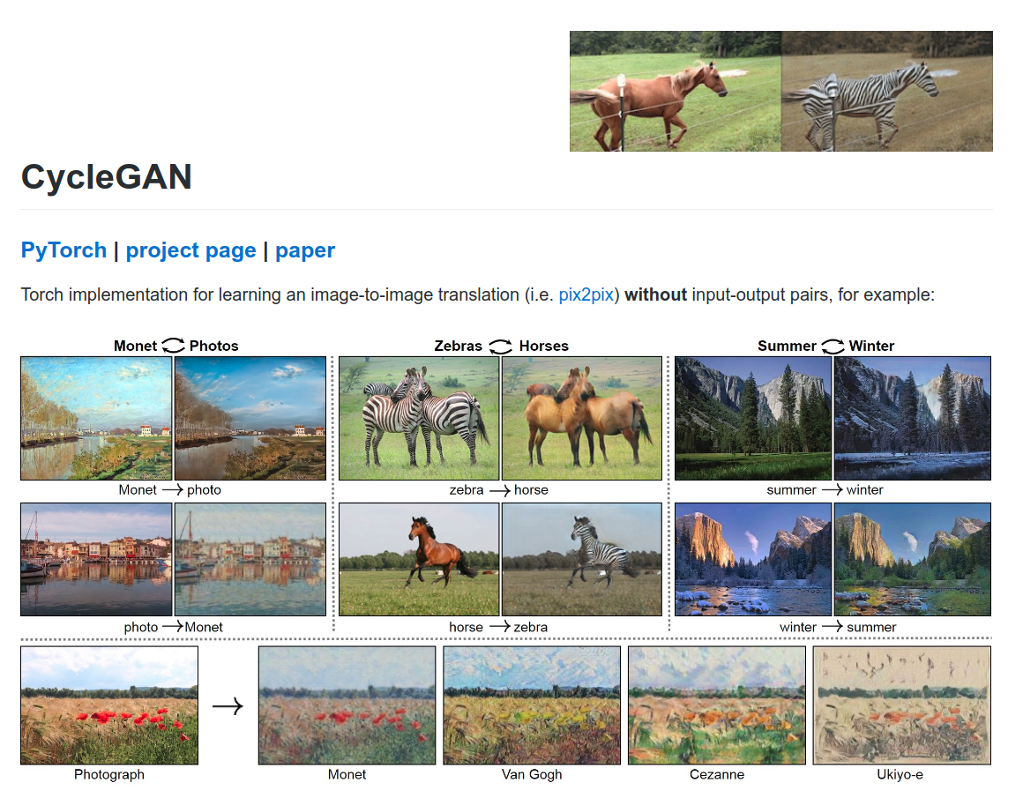
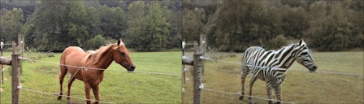
2017
‘17 J. Zhu, T. Park et al.

Slide 46
Progressive Growing of GANs for Improved Quality, Stability, and Variation - 01:50
2017
‘17 T. Karras et al.

Slide 47
Conditional GAN (pix2pixHD) – 02:12
2018
‘18 T.Wang et al.

Slide 48
GauGAN – 02:16
Semantic Image Synthesis with Spatially-Adaptive Normalization
2019
‘19 T. Park et al.

Slide 49
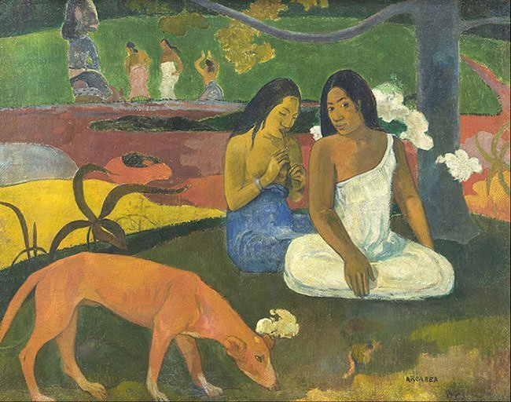
GauGAN – Gaugain – Gaussian
2019

Slide 50
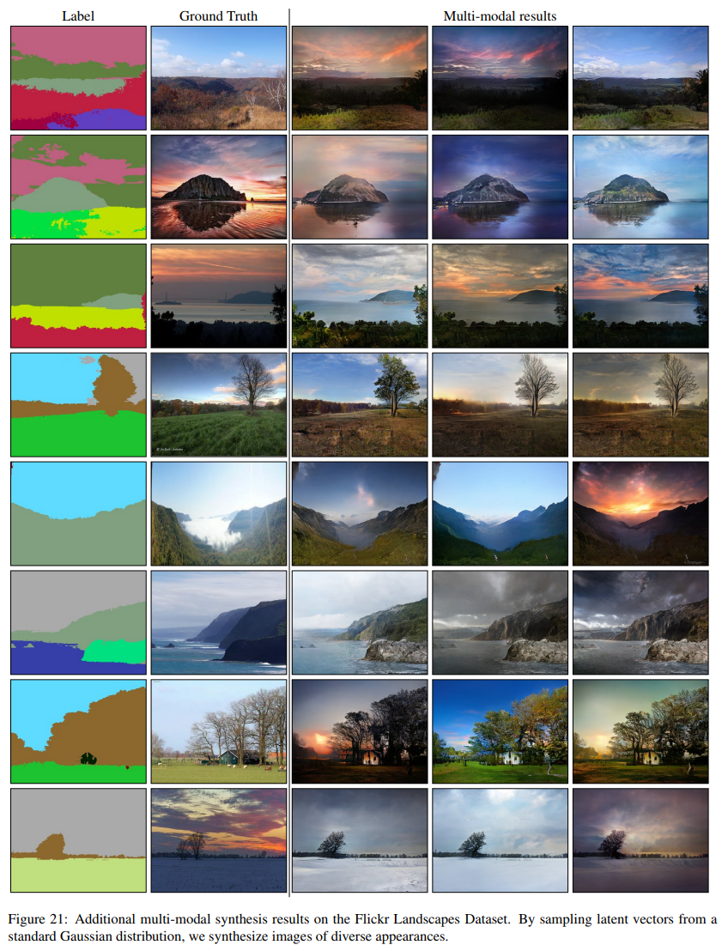
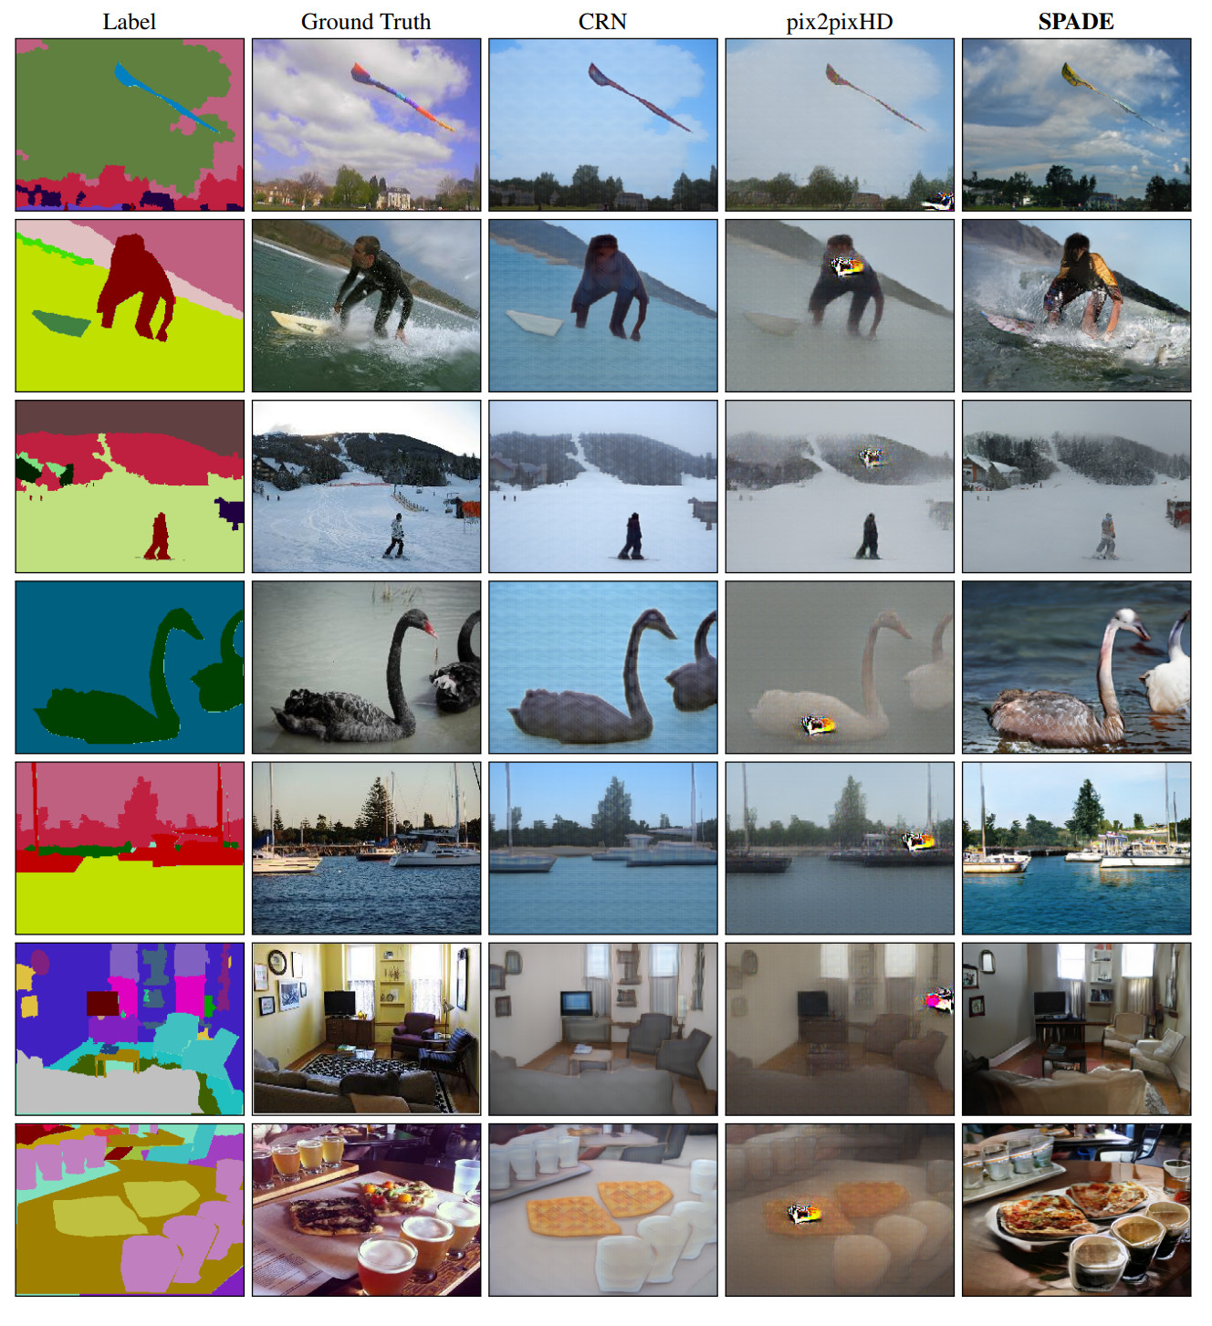
2019

Slide 51
Li(nk)brary
Topic | Type | Link
Colorization of B&W photos – DCGAN, pytorch | Article | https://blog.floydhub.com/colorizing-and-restoring-old-images-with-deep-learning/
DCGAN | Paper | https://arxiv.org/pdf/1511.06434.pdf
Edge2Cat | Sandbox | https://affinelayer.com/pixsrv/index.html
How to learn ML | Article | https://hackernoon.com/how-not-to-do-fast-ai-or-any-ml-mooc-3d34a7e0ab8c
Applications of GANs | Article | https://medium.com/@jonathan_hui/gan-some-cool-applications-of-gans-4c9ecca35900
Denoising autoencoders | Paper | http://www.cs.toronto.edu/~larocheh/publications/icml-2008-denoising-autoencoders.pdf
Introduction to autoencoders | Article | https://www.jeremyjordan.me/autoencoders/
Variational autoencoder - intuition | Article | http://kvfrans.com/variational-autoencoders-explained/
Gaugan | Project page | https://nvlabs.github.io/SPADE/
Semantic Image Synthesis with Spatially-Adaptive Normalization | Paper | https://arxiv.org/abs/1903.07291
CycleGAN | Project page | https://junyanz.github.io/CycleGAN/
CycleGAN | Paper | https://arxiv.org/pdf/1703.10593.pdf
Conditional GAN | Paper | https://arxiv.org/pdf/1711.11585.pdf
pix2pixHD | Project page | https://tcwang0509.github.io/pix2pixHD/a

Slide 52
Li(nk)brary
Topic | Type | Link
Conditional Adversarial Network | Paper | https://arxiv.org/abs/1611.07004v1
Image-to-Image Translation | Project page | https://phillipi.github.io/pix2pix/
Text2image | Paper | https://arxiv.org/pdf/1605.05396.pdf
Attribute2Image | Paper | https://arxiv.org/pdf/1512.00570.pdf
GPT-2 | Article | https://openai.com/blog/better-language-models/
Generative Adversarial Networks : Engine and Applications | Article | https://blog.statsbot.co/generative-adversarial-networks-gans-engine-and-applications-f96291965b47
VAE-GAN | Article | https://towardsdatascience.com/what-the-heck-are-vae-gans-17b86023588a
Autoencoding beyond pixels using a learned similarity metric | Paper | https://arxiv.org/abs/1512.09300
GAN vs Autoencoder | Forum | https://www.quora.com/What-is-the-difference-between-Generative-Adversarial-Networks-and-Autoencoders
GAN intuition | video | https://www.youtube.com/watch?v=Sw9r8CL98N0&index=6&list=FLeE5MxdzxsfuAkY9A1Y0kdA&t=0s
Auto-Encoding Variational Bayes | Paper | https://arxiv.org/abs/1312.6114
Visual Concept Learning with Unsupervised Deep Learning | Paper | https://arxiv.org/abs/1606.05579
Introducing Variational Autoencoders (in Prose and Code) | Article | https://blog.fastforwardlabs.com/2016/08/12/introducing-variational-autoencoders-in-prose-and.html
Gan applications | Article | https://medium.com/@jonathan_hui/gan-some-cool-applications-of-gans-4c9ecca35900

Slide 53
Li(nk)brary
Topic | Type | Link
Introduction to Autoencoders | Article | https://www.jeremyjordan.me/autoencoders/
Variational Autoencoders Explained | Article | http://kvfrans.com/variational-autoencoders-explained/
Variational Autoencoders | Video | https://www.youtube.com/watch?v=9zKuYvjFFS8&list=FLeE5MxdzxsfuAkY9A1Y0kdA&index=4&t=0s
Learning a Probabilistic Latent Space of Object Shapes via 3D Generative-Adversarial Modeling | Paper | https://arxiv.org/pdf/1610.07584v2.pdf
Photo-Realistic Single Image Super-Resolution Using a Generative Adversarial Network | Paper | https://arxiv.org/pdf/1609.04802.pdf
Pose Guided Person Image Generation | Paper | https://papers.nips.cc/paper/6644-pose-guided-person-image-generation.pdf
Progressive Growing of GANs for Improved Quality, Stability, and Variation | Paper | https://arxiv.org/abs/1710.10196

Slide 54

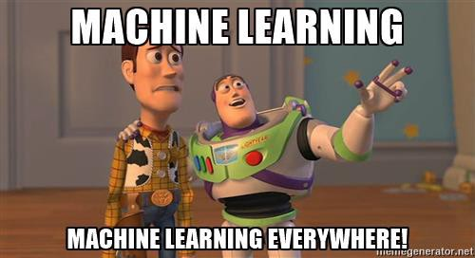
Thank you for your attention

