Slide 1
TFS/VSTS, Visual Studio 2015 – DevOps and Azure
Abel Wang
sr. developer technology specialist
abel.wang@microsoft.com | @abelsquidhead |
http://abelsquidhead.com

Slide 2
Presenter Introduction
Abel Wang
Sr. Developer Technology Specialist
20 years of experience in IT, Mission Critical Design and Architecture, Product Development, Support & Consulting
Process Consultant, Certified Scrum Master, ALM Ranger, VSTS Team
Focus on:
DevOps/Application Lifecycle Management – DevOps/ALM
General Application Development
Software & Solutions Architecture.
Project Management.
Email: abel.wang@microsoft.com
Blog: http://abelsquidhead.com
Twitter: @abelsquidhead

Slide 3
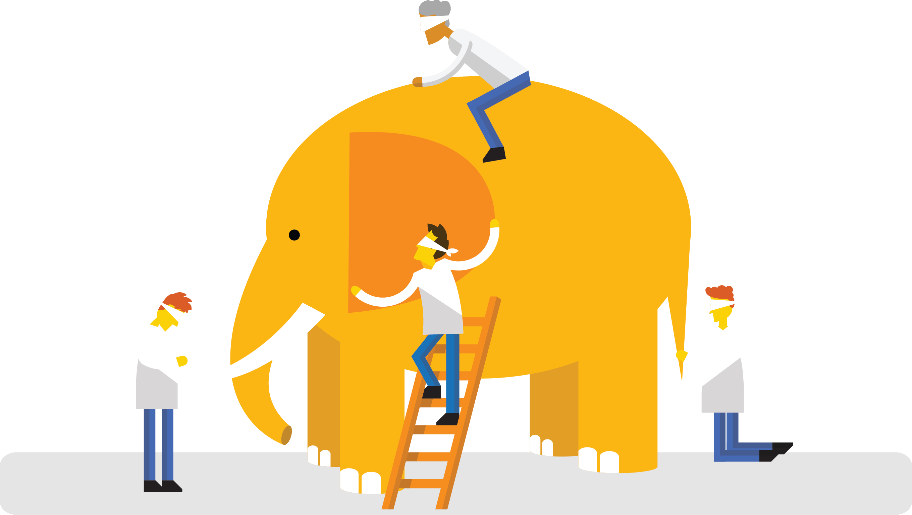
What is DevOps?
“DevOps is development and operations collaboration”
“DevOps is treating your infrastructure as code”
It’s DevOps!
It’s DevOps!
“DevOps is using automation”
It’s DevOps!
“DevOps is feature switches”
It’s DevOps!
“DevOps is small deployments”
“Kanban for Ops?”

Slide 4
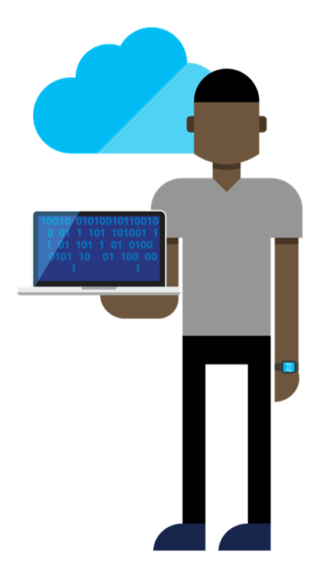
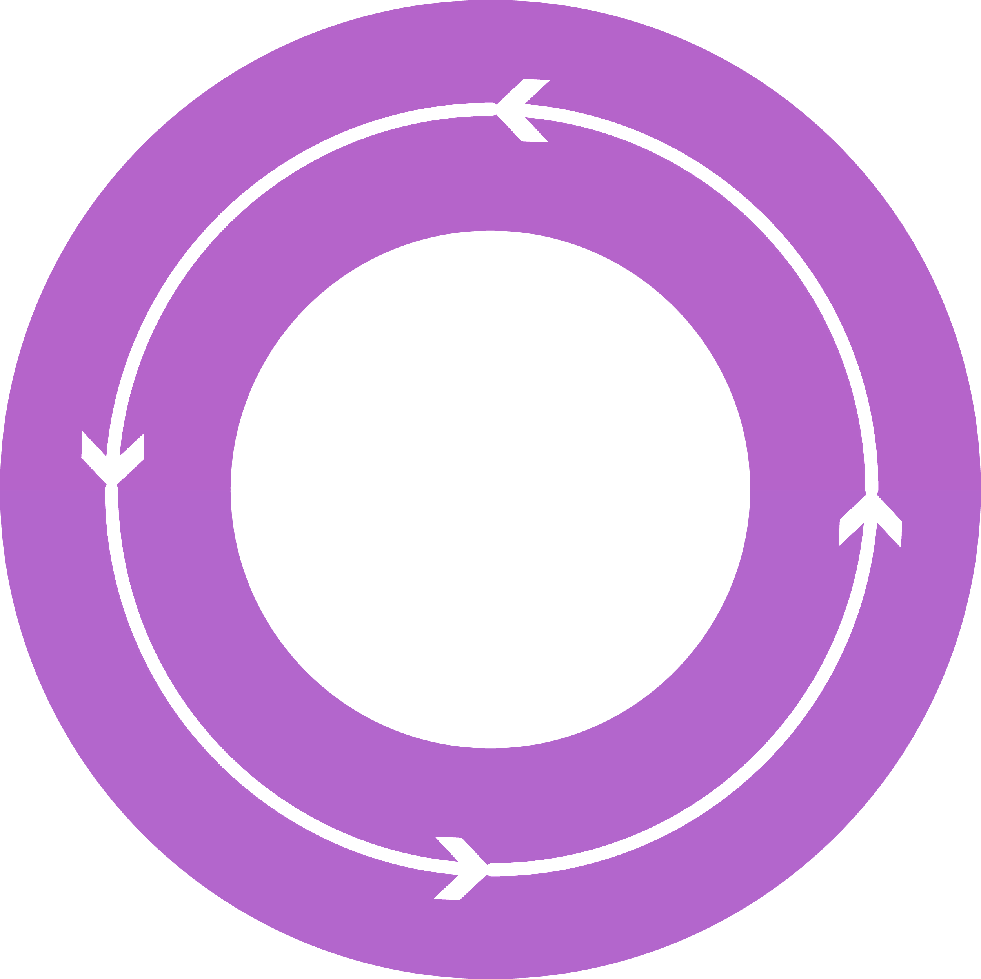




DevOps: the three stage conversation
DEV
OPS
1
People
2
Process
3
Tooling
Notes:
People = Culture
Fundamental attributes of successful cultures:
Shared mission and incentives: infrastructure as code, apps as services, DevOps/all as teams
You need to consider your hardware as a commodity, (don't give your servers names) , servers are like farm animals, it is just harder if you let theids name them
Build deep instrumentation into services, push complexity up the stack
Rally around agile, shared metrics, CI, service owners on call, etc.
Changing the culture: any change takes time, changing culture is no exception and you can't do it alone, exploit compelling events to change culture: downtimes, cloud adoption, devops buzz
PROCESS Definition and design, compliance, and continuous improvement
PEOPLE Responsibilities, management, skills development, and discipline
Products Tools and infrastructure

Slide 5
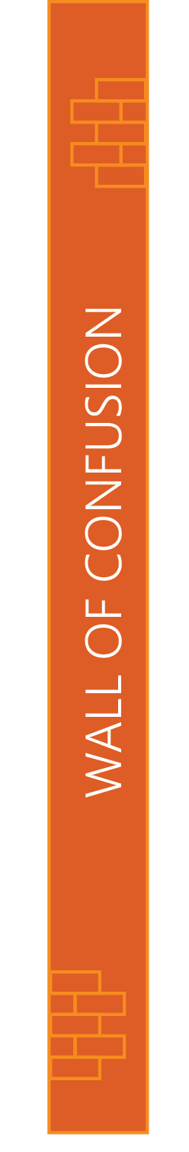

People
DEV
OPS
Notes:
Taken from: http://dev2ops.org/2010/02/what-is-devops/
Development kicks things off by “tossing” a software release “over the wall” to Operations. Operations picks up the release artifacts and begins preparing for their deployment. Operations manually hacks the deployment scripts provided by the developers or creates their own scripts. They also hand edit configuration files to reflect the production environment, which is significantly different than the Development or QA environments. At best they are duplicating work that was already done in previous environments, at worst they are about to introduce or uncover new bugs.
Operations then embarks on what they understand to be the currently correct deployment process, which at this point is essentially being performed for the first time due to the script, configuration, process, and environment differences between Development and Operations. Of course, somewhere along the way a problem occurs and the developers are called in to help troubleshoot. Operations claims that Development gave them faulty artifacts. Developers respond by pointing out that it worked just fine in their environments, so it must be the case that Operations did something wrong. Developers are having a difficult time even diagnosing the problem because the configuration, file locations, and procedure used to get into this state is different then what they expect (if security policies even allow them to access the production servers!).
Time is running out on the change window and, of course, there isn’t a reliable way to roll the environment back to a previously known good state. So what should have been an eventless deployment ended up being an all-hands-on-deck fire drill where a lot of trial and error finally hacked the production environment into a usable state.

Slide 6
Process
1
4
Plan
Monitor + Learn
Development
Production
2
3
Develop + Test
Release

Slide 7

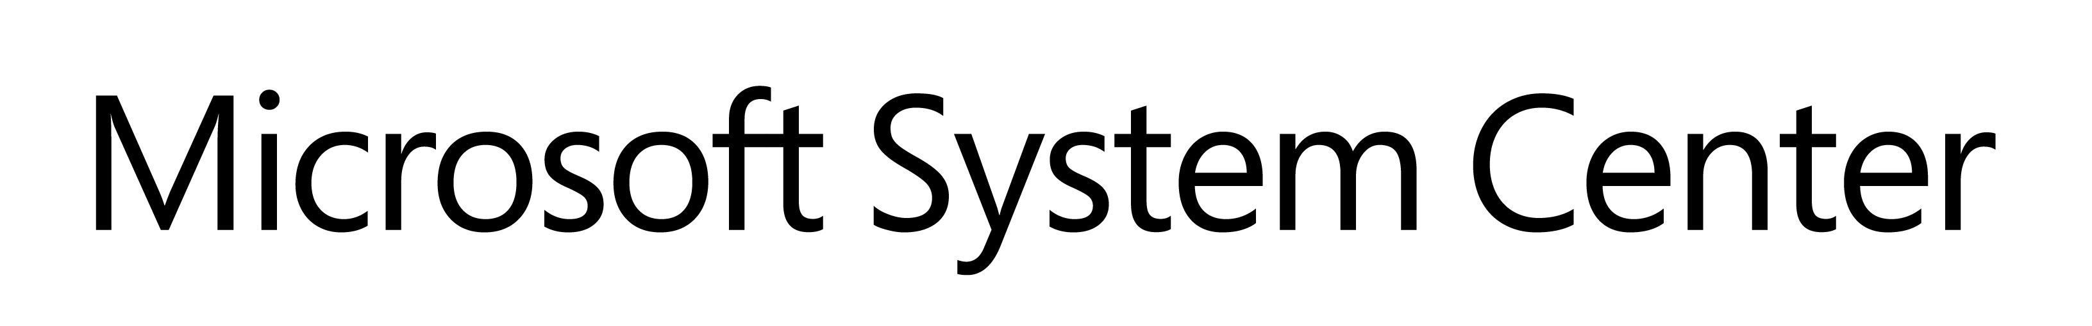


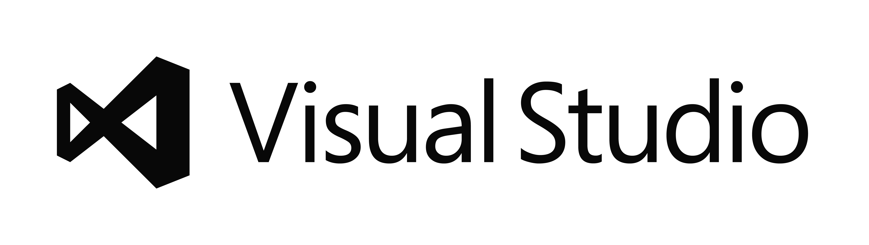
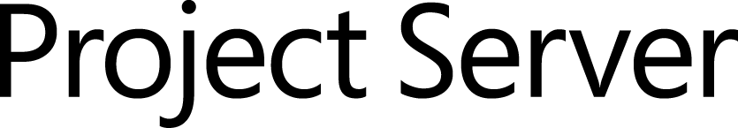
Tooling
Source control
TFS/VSTS
Agile planning
+ Azure
Test case management
Build automation
Continuous deployment
Release management
Load testing
Feedback management
Team collaboration
Application telemetry
Lab management

Slide 8
What is Team Foundation Server?
It’s a source control system!
Wrong. It is FAR more than a source control system.
Tool to help manage all aspects of creating software. From application inception to application sun setting.
DevOps Collaboration Hub
Key Functional Areas
Agile Planning & Management/Work Item Tracking
Version Control
Build Management & Automation
Testing
Release Management
Application Monitoring

Slide 9

Enabling Value Delivery
Plan
REQUIREMENTS
Backlog
Continuous Learning throughout the lifecycle
Agile Planning
Business
Product Owners
+ all other
Stakeholders
Collaborative Team Experiences
Development
Production
Automated
Dev and Test Tools
Developers
Testers
Operations
Flexibility, Extensibility,
Hybrid IT capable
Visibility, Traceability during whole Lifecycle
Develop + Test
Release
Build & Release

Slide 10
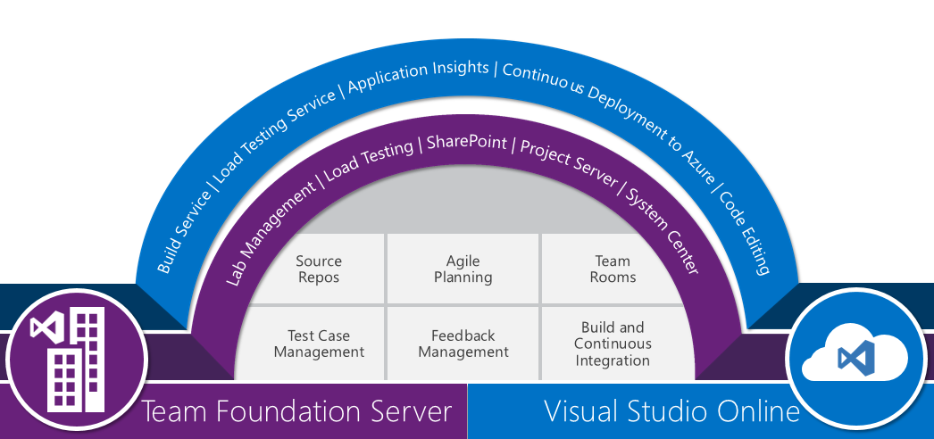
Microsoft ALM/DevOps Hub
Notes:
Review ALM Features

