Slide 1
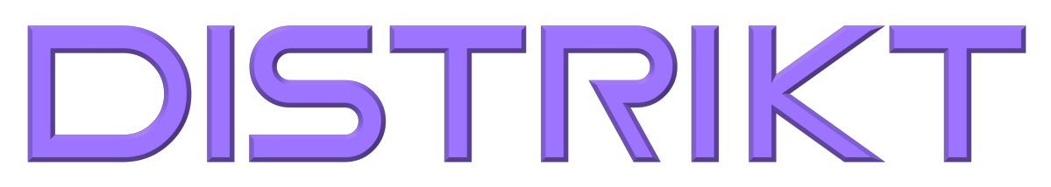
Data. Media. Intelligence.
PAID MEDIA INTELLIGENCE
Every marketing platform tells a different story.
We tell you which one is true.
Because advice should never depend on how much you spend.
ONE FLAT MONTHLY FEE / $0 MANAGEMENT FEES / $0 MARKUPS

Slide 2
THE PROBLEM
More spend ≠ faster decisions.
If any of these sound familiar, you already know why growth stalled.
Spend first, learn later.
Platforms grade their own homework.
Most brands buy the lesson after the budget is gone. The report arrives; the money already left.
Every ad platform's recommendations optimize for its own revenue. Of course Google says spend more on Google.
Data sits in silos.
Reporting eats the week.
Sales in one system, media in five others, attribution stitched together in a spreadsheet nobody fully trusts.
Hours assembling numbers that still don't answer the only question that matters: what do we scale?
None of this is a spending problem. It's a decision problem, and decisions need intelligence.

Slide 3
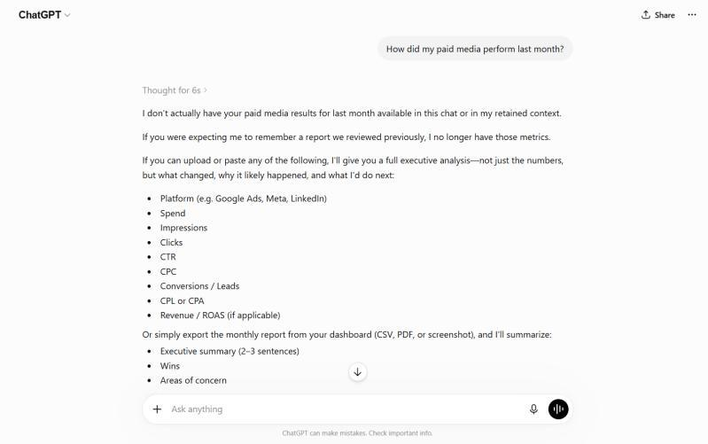
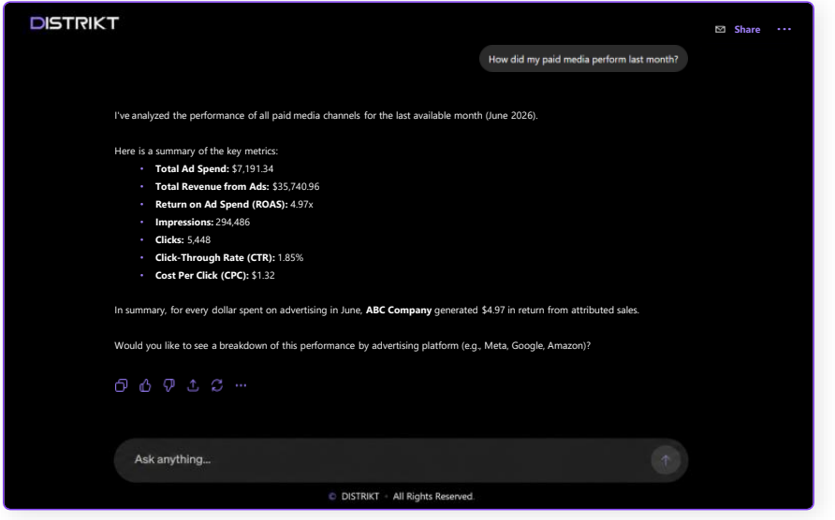
SEE THE DIFFERENCE
Same prompt. Two different answers
ChatGPT
DISTRIKT
No access to your accounts. It asks you for the numbers, then summarizes what you already knew.
Plugged into your accounts. It answers with your numbers: spend, ROAS, attribution, and what to do next.
Other tools guess. DISTRIKT knows.

Slide 4
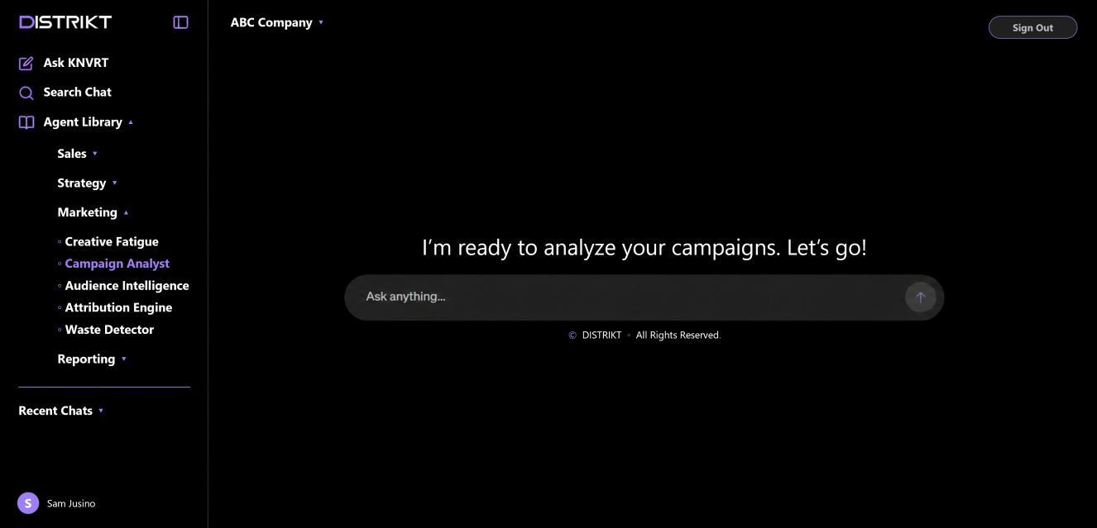
OUR PLATFORM
Not another chatbot.
Meet KNVRT: AI agent workflows, built into your business.
Every channel.
One system.
One answer.
What's working. What's not.
What to scale. What to cut.
In seconds.

Slide 5
Your data is a mess? Good.
If your data were clean, you wouldn't need us. Untangling it is day one of the engagement, not a prerequisite. We have never met clean data.

Slide 6
WHERE YOU ARE VS. WHERE YOU NEED TO BE
Paid media is the entry point. Not the ceiling.
YOU ARE HERE
YOU NEED TO BE HERE
Legacy Paid Media
DISTRIKT Paid Media
NEXT
BEYOND
Your Company Brain
Agentic Architecture
POWERED BY KNVRT
Every platform reports its own truth, and you stitch it together.
Scaling calls made on gut feel.
Black-box agency fees that grow as you spend.
Finally see what to scale.
AN INTELLIGENCE CORE
$0 in management fees
One intelligence layer your whole company works from. Marketing, sales, operations.
AI agents working inside your business. Built on our proprietary Five Pillar Framework.
$0 in markups
Every dollar streams into one intelligence layer, daily.
Humans make every change by hand. No black boxes.
The bottleneck is not your budget. It is where your intelligence lives.

Slide 7
THE HONEST ECONOMICS
Same budget. More machine.
Every dollar buys ads. Every result buys intelligence.
$0
$0
1
100%
Management fee on your media
Markup on CPMs or platform costs
Flat monthly KNVRT fee, scoped to your account
Of your ad spend goes to buying ads
The old model has a name. It is called arbitrage.
In the media buying industry, arbitrage means trading against your client's budget: they buy your media low, bill you high, and pocket the spread. It is rarely disclosed and never itemized. Some agencies do it through marked-up CPMs, some through opaque fees, some through both. Our answer is structural: we take no margin on media at all, so there is nothing to hide and nothing to audit.

Slide 8
THE DISTRIKT DISCIPLINE
Why DISTRIKT?
Budget follows evidence and data. Not opinion.
Because our incentives are actually aligned with yours. Most agencies get paid a percentage of what you spend, which means every honest test result that says "spend less here" costs them money. We don't take a cut of media at all. No management fee and no CPM markup. KNVRT is one flat fee regardless of your ad budget.
That single structural difference is what makes the rest possible. It lets us scale or shift your budget toward whatever the data says is working, because we have nothing to lose when the truth points away from a certain media type or from spending more.
Our KNVRT fee is honest by construction, not by promise.

Slide 9
RESULTS FROM REAL DEPLOYMENTS
Real data. Real results.
HOME WARRANTY PROVIDER
NUTRACEUTICAL BRAND
Couldn't identify where to put budget. Performance signals were unclear. Media spend was misaligned.
Drowning in data across Amazon, Shopify, multiple ad platforms. Teams reported for hours. Growth stalled.
120%
Sales Growth
32%
Sales Growth
$500K+
New Monthly Revenue
340%
Return on Q1 Ad Spend
84%
Increase in Ad Efficiency
92%
Less Time on Reporting
*Client investment recovered within the first month. Still active.
*Client investment recovered within three months of deployment.

Slide 10








CLIENTS SERVED
Trusted with media for the brands people know.

Slide 11
Stop guessing. Start scaling.
You show us what you spend and where.
We show you what's working, what's bleeding, and what we'd scale first.
You leave with your flat KNVRT fee. No obligation.
Worst case, you walk away knowing exactly what your media should cost.
Get Your Media Clarity Audit
calendly.com/kevin-teeven/30min | kevin@distriktww.com

