Slide 1
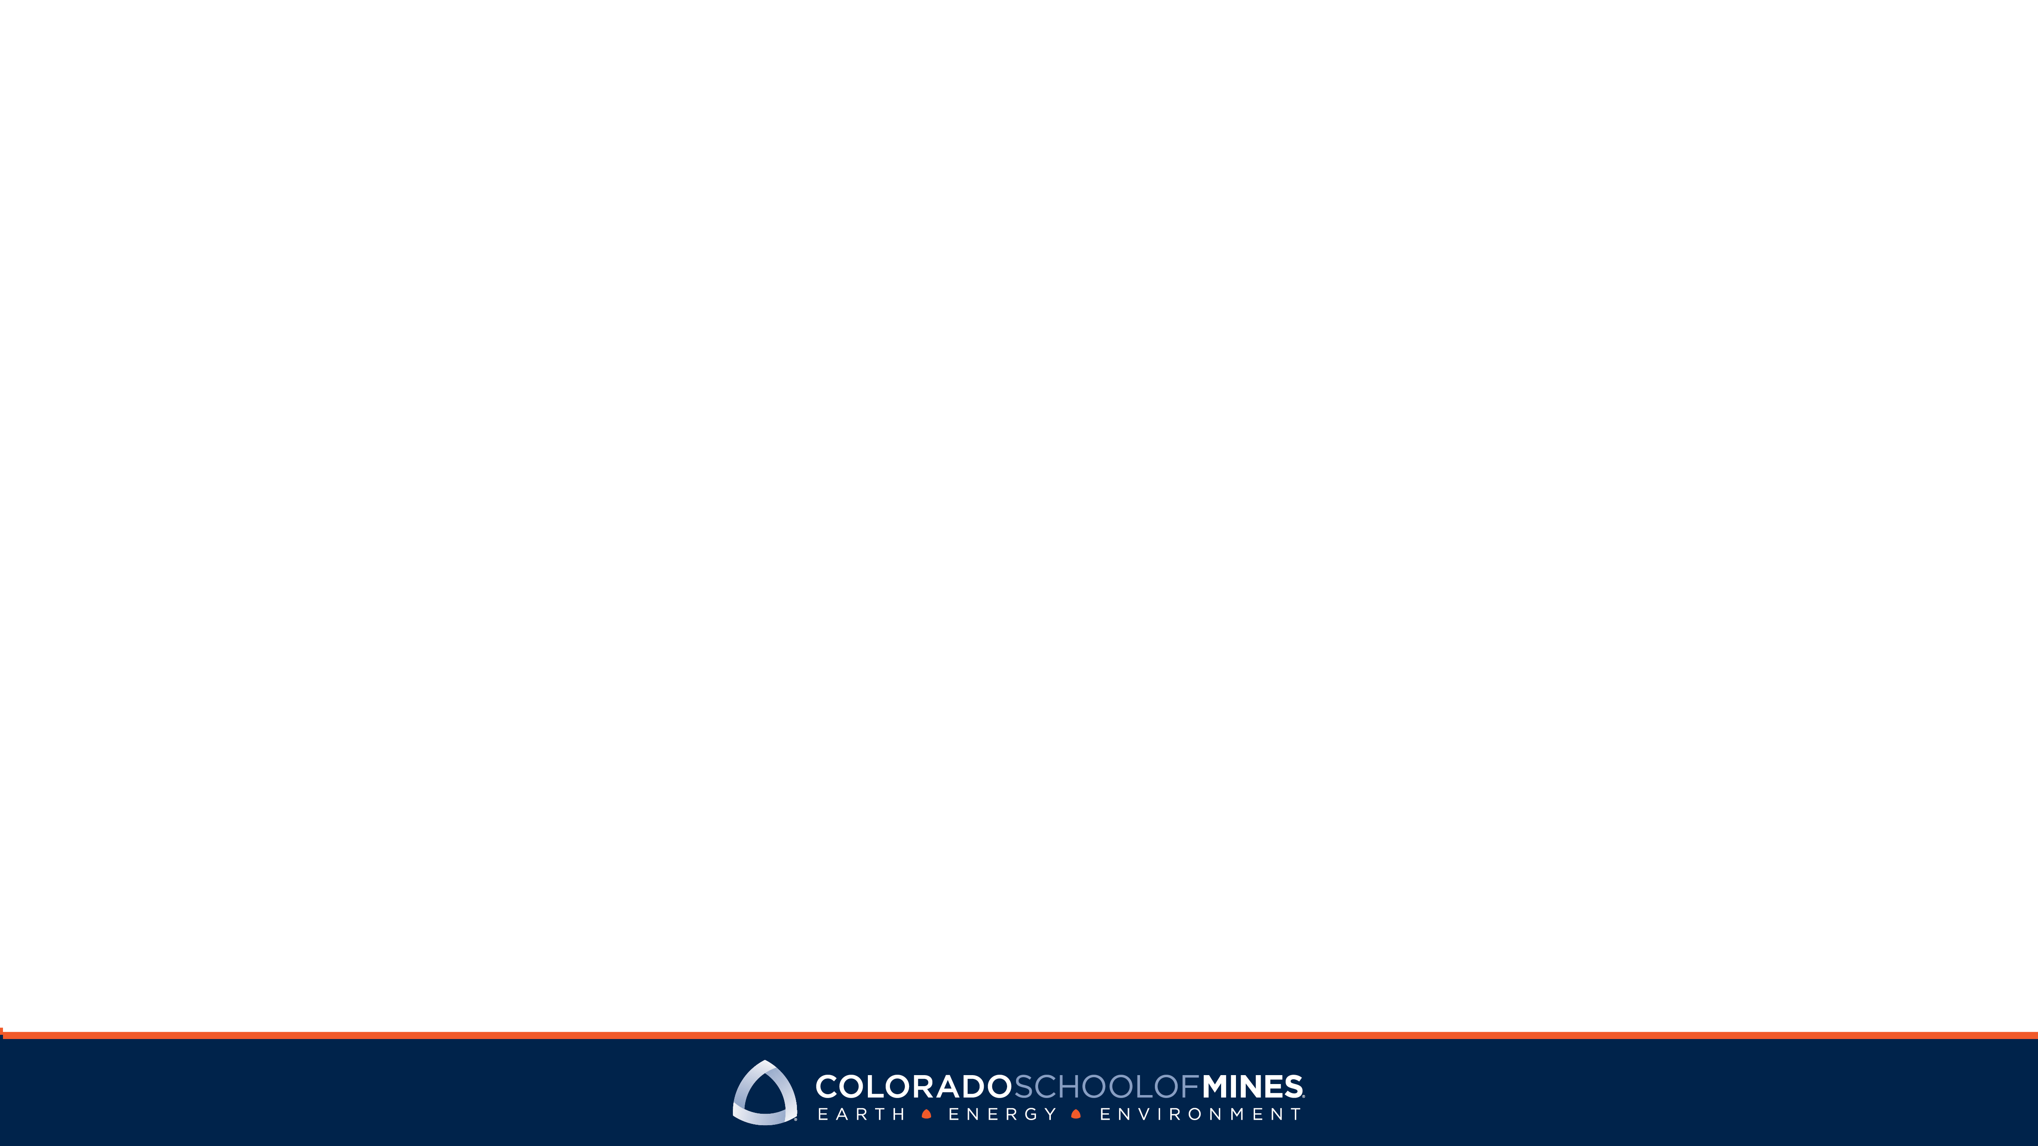
Presentation Title Goes Here
Subhead, name or date goes here

Slide 2
20
5,800
16:1
Undergraduate degree programs
Degree-seeking students
Student/faculty ratio
Colorado School of Mines is a public university focused on science and engineering, dedicated to pioneering research that addresses the great challenges society faces today—particularly as they relate to the Earth, energy and the environment—and committed to educating students who will do the same.

Slide 4
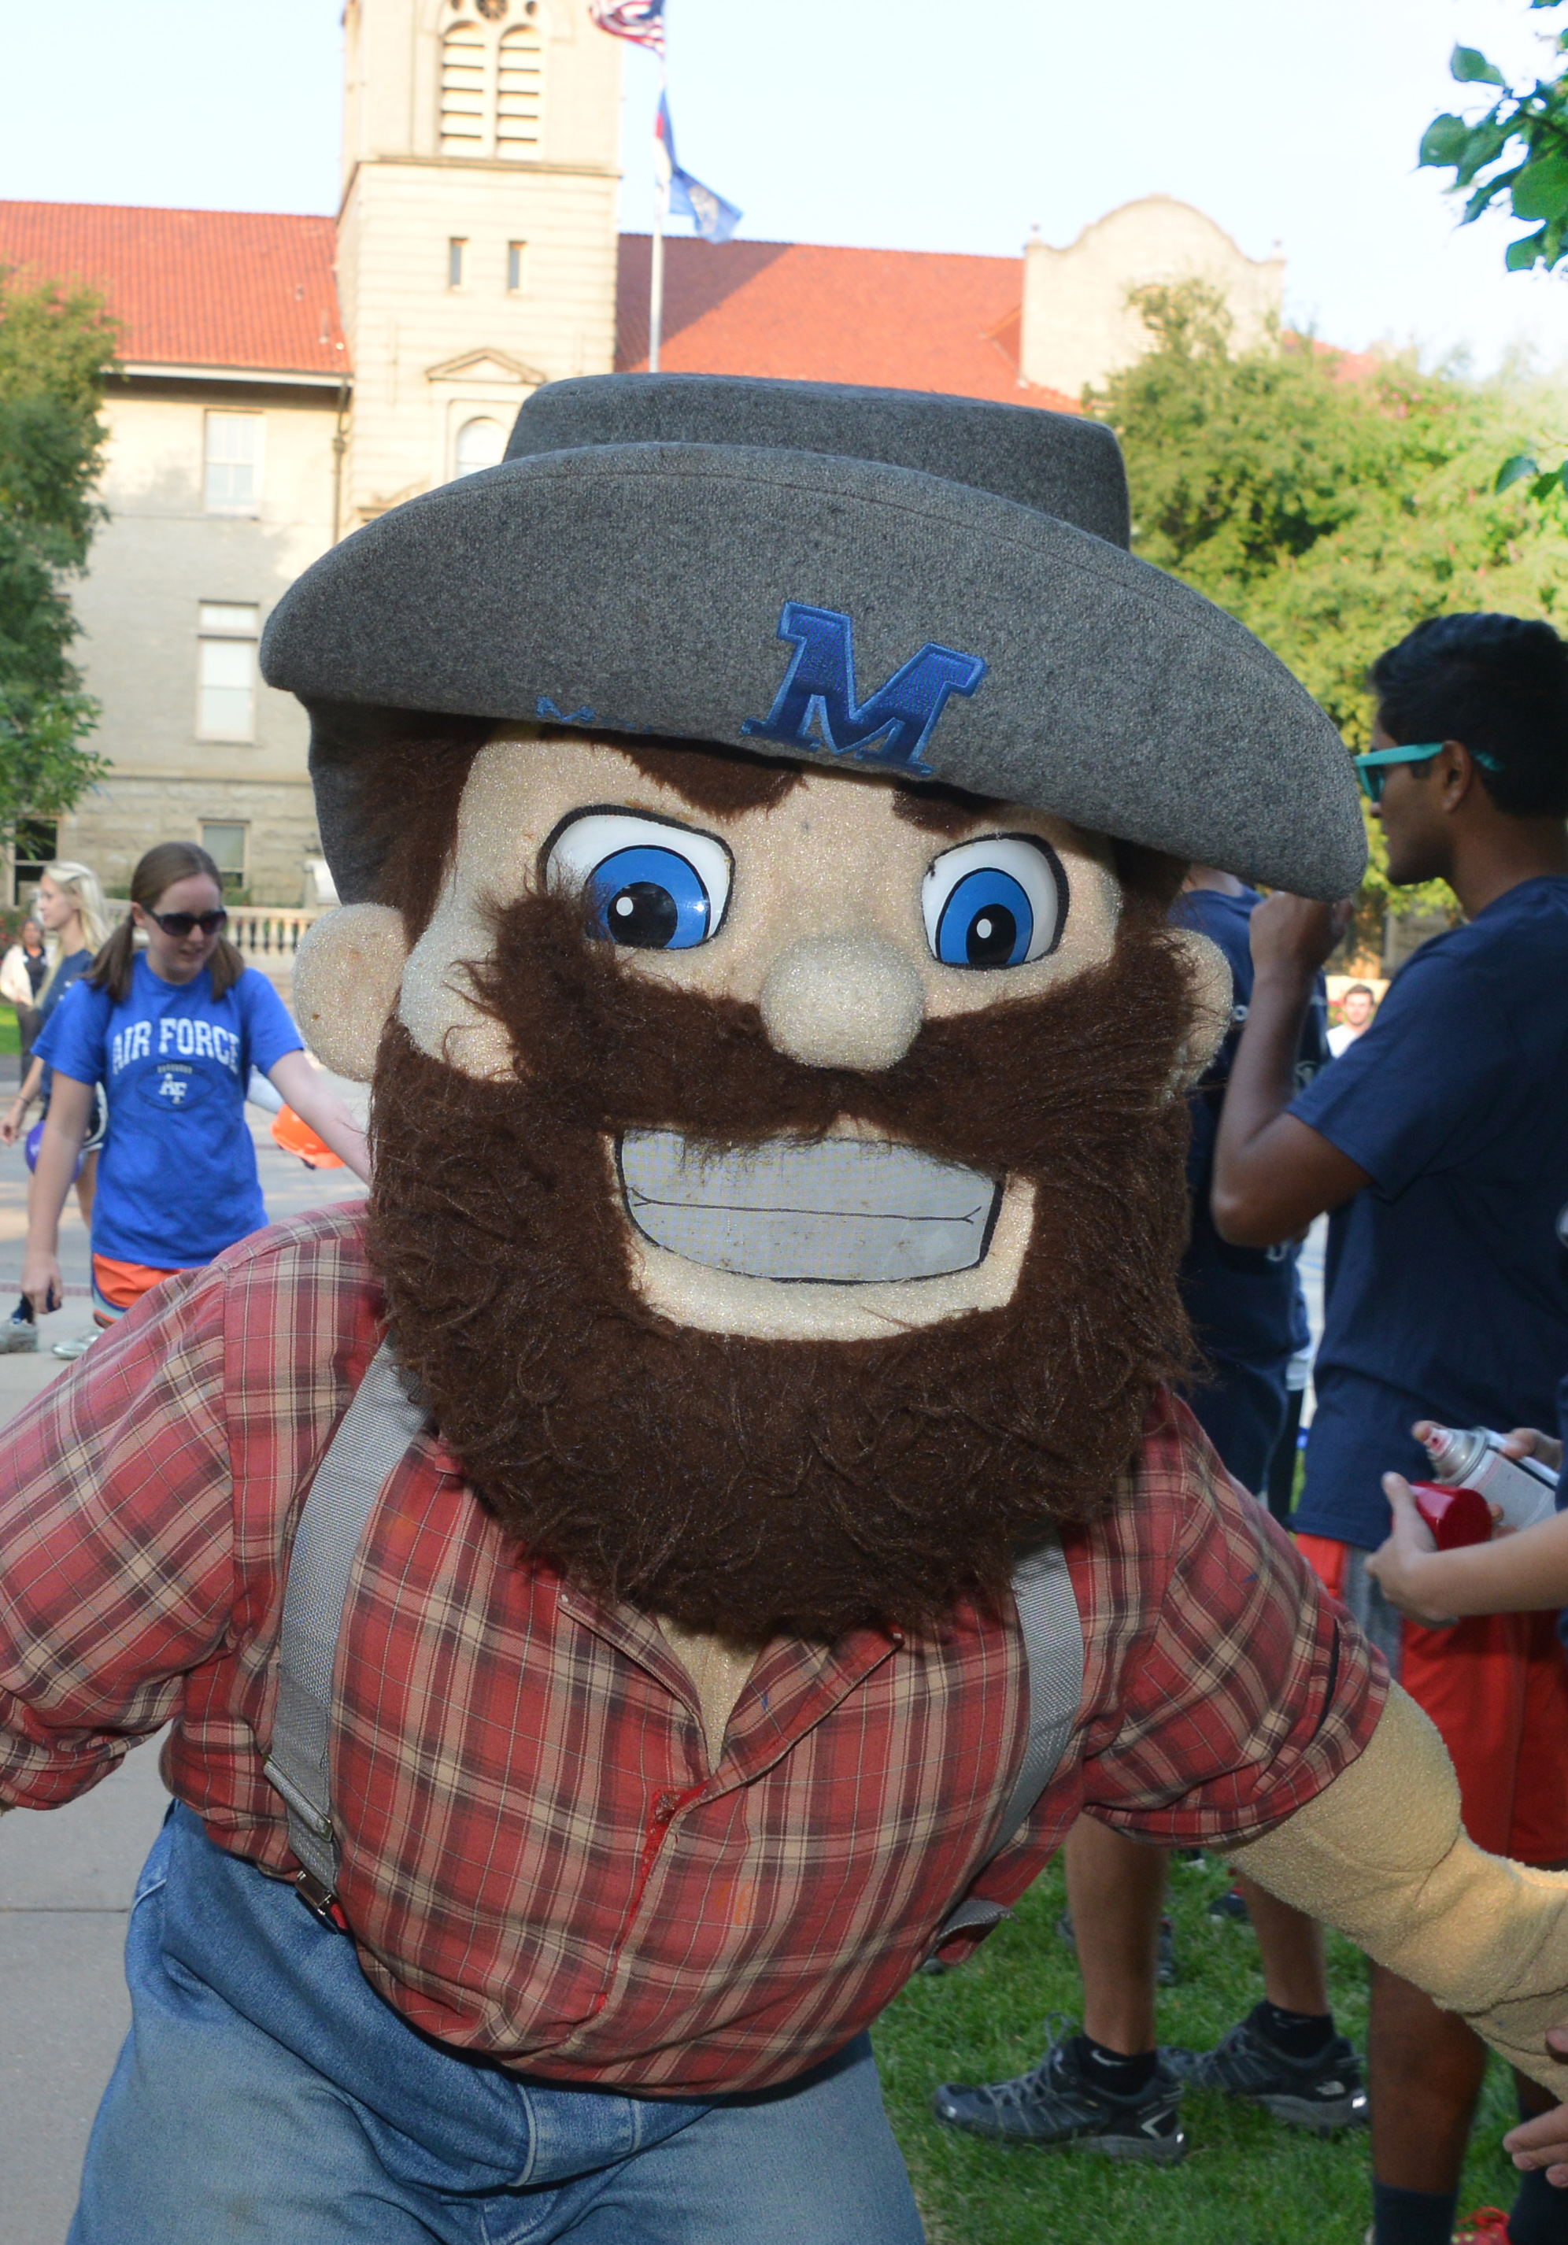
Slide Title Goes Here
Insert body copy here

