Slide 1
Multivariate fault detection in WWTP
Kathryn B. Newhart

Slide 2
Introduction to fault detection
Single variable monitoring is traditional approach in WWTP
Trend analysis is used, but methods are kept private
Multivariate statistical process monitoring is widespread in literature, but not in practice

Slide 3
Why use statistical process control?
Statistical Process Control (SPE)
There is inherent variability in WWTP that cannot be accounted for with an empirical model
Operator-determined setpoints may not be valid for all operating conditions, making the system reliant on diligent supervison.
To improve efficiency, need to improve process control

Slide 4
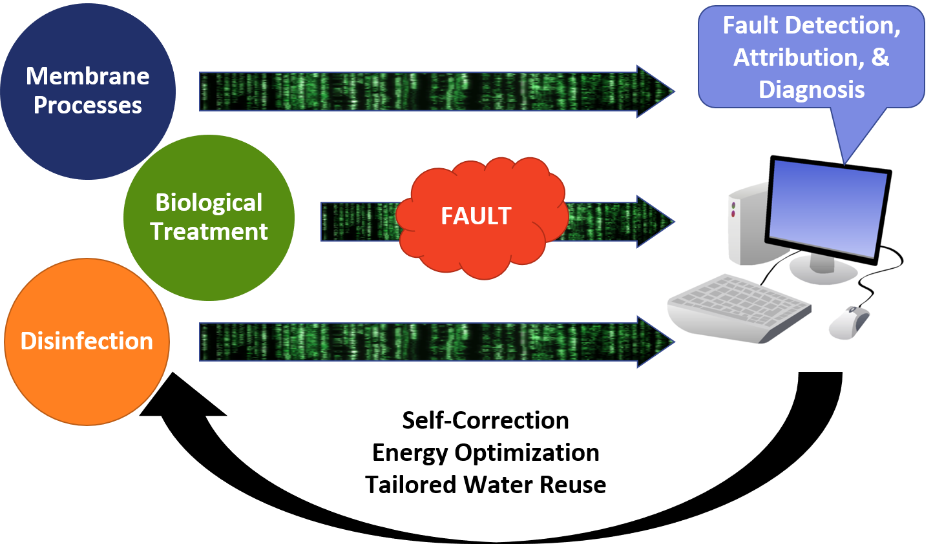
Why use statistical process control?

Slide 5
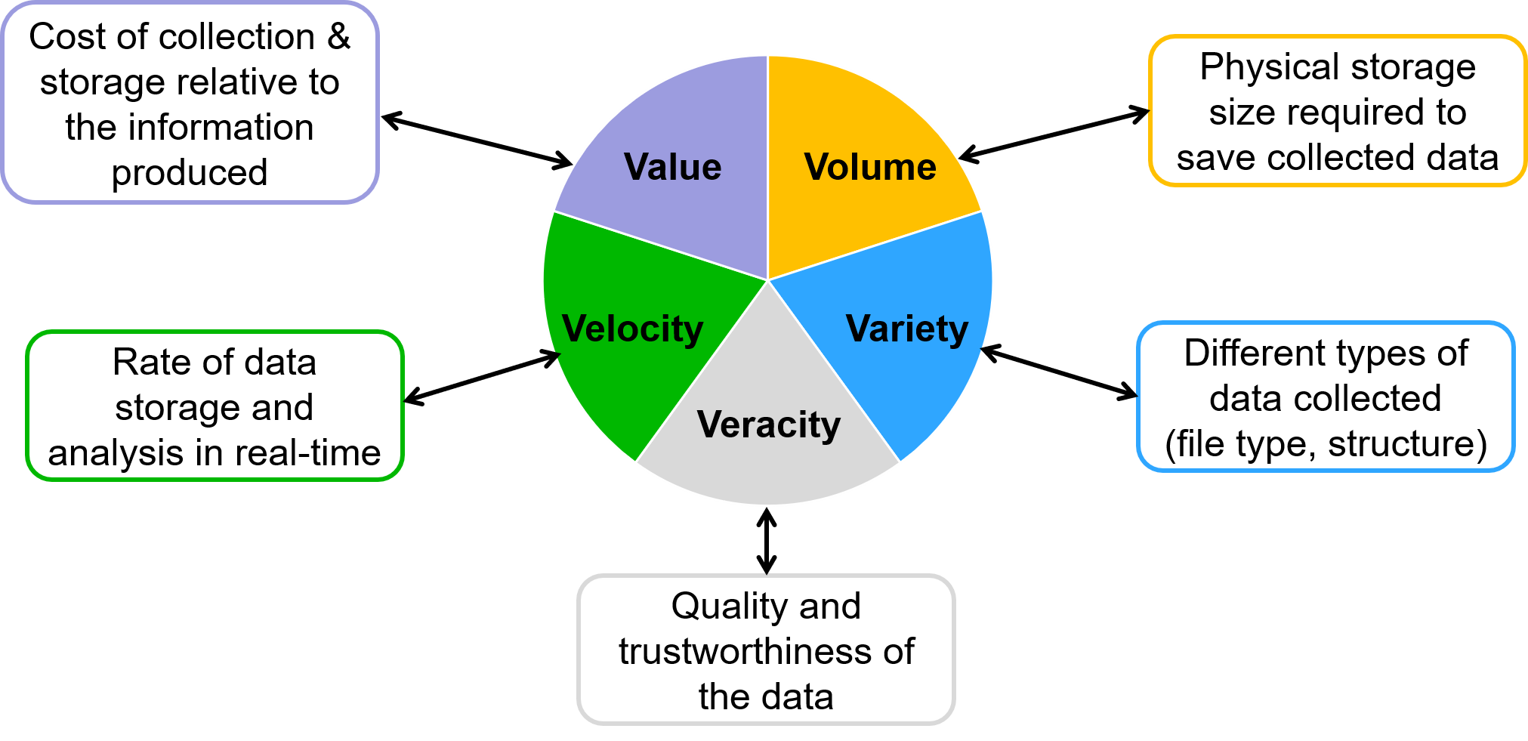
Characteristics of big data

Slide 6
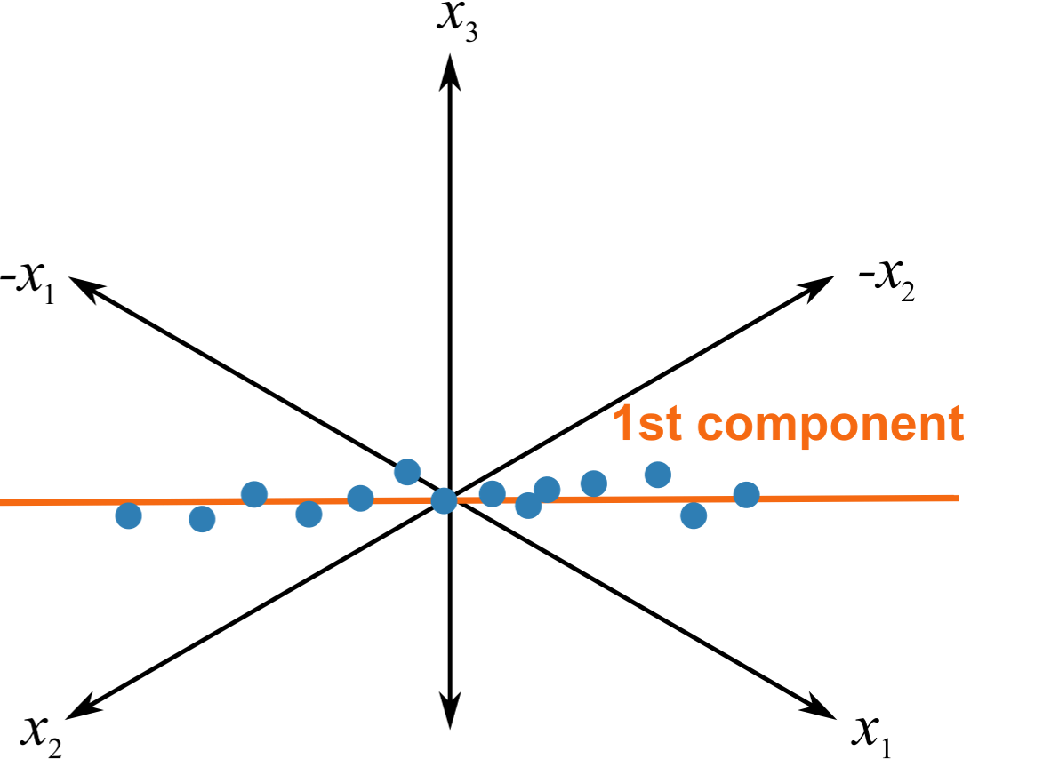
Principal Component Analysis
Data reduction technique
Complex relationships between water quality variables
Interpretable linear combinations of data
Which components represent the most variability?
1st component = maximum variance

Slide 7
Mines Park WWTP

Slide 8
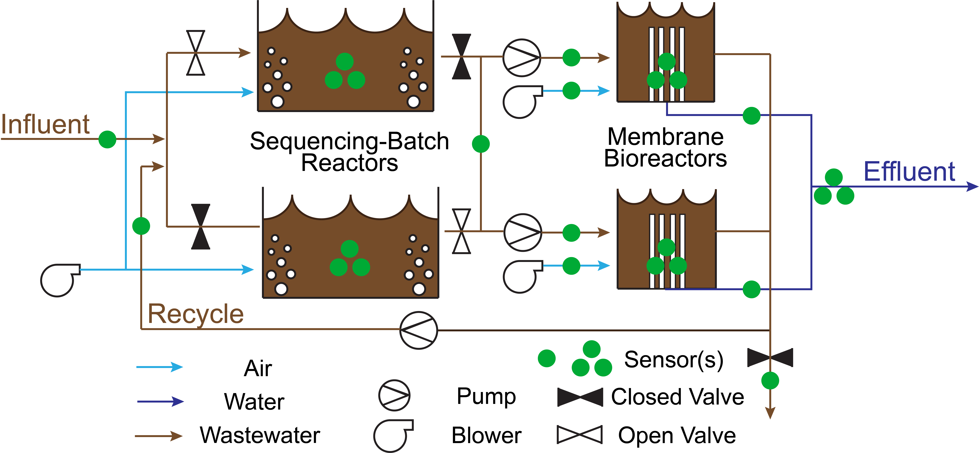
Mines Park WWTP

Slide 9
Case studies
Steps for each case study:
Declare case study parameters
Compile & clean raw data
Train ADPCA model
Test ADPCA model
Calculate fault detection statistics
Summarize results
Required software:
R (free)
Student-developed packages (e.g., mvMonitoring, ADPCA)

Slide 10
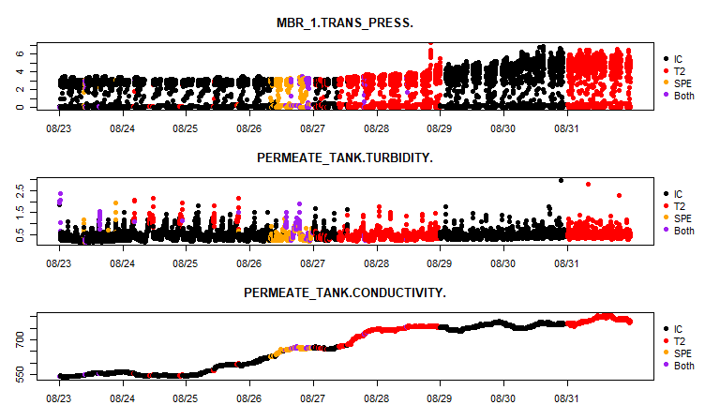
Case study: membrane failure - 7 days

Slide 11
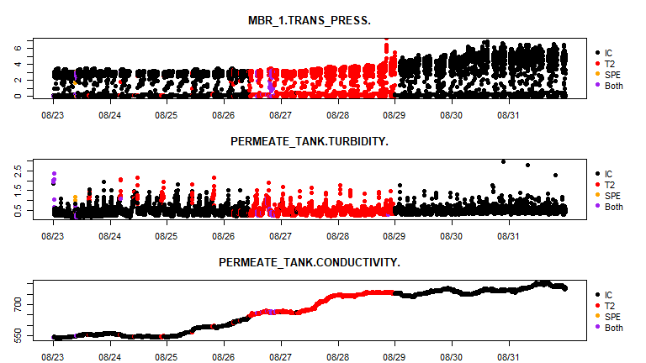
Case study: membrane failure - 5 days

Slide 12
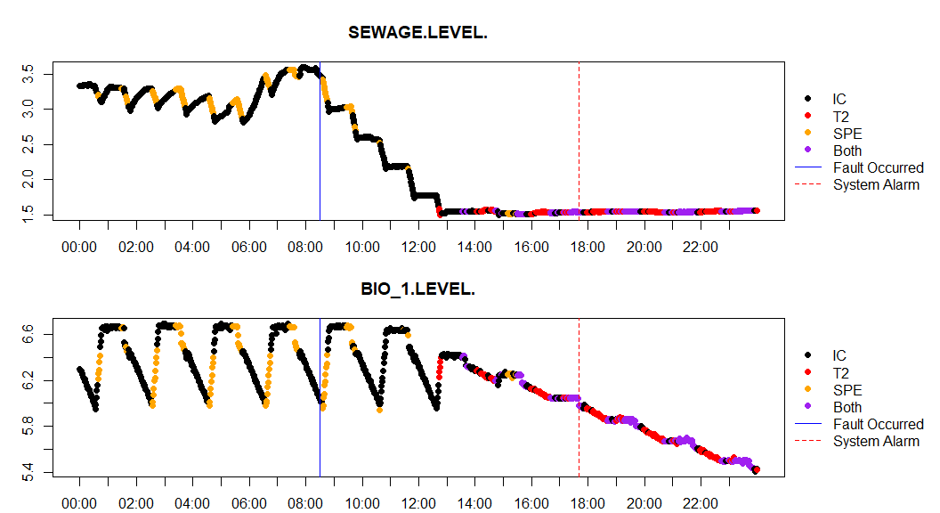
Case study: pump shutdown - 10 days - ms

Slide 13
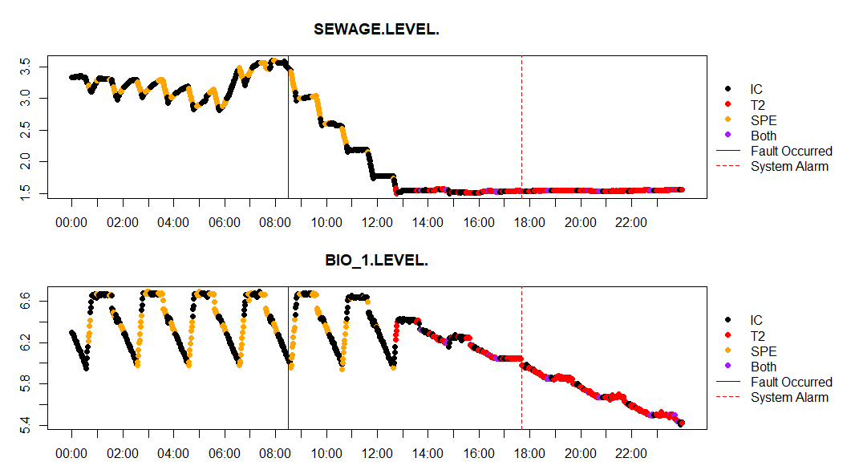
Case study: pump shutdown - 7 days - ms

Slide 14
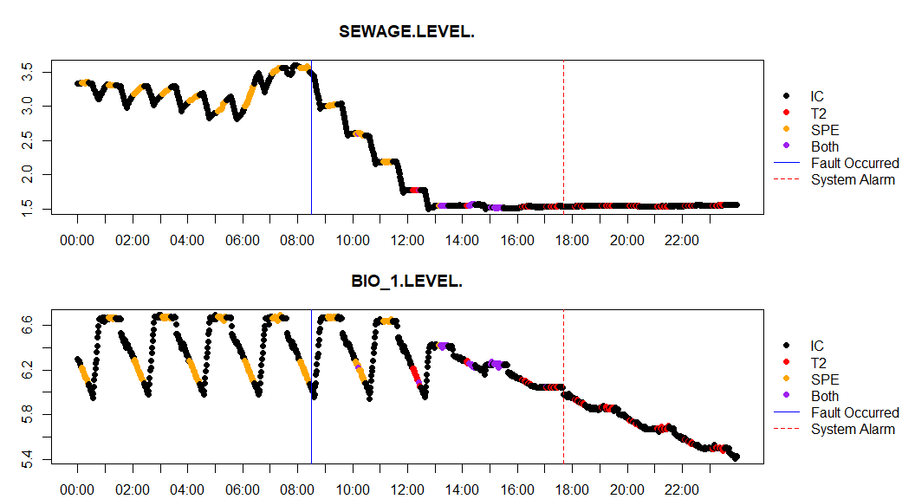
Case study: pump shutdown - 5 days - ms

Slide 15
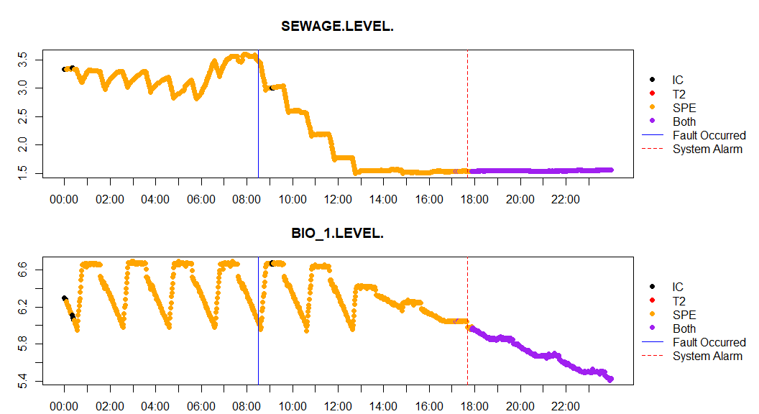
Case study: pump shutdown - 10 days - ss

Slide 16
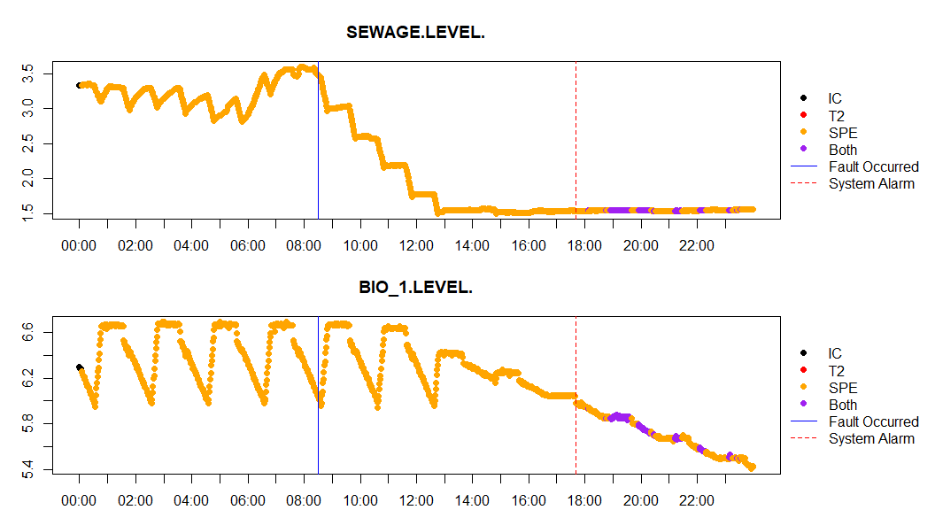
Case study: pump shutdown - 7 days - ss

Slide 17
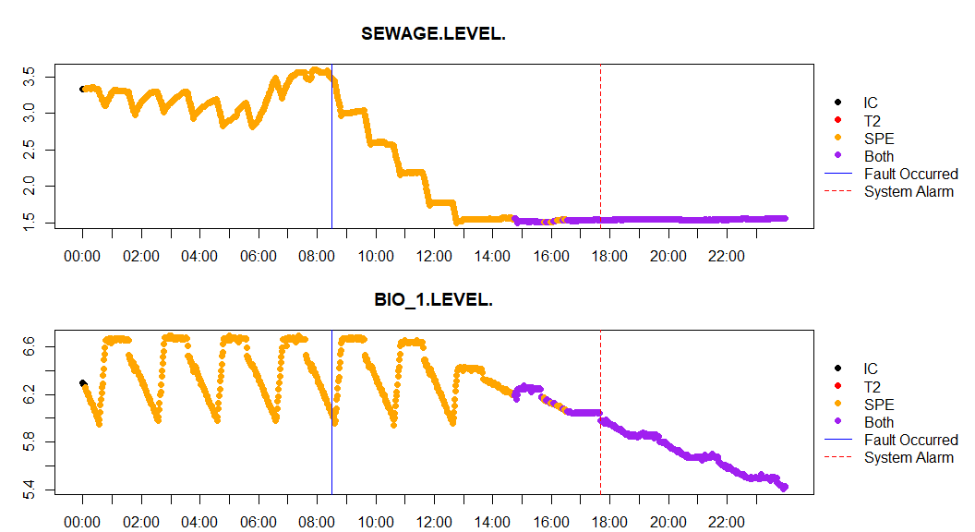
Case study: pump shutdown - 5 days - ss

Slide 18
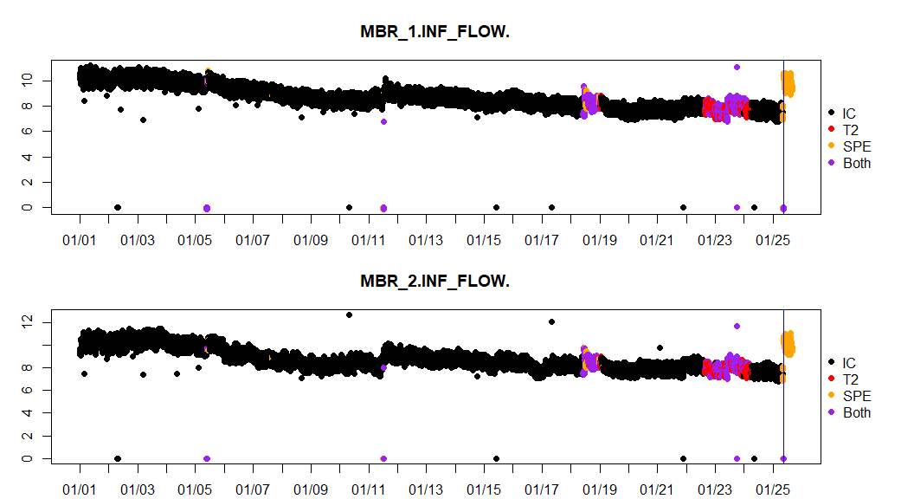
Case study: pump clog - 5 days

Slide 19
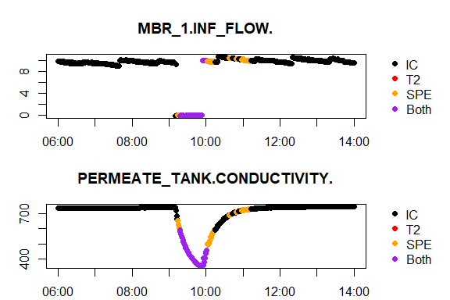
Case study: membrane shutdown - 10 days - ss

Slide 20
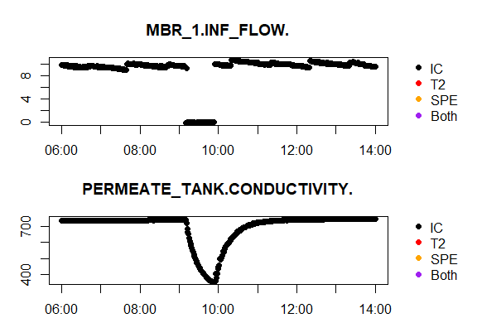
Case study: membrane shutdown - 10 days - ms

Slide 21
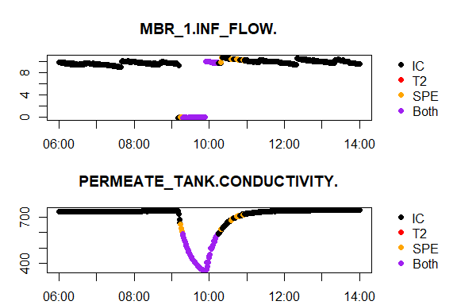
Case study: membrane shutdown - 5 days - ss

Slide 22
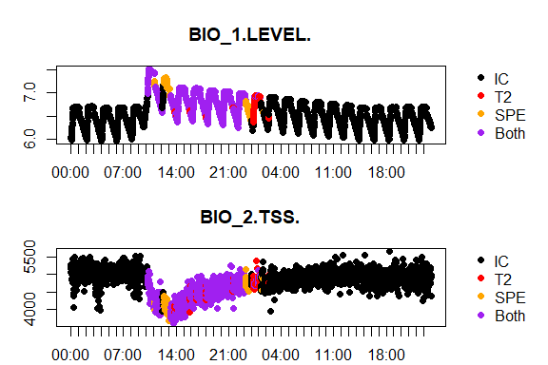
Case study: influent overdose - 5 days

Slide 23
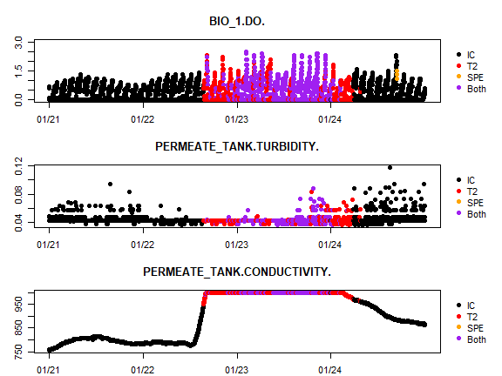
Case study: inf/eff quality changes - 5 days - ss

Slide 24
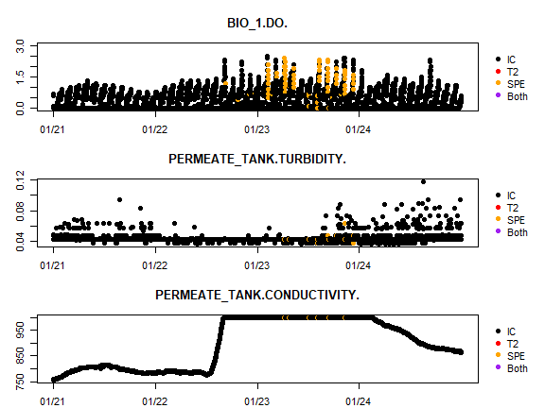
Case study: inf/eff quality changes - 10 days - ss

Slide 25
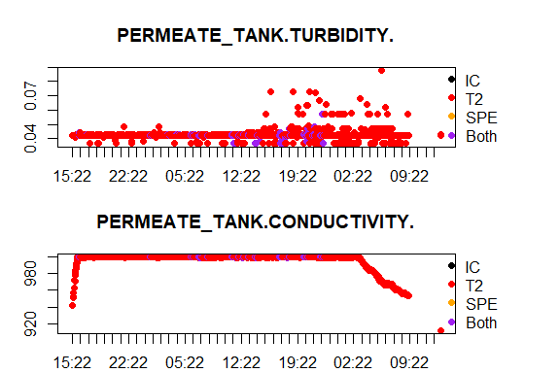
Case study: inf/eff quality changes - 10 days - ms

Slide 26
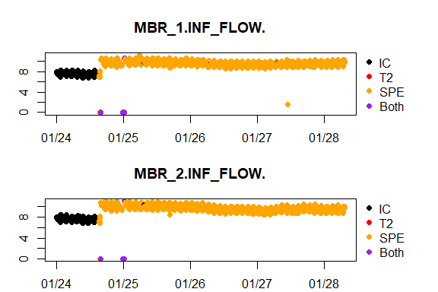
Case study: Clear clog in pump - 5 days - ss

Slide 27
<img src="“images/5 day SS allGraphs 2018-01-24 2018-01-29.svg”>

Slide 28
Alarm rates: January - 5 day

Slide 29
Alarm rates: January - 10 day

