Slide 1
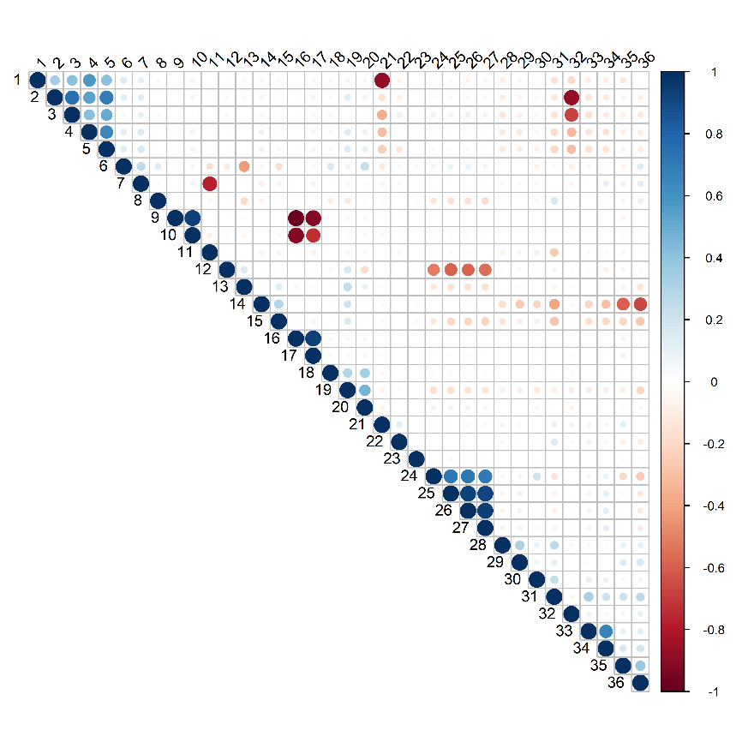
1 |  | MBR 1 TRANS PRESS
2 |  | MBR 2 TRANS PRESS
3 |  | PERMEATE TANK LEVEL
4 |  | MBR 1 PERM FLOW
5 |  | MBR 2 PERM FLOW
6 |  | MBR 2 INF FLOW
7 |  | BIO 2 LEVEL
8 |  | BIO 1 TSS
9 |  | MBR AIR SCOUR FLOW TANK 1
10 |  | MBR AIR SCOUR PRESSURE 1
11 |  | BIO 1 LEVEL
12 |  | PERMEATE TANK TURBIDITY
13 |  | BIO 2 TSS
14 |  | SEWAGE FLOW
15 |  | RAS TROUGH PH
16 |  | MBR AIR SCOUR FLOW TANK 2
17 |  | MBR AIR SCOUR PRESSURE 2
18 |  | MBR AIR SCOUR PRESSURE
19 |  | MBR 1 INF FLOW
20 |  | PERMEATE TANK CONDUCTIVITY
21 |  | MBR 1 PERM PRESS
22 |  | WAS FLOW
23 |  | RAS TROUGH DO
24 |  | AMBIENT TEMP
25 |  | BIO 2 TEMPERATURE
26 |  | RAS TROUGH TEMPERATURE
27 |  | BIO 1 TEMPERATURE
28 |  | BIO 1 DO
29 |  | BIO BLOWER 1 FLOW
30 |  | SEWAGE LEVEL
31 |  | RAS TROUGH TSS
32 |  | MBR 2 PERM PRESS
33 |  | BIO 2 DO
34 |  | BIO BLOWER 2 FLOW
35 |  | MBR 1 LEVEL
36 |  | MBR 2 LEVEL

