Slide 1

Document Management Insights and Recommendations
Annual Performance
Keith Ng - Data Analyst

Slide 2
Table of Contents
Project Overview
Document Inventory Metrics
Insights Deep-Dive
Recommendation
Appendix (Supplementary information)

Slide 3
Context
Our goal is to investigate the performance of the Scan Hub team's document management to
find areas of large amounts of undigitised and unreturned documents, providing recommendations for better management of such in the future.
Ultimately, we want to control growing backlog(s) properly, to maintain progress and
prevent resources being strained, allowing us to meet demands and stipulated timelines
around the digitisation and returning of the respective agencies' documents.

Slide 4
Document Inventory Metrics (1)
To evaluate the performance of the document inventory's management, the following key metrics will be
followed:
Completed Documents per Stages
Received, Digitised and Returned Documents
The three stages of document management within the Scan Hub, in that order.
Ideally, received documents should be digitised and then returned to their original agency, over
being unfinished at any point within the last two stages.

Slide 5
Document Inventory Metrics (2)
To evaluate the performance of the document inventory's management, the following key metrics will be
followed:
Completed Documents per Category
1) Agency
Where the received documents belong to each of such. Being a top-level category, we will focus on this first before vendors.
2) Vendor
The suppliers assigned to each agency that provide documents of varying amounts.
3) Year/Month
Tracks the total amount of documents received/digitised/returned over given years/months.

Slide 6
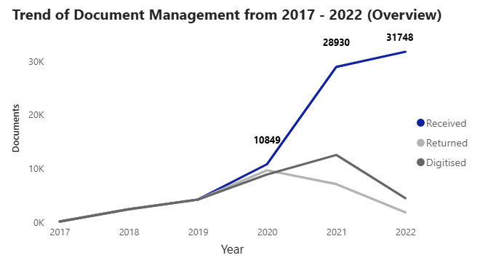
Document management was relatively stable until 2021 and 2022, when the
received documents alarmingly increased, but left unfinished. (1)
  Between 2020 to 2022, received documents
  increased from 10849 in 2020 to 28930 in 2021, followed by 31748 in 2022.
    In total, the received documents increased by192% from 2020 to 2022.

Slide 7
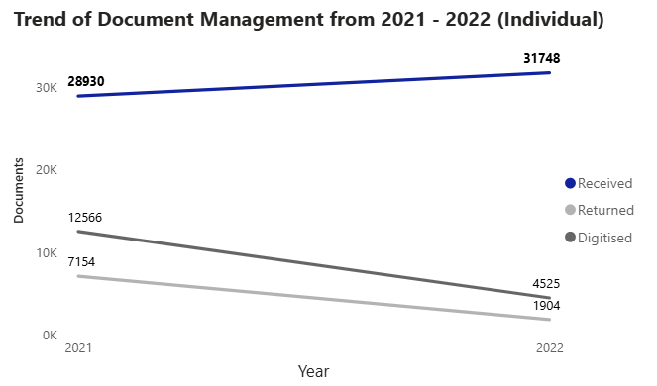
Document management was relatively stable until 2021 and 2022, when the
received documents alarmingly increased, but left unfinished. (2)
  Inversely, returned and digitised documents
  failed to keep up, with values of 7154 (24% done)
  and 12566 (43%) in 2021.
  This worsened in 2022 by declining further in
  both categories while the received documents rose,
  with 1904 (5%) and 4525 (15%).

Slide 8
Agency 0 is the biggest source of documents between the two years of 2021 - 2022.
Under both years, Agency 0 provided the amount documents below (received):
  20021/28930 (69% in 2021)
  25294/31748 (79% in 2022)
However, when drilling Agency 0 down by Vendor, we can find a more direct source of these documents, to better understand where the problem should be addressed.

Slide 9
Vendor D is the source of almost all of Agency 0's documents across both years, causing its overflow.
In 2021 and 2022 respectively, Vendor D contributed to Agency 0 by:
  19811/20021 (98% in 2021)
  24671/25294 (97% in 2022)
However, with only one vendor behind the huge influx of documents, it may be easier to
control/investigate over having multiple to attend to.

Slide 10
Agency 0 under Vendor D is the biggest source of documents between the two years, causing the high number of undigitized and unreturned amounts within the timeframe. (1)
With a very low completion rate, it caused the gap in our trends:
  7380/19881 (37% digitised in 2021)
  1894/19881 (9% returned in 2021)
Worse still, it had 0 digitised or returned documents in 2022.

Slide 11
Agency 0 under Vendor D is the biggest source of documents between the two years, causing the high number of undigitized and unreturned amounts within the timeframe. (2)
To further highlight its low progress within both years, when adding their total received documents
together, no values even match a quarter of work done.
  7380/44482 (16% digitised overall)
  1894/44482 (4% returned overall)
As Agency 0 is related to many Singaporean students' academic records, it becomes more urgent
for it to be resolved as soon as possible.

Slide 12
Where will the presentation go from here?
We will determine the problems within Agency 0’s management (provided only by Vendor D only), which can be used for other agencies if necessary.
To focus on important takeaways, no other agencies/vendors will be covered due to them generally providing less documents, making them of a lower priority.

Slide 13
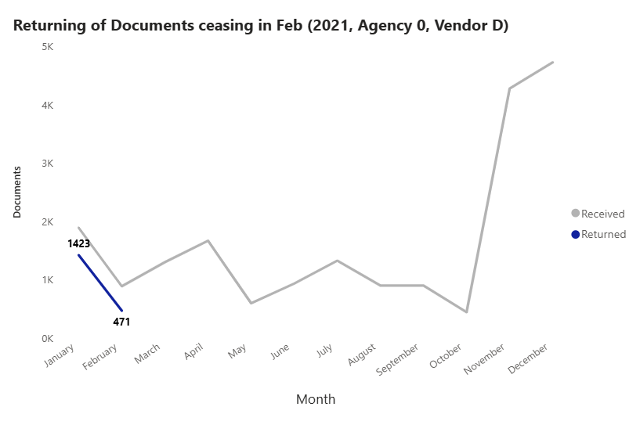
2021 and 2022's inconsistencies and/or neglect with the digitisation and
returning of documents caused its poor document management. (1)
  Agency 0's Vendor D in 2021 returned no
  documents beyond February, besides
  being incomplete for both months.
  Oddly, the returning of documents lasted much shorter than its own digitisation, adding an
  inconsistency the two to be investigated by the team.

Slide 14
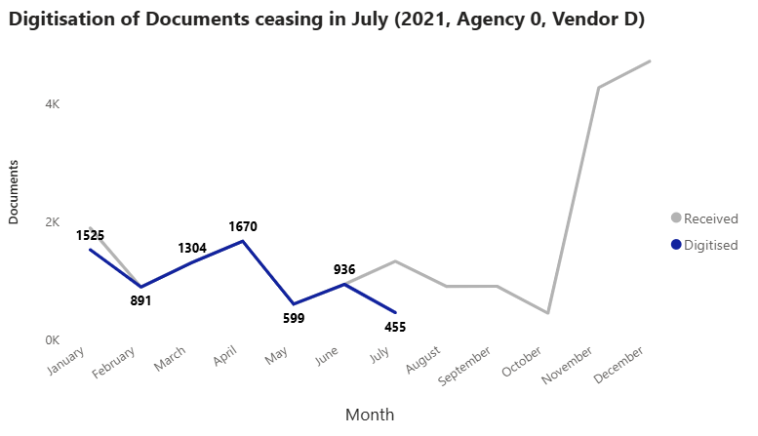
2021 and 2022's inconsistencies and/or neglect with the digitisation and
returning of documents caused its poor document management. (2)
Except for January, all documents were
consistently digitised from February to June.
  This stopped in July with less than half done
  (455/1328), before abruptly failing to digitise
  any more documents for the rest of 2021.
The inconsistency within both categories,
through completing some/all work and then not
across months, and a mismatch in both categories’
actions could bring down and progress in the
long run.

Slide 15
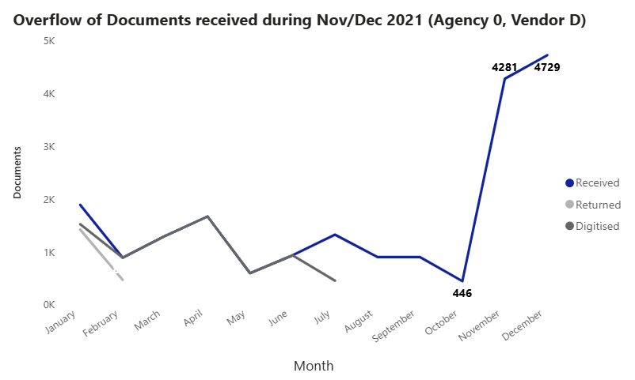
2021 and 2022's inconsistencies and/or neglect with the digitisation and
returning of documents caused its poor document management. (3)
The spike of received documents between
November/December (summed to 9010) from 446 in October, caused the overflow in 2021.
With no returned/digitised documents by then,
this issue worsened by possibly being undetected – an notable stack of unfinished work over a year old, which could happen again if not addressed.

Slide 16
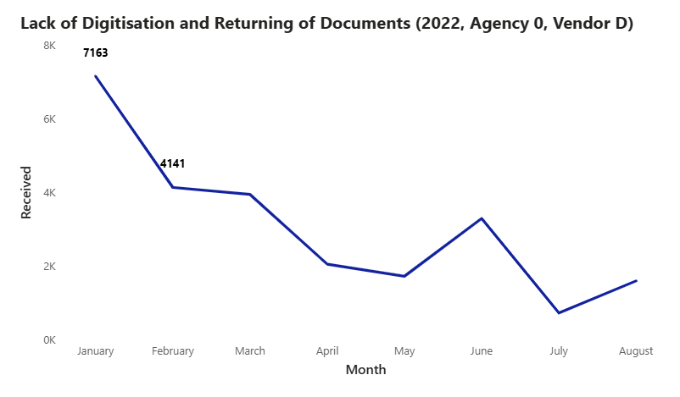
2021 and 2022's inconsistencies and/or neglect with the digitisation and
returning of documents caused its poor document management. (4)
Despite the downward trend in received documents, more were still present by the end of he year, as 24671 in 2022 over 19881.
  However, it regressed further by returning
  nor digitising any, creating even more
  outstanding work to finish on top of the previous year.

Slide 17
Why is any of this important?
Given the older years, it may be more challenging to attend to unfinished work due to newer
priorities, thus making it harder to resolve presently - the reason why timeliness of output remains
crucial within the document’s management.

Slide 18
Recommendations
and Next Steps

Slide 19
Key Recommendations
Recommendations focus on two given strategies: Re-examining the status of the Scan Hub team as well as addressing prioritized
agencies and/or vendors and frequent monitoring of both categories in general.
Improve the Consistency of Completed Work
Check for sufficient manpower: If possible, increase the manpower via taking in consideration the overall amount of
documents to handle, especially with the possibility of agencies/vendors that send higher amounts.
Solve the reason behind inconsistency: Investigate the general management of documents to know the actual reason
behind inconsistent/incomplete digitisation and returning, before taking appropriate action.
Track progress frequently: At the end of every week, use a bar graph in Excel to detect what documents have yet to be
digitised and returned, against what has been received.
Pay closer attention to areas of larger output: Keep a close eye on any agency/vendors with a history of sending higher
amounts of documents, to detect and address unexpected anomalies as soon as possible.

Slide 20
Thank You!

Slide 21
Appendix
(There’s no more analysis, just misc. stats)

Slide 22
Technical Process
Dataset stats:
A total of 37 unique agencies were analyzed alongside 6 vendors (1 is unidentified, while 5 are identified) underneath them
Data ranges from 20 November 2017 - 20 December 2022
Out of 78530 received documents across the 5 years, only 32992 (42.01%) and 25774 (32.82%) had been digitised and returned
respectively
Data points involved:
Date: Months, Year
Document Progress: Returned, Received, Digitised
Document Sources: Agency, Vendor
Technical process included:
Loading data into Power BI from Excel
Building a self-service dashboard in Power BI for visualization through toggleable filters (Agency, Year/Qtr/Month, Vendor)
Creating calculated functions to display % of Digitised/Returned
Basic data cleaning for the dataset per agency (e.g. Removing redundant columns, managing missing data, etc)

