Slide 1
Cebu Programming Training
Fashion Team
Notes:
Now, We fashion team will give project report.

Slide 2
１
Introduction
Notes:
First, introduce the team members.
紹介
Let's go back to the presentation.

Slide 3


1. Introduction
Our goal
Create a prototype of website that you can find products in a shortest way
Notes:
As the team name, we were in charge of fashion field.
Our goal is to reduce the stress that users have as much as possible when shopping.
The services we have developed make it possible.
This will be explained later.
Next, I explain the team's technology.

Slide 4
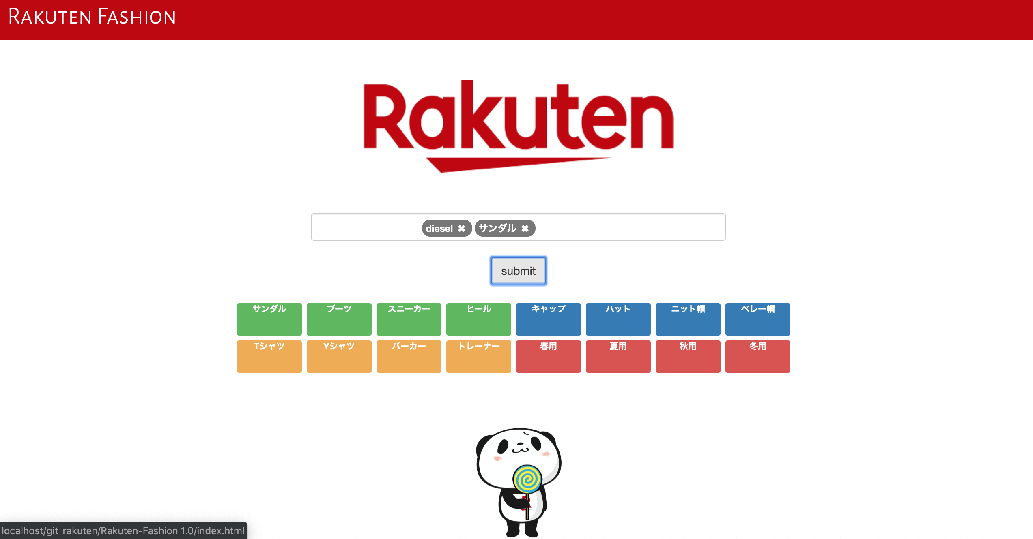
1. Introduction
Front End Group
Back End Group
Rakuten API
Member
Takehiro Tezuka
Lei Puwen
Nobuki Kasai
Role
Make Web pages
Using Technology
HTML , Javascript , CSS
Member
Ryo Yamaguchi
Yuka Oe
Role
get necessary item data from “Rakuten API”
Using Technology
PHP, Rakuten API
Various data
Only the necessary data
Json data
Notes:
We developed in frontend and backend.
I and Ryo are from the backend team.
We backend team get datasets from Rakuten API.
API is the port which enables the third party to use company's data and service easily.
And then we combine only the information we need into a single array.
We provide frontend team those datasets after converting to json type.
Next, the frontend team.
they make Web pages by using datasets backend team made.
they use HTML, CSS and javascript;
Next, Nobu will explain the current problems on the Rakuten’s web page.

Slide 5
２
Current Problems
Notes:
Let me explain the current problems in online shopping

Slide 6
2. Current Problems
PUSH
PUSH
PUSH
PUSH
Press the button
PUSH
PUSH
Press the button above of red button
PUSH
Notes:
At first, there are two pages that has different designs
The left one describes Press the button above of red button
The right one describe Press the button only
Could you tell me which design do you like, left or right
Can you tell me your opinion, Mr.eli, Ms.inoue
Exactly! in my opinion, The right design is better than left one
Because the left page has too much information and so complicated
Right page is simplified and you can focus on the function that the page have
So we should make the simplified page

Slide 7
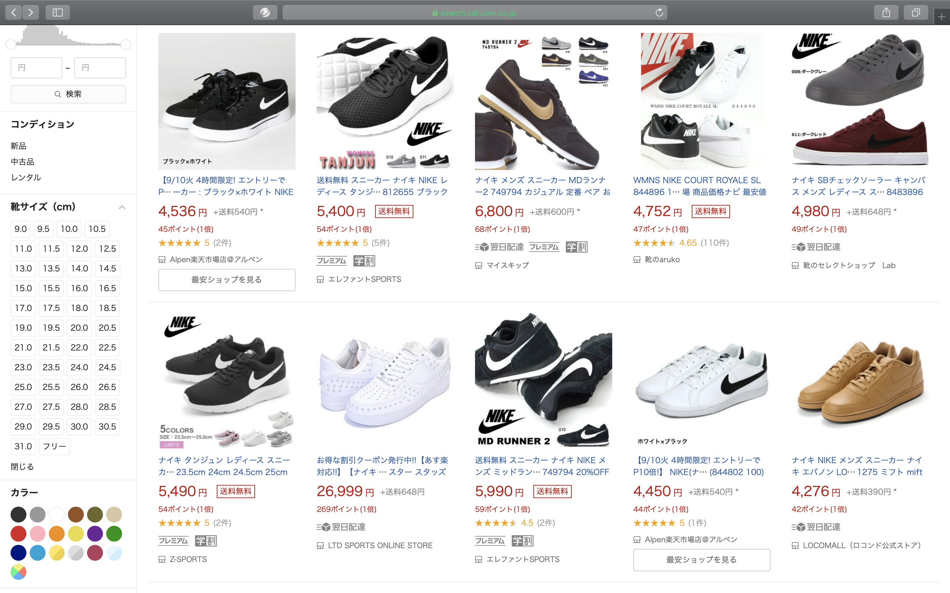
2. Current Problems
Current Problems of “Rakuten Ichiba”
Same item
Notes:
But some online shopping web sites have this problem
This is the page of the Rakuten ichiba that is showing a shoes list
In Rakuten ichiba, there are same items that has information and are from different shops
This problem can be a factor that reduces user`s experience
So we focused on this problem

Slide 8
３
Challenges and Solutions
Notes:
Let me explain the solutions

Slide 9
3. Challenges and Solutions
Our solution
Cluster the same item from various shops
Enable to search with tags
Compare similar good in one cluster or page
Notes:
We have three solutions that can solve the problem
The first solution is to Cluster the same item from various shops
The second solution is to Enable searching items with tags
The third solution is to Compare similar good in one cluster or page.
And, the first solution is the biggest or the most important solution for us
ryo will explain this proposed solution

Slide 10
How to Cluster ?

Slide 11
3. Challenges and Solutions
Clustering one item
Get item information from ”Rakuten API”
Cluster the same item from different shops
Show the overview of item and the range of price in search result page
Compare the price and Rakuten Point by shops in detail page
Notes:
I will explain our clustering method in this page.

Slide 12
3. Challenges and Solutions
Clustering one item
Get item information from “Rakuten API”
Our WebSite
Rakuten API
GET
Notes:
First, Rakuten API is a function that we can get item information from “rakuten ichiba".
When you search some items, our site use the search keyword as a key of API, and call Rakuten API.
Then our web site get item information as JSON data.

Slide 13
3. Challenges and Solutions
Clustering one item
Get item information from ”Rakuten API”
Cluster the same item from different shops
Show the overview of item and the range of price in search result page
Compare the price and Rakuten Point by shops in detail page
Notes:
I will explain our clustering procedure in this flow.

Slide 14

3. Challenges and Solutions
Clustering one item
Cluster the same item from different shops
Show the overview of item and the range of price
Rakuten Ichiba
Our WebSite
Shoes A
$30
ABC shop
Shoes A
$30 - $40
Shoes A
$40
XYZ shop
ShowDetail
Notes:
Using received JSON data, cluster same items as one item.
In this case, current page shows same items but different seller, so our web site shows the item in one page.

Slide 15
3. Challenges and Solutions
Clustering one item
Get item information from ”Rakuten API”
Cluster the same item from different shops
Show the overview of item and the range of price in search result page
Compare the price and Rakuten Point by shops in detail page
Notes:
I will explain our clustering method in this flow.

Slide 16
3. Challenges and Solutions
Grouping one item
Compare the price and Rakuten Point by shops
Our WebSite (Detail)
Shoes A
$30 - $40
White
24.0 – 28.0
ABC Shop
$30
10 Point
XYZ Shop
$40
20 Point
Purchase
Purchase
Notes:
In detail page, we show one item, and we can compare the price and points from different shops in one page.

Slide 17
Frame Layer
index.html
URL
ajax
PHP
Rakuten
Server &
DataBase
search.html
API
key
JSON
JSON
URL
ajax
detail.html
key
JSON
3. Challenges and Solutions
Notes:
We have prepared three pages. Index.html provides searching function, searchList.html can show the search results, detail.html shows the detail of items.
Each page interacts with others by passing key words through URL, and data of search results and item details can be received by connecting to the backend using ajax and Rakuten API.

Slide 18
４
Demo

Slide 19
５
How to make use of it after joining Rakuten?

Slide 20
Use learned knowledge of “HTML/JavaScript/PHP/API”
All-round engagement from design to development
We learned what service is useful for users
Experience of Team Development
絆(KIZUNA)
5. How to make use of it after joining Rakuten?

Slide 21
Acknowledgement
All of NexSeed Staff and Student
Ms. Inoue, Ms. Melissa, Mr. Yoshida

Slide 22
Thank you for your listening.

