Slide 1
Cebu Programming Training
Fashion Team

Slide 2


Our goal
Create a prototype of website that you can find products in a shortest way

Slide 3
１
Team Introduction

Slide 4
1. Team Introduction
Front End Group
Back End Group
Member
Takehiro Tezuka
Lei Puwen
Nobuki Kasai
Role
Make Web pages
Using Technology
HTML , Javascript , CSS
Member
Ryo Yamaguchi
Yuka Oe
Role
get necessary item data from “Rakuten API”
Using Technology
PHP, Rakuten API

Slide 5
２
Current Problems

Slide 6
2. Current Problems
PUSH
PUSH
PUSH
Which design is
User Friendly?
PUSH
PUSH
Press the button above of red button
Press the button
PUSH
PUSH
Notes:
欲しい商品になかなかたどり着けない
同じ商品が何度も表示され、比較するのが大変
などなど、既存サイトへの不満をここでぶちまける
https://search.rakuten.co.jp/search/mall/nike+スニーカー/?p=2

Slide 7
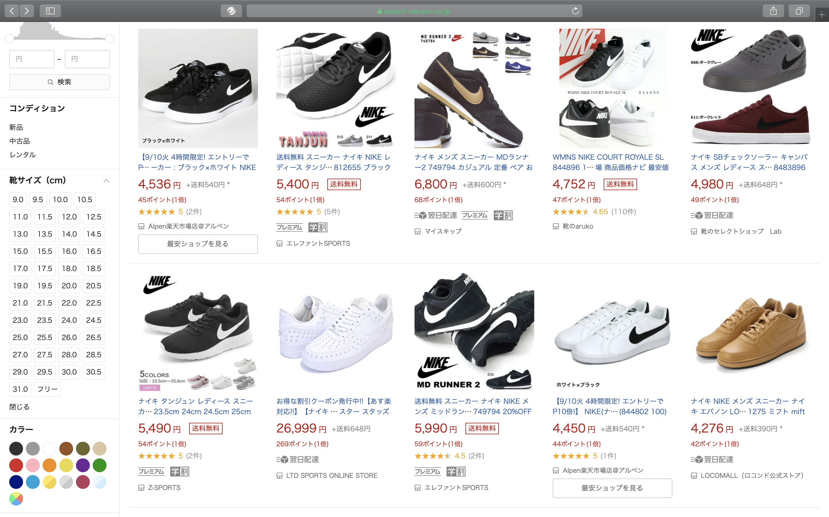
2. Current Problems
Current Problems of “Rakuten Ichiba”
Same item
Notes:
欲しい商品になかなかたどり着けない
同じ商品が何度も表示され、比較するのが大変
などなど、既存サイトへの不満をここでぶちまける
https://search.rakuten.co.jp/search/mall/nike+スニーカー/?p=2

Slide 8
３
Challenges and Solutions

Slide 9
3. Challenges and Solutions
Our solution
Group the same item from various shops
Enable to search with tags
Notes:
同じ商品をまとめて表示する機能
タグ検索
ユーザごとに表示項目をカスタマイズできるようにする機能

Slide 10
3. Challenges and Solutions
Grouping one item
Get item information from ”Rakuten API”
Group the same item from different shops
Show the abstruct of item and the range of price in search result page
Compare the price by shops in detail page
Notes:
商品情報を楽天APIから取得
出品者が異なるが商品は同じ場合，すべてまとめて１件として表示
検索結果では、商品の概要と概算額のみ表示＆詳細は次のページで
詳細ページではショップごとに比較可能

Slide 11
3. Challenges and Solutions
Grouping one item
Get item information from “Rakuten API”
Our WebSite
Rakuten API
GET

Slide 12

3. Challenges and Solutions
Grouping one item
Group the same item from different shops
Rakuten Ichiba
Our WebSite
Shoes A
$30
ABC shop
Shoes A
$30 - $40
Shoes A
$40
XYZ shop
ShowDetail
Notes:
出品者が異なるが同じ商品であるものは、すべてまとめて１件として表示

Slide 13
3. Challenges and Solutions
Grouping one item
Compare the price by shops
Our WebSite (Detail)
Shoes A
$30 - $40
White
24.0 – 28.0
ABC Shop
$30
10 Point
XYZ Shop
$40
20 Point
Purchase
Purchase

Slide 14
４
Demo

Slide 15
５
How to make use of it after joining Rakuten?

Slide 16
Experience of Team Development
Use learned knowledge of “HTML/JavaScript/PHP/API”
We learned what service is useful for Users
5. How to make use of it after joining Rakuten?

Slide 17
Thank you for your listening.

