Slide 1
Cebu Programming Training
Fashion Team

Slide 2
１
Introduction

Slide 3


1. Introduction
Our goal
Create a prototype of website that you can find products in a shortest way

Slide 4
1. Introduction
Front End Group
Back End Group
Member
Takehiro Tezuka
Lei Puwen
Nobuki Kasai
Role
Make Web pages
Using Technology
HTML , Javascript , CSS
Member
Ryo Yamaguchi
Yuka Oe
Role
get necessary item data from “Rakuten API”
Using Technology
PHP, Rakuten API

Slide 5
２
Current Problems

Slide 6
2. Current Problems
PUSH
PUSH
PUSH
PUSH
PUSH
Press the button above of red button
Press the button
PUSH
PUSH
Notes:
欲しい商品になかなかたどり着けない
同じ商品が何度も表示され、比較するのが大変
などなど、既存サイトへの不満をここでぶちまける
https://search.rakuten.co.jp/search/mall/nike+スニーカー/?p=2

Slide 7
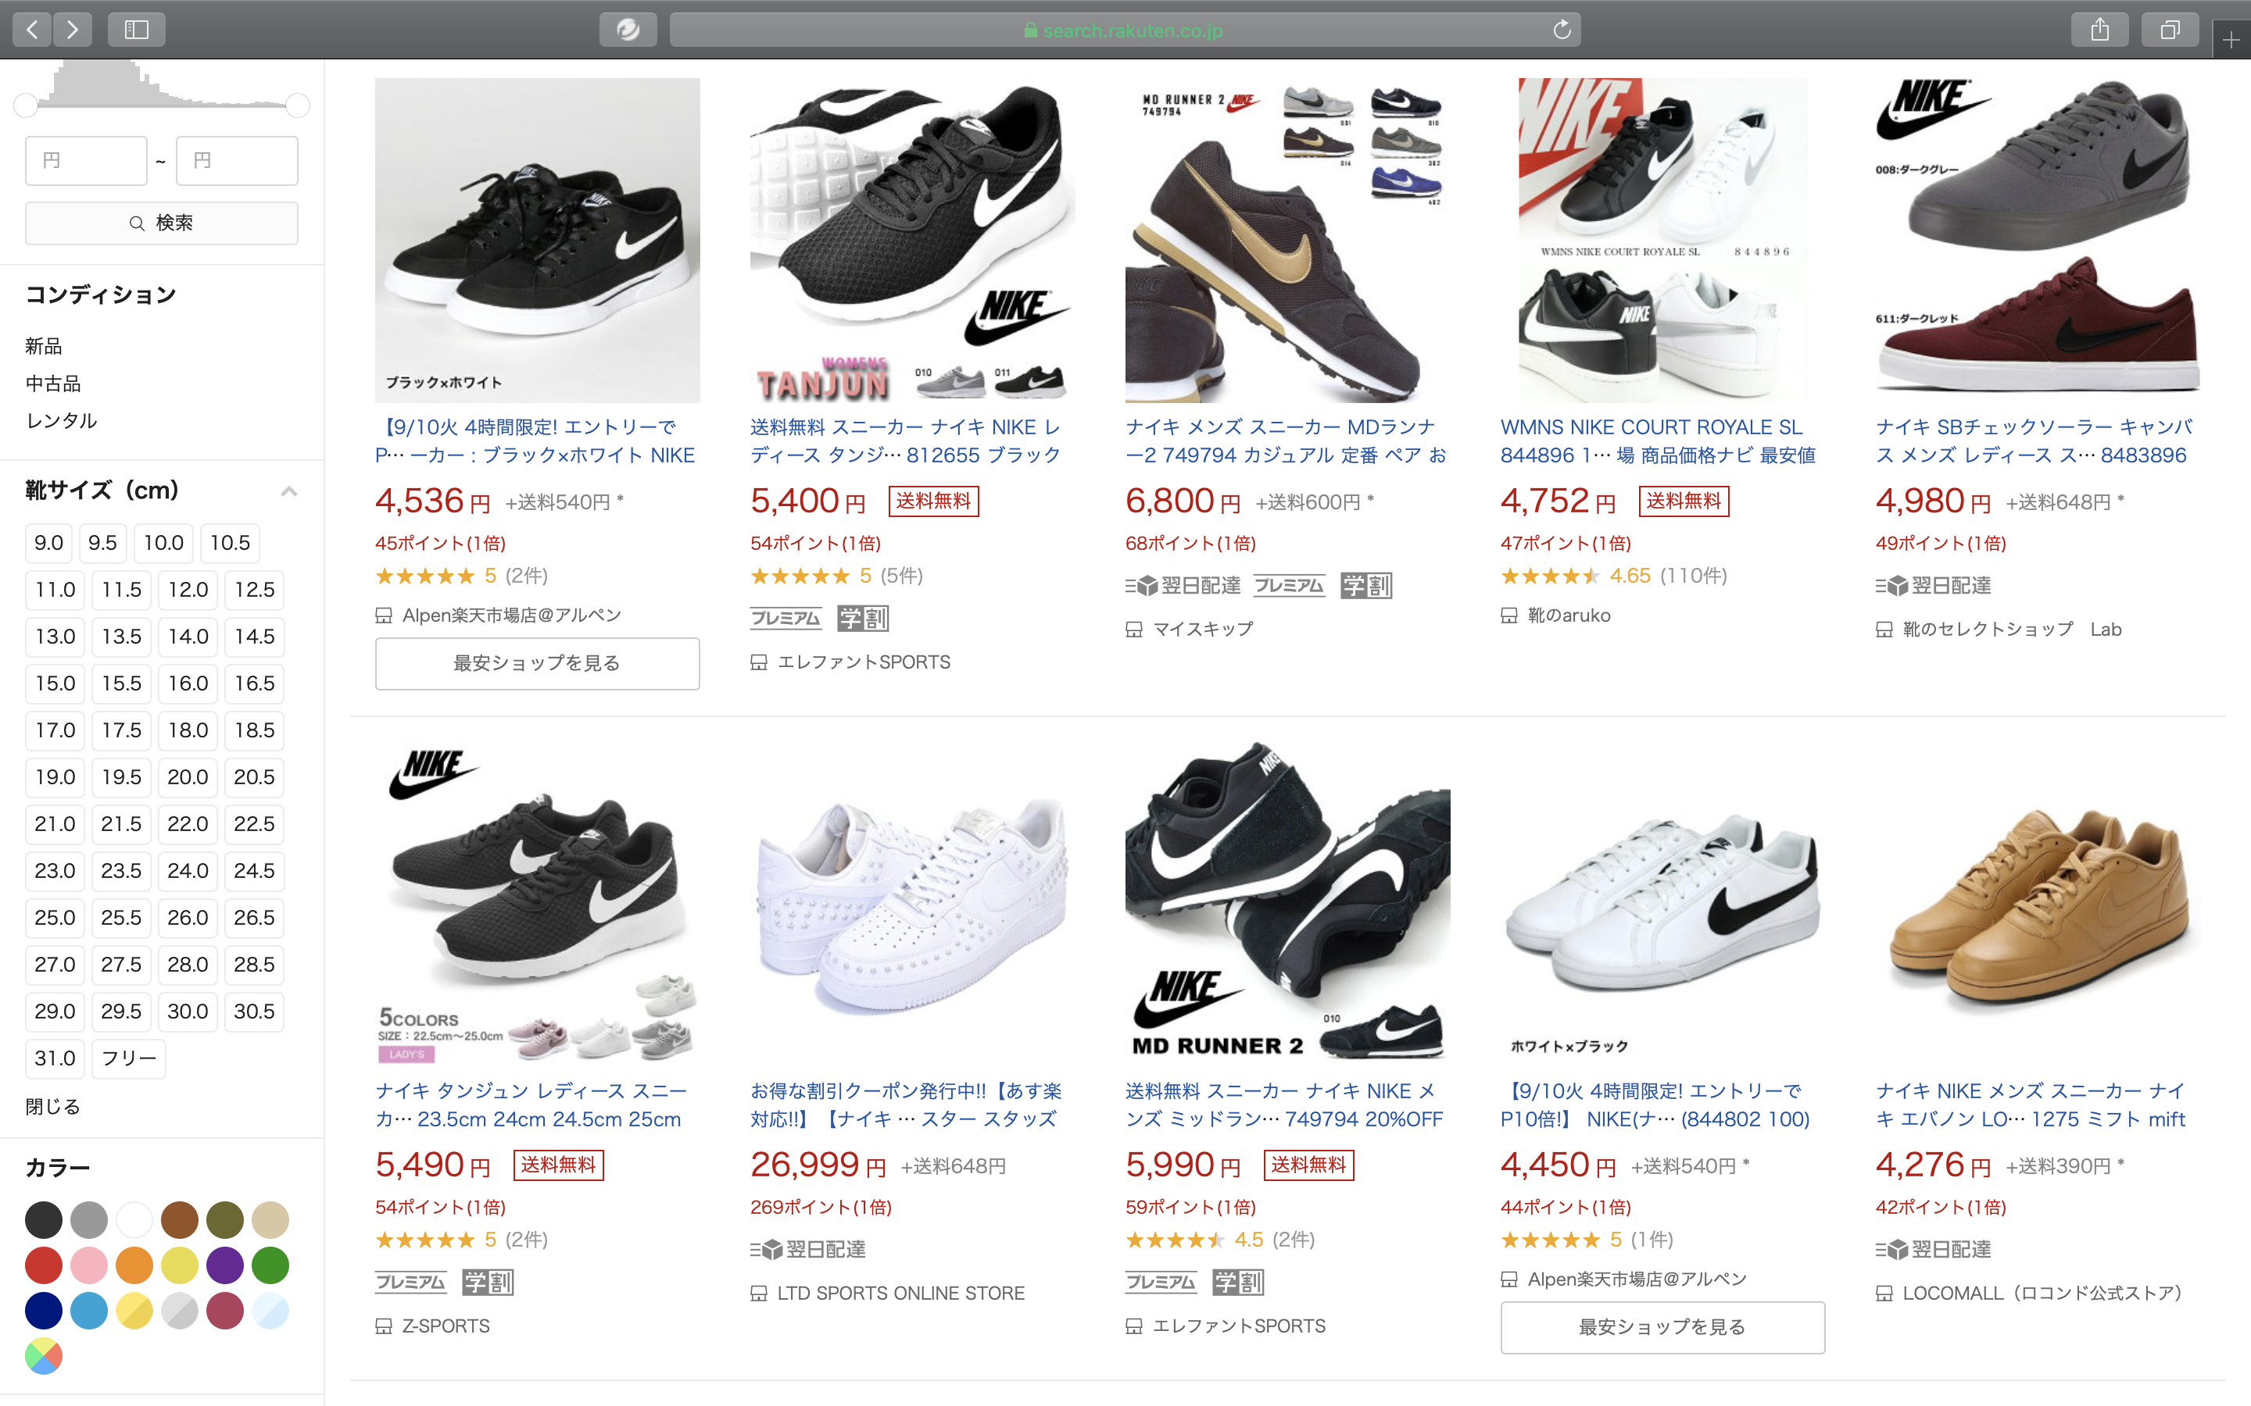
2. Current Problems
Current Problems of “Rakuten Ichiba”
Same item
Notes:
欲しい商品になかなかたどり着けない
同じ商品が何度も表示され、比較するのが大変
などなど、既存サイトへの不満をここでぶちまける
https://search.rakuten.co.jp/search/mall/nike+スニーカー/?p=2

Slide 8
３
Challenges and Solutions

Slide 9
3. Challenges and Solutions
Our solution
Cluster the same item from various shops
Enable to search with tags
Compare with similar goods
Notes:
同じ商品をまとめて表示する機能
タグ検索
ユーザごとに表示項目をカスタマイズできるようにする機能

Slide 10
How to Cluster ?

Slide 11
3. Challenges and Solutions
Clustering one item
Get item information from ”Rakuten API”
Cluster the same item from different shops
Show the detail of item and the range of price in search result page
Compare the price and Rakuten Point by shops in detail page
Notes:
I will explain our clustering method in this flow.

Slide 12
3. Challenges and Solutions
Grouping one item
Get item information from “Rakuten API”
Our WebSite
Rakuten API
GET
Notes:
First, Rakuten API is a function that we can get item information from “rakuten ichiba".
When you search some items, our site use search keyword as key of API, and call Rakuten API.
Then our web site get item information as JSON data.

Slide 13
3. Challenges and Solutions
Clustering one item
Get item information from ”Rakuten API”
Cluster the same item from different shops
Show the detail of item and the range of price in search result page
Compare the price and Rakuten Point by shops in detail page
Notes:
I will explain our clustering procedure in this flow.

Slide 14

3. Challenges and Solutions
Grouping one item
Group the same item from different shops
Show the detail of item and the range of price
Rakuten Ichiba
Our WebSite
Shoes A
$30
ABC shop
Shoes A
$30 - $40
Shoes A
$40
XYZ shop
ShowDetail
Notes:
For example, current website show the same item but different seller. So we want to show as one item in our web site.
(And summarize as price range.)

Slide 15
3. Challenges and Solutions
Clustering one item
Get item information from ”Rakuten API”
Cluster the same item from different shops
Show the detail of item and the range of price in search result page
Compare the price and Rakuten Point by shops in detail page
Notes:
I will explain our clustering method in this flow.

Slide 16
3. Challenges and Solutions
Grouping one item
Compare the price and Rakuten Point by shops
Our WebSite (Detail)
Shoes A
$30 - $40
White
24.0 – 28.0
ABC Shop
$30
10 Point
XYZ Shop
$40
20 Point
Purchase
Purchase
Notes:
In detail page, we show one item, and we can compare the price and points by shops in one page.
In this case, its one item but seller is different. So our website show all of shops which sell same item.

Slide 17
４
Demo

Slide 18
５
How to make use of it after joining Rakuten?

Slide 19
Use learned knowledge of “HTML/JavaScript/PHP/API”
All-round engagement from design to development
We learned what service is useful for users
Experience of Team Development
絆(KIZUNA)
5. How to make use of it after joining Rakuten?
Notes:
We believe our connection is different from just general friendship

Slide 20
Acknowledgement
All of NexSeed Staff and Student
Ms. Inoue, Ms. Melissa, Mr. Yoshida
Notes:
Ms. Inoue arranged our schedule.

Slide 21
Thank you for your listening.

