Slide 1


Slide 2
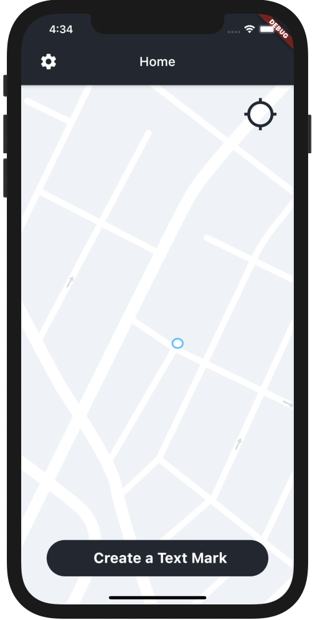
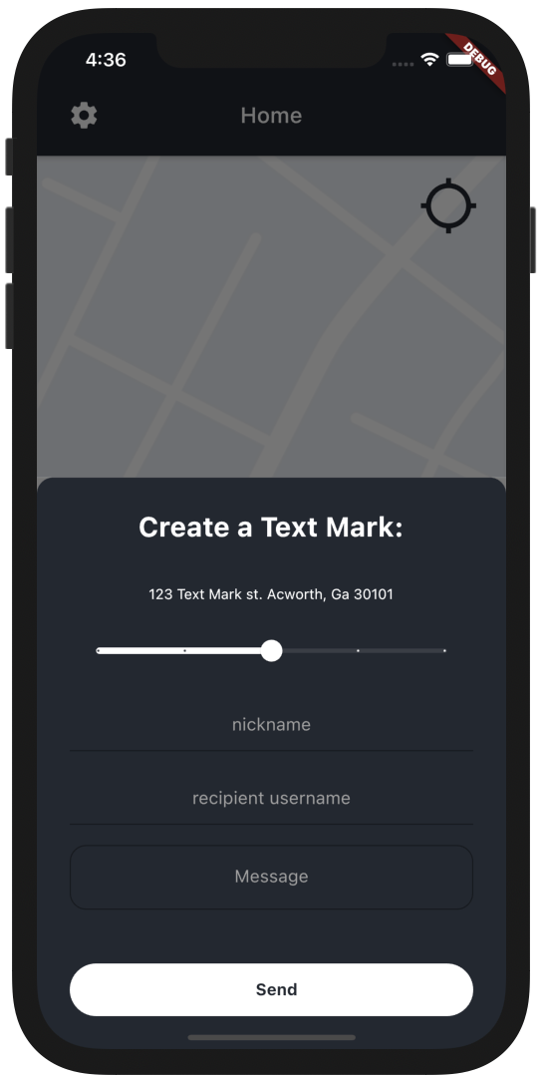
App Overview
Clients: Michael Guris & Matt Hunt of Hot Sake LLC.
Objective: A location driven user to user messaging application.

Slide 3
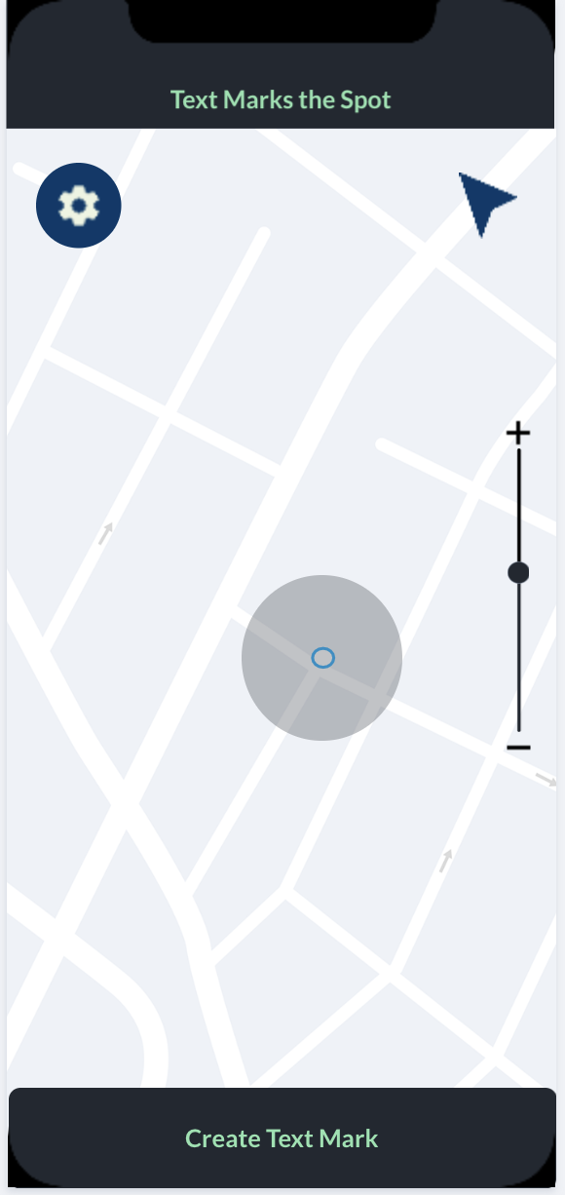
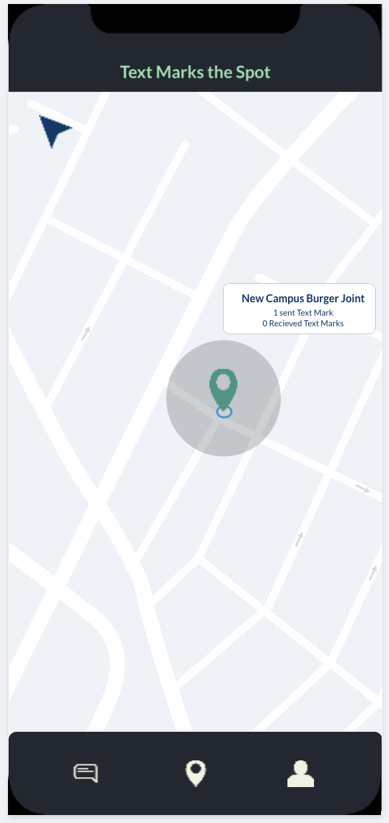
Features
Location Sharing
via Geocache/Location Services
Interactive Map Tagging
Pin can be dropped on location for text mark to be sent.
Text Based Message Sending
Via in-app service
System Notifications
Used externally by the app to alert the user of a text mark.
User Authentication
Done via Google/Apple Sign-in service

Slide 4
Sprint Timeline & Development Progress
JAN 11
FEB 8
FEB 22
MAR 15
MAR 29
APR 12
Project Planning
Sprint 1
Sprint 2
Sprint 3
Sprint 4
Sprint 5
Deployment
User Authentication
UI & Screen Navigation Development
User to User Messaging
User Location Map View
UI Finalizing, Backlog, Testing

Slide 5
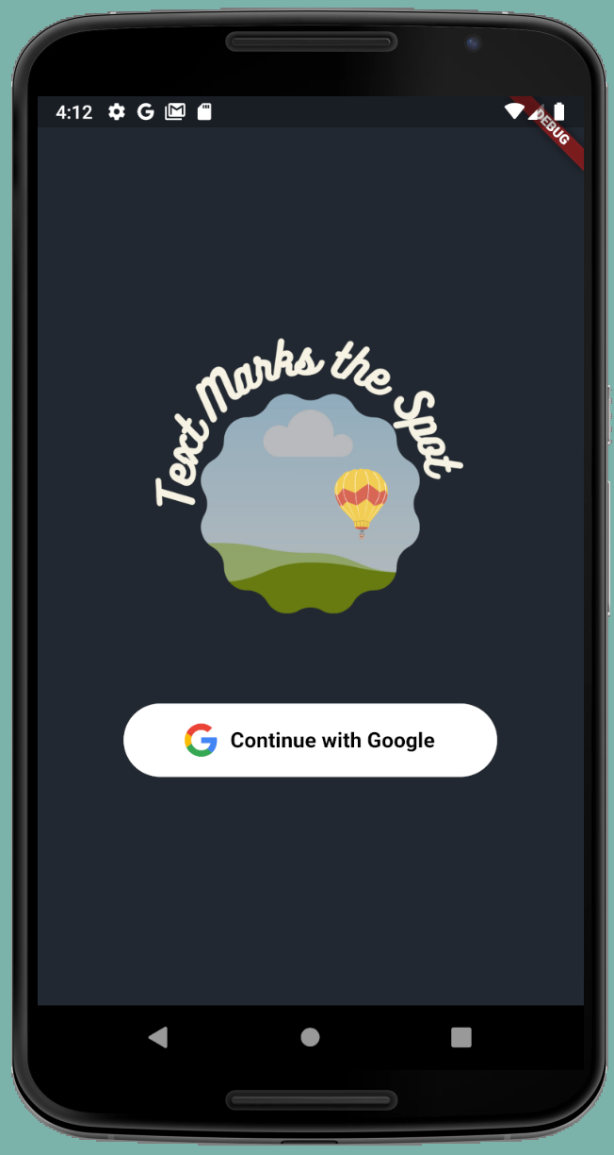
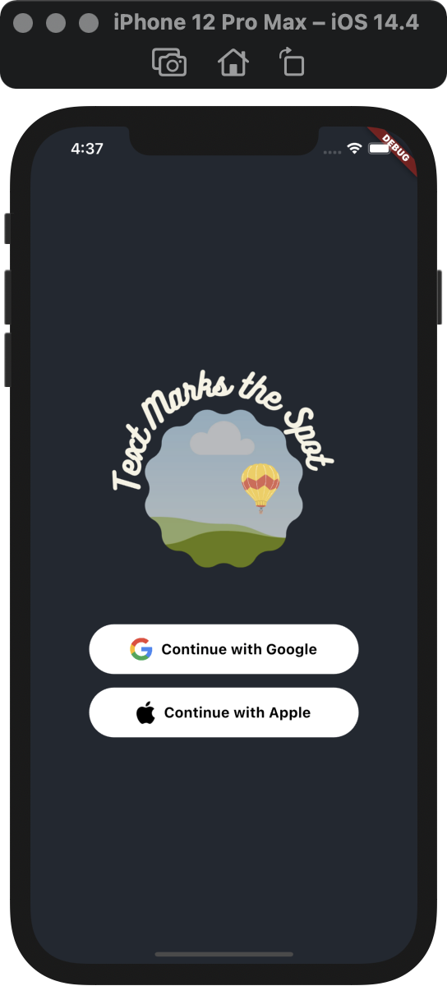
Technologies
Flutter UI Development Framework
Dart programming language
Firebase Mobile Application Development Platform
Firestore Cloud Database
Git/Github Source Code Version Control

Slide 6

Demo
Check it out
- The most current version is shown in the demo to the right. - This was run via Apple Emulator.
Click the Square Box to view!

