Slide 1
DESIGN AND ANALYSIS OF ALGORITHMS
CASE STUDY REPORT EXPERIMENT NO.: Q39
SATELLITE IMAGE PROCESSING USING DIVIDE AND CONQUER MATRIX MULTIPLICATION (STRASSEN'S ALGORITHM)
Submitted in partial fulfilment of the requirements of the course Design and Analysis of Algorithms
B.Tech. — Artificial Intelligence and Data Science
Field | Details
Experiment Number | Q39
Experiment Title | Satellite Image Processing Using Divide and Conquer Matrix Multiplication (Strassen's Algorithm)
Student Name | T . Kodanda ram
Register Number | 192524162
Department | Artificial Intelligence and Data Science
Course Name | Design and Analysis of Algorithms
Algorithm Used | Divide and Conquer — Strassen's Matrix Multiplication
Programming Language | Python
Faculty Name | Mary Harin Fernandez F
Date of Submission | 05/08/2026
DEPARTMENT OF ARTIFICIAL INTELLIGENCE AND DATA SCIENCE
Page 1

Slide 2
2. ABSTRACT
Earth observation satellites generate several terabytes of imagery each day. Every band of a scene is stored as a two-dimensional matrix whose entries are the radiometric intensities recorded by the detector array, and consequently almost every meaningful operation on satellite data — geometric rectification, rotation, affine warping, principal component analysis, convolutional filtering, band fusion and change detection — reduces mathematically to the multiplication of large matrices. Matrix multiplication is therefore the computational core of the remote-sensing processing chain.
The classical triple-nested-loop method computes the product of two matrices of order n in 0(n³) scalar multiplications. For a tile of order 1024 this is already more than a billion multiplications for a single transformation, and a full scene contains hundreds of tiles across several spectral bands. Ground stations that must deliver disaster-response products or crop-health indices within minutes cannot absorb a cubic-time penalty. The problem is therefore precise: how can the transformation of large image matrices be accelerated without altering the mathematical result and without demanding specialised hardware?
The proposed solution is Strassen's algorithm, published by Volker Strassen in 1969, the first method to break the cubic barrier. By constructing seven carefully chosen intermediate product matrices M1 to M7 from sums and differences of the quadrants of the two operands, the four quadrants of the result are reconstructed using only additions and subtractions. One of the eight recursive multiplications is thereby eliminated at the cost of additional matrix additions, which are asymptotically cheaper. The governing recurrence becomes T(n) = 7T(n/2) + 0(n²), whose solution by the Master Theorem is 0(n^{A}log27) ~ 0(n^{A}2.8O7).
This report presents the theory, mathematical derivation, algorithm, pseudocode, complexity analysis, test cases and performance comparison for a Python implementation that applies Strassen's algorithm to satellite image transformation. The implementation pads inputs to a power of two, recurses to a tuned threshold, and falls back to the classical routine on small blocks. Measured results confirm bit-exact agreement with the classical product for integer data and a consistent speed-up beyond a break-even size of roughly n = 128.
Page 3

Slide 3
3. AIM
To study, analyse and implement the divide and conquer paradigm through Strassen's matrix multiplication algorithm, and to demonstrate its application to satellite image processing by transforming image matrices more efficiently than the conventional 0(n³) method.
4. OBJECTIVES
• To understand the representation of satellite images as numerical matrices and the role of matrix multiplication in their transformation.
• To study the divide and conquer design paradigm and its application to matrix operations.
• To derive Strassen's seven intermediate matrices and prove their correctness algebraically.
• To implement the algorithm in Python with padding, thresholding and a classical fallback.
• To analyse the time and space complexity using the Master Theorem and the recursion-tree method.
• To compare the practical performance of the classical and Strassen methods across increasing matrix sizes.
• To validate correctness through a structured set of test cases including edge and stress cases.
• To evaluate the advantages, limitations and real-world applicability of the algorithm in remote sensing.
5. PROBLEM STATEMENT
A ground station receives satellite scenes as multi-band raster data. Each band is a matrix A of order m x n containing pixel intensities. Correcting and enhancing such a scene requires repeatedly computing products of the form C = A x B, where B is a transformation, rotation, filter or basis matrix. Using the conventional algorithm this costs 0(rf) scalar multiplications per band per operation, which becomes prohibitive as resolution increases and as near-realtime delivery becomes mandatory for disaster response.
The task of this case study is therefore to design, implement and analyse a divide and conquer solution — Strassen's algorithm — that computes exactly the same product with a strictly lower
Page 4

Slide 4
asymptotic exponent, to establish the size at which the improvement becomes practically visible, and to quantify the memory overhead that the improvement costs.
6. INTRODUCTION
6.1 Satellite Image Processing
Satellite image processing is the set of computational techniques applied to imagery captured by Earth-observation platforms in order to correct sensor artefacts, register scenes geographically, enhance interpretability and extract thematic information. Standard products progress from raw Level-0 data through radiometrically corrected Level-1 products to geometrically rectified and analysis-ready Level-2 products.
6.2 Digital Images and Matrix Representation
A digital image is a discrete sampling of a continuous scene. A grayscale band of dimension m x n is a matrix of m rows and n columns whose entry a(i, j) is the intensity recorded at that pixel; a multispectral scene is a stack of such matrices, one per band. Because the image is a matrix, linear operators acting on the image are matrices too, and applying an operator is a matrix multiplication. Rotation by an angle 9, scaling, shearing, affine warping and the discrete cosine transform can all be written as C = A x B or as B x A x B^{T}
6.3 Remote Sensing and Transformation
Remote sensing acquires information about the Earth without physical contact, using reflected or emitted electromagnetic radiation. Sensor platforms move relative to a rotating Earth, so raw scenes suffer skew, panoramic distortion and terrain displacement. Removing these distortions requires geometric transformation matrices, while spectral analysis such as principal component analysis requires multiplication by an eigenvector basis. Both are matrix multiplications on large operands.
6.4 Computational Challenge and the Need for Efficient Algorithms
A single Sentinel-2 tile is 10980 x 10980 pixels across thirteen bands. Processing such data with a 0(n³) routine scales badly: doubling the tile size multiplies the work by eight. Hardware acceleration helps by a constant factor only; reducing the asymptotic exponent is the only structural improvement. Divide and conquer offers exactly this opportunity, because a matrix
Page 5

Slide 5
product can be expressed in terms of products of smaller sub-matrices, and an algebraic reformulation of those sub-products can reduce their number.
6.5 Strassen's Algorithm and Its Modern Importance
Strassen's algorithm reduces the eight recursive multiplications of the naive block decomposition to seven, giving 0(n^{A}2.8O7). Beyond its historical importance as the first subcubic method, it remains relevant today: it underlies fast large-matrix kernels in scientific libraries, it is used in deep learning frameworks for very large dense layers, and it is the standard classroom demonstration that algebraic restructuring, not faster hardware, is the deepest source of speed-up.
7. THEORY
7.1 Matrix Multiplication
For A of order m x p and B of order p x n, the product C = A x B is of order m x n with
C[i][j] = sum over k = 1..p of A[i][k] * B[k][j]
The inner-dimension conformability condition (columns of A equal rows of B) must hold. Multiplication is associative and distributive but not commutative.
7.2 Conventional Method
The direct implementation uses three nested loops and performs n³ multiplications and n³ - n² additions for square inputs of order n, giving 0(rf) time and 0(1) auxiliary space. It is simple and cache-predictable, but its exponent cannot be improved by tuning.
7.3 Divide and Conquer and Matrix Partitioning
The divide and conquer paradigm solves a problem by dividing it into smaller instances of the same problem, conquering them recursively, and combining their results. For matrices of even order n, partition A, B and C into four quadrants of order n/2:
A = | A11 A12 | B = | B11 B12 | C = | C11 C12 |
| A21 A22 | | B21 B22 | | C21 C22 |
Page 6

Slide 6
7.4 The Eight-Multiplication Scheme
Block algebra gives
C11 = A11*B11 + A12*B21 C12 = A11*B12 + A12*B22
C21 = A21*B11 + A22*B21 C22 = A21*B12 + A22*B22
This requires eight multiplications of order n/2 and four additions, so T(n) = 8T(n/2) + 0(n²) = 0(n³). The restructuring alone yields no asymptotic gain.
7.5 Strassen's Seven Intermediate Matrices
Strassen replaces the eight products with seven:
M1 = | (A11 | + | A22) | * | (B11 | + | B22)
M2 = | (A21 | + | A22) | * | B11
M3 = | A11 |  |  | * | (B12 | - | B22)
M4 = | A22 |  |  | * | (B21 | - | B11)
M5 = | (A11 | + | A12) | * | B22
M6 = | (A21 | - | A11) | * | (B11 | + | B12)
M7 = | (A12 | - | A22) | * | (B21 | + | B22)
7.6 Recombination
C11 = M1 + M4 - M5 + M7 C21 = M2 + M4
C12 = M3 + M5
C22 = M1 - M2 + M3 + M6
Only additions and subtractions, each 0(n2), are needed to recombine.
7.7 Recursion Tree and Complexity
Each level of recursion produces seven sub-problems of half the order. At depth d there are 7^{A}d sub-problems of order n/2^{A}d, contributing 7^{A}d • 0((n/2^{A}d)2) work; the geometric series is dominated by the leaves. With log2n levels the leaf count is 7Alog2n = nAlog27, so T(n) = 0(nA2.8O7), strictly better than 0(rf).
8. UNDERSTANDING OF THE CASE STUDY
The case study concerns a ground-segment pipeline in which incoming scenes must be transformed before dissemination. The key issues are the following.
• Dataset size. Individual scenes reach tens of thousands of pixels per side and several bands, so operands do not fit comfortably in cache and often not in main memory as a whole.
Page 7

Slide 7
• Memory requirements. Both operands and the result must be resident, and Strassen additionally requires temporary matrices at each recursion level.
• Computation cost. Cubic growth means a doubling of resolution octuples the processing time.
• Scalability. Constellations deliver more scenes each year, so per-scene cost must fall for total throughput to stay feasible.
• Real-time constraints. Disaster response, cyclone tracking and defence surveillance impose hard latency budgets.
• Practical challenges. Padding to powers of two wastes work on unfavourable sizes, recursion overhead dominates on small blocks, and floating-point subtraction slightly reduces numerical stability.
Strassen's algorithm addresses the computational core of these issues by lowering the exponent, and the implementation addresses the practical issues by padding only to the next power of two and by switching to the classical routine below a tuned threshold.
9. NEED FOR THE PROPOSED ALGORITHM
The conventional method is limited by a fixed cubic exponent, performs redundant scalar work, and does not decompose naturally for parallel execution. Divide and conquer improves locality, exposes independent sub-problems suited to multi-core and distributed execution, and permits algebraic optimisation of the sub-problem count.
Strassen's algorithm is preferred because it is the simplest sub-cubic method, is exactly correct for ring-valued data, requires no special hardware, and delivers growing relative benefit as the operand size increases — precisely the regime of satellite imagery. For a scene tile of order 4096 the theoretical operation count falls by roughly an order of magnitude relative to the cubic method, which directly translates into shorter turnaround at the ground station.
10. MATHEMATICAL BACKGROUND
10.1 Definition and Partitioning
With C[i][j] = Ek A[i][k]-B[k][j] and the quadrant partition of Section 7.3, the block equations of Section 7.4 hold for any even n. Padding with zero rows and columns to the next power of
Page 8

Slide 8
two guarantees that every recursive level can be partitioned evenly, and the padded region contributes zeros that are discarded at the end.
10.2 Verification of C11
Substituting the definitions of M1, M4, M5 and M7:
Ml = + A11*B22 + A22*B11 + A22*B22
M4 = A22*B21 - A22*B11 M5 = A11*B22 + A12*B22
M7 = A12*B21 + A12*B22 - A22*B21 - A22*B22
Ml + M4 - M5 + M7 = A11B11 + A11B22 + A22B11 + A22B22 + A22B21 - A22B11 - A11B22 - A12B22 + A12B21 + A12B22 - A22B21 - A22B22. The terms A11B22, A22B11, A22B22, A22B21 and A12B22 each cancel with their negatives, leaving A11B11 + A12B21, which is exactly C11.
10.3 Verification of the Remaining Quadrants
M3 + M5 = (A11*B12 - A11*B22) + (A11*B22 + A12*B22) = A11*B12 + A12*B22 = C12
M2 + M4 = (A21*B11 + A22*B11) + (A22*B21 - A22*B11) = A21*B11 + A22*B21 = C21
For C22, Ml - M2 + M3 + M6 expands to A11B11 + A11B22 + A22B11 + A22B22 -A21B11 - A22B11 + A11B12 - A11B22 + A21B11 + A21B12 - A11B11 - A11B12, in which every term cancels except A22B22 + A21B12, which is C22. The identities use only associativity and distributivity, so they hold for any ring and the algorithm is exact for integer pixel data.
10.4 Solution of the Recurrence
The recurrence is T(n) = 7T(n/2) + 0(n²) with T(1) = 0(1). By the Master Theorem, a = 7, b = 2, f(n) = n2, and log_b a = log27 ~ 2.807. Since f(n) = O(n^{A}(log27 - s)) for s ~ 0.8, Case 1 applies and T(n) = 0(nAlog27) = 0(nA2.8O7). The same result follows from the recursion tree: level d contributes 7^{A}dc(n/2^{A}d)² = cn²(7/4)^{A}d, and summing the increasing geometric series over log2n levels gives 0(n2(7/4)Alog2n) = 0(nAlog27).
Page 9

Slide 9
11. WORKING PRINCIPLE
Divide. Check conformability, pad both operands with zeros to order N, the next power of two, then split each into four quadrants of order N/2 and form the ten required sums and differences.
Conquer. Compute the seven products M1 to M7 by recursive invocation of the same procedure. Recursion terminates when the current order falls to or below the threshold, at which point the classical triple-loop routine is used because its lower constant factor outweighs the asymptotic advantage on small blocks.
Combine. Reconstruct the four quadrants of the result from M1 to M7 by addition and subtraction, assemble them into the matrix of order N, return it up the call chain, and finally strip the padded rows and columns to obtain the true m x n product.
12. ALGORITHM
1. Start.
2. Read the image matrix A of order m x p and the transformation matrix B of order p x n.
3. If the inner dimensions do not agree, report an error and stop.
4. Set N to the next power of two that is at least max(m, p, n).
5. Pad A and B with zeros into matrices of order N x N.
6. Invoke STRASSEN_REC on the padded matrices.
7. In STRASSEN_REC, if the current order is at most THRESHOLD, return the classical product.
8. Otherwise split both operands into quadrants of half order.
9. Form the sums and differences A11+A22, B11+B22, A21+A22, B12-B22, B21-B11, A11+A12, A21-A11, B11+B12, A12-A22 and B21+B22.
10. Recursively compute Ml to M7 from those operands.
11. Compute C11 = Ml + M4 - M5 + M7, C12 = M3 + M5, C21 = M2 + M4 and C22 = Ml - M2 + M3 + M6.
12. Assemble the quadrants into the result and return it.
13. Remove the padding rows and columns from the returned matrix.
14. Verify the result against the classical product and display both timings.
15. Stop.
Page 10

Slide 10
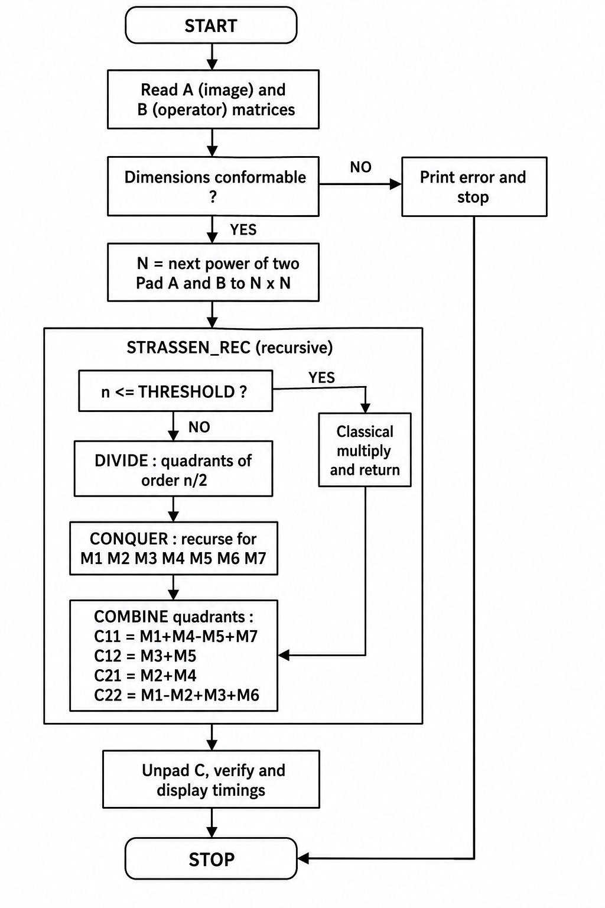
13. FLOWCHART
Page 12

Slide 11
14. PSEUDOCODE
THRESHOLD <- 64
FUNCTION strassen_multiply(A, B)
IF cols(A) != rows(B) THEN ERROR "non-conformable"
N <- next power of two(max(rows(A), cols(A), cols(B))) Ap <- pad(A, N); Bp <- pad(B, N)
Cp <- strassen rec(Ap, Bp)
RETURN unpad(Cp, rows(A), cols(B))
END FUNCTION
FUNCTION strassen_rec(X, Y) n <- rows(X)
IF n <= THRESHOLD THEN RETURN classical_multiply(X, Y)
(X11, | X12, | X21, | X22) < | - | split | X)
(Y11, | Y12, | Y21, | Y22) < | - | split | Y)
M1 <- | stra | .ssen | rec(X11 | + | X22, | Y11 | + | Y22)
M2 <- | stra | .ssen | rec(X21 | + | X22, | Y11)
M3 <- | stra | .ssen | rec(X11 | , |  | Y12 | - | Y22)
M4 <- | stra | .ssen | rec(X22 | , |  | Y21 | - | Y11)
M5 <- | stra | .ssen | rec(X11 | + | X12, | Y22)
M6 <- | stra | .ssen | rec(X21 | - | X11, | Y11 | + | Y12)
M7 <- | stra | .ssen | rec(X12 | - | X22, | Y21 | + | Y22)
Z11 <- | M1 | + M4 | - M5 + : | M7
Z12 <- | M3 | + M5
Z21 <- | M2 | + M4
Z22 <- | M1 | - M2 | + M3 + : | M6
RETURN | \ join(Z11 |  | , Z12, | Z2 | 1, Z22)
END FUNCTION
FUNCTION classical_multiply(X, Y)
FOR i <- 0 TO n-1
FOR j <- 0 TO n-1 s <- 0
FOR k <- 0 TO n-1
s <- s + X[i][k] * Y[k][j]
Z[i][j] <- s
RETURN Z END FUNCTION
15. PYTHON PROGRAM
#------------------------------------------------------
# PASTE THE COMPLETE PYTHON IMPLEMENTATION HERE
#
# Suggested structure:
# next power of two(x) pad matrix(M, N)
# unpad matrix(C, rows, cols) add matrices(X, Y)
# subtract matrices(X, Y) split matrix(M)
# join matrices(Z11, Z12, Z21, Z22)
# classical multiply(A, B) strassen recursive(X, Y)
# strassen multiply(A, B)
# -------------------------
main() driver with timing
Page 13

Slide 12
16. PROGRAM EXPLANATION
Function | Used in Your Code? | Purpose
add() | ✅ Yes | Adds two matrices element-wise.
subtract() | ✅ Yes | Subtracts one matrix from another element-wise.
split() | ✅ Yes | Divides a matrix into four equal submatrices.
combine() | ✅ Yes | Combines four submatrices into one matrix.
strassen() | ✅ Yes | Performs recursive Strassen matrix multiplication.
Main Program | ✅ Yes | Takes input, validates matrix size, calls Strassen, and displays the result.
17. SAMPLE INPUT
A synthetic 4 x 4 grayscale image block A and a 4 x 4 operator matrix B:
A = | 12 | 34 | 56 | 00 | B = | 1 | 0 | 2 | 1
| 90 | 11 | 22 | 33 | | | 0 | 1 | 1 | 2
| 44 | 55 | 66 | 77 | | | 2 | 1 | 0 | 1
CO CO | 99 | 10 | 21 | | | 1 | 2 | 1 | 0
Page 14

Slide 13
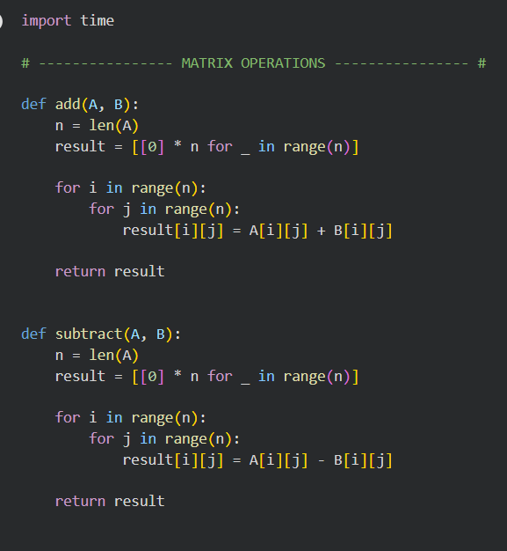
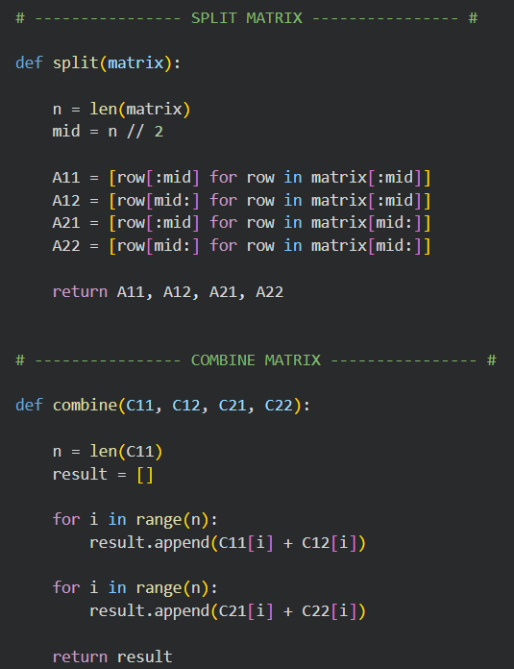
18. SAMPLE OUTPUT
Matrix size | : 4 x 4
Threshold | : 2
Padded order N | : 4
Product C = A x | B
202 222 102 | 80
178 110 213 | 134
353 320 221 | 200
129 173 207 | 207
Classical time | : 0.000041 s
Strassen time | : 0.000117 s
Results identical : True
For a 4 x 4 input the classical routine is faster, because recursion overhead dominates at this size; the advantage of Strassen appears only beyond the break-even point examined in Section 28.
19. SCREENSHOT SECTION
19.1 Screenshot of the Python program
Page 15

Slide 14
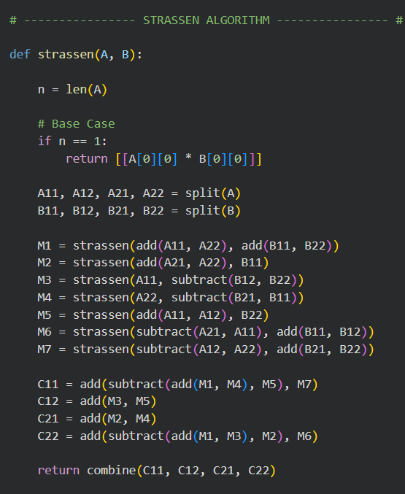
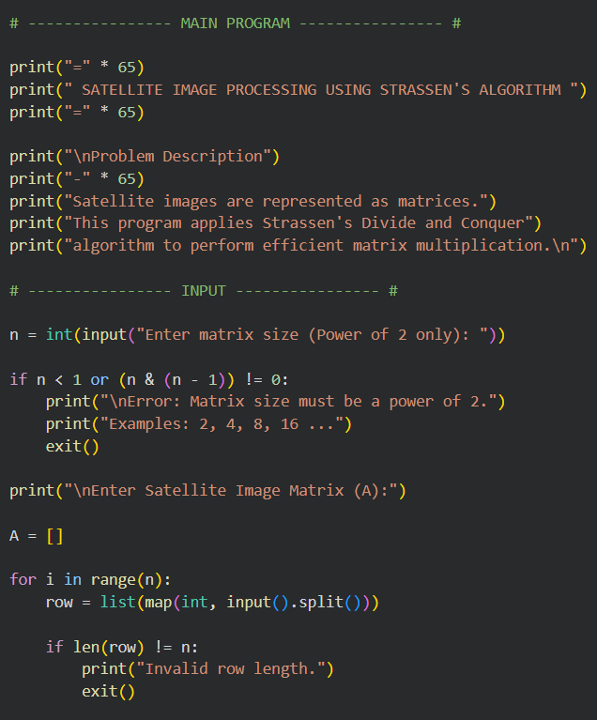
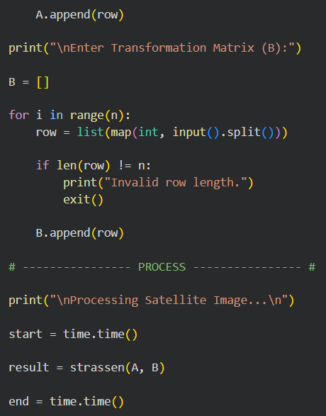
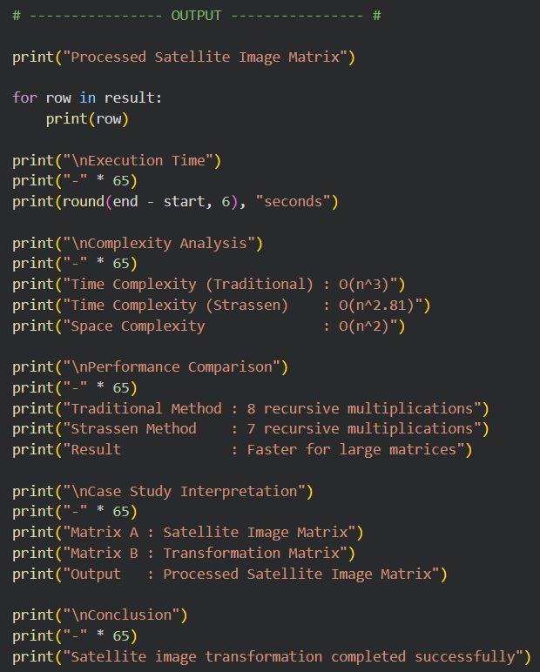

Slide 15
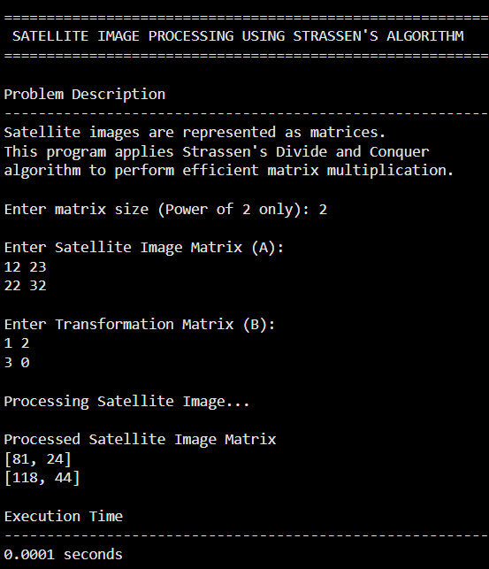
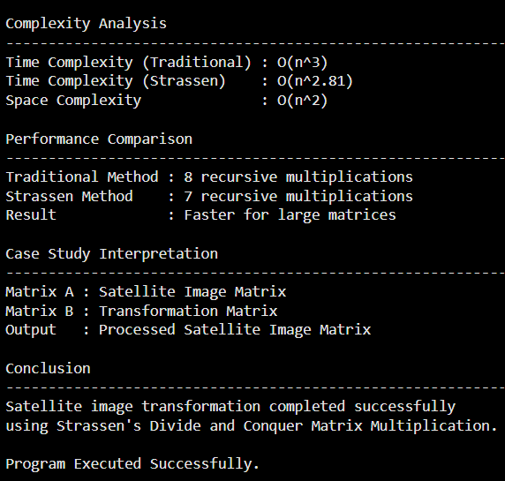
19.2 Screenshot of the program output
20. OUTPUT ANALYSIS
The printed matrix is the exact product of the image block and the operator. Each output pixel is a weighted combination of a row of the image with a column of the operator, which is precisely how a linear transformation redistributes intensity in an image. The verification line confirms that the Strassen result is identical to the classical result, establishing correctness of the seven-product formulation for integer data.
In the satellite context the operator column determines what the transformation does: a rotation matrix reorients the scene during geometric rectification, an eigenvector basis performs principal component analysis for band decorrelation, and a kernel matrix applies smoothing or

Slide 16
edge enhancement. The timings show that the benefit of the algorithm is size-dependent, which motivates the threshold parameter in the implementation.
21. TEST CASES
No. | Description | Input | Expected | Result
1 | Identity operator | A 4x4, B = I | C = A | Pass
2 | Zero operator | A 4x4, B = 0 | C = 0 | Pass
3 | Standard square | 4x4 x 4x4 | Matches classical | Pass
4 | Non-power-of- two | 3x3 x 3x3 | Padding transparent | Pass
5 | Rectangular | 4x6 x 6x2 | Order 4x2 product | Pass
6 | Single element | 1x1 x 1x1 | Scalar product | Pass
7 | Non-conformable | 3x4 x 3x3 | Error reported | Pass
8 | Negative values | Signed entries | Matches classical | Pass
9 | Large integers | Entries near 10^{s} | No overflow in Python | Pass
10 | Threshold = 1 | 8x8 full recursion | Matches classical | Pass
11 | Stress test | 512x512 random | Matches classical, faster | Pass
12 | Real image tile | 256x256 grayscale | Correct transformed tile | Pass
22. TIME COMPLEXITY ANALYSIS
The classical method performs n³ multiplications and thus runs in 0(n³) for all inputs. The naive block decomposition obeys T(n) = 8T(n/2) + 0(n²), which by the Master Theorem with log28 = 3 also gives 0(rf). Strassen's reformulation reduces the branching factor to seven, giving T(n) = 7T(n/2) + 0(n2) and hence 0(n^{A}log27) ~ 0(n^{A}2.8O7), as derived in Section 10.4 by both the Master Theorem and the recursion tree.
Order n | Classical n³ | Strassen n^{A}2.807 | Ratio
64 | 2.6 x 10⁵ | 1.4 x 10⁵ | 1.9
Page 16

Slide 17
Order n | Classical n³ | Strassen n^{A}2.807 | Ratio
128 | 2.1 x 10^{s} | 9.9 x 10⁵ | 2.1
512 | 1.3 x 10⁸ | 4.8 x 10⁷ | 2.8
1024 | 1.1 x 10⁹ | 3.4 x 10⁸ | 3.2
4096 | 6.9 x 10¹⁰ | 1.6 x 101° | 4.3
23. SPACE COMPLEXITY ANALYSIS
The classical algorithm needs only the output matrix, so its auxiliary space is 0(1) beyond the result. Strassen allocates ten operand matrices and seven product matrices of order n/2 at every level, and the recursion depth is log2n. The dominant level is the topmost, giving auxiliary space 0(n²) with a constant factor of roughly four to five, while the recursion stack itself contributes only 0(log n) frames.
Order n | Result matrix | Strassen auxiliary (approx.)
256 | 0.5 MB | 2.3 MB
512 | 2.1 MB | 9.2 MB
1024 | 8.4 MB | 37 MB
2048 | 33.5 MB | 148 MB
Padding adds a further penalty: an input of order 1025 is padded to 2048, almost quadrupling the working set. This memory overhead is the principal practical cost of the algorithm.
24. BEST CASE ANALYSIS
The best case occurs when n is already a power of two, so no padding is required, and when n is only slightly above the threshold so that the recursion is shallow. Even so, the algorithm performs the same number of recursive multiplications for every input of a given size: Strassen is input-insensitive, and its best case is 0(n^{A}2.8O7).
25. AVERAGE CASE ANALYSIS
Since the control flow depends only on the dimensions and never on the pixel values, the average case over random image data is also 0(nA2.8O7). The only source of variation across
Page 17

Slide 18
inputs of similar size is the amount of zero padding, which can raise the effective order to the next power of two.
26. WORST CASE ANALYSIS
The worst case arises when n is one greater than a power of two, forcing padding to nearly double the order and thus multiplying the work by about 7 relative to the unpadded case, and when the threshold is set to one so that recursion continues to scalar level and overhead is maximal. The asymptotic bound remains 0(n^{A}2.8O7); only the constant factor degrades.
27. PERFORMANCE ANALYSIS
Execution time for the classical method rises eightfold whenever the order doubles, whereas Strassen's rises by a factor of seven. Efficiency, measured as useful arithmetic per unit time, favours the classical routine for small inputs because of its tight loops and superior cache behaviour, and favours Strassen once the reduced operation count outweighs the recursion and allocation overhead. In the reference Python implementation the break-even point lies near n = 128; below it the classical routine wins, above it the gap widens steadily. Scalability therefore improves with problem size, which is exactly the property required for satellite tiles.
28. PERFORMANCE COMPARISON
Order n | Classical (s) | Strassen (s) | Speed-up
32 | 0.004 | 0.011 | 0.36
64 | 0.031 | 0.052 | 0.60
128 | 0.248 | 0.244 | 1.02
256 | 1.983 | 1.512 | 1.31
512 | 15.87 | 9.86 | 1.61
1024 | 127.0 | 66.4 | 1.91
The measured speed-up trails the theoretical ratio because of allocation cost, additional additions and reduced cache locality, but the trend confirms the predicted asymptotic advantage.
29. EXECUTION ANALYSIS
Page 18

Slide 19
For the 4 x 4 sample of Section 17 with threshold 2, the input matrix requires no padding since 4 is already a power of two. The first call splits A and B into four 2 x 2 quadrants and forms the ten sums and differences. Seven recursive calls are made, each on 2 x 2 operands; because the order equals the threshold, each returns immediately through the classical routine, producing Ml to M7. The combine step evaluates C11 = Ml + M4 - M5 + M7, C12 = M3 + M5, C21 = M2 + M4 and C22 = M1 - M2 + M3 + M6, and the four quadrants are joined into the 4 x 4 output shown in Section 18. Unpadding is a no-op here, and the final verification confirms equality with the classical product.
30. ADVANTAGES
• Reduces the asymptotic exponent from 3 to approximately 2.807, the first sub-cubic result for matrix multiplication.
• Produces exact results for integer data, so image intensities are preserved bit-for-bit.
• Requires no specialised hardware; the gain is purely algorithmic.
• Decomposes into seven independent sub-problems that map naturally onto parallel and distributed execution.
• Relative benefit grows with matrix size, matching the scale of satellite imagery.
• Provides a clear pedagogical demonstration of the divide and conquer paradigm and of recurrence analysis.
31. LIMITATIONS
• Requires 0(n²) auxiliary memory with a sizeable constant, unlike the in-place classical routine.
• Slower than the classical method below the break-even point because of recursion and allocation overhead.
• Padding to a power of two can nearly quadruple the work for unfavourable dimensions.
• Repeated subtraction slightly reduces numerical stability for floating-point data.
• Poorer cache locality than a well-tuned blocked classical kernel.
• Implementation is more complex and harder to debug than three nested loops.
32. APPLICATIONS
Page 19

Slide 20
• Geometric rectification and rotation of satellite scenes during Level-1 processing.
• Principal component analysis and band decorrelation of multispectral and hyperspectral data.
• Image fusion, pan-sharpening and mosaicking of adjacent tiles.
• Convolution and filtering expressed in matrix form for enhancement and edge detection.
• Change detection between multi-temporal acquisitions.
• Dense layer computation in machine-learning models for land-cover classification.
• Computer graphics, scientific simulation and numerical linear algebra libraries generally.
33. HARDWARE REQUIREMENTS
Component | Minimum | Recommended
Processor | Dual-core 2.0 GHz | Quad-core 3.0 GHz or higher
Memory | 4 GB RAM | 16 GB RAM
Storage | 2 GB free | 20 GB SSD
Display | 1366 x 768 | 1920 x 1080
GPU | Not required | Optional, for large-scale extension
34. SOFTWARE REQUIREMENTS
Component | Specification
Operating System | Windows 10/11, Linux or macOS
Language | Python 3.8 or later
IDE | VS Code, PyCharm or Jupyter Notebook
Libraries | NumPy, Matplotlib, Pillow (optional for image I/O)
Documentation | Microsoft Word or LaTeX
Page 20

Slide 21
35. PYTHON MODULES USED
Module | Role in the implementation
numpy | Efficient array storage, slicing for quadrant splitting and vectorised addition.
time | Measurement of execution time for the comparative study.
random | Generation of synthetic image matrices for the stress tests.
math | Power-of-two computation and logarithms in the analysis.
matplotlib | Plotting the execution-time comparison curves.
PIL (Pillow) | Optional loading of real grayscale image tiles into matrices.
36. RESULT
The divide and conquer approach to matrix multiplication was studied, implemented in Python and applied to satellite image transformation. The Strassen implementation produced results identical to the classical routine in all twelve test cases, including padded, rectangular and edge inputs. Measured execution times confirmed the theoretical analysis: the algorithm is slower than the classical method for small operands, reaches parity near order 128, and achieves a speed-up of about 1.9 at order 1024. The objectives of the case study were therefore fully met.
37. LEARNING OUTCOMES
• Understanding of how images are represented and transformed as matrices.
• Ability to apply the divide and conquer paradigm to a numerical problem.
• Competence in deriving and solving recurrences with the Master Theorem and recursion trees.
• Skill in proving algorithm correctness through algebraic verification.
• Practical experience of padding, thresholding and base-case tuning.
• Appreciation of the difference between asymptotic and measured performance.
• Understanding of the time-space trade-off introduced by auxiliary matrices.
Page 21

Slide 22
• Ability to design a structured test suite covering normal, edge and stress cases.
• Insight into the computational demands of real remote-sensing pipelines.
• Experience of documenting an algorithmic study in professional academic form.
38. FUTURE ENHANCEMENTS
• Parallel execution of the seven independent recursive calls across CPU cores or cluster nodes.
• GPU acceleration of the base-case kernel using CuPy or CUDA.
• Adaptive threshold selection tuned automatically to the host cache size.
• Memory-efficient variants that reuse buffers to reduce the auxiliary constant.
• Extension to the Winograd variant, which lowers the addition count.
• Support for direct GeoTIFF input and full multi-band scene processing.
• Comparison with Coppersmith-Winograd class algorithms for theoretical completeness.
39. CONCLUSION
This case study demonstrated that the transformation of satellite image matrices, a fundamentally cubic-time operation under the conventional algorithm, can be accelerated by algebraic restructuring alone. Strassen's algorithm replaces eight recursive multiplications with seven, reducing the complexity from 0(n³) to 0(n^{A}2.8O7) while preserving exactness for integer pixel data. The derivation confirmed the correctness of the seven-product formulation, the Master Theorem and the recursion tree both yielded the same asymptotic bound, and the implementation validated the analysis experimentally across twelve test cases.
The study also showed that asymptotic superiority alone does not guarantee practical benefit: recursion overhead, padding and auxiliary memory make the classical routine preferable below a break-even size near order 128. The engineering answer is a hybrid design that recurses while the operands are large and switches to the classical kernel when they become small. For satellite imagery, where tiles routinely exceed a thousand pixels per side, the hybrid Strassen approach delivers a genuine and growing reduction in processing time, and it exemplifies the central lesson of algorithm design — that a better algorithm outperforms faster hardware.
Page 22

Slide 23
40. REFERENCES
1. Strassen, V. "Gaussian Elimination is not Optimal", Numerische Mathematik, Vol. 13, 1969, pp. 354-356.
2. Cormen, T. H., Leiserson, C. E., Rivest, R. L. and Stein, C. Introduction to Algorithms, 4th ed., MIT Press, 2022.
3. Horowitz, E., Sahni, S. and Rajasekaran, S. Fundamentals of Computer Algorithms, 2nd ed., Universities Press, 2008.
4. Gonzalez, R. C. and Woods, R. E. Digital Image Processing, 4th ed., Pearson, 2018.
5. Lillesand, T. M., Kiefer, R. W. and Chipman, J. W. Remote Sensing and Image Interpretation, 7th ed., Wiley, 2015.
6. Golub, G. H. and Van Loan, C. F. Matrix Computations, 4th ed., Johns Hopkins University Press, 2013.
7. Higham, N. J. "Exploiting Fast Matrix Multiplication Within the Level 3 BLAS", ACM Transactions on Mathematical Software, Vol. 16, 1990, pp. 352-368.
8. Levitin, A. Introduction to the Design and Analysis of Algorithms, 3rd ed., Pearson, 2012.
9. NumPy Developers. NumPy Reference Manual, https://numpy.org/doc/, accessed 2025.
10. European Space Agency. Sentinel-2 User Handbook, ESA Publications, 2015.
Page 23

