Slide 1
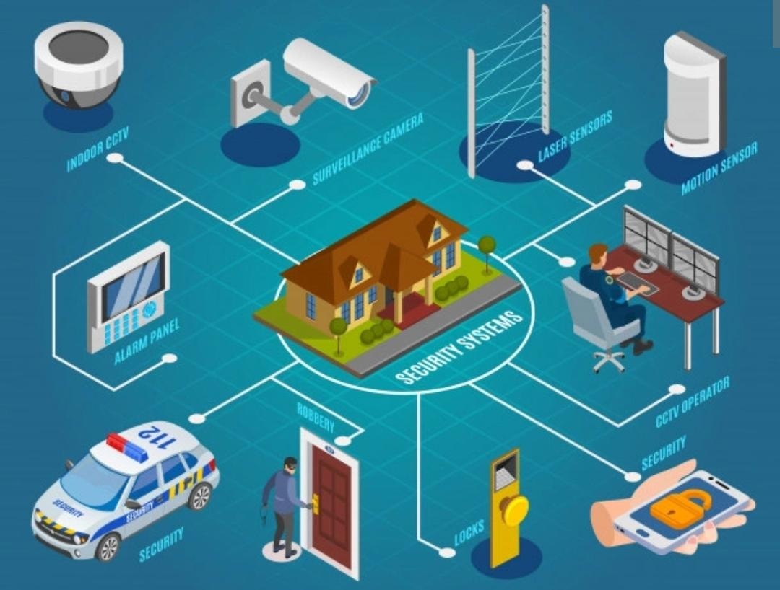
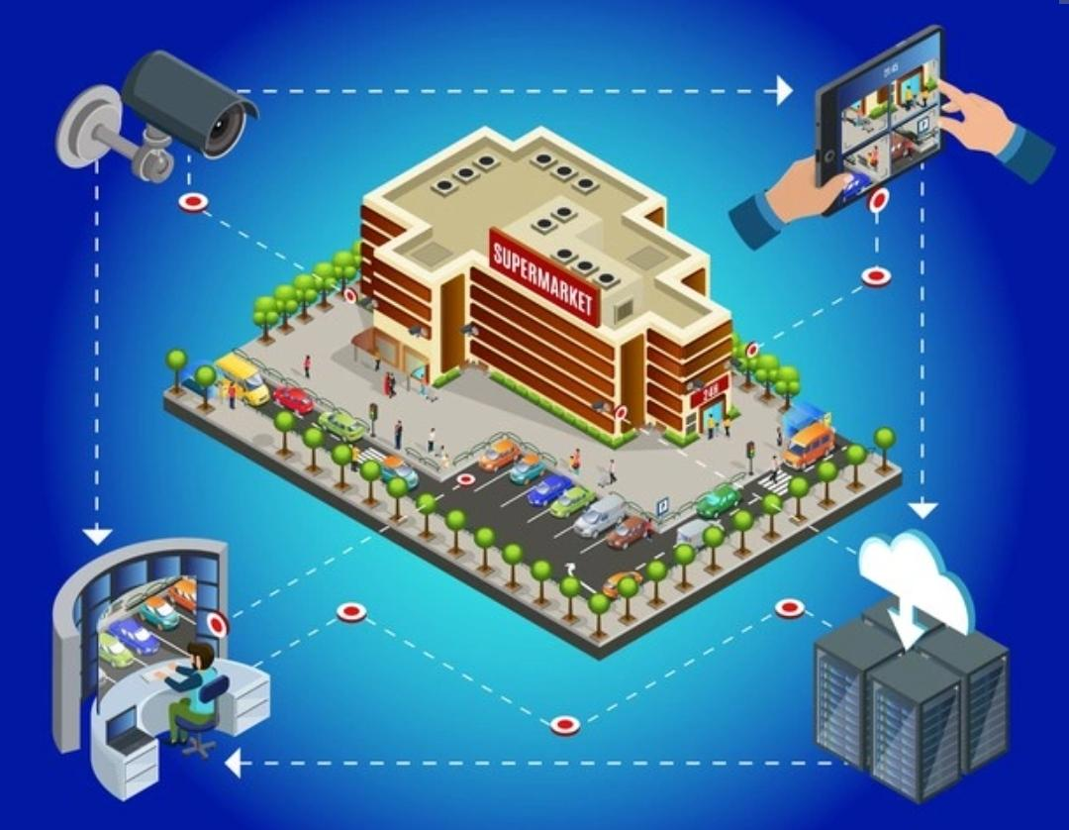
Proposed UI and design
Flowchart-
Team : KODO SHINOBI
DOMAIN :- Detection of event in CCTV Camera

Slide 2

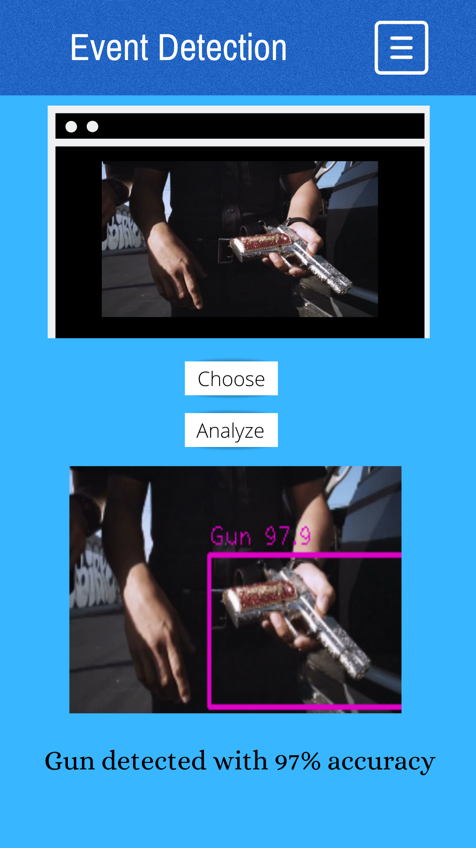
USER INTERFACE DESIGN:-
The interface will look like :
Other features
Media chosen to be analyzed
Deploy the model on the media
Choose file localy from device
Output with detected objects
Display of object name with accuracy percent

Slide 3


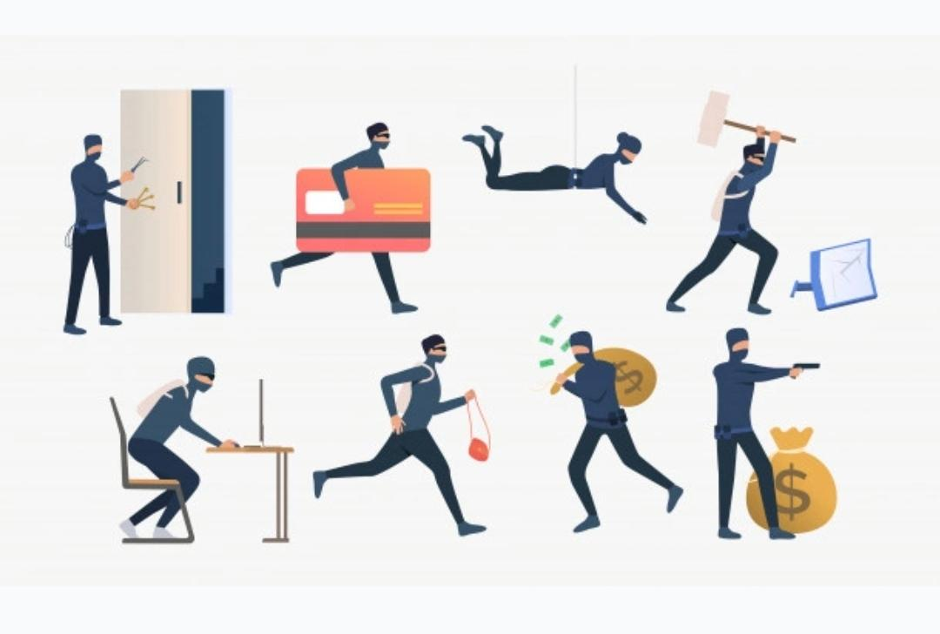
There will be 3 steps:-
1
Uploading
2
Analysizing
3
Event and Alert
First of all, the video footage from a cctv camera will be uploaded in the software.
After receiving the footage will be divided into different frames and will be analysed properly
After proper analysis of footage the software will declare about the accident or event that has occured.

Slide 4
Analysing phase:-
While analysing the footage this software will:-
Analysis and predict about the event occurred (whether it a car accident or bank robbery etc)
Show the weapon involved in case of crime, detect smoke or fire.
Show the number of people involved (uses crowd counting)
Further we shall be adding additional information regarding their age and sex.

Slide 5
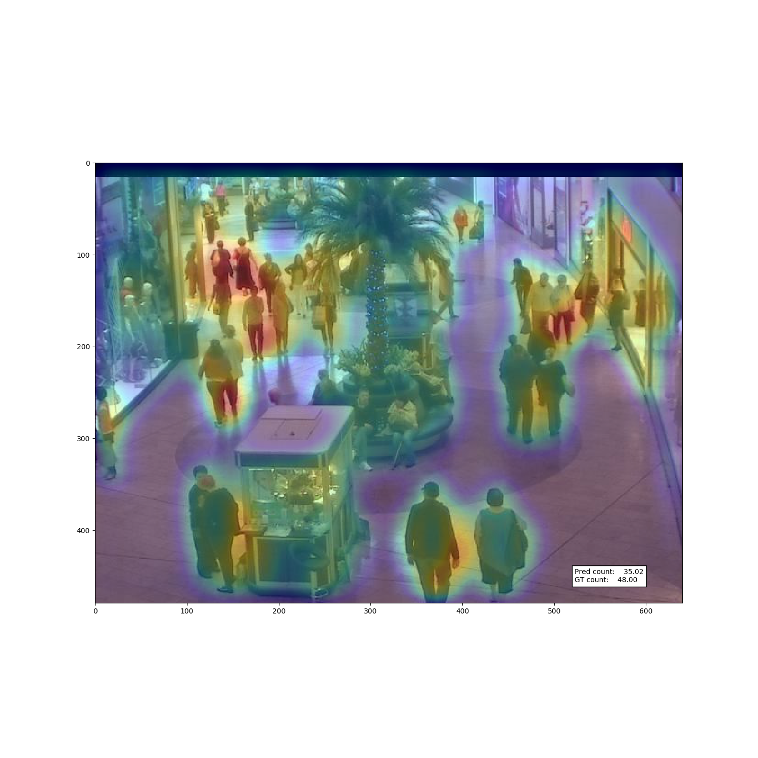
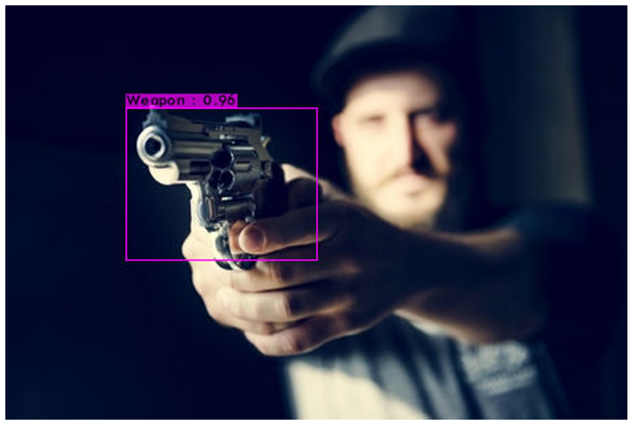
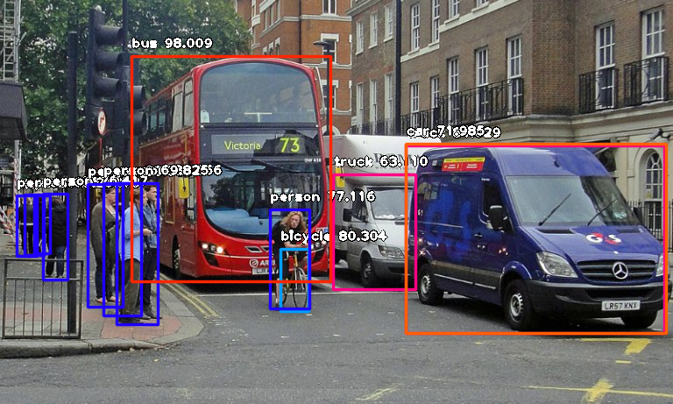
Event Detection software
The future belong to us. It's time to upgrade ourselves and security measures.

