Slide 1

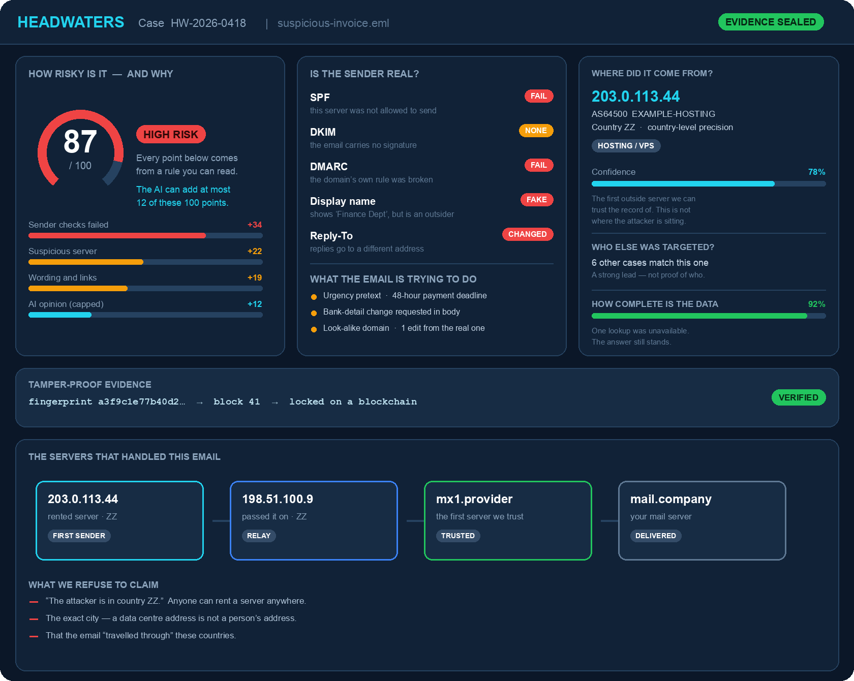
SMART INDIA HACKATHON 2025
HEADWATERS
HEADWATERS
Find out whether an email is an attack — and prove it.
TITLE PAGE
● Problem Statement ID – PS26106
● Problem Statement Title – AI-Powered Email Threat Detection, GeoLocation and Forensic Intelligence Platform
● Theme – Blockchain & Cybersecurity
● PS Category – Software
● Team ID – < Team ID >
● Team Name – < Team Name >
Code checks the facts. The AI only explains them.
@ Team Headwaters · PS26106 · Smart India Hackathon 2025
1
Notes:
SLIDE 1 — TITLE PAGE [ say this in about 20 seconds ]
"Good morning. We are Team <name>. Our problem statement is PS26106 —
AI-powered email threat detection, geolocation and forensic intelligence.
Our product is called HEADWATERS. A headwater is the place a river begins —
and that is exactly what we do. Someone forwards us a suspicious email, and we
trace it back to where it started.
One line to remember for the whole pitch: CODE CHECKS THE FACTS, THE AI ONLY
EXPLAINS THEM. That is what makes our answer something you can defend.
On the right is our actual dashboard. One email in — and you get a risk score
with reasons, where it came from, and evidence that is locked."
IF A JUDGE ASKS
- Why that name? A headwater is the source of a river. We trace an attack
back to its beginning.
- Do you need to be an expert to use it? No. Anyone can forward an email.
The report is written in plain English.

Slide 2
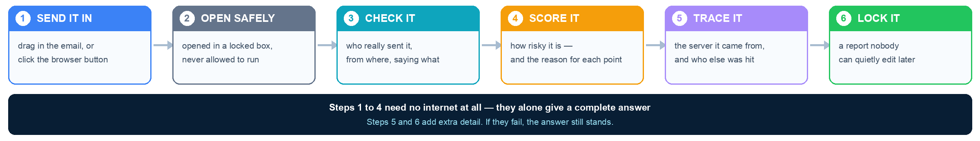
PROBLEM AND PROPOSED SOLUTION
HEADWATERS
PROBLEM STATEMENT
Email is still how most attacks arrive — fake invoices, fake bosses, fake login pages. And every email an employee reports has to be checked by a person.
THE PERSON DOING THIS JOB TODAY
A security analyst — two to five of them in a bank, a university IT team, a government CERT or a cybercrime cell.
Today's queue: about 40 reported emails, roughly an hour on each.
▪ Old filters miss new attacks — and never explain the ones they let through
▪ Attackers now write with AI, and copy real company names and logos
▪ Two analysts often reach two different answers on the same email
▪ The proof is not preserved, so it cannot be handed over later
OUR SOLUTION — HEADWATERS does that hour of work in about a minute, and proves it
INNOVATION & UNIQUENESS
EVERY SCORE HAS A REASON
We never say “the AI thinks it is bad”. Each point of the risk score comes from a rule you can read. The AI is allowed to add only 12 of the 100 points.
WE CLAIM ONLY WHAT WE CAN PROVE
We show the server the email most likely came from, and how sure we are. We never claim to know the attacker's city or name. We give leads, not accusations.
WORKS WITHOUT INTERNET
The main checks need no outside lookups at all. Pull the network cable and it still gives a full answer. The extra lookups only add detail.
PROOF NOBODY CAN EDIT
Every step is locked with a digital fingerprint and anchored on a blockchain, so the evidence cannot be quietly changed afterwards.
@ Team Headwaters · PS26106 · Smart India Hackathon 2025
2
Notes:
SLIDE 2 — PROBLEM AND SOLUTION [ about 40 seconds ]
"First the problem — and it helps to picture the person who actually has it.
At a bank or a large company, when employees report a suspicious email, those
reports go to a small team — usually two to five people — whose full-time job is
to look at them. They are called SECURITY ANALYSTS, and they sit in a SOC, a
Security Operations Centre. The same role exists in a university IT team, a
government CERT, or a cybercrime police cell.
Picture one of them at a desk with FORTY reported emails to get through today.
Right now they do it by hand — copy the hidden headers out of the email, paste
them into one website, look up the IP address on another, check the link on a
third, then write a Word document. About an hour per email. And nobody can
reproduce their work afterwards.
Notice that our problem statement says FORENSIC and INVESTIGATION — not FILTER.
They are asking for the part that happens AFTER something gets through.
So our solution is six steps. Send the email in. We open it inside a locked box,
so it can never run. We check who really sent it. We score it — and for every
point of that score, we show the rule behind it. We trace the server it came
from and check who else was hit. Then we lock the report.
Look at the dark bar under the six steps. Steps one to four need NO INTERNET.
Even completely offline, you still get a full answer."
IF A JUDGE ASKS
- Who exactly is the user? A security analyst in a SOC — two to five of them at
a typical bank, or the IT team at a university.
- Why does working offline matter? Networks fail, and an investigation must not
stop. It also means we can demo it with the cable pulled out.
- Why cap the AI at 12 points? So that an AI mistake can never flip the verdict.

Slide 3
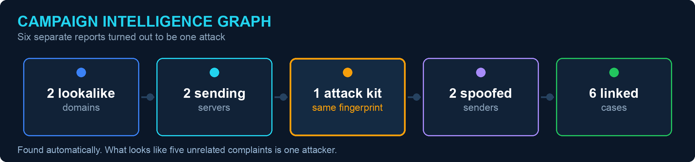
TECHNICAL APPROACH
HEADWATERS
EMPLOYEE OR ANALYST SENDS IT IN · ONE CLICK, OR UPLOAD
OPENED SAFELY + FINGERPRINTED
ANALYSIS ENGINE — TWO PARTS
1 CHECK THE SENDER
2 CHECK THE SERVER
3 READ THE INTENT (AI)
4 CONNECT THE DOTS
PART 1 · FACT CHECKS
PART 2 · EXTRA DETAIL
PART 2 · LIMITED TO 12/100
LINKING RELATED ATTACKS
▪ Reads the email's hidden delivery record
▪ Checks SPF, DKIM and DMARC — the ID proofs
▪ Spots fake sender names
▪ Pulls out every link and attachment
▪ How old the domain is, and who owns it
▪ Whether the server is known for attacks
▪ Which network and country it sits on
▪ Stored offline, so Part 1 never waits
▪ Spots urgency, fear and money pressure
▪ Detects fake-boss and fake-invoice requests
▪ Writes the explanation in plain English
▪ Never decides the final verdict
▪ Builds a fingerprint of the attack
▪ Links domains, servers and senders
▪ Shows if many people were targeted
▪ A strong lead — not proof of who
TECHNOLOGY STACK
FRONTEND Next.js 15 · React 19 · TypeScript · Tailwind
BACKEND FastAPI · Python 3.12 · SQLAlchemy · worker
DATA PostgreSQL · Alembic · jobs queue · Supabase RLS
AI OpenAI GPT · fixed format · limited to 12 points
PROOF digital fingerprints · anchored on a blockchain
ONE PRODUCT, TWO DOORS INTO IT
WHY IT IS RELIABLE
The security checks are kept completely separate from the website code. That means we can test them properly on their own, and the very same engine runs behind the website and the background worker.
THE EMPLOYEE
Clicks one button in Gmail. Gets a red or green badge and a single sentence. That is all they ever see.
THE SECURITY ANALYST
Opens the full dashboard: the score and its reasons, the origin trace, the campaign links, the sealed evidence and a PDF report.
@ Team Headwaters · PS26106 · Smart India Hackathon 2025
3
Notes:
SLIDE 3 — TECHNICAL APPROACH [ about 35 seconds ]
"This is how it works.
The analyst sends the email in — by uploading it, or with one click from a
browser button. We immediately open it safely and take a digital fingerprint,
so nothing can be changed afterwards.
Then four things happen, left to right.
ONE — we read the email's hidden delivery record and check SPF, DKIM and DMARC.
Those are the three standard proofs that a sender really is who they claim.
TWO — we look up the sending server. How old is the domain, is that server
known for attacks, which country and network is it on.
THREE — the AI reads the wording and spots urgency, fear and money pressure.
But notice the label on that card: the AI is limited to 12 points out of 100,
and it never decides the verdict.
FOUR — we compare this email with every past case and link the ones that match.
Bottom left is the real payoff. Six separate complaints turned out to be one
single attacker.
And look at the bottom-left box: ONE PRODUCT, TWO DOORS INTO IT. A normal
employee clicks one button in Gmail and sees a red or green badge with a single
sentence — that is all they ever see. The analyst opens the full dashboard."
IF A JUDGE ASKS
- What are SPF, DKIM and DMARC? Three public standards every mail provider
already uses to check a sender is genuine. We read the result — we do not
invent it.
- Where is the blockchain? In the evidence chain — the fingerprint of every
step is anchored so the record cannot be rewritten.

Slide 4
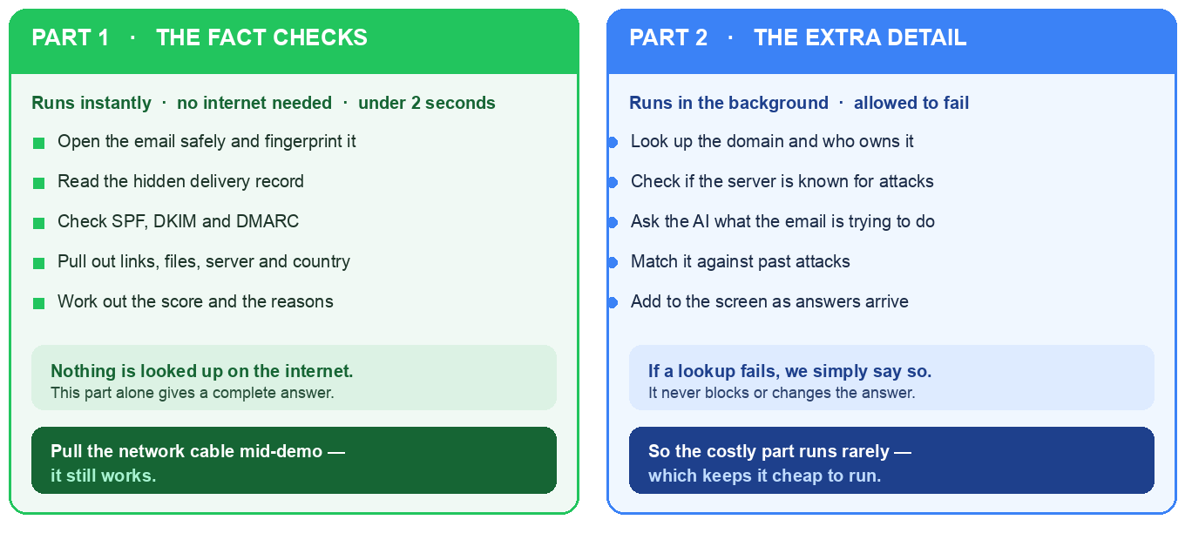
FEASIBILITY AND VIABILITY
HEADWATERS
HOW IT SCALES — THE WORK IS DELIBERATELY SPLIT IN TWO
WHY IT CAN BE BUILT
▪ Nothing new to invent : SPF, DKIM and DMARC are world standards, already used by Gmail and Outlook
▪ Data is public : domain, server and network records are open to anyone
▪ AI on a short leash : fixed format, and a hard limit of 12 points out of 100
▪ Proof is standard : digital fingerprints, anchored on a blockchain
DEPLOYMENT READINESS
FRONTEND
Vercel
BACKEND
FastAPI + Docker
DATABASE
PostgreSQL
STORAGE
Secure object store
MONITORING
Sentry
CI
ruff · mypy · bandit
TECHNICAL CHALLENGE & MITIGATION
VIABILITY & ADOPTION
▪ Risk : if the attacker sent it through a big provider like Gmail, the real sender is hidden. And AI can sometimes invent details.
▪ Our answer : we say so honestly instead of guessing. And the AI is capped at 12 points, so it can never change the verdict on its own.
▪ Who will pay : banks, government teams, colleges and IT security firms already spend staff hours doing exactly this by hand.
▪ Easy to adopt : it sits beside the email security they already own. Nothing about their email setup has to change.
@ Team Headwaters · PS26106 · Smart India Hackathon 2025
4
Notes:
SLIDE 4 — FEASIBILITY AND VIABILITY [ about 25 seconds ]
"Can this actually be built? Yes — because we are not inventing anything new.
SPF, DKIM and DMARC are world standards that Gmail and Outlook already use.
Domain and server records are public. The AI is off-the-shelf, kept on a short
leash.
The picture on the left is why it scales. We deliberately split the work in two.
Part one is the fact checks — instant, no internet needed, under two seconds.
Part two is the extra detail: the lookups and the AI. That runs in the
background and is ALLOWED to fail. If it fails, we simply say the data was
incomplete. The answer still stands.
That split is also why it is cheap to run — the costly AI part runs rarely, and
never on the main path.
And deployment is ready today: Vercel, Docker, PostgreSQL, Sentry. All standard,
all proven."
IF A JUDGE ASKS
- What will it cost to run? The AI only runs in part two, on a fraction of each
case, so cost grows with detail — not with the number of emails.
- What is your biggest risk? If the attacker sent it through a big provider
like Gmail, the true origin is hidden. We say so honestly instead of guessing.

Slide 5
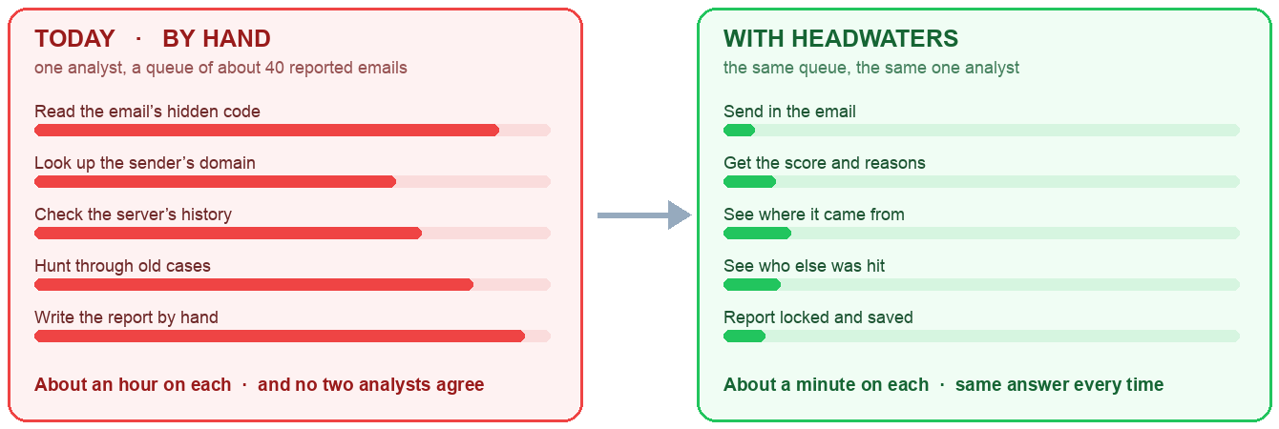
IMPACT AND BENEFITS
HEADWATERS
COMPARED WITH TODAY'S EMAIL FILTERS
CAPABILITY
FILTERS
OURS
Blocks known attacks
Yes
Yes
Explains why, in plain English
No
Yes
Shows where it came from
No
Yes
Shows how sure it is
No
Yes
Links related attacks
Partly
Yes
Proof that cannot be edited
No
Yes
Works without internet
No
Yes
WHO IT SERVES
MEASURABLE OUTCOMES
STRATEGIC IMPACT
▪ A bank's security team — usually 2 to 5 analysts
▪ Government departments and national CERTs
▪ University and college IT teams
▪ Cybercrime police cells
▪ IT security firms and response teams
▪ One email now takes about a minute instead of an hour
▪ Every analyst gets the same answer, every time
▪ Group attacks get spotted, instead of being closed one by one
▪ The proof still stands when handed to police or auditors
▪ Every email checked adds to what the team knows
▪ Findings are solid enough for real investigations and official reports
▪ The human still decides — we supply evidence, never opinions
@ Team Headwaters · PS26106 · Smart India Hackathon 2025
5
Notes:
SLIDE 5 — IMPACT AND BENEFITS [ about 30 seconds ]
"What difference does it make?
Remember our analyst with forty emails in the queue. Today, for each one, they
read the hidden code by hand, look up the domain, check the server's history,
hunt through old cases, and type the report. About an hour, for a single email.
With Headwaters that becomes about a minute — and just as important, the SAME
ANSWER EVERY TIME, no matter who is on duty.
On the right is how we compare with the email filters people already have. They
block known attacks well. But they do not explain why, they do not show where it
came from, they do not link related attacks, and they do not give proof that
stands up later. We do all four.
This matters for banks, government departments, colleges, and any security team.
And because the proof is locked, the findings can support a real investigation."
IF A JUDGE ASKS
- Are you replacing their existing filter? No. We sit beside it. It blocks;
we explain what got through.
- How much time is saved? About an hour down to about a minute per email —
plus consistency between analysts, often the bigger win.

Slide 6
RESEARCH AND REFERENCES
HEADWATERS
STANDARDS, FRAMEWORKS & PRIOR ART
▪ MITRE ATT&CK : The world's standard catalogue of attack methods. Our phishing checks map to its official numbers (T1566, T1534).
▪ NIST SP 800-86 : The US government guide on handling digital evidence. Our evidence locking follows it.
▪ The sender ID standards : SPF, DKIM and DMARC — the three published checks that prove an email really came from who it claims (RFC 7208 / 6376 / 7489).
▪ How email is written : The official rules for email format (RFC 5322, MIME), and the public record of who owns a domain (RDAP).
▪ OpenAI : Used only to judge what the email is trying to do, and to write the explanation — never to decide the verdict.
▪ Tools we build alongside : Microsoft Defender for Office 365 · Proofpoint · Abnormal Security.
SOLUTIONS THAT ALREADY EXIST
WHERE HEADWATERS STANDS OUT
▪ Microsoft Defender, Proofpoint and Abnormal block known attacks well
▪ But they take over your email system, which is costly and disruptive
▪ And they give a yes-or-no answer — not an explanation, not a source, and not proof you could hand to the police
▪ It explains itself : every point of the score comes from a rule you can read
▪ It traces the source : shows the likely server, and how sure we are
▪ It connects attacks : spots when many people were hit by the same attacker
▪ It locks the proof : evidence anchored on a blockchain, so it cannot be edited
▪ It fits alongside : no change to the email system they already use
OUR POSITION
“We are not replacing email security. Filters decide what to block. Headwaters explains what got through — and gives the analyst an answer, a source and a piece of proof they can stand behind.”
PROJECT RESOURCES
▪ Demo video : < link >
▪ Repository : < link >
▪ Docs : architecture · claim contract · threat model
@ Team Headwaters · PS26106 · Smart India Hackathon 2025
6
Notes:
SLIDE 6 — RESEARCH AND REFERENCES [ about 20 seconds ]
"Finally, credibility.
We build on MITRE ATT&CK — the world's standard catalogue of attack methods. On
the NIST guide for handling digital evidence. And on the published internet
standards for email.
And we are honest about where we sit. We are not replacing Microsoft Defender or
Proofpoint. Those tools decide what to BLOCK. We explain what got THROUGH — we
show where it came from, and we give the analyst proof they can stand behind.
That is Headwaters. Thank you — we are happy to take questions."
IF A JUDGE ASKS
- What is left to build? The engine and the claim rules are designed and
documented. The remaining work is the dashboard polish and the browser
extension.
- Is this original? The individual checks are standards. What is new is putting
explainable scoring, source tracing and locked evidence in one analyst tool.

