Slide 1

Full-Stack Project review Project Title: Go-Clean Laundry Services
K.Surya satya raviteja
B.Satya sai ram
K.Kumar
K.Chandra Harsha
Batch-07

Slide 2
Problem Statement
One of the activities that consume a lot of time is laundry. Consider the amount of time it takes us to wash, dry, and iron our clothes each week.
To facilitate a web application that will address the laundry issues and provide a seamless experience to the customers
To save the customers time and physical effort
A framework that offers laundry services to customers

Slide 3
Objectives
To provide customers with a convenient way to get their laundry done without having to leave their homes or office.
To build trust and credibility with customers by ensuring high-quality laundry services and timely delivery of orders.
To design a website such that even the naïve user can schedule and
manage laundry service and check their order status.
To extend this application in such a way that it can provide employment opportunities.

Slide 4






TECHNOLOGY STACK
Frontend | Reactjs
Backend | Spring Boot
Database | MySQL
ORM Mapping | JPA(Hibernate)
Testing | Junit, Mockito
Code Coverage | Eclemma, Jococo

Slide 5
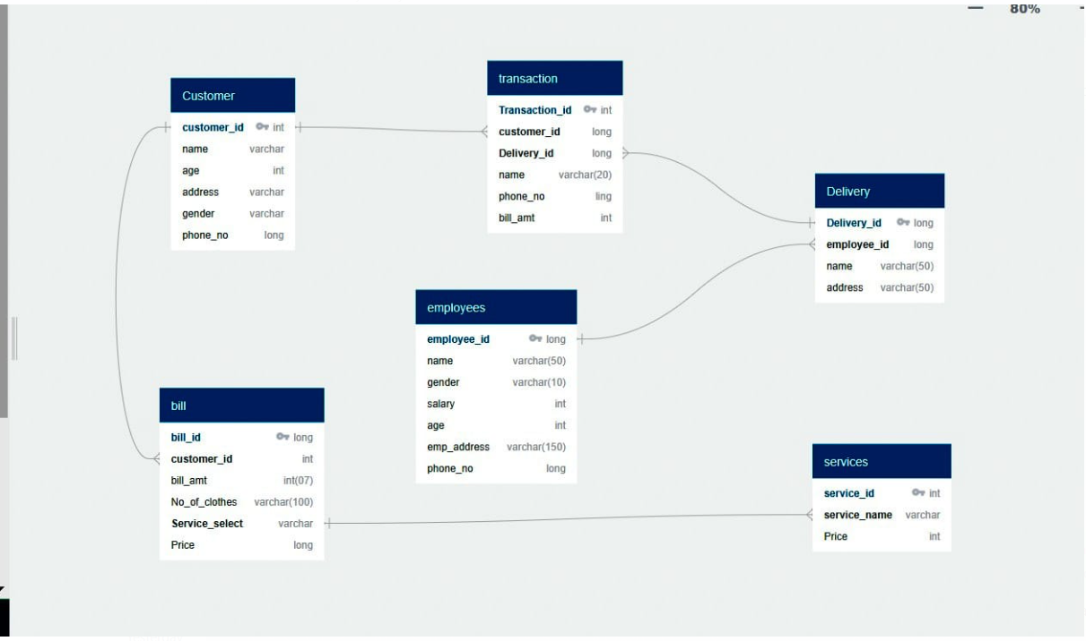
Entity-Relationship Diagram

Slide 6
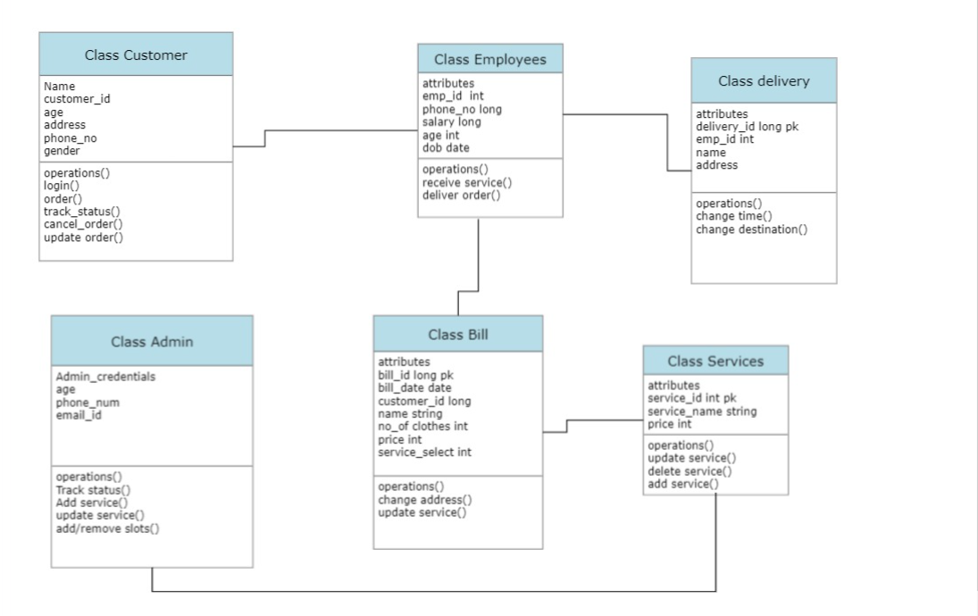
Class Diagram

Slide 7
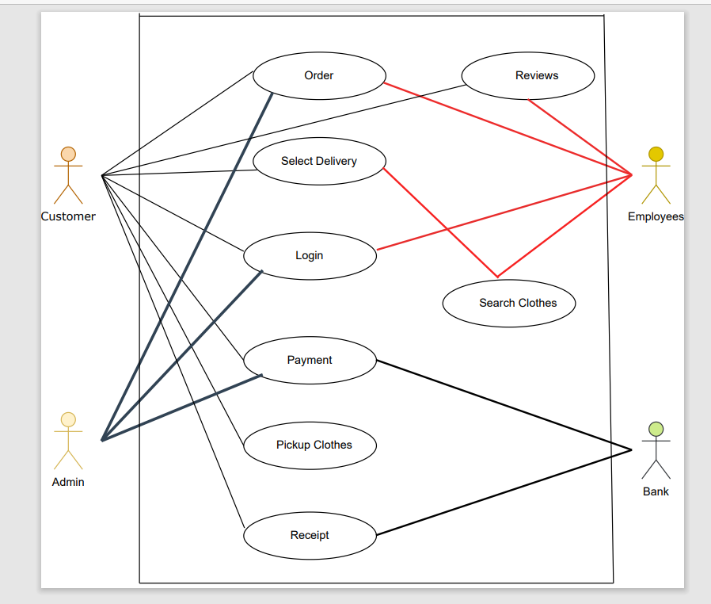
Use-Case Diagram

