Slide 1
Detection and Prediction of Fault Lights
TEAM BIT

Slide 2
WORKING
We are interfacing LDR Sensor with ATMEGA2560 microcontroller which will give us the analog values as the output .
Since we are interfacing 86 lights through one controller,so inorder to overcome the wiring data loses and to cut the wiring price we are using module RS-485
The major benefit of using RS –485 is , it is able to transfer data to long distances through a single wire .
Now this data will be uploaded on the cloud(thingspeak),and also we are providing you with the graphical representation where the peak values represent that the lamp is a faulty lamp and the lowest value indicating that the lamp is fine .
So , here we are detecting the faulty lamp .

Slide 3

USP
Along with the fault detection we are also providing the intensity data of the street lights . Now this data is also uploaded on the cloud and through the API KEY of the cloud , we are able to get the complete data in an excel sheet for better analysis .
For detecting the pole number we are using JUPYTER NOTEBOOK which tells us whether the lamp is working condition or not , and if it is not in the working condition it tells us the POLE number .
Also we are predicting that when the lamp will be in a situation that it can not work by Data Extracting from cloud .

Slide 4
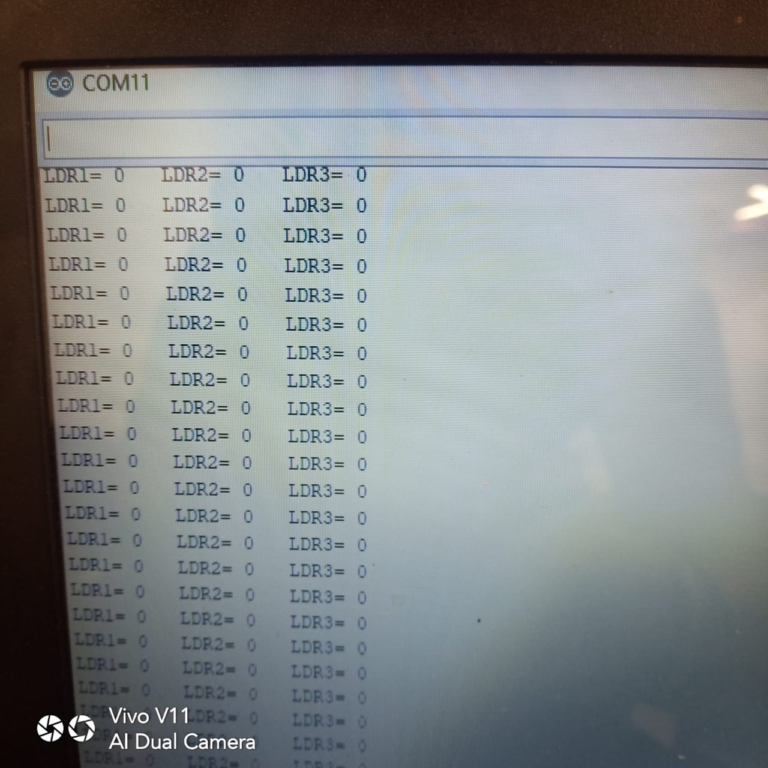
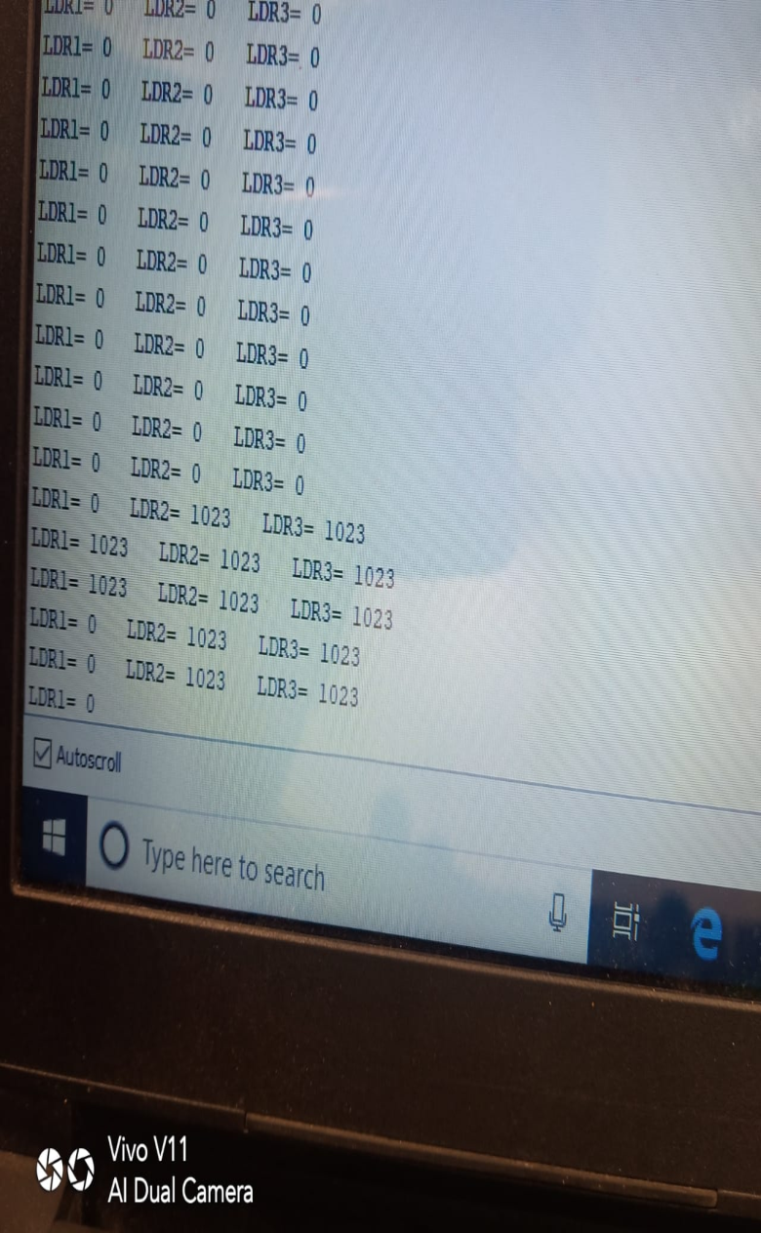
LAMP FINE
LAMP FAULT

Slide 5
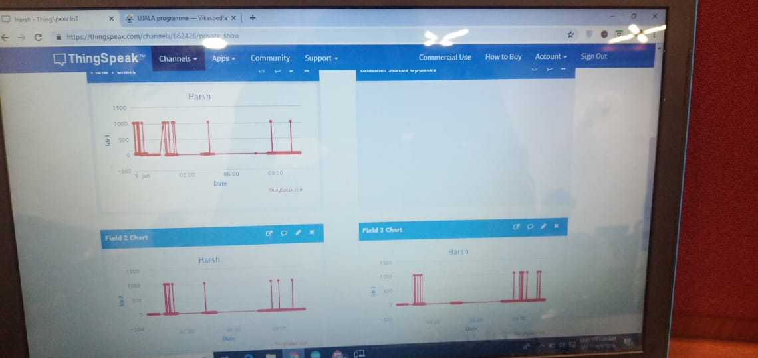

Slide 6
BUSINESS MODEL
As per the UJALA REPORT , we analysed that if faulty lights are replaced per year we can save energy to a greater level which will further reduce the greenhouse emission .
Our product cost per light when done in mass production will be around 40 Rs . To 50 Rs .
Suppose we replace around 9 Lakh faulty LEDs in a year , we could save around .1 Bn kWh which will thus save a whooping 17 crore per year according to the average power tariff in India which is 5 Rs. Per watt .
Also our product life is approx 10 years .

