Slide 1
ProcureFlow – Enterprise Procurement Management Platform
Building a secure, scalable, highly available procurement system using AWS and Terraform
Presented by: Vinay Kumar Kondoju
AWS Cloud
Terraform
DevOps
Procurement Platform
Enterprise Architecture

Slide 2

Business Challenges in Traditional Procurement
Legacy procurement processes create operational, security, and audit risk that slows enterprise decision-making and increases cost.
Spreadsheet-based Data
Manual Workflows
Vendor details and pricing scattered across files — high risk of inconsistency and errors.
Approval steps are slow, paper-heavy, and hard to track — delays and missed SLAs.
Fragmented Documents
Security & Scale
Contracts, invoices, and POs live in multiple systems — retrieval and compliance suffer.
No centralized audit trail or scalable controls — compliance risks increase with growth.
This slide maps core pain points that ProcureFlow must eliminate to deliver measurable business value: speed, visibility, security, and scale.

Slide 3
ProcureFlow Solution (High-level)
A cloud-native procurement platform that digitizes vendor lifecycle, automates approvals, centralizes documents, and provides auditable, role-based controls.
01
02
1. Vendor Management
2. Purchase Requests & Approvals
Central repository: onboarding, credentials, risk scores, attachments.
Configurable multi-step workflows, SLA enforcement, approver escalation.
03
04
3. Contracts & Invoices
4. Reporting & Audit
Versioned contracts, invoice matching, automated reconciliation hints.
Immutable audit trail, role-based access, activity logs for compliance.
Primary users: Admin, Procurement Manager, Finance Team, Auditor — each with tailored interfaces and RBAC.

Slide 4
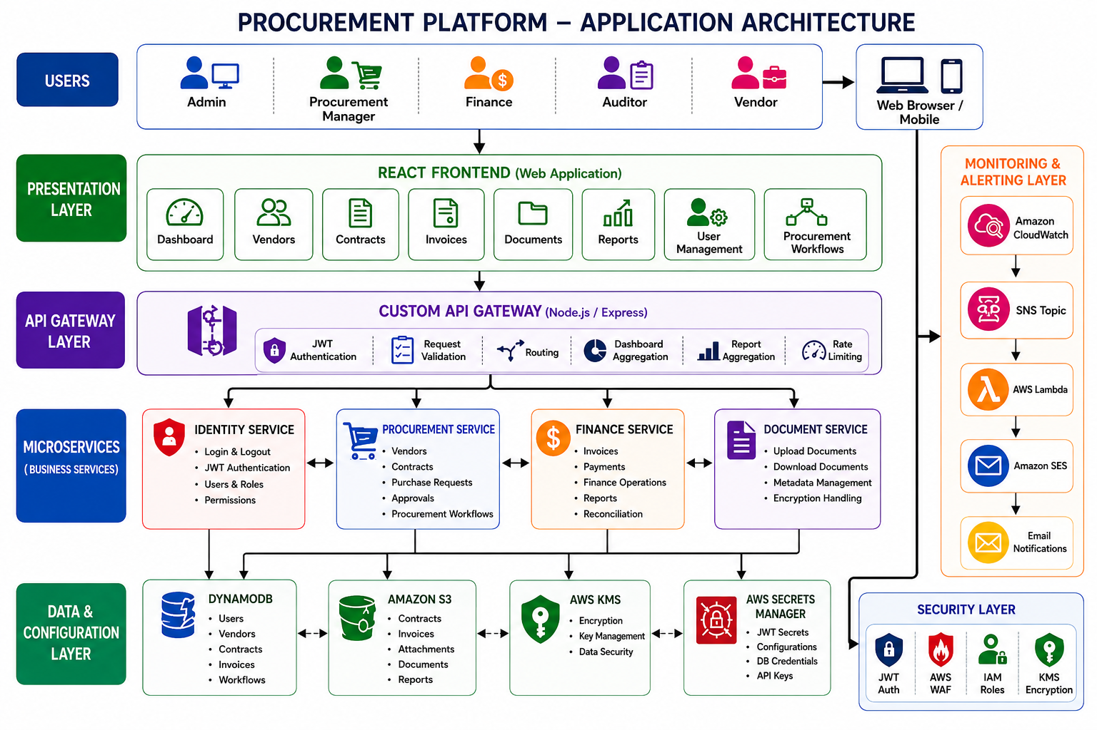

Slide 5
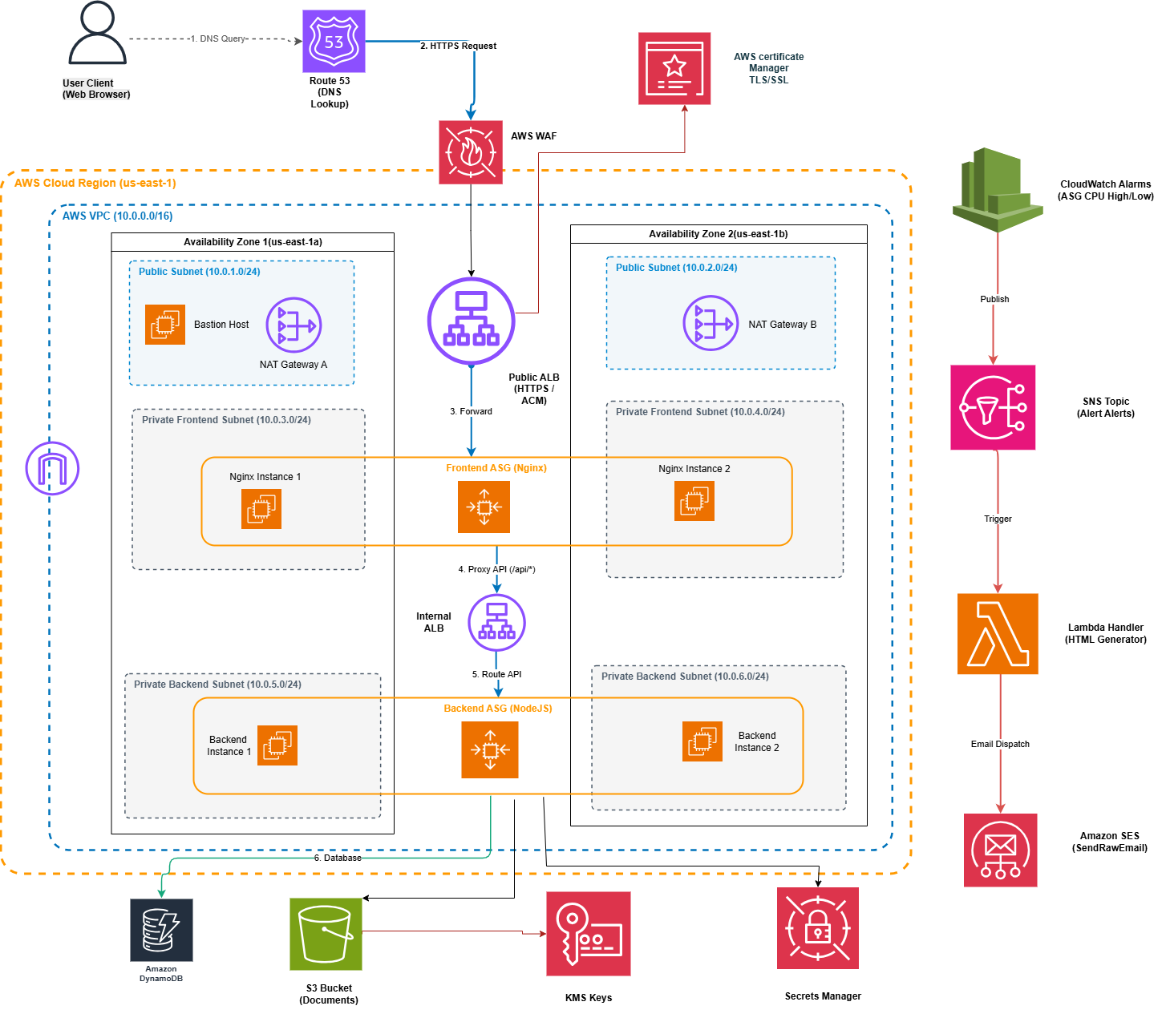
AWS Architecture

Slide 6
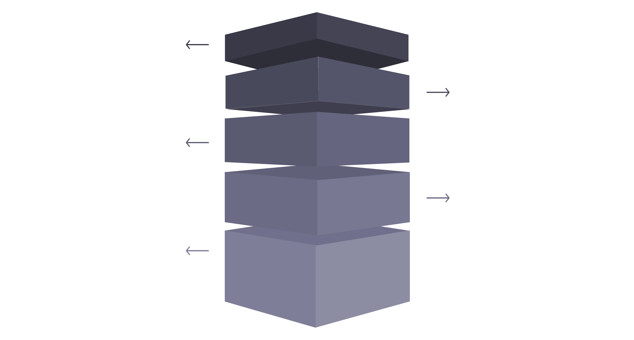
Scalability & High Availability
Design choices that remove single points of failure and enable predictable scaling during load spikes.
Scaling Policy
Auto Scaling Groups (Backend)
Target tracking on CPU utilization — target = 60% for scale-in/scale-out stability.
Auto Scaling Groups (Frontend)
Min: 2 — Desired: 3 — Max: 4
Min: 2 — Desired: 3 — Max: 4
Multi-AZ ALBs
Distribute traffic across Availability Zones for HA.
ASGs Frontend
Min 2 Desired 3 Max 4; span AZs for no SPOF.
ASGs Backend
Min 2 Desired 3 Max 4; redundant across AZs.
Target Tracking
CPU target 60% triggers scale-out/scale-in.
Automatic Resilience
Eliminates single points of failure automatically.

Slide 7

Monitoring, Alerting & Automation
Operational workflow for alert detection and automated notification delivery to on-call teams.
CloudWatch alarms
CPU high/low, health checks, ASG events
Automated notifications
Automated Alert Delivery
SNS topic
Fan-out to subscribers and Lambda
On-call paging and summary emails
Amazon SES
Lambda transformer
Sends HTML email templates to stakeholders
Enriches and formats alert payloads
CloudWatch Alerts
Automated Workflow
Operational Benefits
CPU high/low, health checks, and ASG lifecycle events trigger alarms.
SNS fans out to Lambda which formats alerts and sends via SES — HTML templates for clear on-call action.
Faster incident response, consistent notifications, and audit-ready alert records.

Slide 8

Infrastructure as Code — Terraform Implementation
Terraform drives reproducible, reviewed infrastructure with modular design and remote state management.
Modular Architecture
Key Terraform Concepts
Automation
Modules for networking, security-groups, alb, asg, kms, s3, secretsmanager, waf, route53, cloudwatch, sns, iam.
Variables, outputs, remote backend (S3 + DynamoDB lock), state management, resource dependencies, and launch templates.
CI pipeline runs plan/apply with policy checks, automated ACM and Route53 provisioning, WAF rules deployment, and CloudWatch alarms creation.
Monitoring & Alerts
Networking
CloudWatch metrics and SNS
VPC, subnets, routing
Composable Terraform Modules
Secrets & Storage
Security Groups
KMS, S3, Secrets Manager
Instance and ALB rules
Auto Scaling Group
Application Load Balancer
Managed compute scaling
Traffic routing and health checks

Slide 9
Outcomes & Key Learnings
Delivered Outcomes
Technical Learnings
Skills Demonstrated
Enterprise-grade procurement platform built and validated
Secure multi-AZ AWS architecture with centralized audit trail
Full IaC via Terraform with reusable modules and remote state
Automated monitoring/alerting pipeline (CloudWatch → SNS → Lambda → SES)
Designing for scale requires early decisions on partitioning and state
Secrets and KMS policies must be explicit and audited
ASG tuning + ALB health checks reduce false positives in autoscaling
AWS architecture & services
Terraform modularization & automation
DevOps practices, monitoring, and security design
Closing: ProcureFlow demonstrates how cloud-native architecture and Infrastructure as Code deliver secure, auditable, and scalable procurement operations — ready for enterprise roll-out and continuous improvement.

