Slide 1
Chapter 24: Advanced Application Development

Slide 2
Chapter 24: Advanced Application Development
Performance Tuning
Performance Benchmarks
Standardization
E-Commerce
Legacy Systems

Slide 3
Performance Tuning
Adjusting various parameters and design choices to improve system performance for a specific application.
Tuning is best done by
  identifying bottlenecks, and
  eliminating them.
Can tune a database system at 3 levels:
  Hardware -- e.g., add disks to speed up I/O, add memory to increase buffer hits, move to a faster processor.
  Database system parameters -- e.g., set buffer size to avoid paging of buffer, set checkpointing intervals to limit log size. System may have automatic tuning.
  Higher level database design, such as the schema, indices and transactions (more later)

Slide 4
Bottlenecks
Performance of most systems (at least before they are tuned) usually limited by performance of one or a few components: these are called bottlenecks
  E.g., 80% of the code may take up 20% of time and 20% of code takes up 80% of time
    Worth spending most time on 20% of code that take 80% of time
Bottlenecks may be in hardware (e.g., disks are very busy, CPU is idle), or in software
Removing one bottleneck often exposes another
De-bottlenecking consists of repeatedly finding bottlenecks, and removing them
  This is a heuristic

Slide 5
Identifying Bottlenecks
Transactions request a sequence of services
  E.g., CPU, Disk I/O, locks
With concurrent transactions, transactions may have to wait for a requested service while other transactions are being served
Can model database as a queueing system with a queue for each service
  Transactions repeatedly do the following
    request a service, wait in queue for the service, and get serviced
Bottlenecks in a database system typically show up as very high utilizations (and correspondingly, very long queues) of a particular service
  E.g., disk vs. CPU utilization
  100% utilization leads to very long waiting time:
    Rule of thumb: design system for about 70% utilization at peak load
    utilization over 90% should be avoided

Slide 6
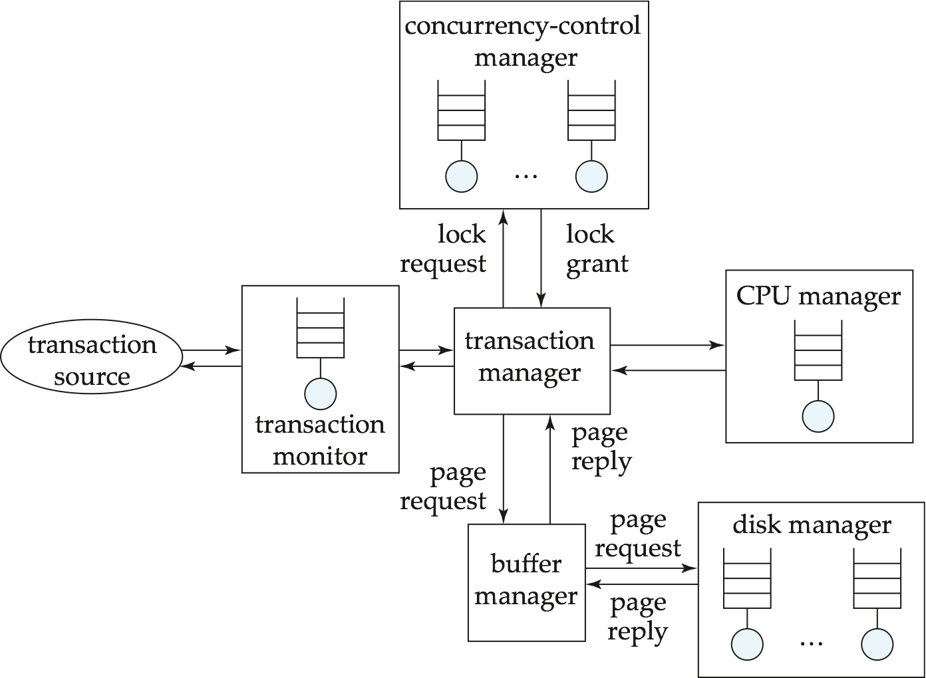
Queues In A Database System

Slide 7
Tunable Parameters
Tuning of hardware
Tuning of schema
Tuning of indices
Tuning of materialized views
Tuning of transactions

Slide 8
Tuning of Hardware
Even well-tuned transactions typically require a few I/O operations
  Typical disk supports about 100 random I/O operations per second
  Suppose each transaction requires just 2 random I/O operations. Then to support n transactions per second, we need to stripe data across n/50 disks (ignoring skew)
Number of I/O operations per transaction can be reduced by keeping more data in memory
  If all data is in memory, I/O needed only for writes
  Keeping frequently used data in memory reduces disk accesses, reducing number of disks required, but has a memory cost

Slide 9
Hardware Tuning: Five-Minute Rule
Question: which data to keep in memory:
  If a page is accessed n times per second, keeping it in memory saves
    n * price-per-disk-drive
    accesses-per-second-per-disk
  Cost of keeping page in memory
    price-per-MB-of-memory
    ages-per-MB-of-memory
  Break-even point: value of n for which above costs are equal
    If accesses are more then saving is greater than cost
  Solving above equation with current disk and memory prices leads to:
  5-minute rule: if a page that is randomly accessed is used more frequently than once in 5 minutes it should be kept in memory
    (by buying sufficient memory!)

Slide 10
Hardware Tuning: One-Minute Rule
For sequentially accessed data, more pages can be read per second. Assuming sequential reads of 1MB of data at a time:
1-minute rule: sequentially accessed data that is accessed
once or more in a minute should be kept in memory
Prices of disk and memory have changed greatly over the years, but the ratios have not changed much
  So rules remain as 5 minute and 1 minute rules, not 1 hour or 1 second rules!

Slide 11
Hardware Tuning: Choice of RAID Level
To use RAID 1 or RAID 5?
  Depends on ratio of reads and writes
    RAID 5 requires 2 block reads and 2 block writes to write out one data block
If an application requires r reads and w writes per second
  RAID 1 requires r + 2w I/O operations per second
  RAID 5 requires: r + 4w I/O operations per second
For reasonably large r and w, this requires lots of disks to handle workload
  RAID 5 may require more disks than RAID 1 to handle load!
  Apparent saving of number of disks by RAID 5 (by using parity, as opposed to the mirroring done by RAID 1) may be illusory!
Thumb rule: RAID 5 is fine when writes are rare and data is very large, but RAID 1 is preferable otherwise
  If you need more disks to handle I/O load, just mirror them since disk capacities these days are enormous!

Slide 12
Tuning the Database Design
Schema tuning
  Vertically partition relations to isolate the data that is accessed most often -- only fetch needed information.
    E.g., split account into two, (account-number, branch-name) and (account-number, balance).
      Branch-name need not be fetched unless required
  Improve performance by storing a denormalized relation
    E.g., store join of account and depositor; branch-name and balance information is repeated for each holder of an account, but join need not be computed repeatedly.
      Price paid: more space and more work for programmer to keep relation consistent on updates
    Better to use materialized views (more on this later..)
  Cluster together on the same disk page records that would
  match in a frequently required join
    Compute join very efficiently when required.

Slide 13
Tuning the Database Design (Cont.)
Index tuning
  Create appropriate indices to speed up slow queries/updates
  Speed up slow updates by removing excess indices (tradeoff between queries and updates)
  Choose type of index (B-tree/hash) appropriate for most frequent types of queries.
  Choose which index to make clustered
Index tuning wizards look at past history of queries and updates (the workload) and recommend which indices would be best for the workload

Slide 14
Tuning the Database Design (Cont.)
Materialized Views
Materialized views can help speed up certain queries
  Particularly aggregate queries
Overheads
  Space
  Time for view maintenance
    Immediate view maintenance: done as part of update txn
      time overhead paid by update transaction
    Deferred view maintenance: done only when required
      update transaction is not affected, but system time is spent on view maintenance
        until updated, the view may be out-of-date
Preferable to denormalized schema since view maintenance
is systems responsibility, not programmers
  Avoids inconsistencies caused by errors in update programs

Slide 15
Tuning the Database Design (Cont.)
How to choose set of materialized views
  Helping one transaction type by introducing a materialized view may hurt others
  Choice of materialized views depends on costs
    Users often have no idea of actual cost of operations
  Overall, manual selection of materialized views is tedious
Some database systems provide tools to help DBA choose views to materialize
  “Materialized view selection wizards”

Slide 16
Tuning of Transactions
Basic approaches to tuning of transactions
  Improve set orientation
  Reduce lock contention
Rewriting of queries to improve performance was important in the past, but smart optimizers have made this less important
Communication overhead and query handling overheads significant part of cost of each call
  Combine multiple embedded SQL/ODBC/JDBC queries into a single set-oriented query
    Set orientation -> fewer calls to database
    E.g., tune program that computes total salary for each department using a separate SQL query by instead using a single query that computes total salaries for all department at once (using group by)
  Use stored procedures: avoids re-parsing and re-optimization
  of query

Slide 17
Tuning of Transactions (Cont.)
Reducing lock contention
Long transactions (typically read-only) that examine large parts of a relation result in lock contention with update transactions
  E.g., large query to compute bank statistics and regular bank transactions
To reduce contention
  Use multi-version concurrency control
    E.g., Oracle “snapshots” which support multi-version 2PL
  Use degree-two consistency (cursor-stability) for long transactions
    Drawback: result may be approximate

Slide 18
Tuning of Transactions (Cont.)
Long update transactions cause several problems
  Exhaust lock space
  Exhaust log space
    and also greatly increase recovery time after a crash, and may even exhaust log space during recovery if recovery algorithm is badly designed!
Use mini-batch transactions to limit number of updates that a single transaction can carry out. E.g., if a single large transaction updates every record of a very large relation, log may grow too big.
  * Split large transaction into batch of “mini-transactions,'' each performing part of the updates
  Hold locks across transactions in a mini-batch to ensure serializability
    If lock table size is a problem can release locks, but at the cost of serializability
  * In case of failure during a mini-batch, must complete its
  remaining portion on recovery, to ensure atomicity.

Slide 19
Performance Simulation
Performance simulation using queuing model useful to predict bottlenecks as well as the effects of tuning changes, even without access to real system
Queuing model as we saw earlier
  Models activities that go on in parallel
Simulation model is quite detailed, but usually omits some low level details
  Model service time, but disregard details of service
  E.g., approximate disk read time by using an average disk read time
Experiments can be run on model, and provide an estimate of measures such as average throughput/response time
Parameters can be tuned in model and then replicated in real system
  E.g., number of disks, memory, algorithms, etc.

Slide 20
Performance Benchmarks
Suites of tasks used to quantify the performance of software systems
Important in comparing database systems, especially as systems become more standards compliant.
Commonly used performance measures:
  Throughput (transactions per second, or tps)
  Response time (delay from submission of transaction to return of result)
  Availability or mean time to failure

Slide 21
Performance Benchmarks (Cont.)
Suites of tasks used to characterize performance
  single task not enough for complex systems
Beware when computing average throughput of different transaction types
  E.g., suppose a system runs transaction type A at 99 tps and transaction type B at 1 tps.
  Given an equal mixture of types A and B, throughput is not (99+1)/2 = 50 tps.
  Running one transaction of each type takes time 1+.01 seconds, giving a throughput of 1.98 tps.
  To compute average throughput, use harmonic mean:
  n
  Interference (e.g., lock contention) makes even this incorrect if
  different transaction types run concurrently
1/t₁ + 1/t₂ + … + 1/t_{n}

Slide 22
Database Application Classes
Online transaction processing (OLTP)
  requires high concurrency and clever techniques to speed up commit processing, to support a high rate of update transactions.
Decision support applications
  including online analytical processing, or OLAP applications
  require good query evaluation algorithms and query optimization.
Architecture of some database systems tuned to one of the two classes
  E.g., Teradata is tuned to decision support
Others try to balance the two requirements
  E.g., Oracle, with snapshot support for long read-only transaction

Slide 23
Benchmarks Suites
The Transaction Processing Council (TPC) benchmark suites are widely used.
  TPC-A and TPC-B: simple OLTP application modeling a bank teller application with and without communication
    Not used anymore
  TPC-C: complex OLTP application modeling an inventory system
    Current standard for OLTP benchmarking

Slide 24
Benchmarks Suites (Cont.)
TPC benchmarks (cont.)
  TPC-D: complex decision support application
    Superceded by TPC-H and TPC-R
  TPC-H: (H for ad hoc) based on TPC-D with some extra queries
    Models ad hoc queries which are not known beforehand
      Total of 22 queries with emphasis on aggregation
    prohibits materialized views
    permits indices only on primary and foreign keys
  TPC-R: (R for reporting) same as TPC-H, but without any restrictions on materialized views and indices
  TPC-W: (W for Web) End-to-end Web service benchmark modeling a Web bookstore, with combination of static and dynamically generated pages

Slide 25
TPC Performance Measures
TPC performance measures
  transactions-per-second with specified constraints on response time
  transactions-per-second-per-dollar accounts for cost of owning system
TPC benchmark requires database sizes to be scaled up with increasing transactions-per-second
  Reflects real world applications where more customers means more database size and more transactions-per-second
External audit of TPC performance numbers mandatory
  TPC performance claims can be trusted

Slide 26
TPC Performance Measures
Two types of tests for TPC-H and TPC-R
  Power test: runs queries and updates sequentially, then takes mean to find queries per hour
  Throughput test: runs queries and updates concurrently
    multiple streams running in parallel each generates queries, with one parallel update stream
  Composite query per hour metric: square root of product of power and throughput metrics
  Composite price/performance metric

Slide 27
Other Benchmarks
OODB transactions require a different set of benchmarks.
  OO7 benchmark has several different operations, and provides a separate benchmark number for each kind of operation
  Reason: hard to define what is a typical OODB application
Benchmarks for XML being discussed

Slide 28
Standardization
The complexity of contemporary database systems and the need for their interoperation require a variety of standards.
  syntax and semantics of programming languages
  functions in application program interfaces
  data models (e.g., object oriented/object relational databases)
Formal standards are standards developed by a standards organization (ANSI, ISO), or by industry groups, through a public process.
De facto standards are generally accepted as standards without any formal process of recognition
  Standards defined by dominant vendors (IBM, Microsoft) often become de facto standards
  De facto standards often go through a formal process of recognition and become formal standards

Slide 29
Standardization (Cont.)
Anticipatory standards lead the market place, defining features that vendors then implement
  Ensure compatibility of future products
  But at times become very large and unwieldy since standards bodies may not pay enough attention to ease of implementation (e.g., SQL-92 or SQL:1999)
Reactionary standards attempt to standardize features that vendors have already implemented, possibly in different ways.
  Can be hard to convince vendors to change already implemented features. E.g., OODB systems

Slide 30
SQL Standards History
SQL developed by IBM in late 70s/early 80s
SQL-86 first formal standard
IBM SAA standard for SQL in 1987
SQL-89 added features to SQL-86 that were already implemented in many systems
  Was a reactionary standard
SQL-92 added many new features to SQL-89 (anticipatory standard)
  Defines levels of compliance (entry, intermediate and full)
  Even now few database vendors have full SQL-92 implementation

Slide 31
SQL Standards History (Cont.)
SQL:1999
  Adds variety of new features --- extended data types, object orientation, procedures, triggers, etc.
  Broken into several parts
    SQL/Framework (Part 1): overview
    SQL/Foundation (Part 2): types, schemas, tables, query/update statements, security, etc.
    SQL/CLI (Call Level Interface) (Part 3): API interface
    SQL/PSM (Persistent Stored Modules) (Part 4): procedural extensions
    SQL/Bindings (Part 5): embedded SQL for different embedding languages

Slide 32
SQL Standards History (Cont.)
More parts undergoing standardization process
  Part 7: SQL/Temporal: temporal data
  Part 9: SQL/MED (Management of External Data)
    Interfacing of database to external data sources
      Allows other databases, even files, can be viewed as part of the database
  Part 10 SQL/OLB (Object Language Bindings): embedding SQL in Java
  Missing part numbers 6 and 8 cover features that are not near standardization yet

Slide 33
Database Connectivity Standards
Open DataBase Connectivity (ODBC) standard for database interconnectivity
  based on Call Level Interface (CLI) developed by X/Open consortium
  defines application programming interface, and SQL features that must be supported at different levels of compliance
JDBC standard used for Java
X/Open XA standards define transaction management standards for supporting distributed 2-phase commit
OLE-DB: API like ODBC, but intended to support non-database sources of data such as flat files
  OLE-DB program can negotiate with data source to find what features are supported
  Interface language may be a subset of SQL
ADO (Active Data Objects): easy-to-use interface to OLE-DB functionality

Slide 34
Object Oriented Databases Standards
Object Database Management Group (ODMG) standard for object-oriented databases
  version 1 in 1993 and version 2 in 1997, version 3 in 2000
  provides language independent Object Definition Language (ODL) as well as several language specific bindings
Object Management Group (OMG) standard for distributed software based on objects
  Object Request Broker (ORB) provides transparent message dispatch to distributed objects
  Interface Definition Language (IDL) for defining language-independent data types
  Common Object Request Broker Architecture (CORBA) defines specifications of ORB and IDL

Slide 35
XML-Based Standards
Several XML based Standards for E-commerce
  E.g., RosettaNet (supply chain), BizTalk
  Define catalogs, service descriptions, invoices, purchase orders, etc.
  XML wrappers are used to export information from relational databases to XML
Simple Object Access Protocol (SOAP): XML based remote procedure call standard
  Uses XML to encode data, HTTP as transport protocol
  Standards based on SOAP for specific applications
    E.g., OLAP and Data Mining standards from Microsoft

Slide 36
E-Commerce
E-commerce is the process of carrying out various activities related to commerce through electronic means
Activities include:
  Presale activities: catalogs, advertisements, etc.
  Sale process: negotiations on price/quality of service
  Marketplace: e.g., stock exchange, auctions, reverse auctions
  Payment for sale
  Delivery related activities: electronic shipping, or electronic tracking of order processing/shipping
  Customer support and post-sale service

Slide 37
E-Catalogs
Product catalogs must provide searching and browsing facilities
  Organize products into intuitive hierarchy
  Keyword search
  Help customer with comparison of products
Customization of catalog
  Negotiated pricing for specific organizations
  Special discounts for customers based on past history
    E.g., loyalty discount
  Legal restrictions on sales
    Certain items not exposed to under-age customers
Customization requires extensive customer-specific information

Slide 38
Marketplaces
Marketplaces help in negotiating the price of a product when there are multiple sellers and buyers
Several types of marketplaces
  Reverse auction
  Auction
  Exchange
Real world marketplaces can be quite complicated due to product differentiation
Database issues:
  Authenticate bidders
  Record buy/sell bids securely
  Communicate bids quickly to participants
    Delays can lead to financial loss to some participants
  Need to handle very large volumes of trade at times
    E.g., at the end of an auction

Slide 39
Types of Marketplace
Reverse auction system: single buyer, multiple sellers.
  Buyer states requirements, sellers bid for supplying items. Lowest bidder wins. (also known as tender system)
  Open bidding vs. closed bidding
Auction: Multiple buyers, single seller
  Simplest case: only one instance of each item is being sold
  Highest bidder for an item wins
  More complicated with multiple copies, and buyers bid for specific number of copies
Exchange: multiple buyers, multiple sellers
  E.g., stock exchange
  Buyers specify maximum price, sellers specify minimum price
  exchange matches buy and sell bids, deciding on price for the trade
    e.g., average of buy/sell bids

Slide 40
Order Settlement
Order settlement: payment for goods and delivery
Insecure means for electronic payment: send credit card number
  Buyers may present some one else’s credit card numbers
  Seller has to be trusted to bill only for agreed-on item
  Seller has to be trusted not to pass on the credit card number to unauthorized people
Need secure payment systems
  Avoid above-mentioned problems
  Provide greater degree of privacy
    E.g., not reveal buyers identity to seller
  Ensure that anyone monitoring the electronic transmissions cannot access critical information

Slide 41
Secure Payment Systems
All information must be encrypted to prevent eavesdropping
  Public/private key encryption widely used
Must prevent person-in-the-middle attacks
  E.g., someone impersonates seller or bank/credit card company and fools buyer into revealing information
    Encrypting messages alone doesn’t solve this problem
    More on this in next slide
Three-way communication between seller, buyer and credit-card company to make payment
  Credit card company credits amount to seller
  Credit card company consolidates all payments from a buyer and collects them together
    E.g., via buyer’s bank through physical/electronic
    check payment

Slide 42
Secure Payment Systems (Cont.)
Digital certificates are used to prevent impersonation/man-in-the middle attack
  Certification agency creates digital certificate by encrypting, e.g., seller’s public key using its own private key
    Verifies sellers identity by external means first!
  Seller sends certificate to buyer
  Customer uses public key of certification agency to decrypt certificate and find sellers public key
    Man-in-the-middle cannot send fake public key
  Sellers public key used for setting up secure communication
Several secure payment protocols
  E.g., Secure Electronic Transaction (SET)

Slide 43
Digital Cash
Credit-card payment does not provide anonymity
  The SET protocol hides buyers identity from seller
  But even with SET, buyer can be traced with help of credit card company
Digital cash systems provide anonymity similar to that provided by physical cash
  E.g., Dig Cash
  Based on encryption techniques that make it impossible to find out who purchased digital cash from the bank
  Digital cash can be spent by purchaser in parts
    much like writing a check on an account whose owner is anonymous

Slide 44
Legacy Systems
Legacy systems are older-generation systems that are incompatible with current generation standards and systems but still in production use
  E.g., applications written in Cobol that run on mainframes
    Today’s hot new system is tomorrows legacy system!
Porting legacy system applications to a more modern environment is problematic
  Very expensive, since legacy system may involve millions of lines of code, written over decades
    Original programmers usually no longer available
  Switching over from old system to new system is a problem
    more on this later
One approach: build a wrapper layer on top of legacy application to allow interoperation between newer systems and legacy application
  E.g., use ODBC or OLE-DB as wrapper

Slide 45
Legacy Systems (Cont.)
Rewriting legacy application requires a first phase of understanding what it does
  Often legacy code has no documentation or outdated documentation
  reverse engineering: process of going over legacy code to
    Come up with schema designs in ER or OO model
    Find out what procedures and processes are implemented, to get a high level view of system
Re-engineering: reverse engineering followed by design of new system
  Improvements are made on existing system design in this process

Slide 46
Legacy Systems (Cont.)
Switching over from old to new system is a major problem
  Production systems are in every day, generating new data
  Stopping the system may bring all of a company’s activities to a halt, causing enormous losses
Big-bang approach:
  Implement complete new system
  Populate it with data from old system
    No transactions while this step is executed
    scripts are created to do this quickly
  Shut down old system and start using new system
  Danger with this approach: what if new code has bugs or performance problems, or missing features
    Company may be brought to a halt

Slide 47
Legacy Systems (Cont.)
Chicken-little approach:
  Replace legacy system one piece at a time
  Use wrappers to interoperate between legacy and new code
    E.g., replace front end first, with wrappers on legacy backend
      Old front end can continue working in this phase in case of problems with new front end
    Replace back end, one functional unit at a time
      All parts that share a database may have to be replaced together, or wrapper is needed on database also
  Drawback: significant extra development effort to build wrappers and ensure smooth interoperation
    Still worth it if company’s life depends on system

Slide 48
End of Chapter

