Slide 1
Algorithm Design and Applications
算法设计与应用基础
Xiaola Lin （林小拉）
Department of Computer Science
Sun Yat-sen University
Email: linxl@mail.sysu.edu.cn

Slide 2
中文版教材
算法概论（注释版）
[美] Sanjoy Dasgupta，
[美] Christos Papadimitriou，
[美] Umesh Vazirani 著；
钱枫，邹恒明 注
ISBN：9787111253617
机械工业出版社

Slide 3
Grading Scheme
Homework assignments: 20%
Midterm examination or project: 20%
Final examination (online): 60%

Slide 4
Outlines
Prologue
Algorithms with Numbers
Divide & Conquer Algorithms
Sorting in Linear Time
Decomposition of Graphs and Paths in Graphs
Greedy Algorithms
Dynamic Programming
Backtracking
Linear Programming & Reductions
NP-Completeness

Slide 5
Two ideas changed the world
Because of the typography, literacy spread, the Dark Ages ended, the human intellect was liberated, science and technology triumphed, the Industrial Revolution happened.
Many historians say we owe all this to typography. But others insist that the key development was not typography, but algorithms.

Slide 6
Algorithms
Algorithm ?= Program
Algorithm (webster.com)
-- A well-defined computational procedure that takes some value, or set of values, as input and produces some value, or set of values, as output.
-- Broadly: a step-by-step procedure for solving a problem or accomplishing some end especially by a computer.
Input
Algorithm
Output
-- Issues: correctness, efficiency (amount of work done and space used), simplicity and clarity, optimality, etc.

Slide 7
A concrete problem
Problem: you are given n integers (there may be negative ones but not all) a₁, a₂, …, a_{n}, determine i and j which maximize the sum from a_{i} to a_{j .}
Case: 6 integers: (-2，11，-4，13，-5，-2)
Answer: i=2, j=4, max sum is 20.

Slide 8
Three questions about an algorithm
Is it correct?
How much time does it take, as a function of n?
And can we do better?

Slide 9
Counting the number of steps
We’ve seen how sloppiness in the analysis of running times can lead to unacceptable inaccuracy.
But it is also possible to be too precise to be useful.
Expressing running time in terms of basic computer steps is already a simplification. The time taken by one such step depends crucially on the particular processor, etc. Accounting for these architecture-specific details is too complicated and yields a result that does not generalize from one computer to the next.

Slide 10
Counting the number of steps (cont’d)
It therefore makes more sense to seek an machine-independent characterization of an algorithm’s efficiency.
To this end, we always express running time by counting the number of basic computer steps, as a function of the size of the input.
Moreover, instead of reporting that an algorithm takes, say, 5n³ + 4n + 3 steps on an input of size n, it is much simpler to leave out lower-order terms such as 4n and 3 (which become insignificant as n grows).
Even the detail of the coefficient 5 in the leading term (computers will be five times faster in a few years anyway), and just say that the algorithm takes time O(n³) (pronounced “big oh of n³”).

Slide 11
Big-O notation
f (n) and g (n) are the running times of two algorithms on inputs of size n.
Let f (n) and g (n) be functions from positive integers to positive reals. We say f = O(g) (which means that “f grows no faster than g”) if there is a constant c > 0,
such that f (n) ≤ c · g (n).
f = O(g ) is a very loose analog of “f ≤ g .” It differs from the usual notion of because of the constant c , so that for instance 10n = O(n).

Slide 12
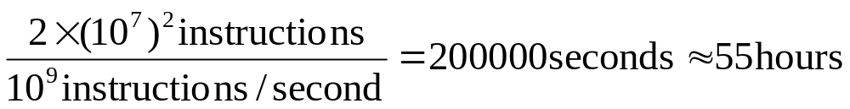
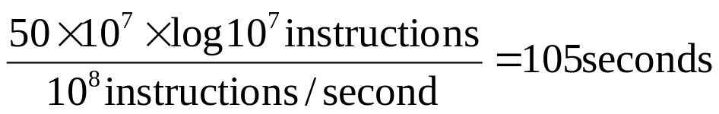
Importance of algorithm efficiency
Problem: sorting 10,000,000 integers
  Case 1: Computer A executes one billion instructions per second (1G/s), an algorithm taking time roughly equal to 2n² to sort n integers.
  Case 2: Computer B executes one hundred million instructions per second (100M/s), an algorithm taking time roughly equal to 50nlgn to sort n integers.
  Case 1:
  Case 2:

Slide 13
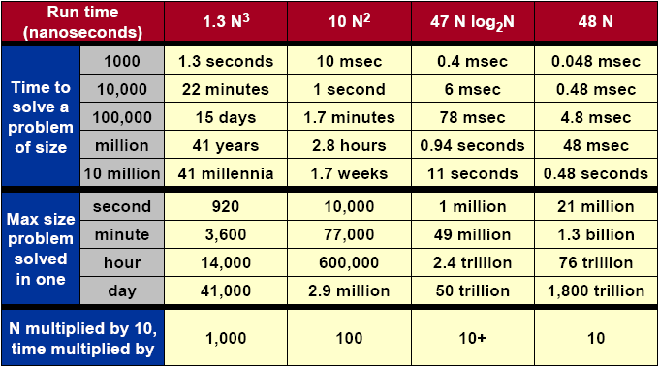
Importance of algorithms

Slide 14
Analysis of algorithms
The theoretical study of computer-program performance and resource usage.
What’s more important than performance?
--modularity --user-friendliness
--correctness --programmer time
--maintainability --simplicity
--functionality --extensibility
--robustness --reliability

Slide 15
Why study algorithm and performance?
Algorithms help us to understand scalability.
Performance often draws the line between what is feasible and what is impossible.
Algorithmic mathematics provides a language for talking about program behavior.
The lessons of program performance generalize to other computing resource.
Speed is fun.
Notes:
Scalability：可量测性

Slide 16
Analysis algorithms
We shall assume a generic one-processor, random-access machine (RAM) model of computation.
-- Instructions are executed one after another, with no concurrent operations.
-- Each time, an instruction of a program is executed as an atom operation. An instruction includes arithmetic operations, logical operations, data movement and control operations.
-- Each such instruction takes a constant amount of time.
-- RAM capacity is large enough.
-- …
Under RAM model: count fundamental operations

Slide 17
Chapter 2. Divide-and-conquer algorithms

Slide 18
The divide-and-conquer strategy solves a problem by:
Breaking it into subproblems that are themselves smaller instances of the same type of problem.
Recursively solving these subproblems.
Appropriately combining their answers.

Slide 19
Merge sort

Slide 20

The algorithm
mergesort(a[1 . . . n])
// Input: an array of numbers a[1 . . . n]
// Output: A sorted version of this array
if n > 1 then
return merge(mergesort(a[1 . . . ln/2 ]),
mergesort(a[ n/2 + 1 . . . n]),
else return a.
merge(x [1 . . . k], y [1 . . . f])
// Input: two sorted arrays x and y
// Output: A sorted version of the union of x and y
if k = 0 then return y [1 . . . f]
if f = 0 then return x [1 . . .k] 3. if x [1] ≤ y [1]
then return x [1]◦merge(x [2 . . . k], y [1 . . . f])
else return y [1]◦merge(x [1 . . . k], y [2 . . . f]).

Slide 21
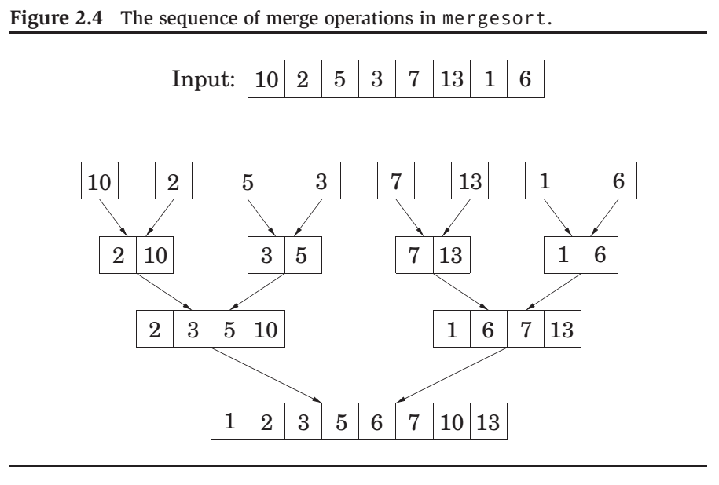

Slide 22
The time analysis
The recurrence relation:
T (n) = 2T (n/2) + O(n);
By Master Theorem
T (n) = O(n log n).

Slide 23
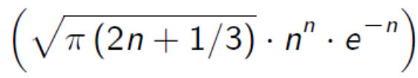
An n log n lower bound for sorting
Sorting algorithms can be depicted as trees.
The depth of the tree – the number of comparisons on the longest path from root to leaf, is exactly the worst-case time complexity of the algorithm.
Consider any such tree that sorts an array of n elements. Each of its leaves is labeled by a permutation of {1, 2, . . . , n}.
every permutation must appear as the label of a leaf.
This is a binary tree with n! leaves. So, the depth of our tree – and the complexity of our algorithm – must be at least
log(n!) ≈ log π (2n + 1/3) · n^{n} · e^{−n} = Ω(n log n),
where we use Stirling’s formula.

Slide 24
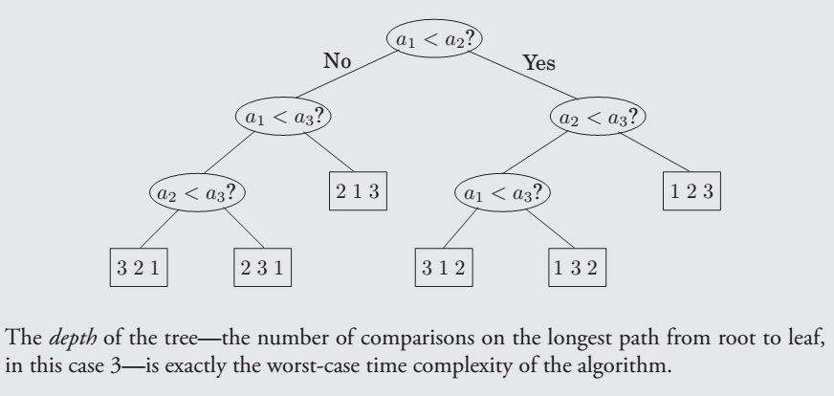
A decision Tree for sorting

Slide 25
Chapter 3. Decompositions of graphs

Slide 26
Depth-First search in undirected graphs

Slide 27
The basic question
Question:
What parts of the graph are reachable from a given vertex?

Slide 28
Exploring graphs
explore(G, v)
Input: G = (V, E) is a graph; v ∈ V
Output: visited(u) is set to true for all nodes u reachable from v
visited(v) = true
previst(v)
for each edge (v, u) ∈ E do
if not visited(u) then explore(u)
postvisit(v)
previsit and postvisit procedures are optional, meant for performing operations on a vertex when it is ﬁrst discovered and also when it is being left for the last time.

Slide 29
Depth-first search (DFS)
DFS(G)
for all v ∈ V do
visited(v) = false
for all v ∈ V do
if not visited(v) then explore(v)

Slide 30
Running time of DFS
Because of the visited array, each vertex is explore’d just once.
During the exploration of a vertex, there are the following steps:
1. Some ﬁxed amount of work – marking the spot as visited,
and the pre/postvisit.
A loop in which adjacent edges are scanned, to see if they lead
somewhere new.
This loop takes a diﬀerent amount of time for each vertex. The total work done in step 1 is then O(|V|).
In step 2, over the course of the entire DFS,
each edge {x, y} ∈ E is examined exactly twice, once during explore(x) and once during explore(y).
The overall time for step 2 is therefore O(|E|) and so the depth-ﬁrst search has a running time of O(|V| + |E|).

Slide 31
Breadth-First Search

Slide 32
The algorithm
bfs(G, s)
Input:
Output:
Graph G = (V,E), directed or undirected; vertex s ∈ V
For all vertices u reachable from s, dist(u) is set
to the distance from s to u.
1.
2.
3.
4.
5.
6.
7.
8.
9.
10.
for all u ∈ V do
dist(u) = ∞
dist(s) = 0
Q = [s] (queue containing just s)
while Q is not empty do
u = eject(Q)
for all edge (u,v) ∈ E do
if dist(v) = ∞ then
inject(Q,v)
dist(v) = dist(u) + 1

Slide 33
Dijkstra’s algorithm

Slide 34

An adaption of breadth-first search
BFS ﬁnds shortest paths in any graph whose edges have unit length.
Can we adapt it to a more general graph G = (V, E) whose
edge lengths l_{e} are positive integers?
A simple trick:
For any edge e = (u,v) of E, replace it by l_{e} edges of length 1, by adding l_{e} − 1 dummy nodes between u and v.
It might take time
which is bad in case we have edges with high length.

Slide 35
Dijkstra’s shortest-path algorithm
dijkstra(G,l,s)
Input: Graph G = (V,E), directed or undirected;
positive edge length {l_{e} | e ∈ E}; vertex s ∈ V
Output: For all vertices u reachable from s, dist(u) is set
to the distance from s to u.
1.
2.
3.
4.
5.
6.
7.
8.
9.
10.
11.
12.
for all u ∈ V do
dist(u) = ∞
prev(u) = nil
dist(s) = 0
H = makequeue(V) (using dist-values as keys)
while H is not empty do
u = deletemin(H)
for all edge (u,v) ∈ E do
if dist(v) > dist(u) + l(u,v) then
dist(v) = dist(u) + l(u,v)
prev(v) = u
decreasekey(H,v)

Slide 36
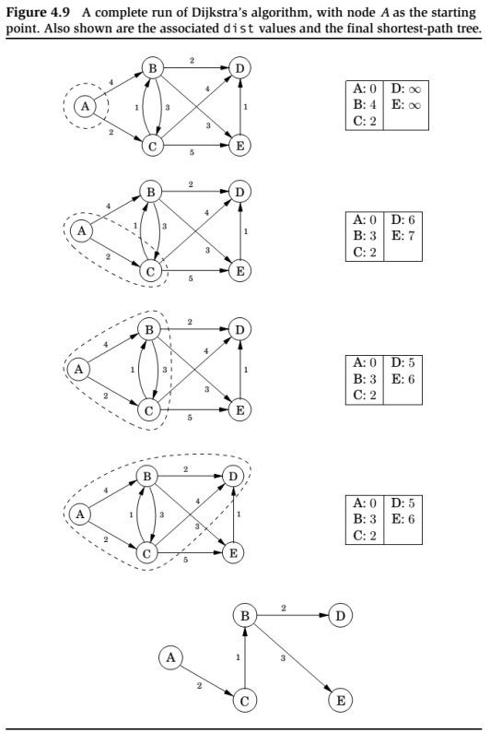

Slide 37
Running time
Since makequeue takes at most as long as |V| insert operations, we get a total of |V| deletemin and |V| + |E| insert/decreasekey operations.
The time needed for these varies by implementation; for instance, a binary heap gives an overall running time of
O((|V| + |E|)log|V|).

Slide 38
Chapter 5. Greedy algorithms

Slide 39
Examples of Greedy Algorithms
Scheduling
  Activity Selection
  Minimizing time in system
  Deadline scheduling
Graph Algorithms
  Minimum Spanning Trees
  Dijkstra’s (shortest path) Algorithm
Other Heuristics
  Huffman coding
  Traveling Salesman Problem
  Set-covering
  Subset-sum problem

Slide 40
Greedy Method
For many optimization problem, Dynamic Programming (cover later) is overkill. A greedy algorithm always makes the choice that looks best at every step. That is, it makes local optimal solution in the hope that this choice will lead to a globally optimal one.
  I make the shortest path to the target at each step. Sometime I win, sometime I lose.

Slide 41
When Greedy Algorithm Works?
How can one tell if a greedy algorithm will solve a particular optimization problem? There is no way in general. If we can demonstrate the following properties, then it is probable to use greedy algorithm:
  Greedy-choice property
  Optimal substructure (the same with that of dynamic programming)

Slide 42
Elements of Greedy Strategy
Greedy-choice property: a global optimal solution can be arrived at by making local optimal (greedy) choice.
  Greedy strategy progresses in a “top-down” (instead of bottom up in dynamic programming), iteratively reducing each given problem to a smaller one
Optimal substructure: if an optimal solution to the problem contains within it optimal solutions to subproblems.
  Be able to demonstrate that if optimal solution A with s₁, then the set A’ = A - {s₁} is an optimal solution to a smaller problem w/o s₁.

Slide 43
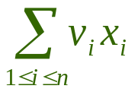
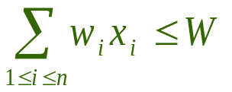
Knapsack Problem
Two variants of a classical optimization problem.
  0-1 knapsack problem
    0-1 knapsack problem: A thief robs a store and finds n items, with item i being worth $v_{i} and having weight w_{i} pounds, The thief can carry at most W ∈ N in his knapsack but he wants to take as valuable a load as possible. Which item should he take?
    i.e., is maximized and s.t.
  Fractional knapsack problem
    The setup is the same, but the thief can take fractions of items.

Slide 44
Optimal Substructure
Both knapsack problems exhibit the optimal substructure property:
  For 0-1 knapsack problem, if we remove item j from this load, the remaining load must be at most valuable items weighing at most W-w_{j} from n -1 items.
  For fractional one, if we remove a weight w of one item j from the optimal load, then the remaining load must be the most valuable load weighing at most W -w that the thief can take from the n-1 original items plus w_{j} –w pounds of item j.

Slide 45

Fractional Knapsack
There are 5 items that have a value and weight list below, the knapsack can contain at most 100 Lbs.
Method 1 choose the least weight first
  Total Weight = 10 + 20 + 30 + 40 = 100
  Total Value = 20 + 30 + 65 + 40 = 155
Method 2 choose the most expensive first
  Total Weight = 30 + 50 + 20 = 100
  Total Value = 65 + 60 + 20 = 145
Method 3 choose the most value/ weight per unit first
  Total Weight = 30 + 10 + 20 + 40 = 100
  Total Value = 65 + 20 + 30 + 48 = 163
What can you draw?

Slide 46
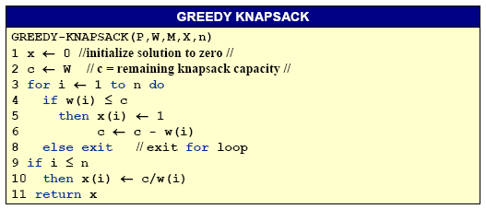
Greedy for Fractional Knapsack
p, w,W, x, n
p(1:n) and w(1:n) contain the values and weights respectively of the n items ordered so that p(i)/w(i) ≥ p(i+1)/w(i+1). W is the knapsack size and x(1:n) is the solution vector.

Slide 47

Huffman codes
Data Compression via Huffman Coding
  Motivation
    Limited network bandwidth.
    Limited disk space.
  Human codes are used for data compression.
    Reducing time to transmit large files, and
    Reducing the space required to store them on disk or tape.
  Huffman codes are a widely used and very effective technique for compressing data, savings of 20% to 90% are typical, depending on the characteristics of the data.

Slide 48
Chapter 6. Dynamic programming

Slide 49
Optimization Problems
A design technique, like divide-and-conquer.
Works bottom-up rather than top-down.
Useful for optimization problems.
Four-step method:
1. Characterize the structure of the optimal solution.
2. Recursively define the value of the optimal solution.
3. Compute the value of the solution in a bottom-up fashion.
4. Construct the optimal solution using the computed information.

Slide 50
Chain matrix multiplication

Slide 51
The problem
Suppose that we want to multiply four matrices, A, B, C , D, of dimensions 50 × 20, 20 × 1, 1 × 10, and 10 × 100, respectively.
Multiplying an m × n matrix by an n × p matrix takes m · n · p multiplications.
Parenthesization | Cost computation | Cost
A × ((B × C ) × D) | 20 · 1 · 10 + 20 · 10 · 100 + 50 · 20 · 100 | 120,200
(A × (B × C )) × D | 20 · 1 · 10 + 50 · 20 · 10 + 50 · 10 · 100 | 60,200
(A × B) × (C × D) | 50 · 20 · 1 + 1 · 10 · 100 + 50 · 1 · 100 | 7,000
How do we determine the optimal order, if we want to compute
A1 × A2 × · · · × An , where the Ai ’s are matrices with dimensions m0 × m1, m₁ × m₂, . . . , m_{n−1} × m_{n} , respectively?

Slide 52
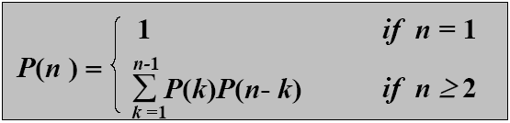

Brute force method
What if we check all possible ways of multiplying? How many ways of parenthesizing are there?
P(n): number of way of parenthesizing. Then P(1) =1 and for n≥2
Fact
These numbers are called Catalan numbers. There are about 65 combinatorial interpretations,
in Stanley, Enumerative Combinatorics, Vol. 2
Notes:
Enumerative Combinatorics ：《计数组合学》

Slide 53
Subproblems
For 1 ≤ i ≤ j ≤ n let
C (i, j) = minimum cost of multiplying
Ai × Ai +1 × · · · × Aj
C (i, j) = min ｛C (i, k) + C (k + 1, j) + mi −1 · mk · mj }
i ≤k<j

Slide 54
The program
for i = 1 to n do C (i, j) = 0
for s = 1 to n − 1 do
for i = 1 to n − s do
j = i + s
C (i, j) = mini ≤k<j ｛C (i, k)+C (k + 1, j) + mi −1 · mk · mj }
return C (1, n)
The over running time is O(n³).

Slide 55
Optimal substructure
Notation. A_{i..j} represents A_{i}…A_{j}.
Any parenthesization of A_{i..j} where i < j must split into two products of the form A_{i..k} and A_{k+1..j}.
Optimal substructure. If the optimal parenthesization splits the product as A_{i..k} and A_{k+1..j}, then parenthesizations within A_{i..k} and A_{k+1..j} must each be optimal.
--We apply cut-and-paste argument to prove the optimal substructure property.

Slide 56
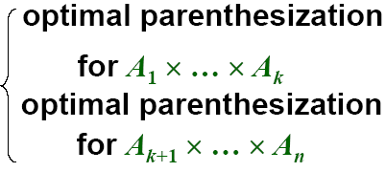
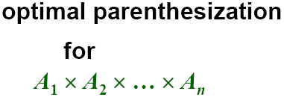
An optimal parenthesization’s structure
If the optimal parenthesization of A₁ * A₂ * … * A_{n} is split between A_{k} and A_{k+1}, then
The only uncertainty is the value of k
--Try all possible values of k. The one that returns the minimum is the right choice.

Slide 57
Edit distance

Slide 58
The problem
When a spell checker encounters a possible misspelling, it looks in its dictionary for other words that are close by. What is the appropriate notion of closeness in this case?
A natural measure of the distance between two strings is the extent to which they can be aligned, or matched up. Technically, an alignment is simply a way of writing the strings one above the other.
The cost of an alignment is the number of columns in which the letters differ. And the edit distance between two strings is the cost of their best possible alignment.
Edit distance is so named because it can also be thought of as the minimum number of edits – insertions, deletions, and substitutions of characters – needed to transform the first string into the second.

Slide 59
A dynamic programming solution
When solving a problem by dynamic programming, the most crucial question is, What are the subproblems?
Our goal is to find the edit distance between two strings
x [1, . . . , m] and y [1, . . . , n].
For every i , j with 1 ≤ i ≤ m and 1 ≤ j ≤ n let
E (i, j): the edit distance between some prefix of the first string,
x [1, . . . , i ], and some prefix of the second, y [1, . . . , j].
E (i, j) = min ｛1 + E (i − 1, j), 1 + E (i, j − 1), diff(i, j) + E (i − 1, j − 1) } where diff(i, j) is defined to be 0 if x [i ] = y [ j] and 1 otherwise.

Slide 60
The algorithm
for i = 0 to m do
E (i, 0) = i
for j = 1 to n do
E (0, j) = j
for i = 1 to m do
for j = 1 to n do
E (i, j) = min ｛1 + E (i − 1, j), 1 + E (i, j − 1),
diff(i, j) + E (i − 1, j − 1)}
return E (m, n)
The over running time is O(m · n).

Slide 61
Elements of DP Algorithms
Optimal substructure (principle of optimality)
  An optimal solution to the problem contains within its optimal solutions to subproblems.
Optimal substructure varies across problem domains in two ways:
  How many subproblems are used in an optimal solution to the original problem
  How many choices we have in determining which subproblem(s) to use in an optimal solution.

Slide 62

Optimal substructure
Optimal substructure does not apply to all optimization problems.
Example. Given a directed graph G = (V, E), and a pair of vertices u and v:
  Shortest path find a path u ~> v with the fewest edges.
  Longest path find a path u ~> v with the most edges.
Shortest path has optimal substructure.
Proof. If there’s a shorter path from u to w, call it p’₁, then p’₁p₂ contains a shorter path than p₁p₂ from u to v, which contradicts the assumption.

Slide 63
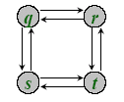
Optimal substructure
Longest path does not have optimal substructure.
Longest path from q to t: q → r → t.
Longest path from r to t: r → q → s → t, which is not contained in the longest path from q to t.
Difference between shortest and longest path:
  Shortest path has independent subproblem (solution to one problem does not depend on the other).
  If (p₁ = uw)(p₂ = wv) is a shortest path, then p₁ and p₂ cannot share any vertex other than w.

Slide 64
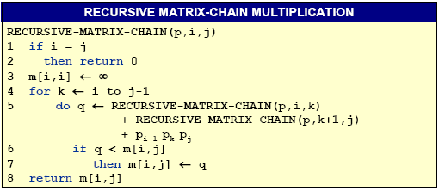
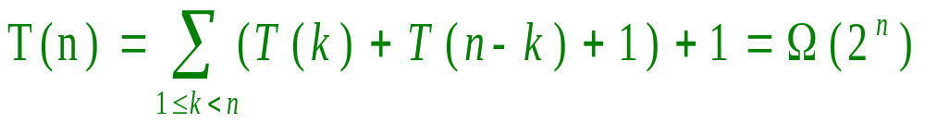
Overlapping Subproblems
To illustrate the overlapping-subproblem property, consider the MCM problem recursive algorithm.

Slide 65
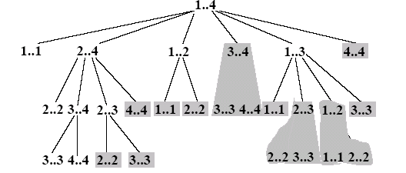
Elements of DP Algorithms
Overlapping subproblems
  The recursion tree for the computation of RECURSIVE-MATRIX-CHAIN(p, 1, 4).

Slide 66
Techniques for DP Algorithms
Reconstructing an optimal solution
  We often store which choice we made in each subproblem in a table.
    In assembly-line scheduling, we store in l_{i}[j] the station preceding S_{i,j}. Reconstructing the predecessor stations takes only O(1) time per station, even without the l_{i}[j].
    For matrix-chain multiplication, we maintain the s[i,j] table, after filling in the table m[i, j] which contains optimal subproblem costs. The table s[i, j] saves us a significant amount of work when reconstructing…. Why ?

Slide 67
Back-Tracking Algorithms

Slide 68
Back-Tracking Paradigm
A design technique, like divide-and-conquer.
Useful for optimization problems and finding feasible solutions.
  Solution to a problem is defined as an n-tuple: (x₁, x₂, …, x_{n}), where x_{i} is taken from a finite set S_{i} . Generally, we need to:
    finding a (or all) vector(s) that satisfy a specific criterion function P(x₁, x₂, …, x_{n}).
    finding a vector which maximize (or minimize) a specific objective function P(x₁, x₂, …, x_{n}).

Slide 69
Back-Tracking——General Method
Constraints
  Explicit constraints
    constrain values of each component x_{i};
    All tuples that satisfy explicit constraints make up a possible solution space.
  Implicit constraints:
    inter-components constraints;
    Implicit constraints identify those satisfying the criterion function in the solution space.

Slide 70
4-Queen problem
1
1
2
1
. | 2
1
. | . | 2
1
. | . | 2
3
1
. | . | 2
. | 3
1
. | . | 2
. | . | 3
:alive node
1
. | . | 2
. | . | . | 3
1
. | . | . | 2
1
. | . | . | 2
3 |  |  | .
: E-node
1
1
:dead node
1
x₁＝1
1
. | . | . | 2
. | 3 |  | .
1
. | . | 2
. | 3
4
1
. | . | 2
. | 3
. | 4
2
2
2
2
2
x₂＝1
x₂＝2
2
x₂＝3
x₂＝4
3
3
4
4
5
5
5
10
10
10
10
10
x₃＝1
x₃＝2
x₃＝4
x₃＝1
x₃＝2
x₃＝4
x₃＝3
x₃＝3
1
. | . | 2
. | 3
. | . | 4
1
. | . | 2
. | 3
. | . | . | 4
1
. | . | . | 2
. | . | 3
6
6
7
7
8
8
9
9
11
11
12
12
12
17
17
18
18
1
. | . | . | 2
. | . | . | 3
x₄＝1
x₄＝2
x₄＝4
x₄＝3
13
13
14
14
15
15
16
16

Slide 71
4-Queen problem
 | 1
 |  |  | 2
3
 |  | 4
:alive node
: E-node
1
1
:dead node
1
x₁＝2
x₁＝1
2
19
2
2
2
2
2
x₂＝1
x₂＝4
x₂＝1
x₂＝2
x₂＝3
x₂＝4
x₂＝3
x₂＝3
3
4
5
20
21
22
23
5
10
10
10
3
4
5
10
10
x₃＝2
x₃＝4
x₃＝2
x₃＝4
x₃＝1
x₃＝3
x₃＝4
x₃＝1
x₃＝3
x₃＝1
x₃＝3
x₃＝2
6
24
29
30
31
6
7
7
8
8
9
9
11
11
12
12
12
17
17
18
18
x₄＝1
x₄＝2
x₄＝4
x₃＝1
x₄＝3
x₃＝4
x₄＝3
x₃＝2
13
25
26
13
14
14
15
15
16
16
27
28

Slide 72
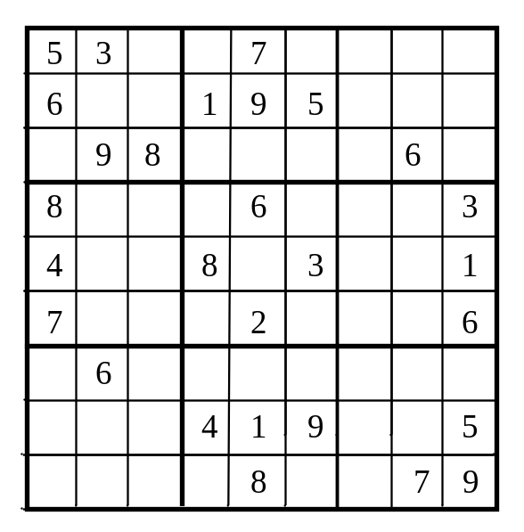
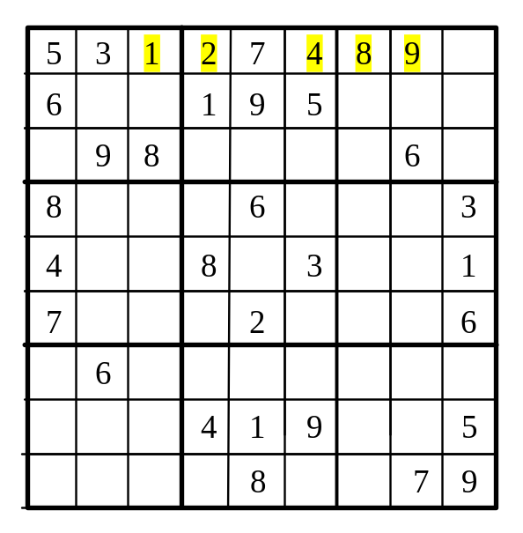
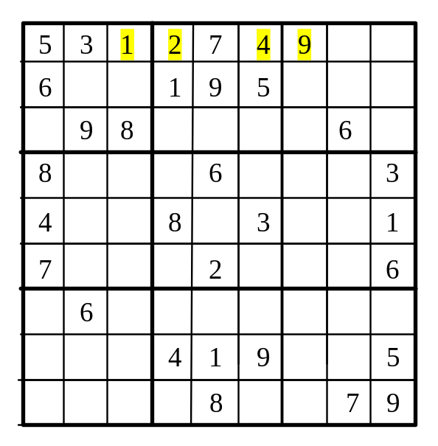
Case Study: Sudoku
Rule 1: Fill in an empty cell from the first to the last.
Rule 2: Fill in a smallest number possible.
Rule 3: If no number can fill in a cell, backtrack.

Slide 73
General Method of Back Tracking
BACKTRACKING
BACKTRACKING(n)
k←1;
while k>0 do
if there are unchecked X(k), X(k)∈T(X(1),…,X(k-1)) and B(X(1),…,X(k))=true
then if (X(1),…,X(k) is an answer）
then print (X(1),…,X(k))
if (k < n)
k←k+1
else
k←k-1
Construct solution in X(1:n), an answer is output immediately after it is determined.
T(X(1),...,X(k-1)) : returns all possible X(k), given X(1),…,X(k-1).
B(X(1),…,X(k)): returns whether X(1),…,X(k) satisfies the implicit constraints.

Slide 74
Recursive Method of Back Tracking
RECUSIVE-BACKTRACKING
RECURSIVE-BACKTRACKING( k )
for each X(k), X(k)∈T(X(1),…,X(k-1)) and B(X(1),…,X(k))=true do
if (X(1),…,X(k) is an answer）
then print (X(1),…,X(k))
if (k<n)
then call RECURSIVE-BACKTRACKING( k+1 )
Construct solution in X(1:n), an answer is output immediately after it is determined.
T(X(1),...,X(k-1)) : returns all possible X(k) ,given X(1),…,X(k-1).
B(X(1),…,X(k)): returns whether X(1),…,X(k) satisfies the implicit constraints.

Slide 75

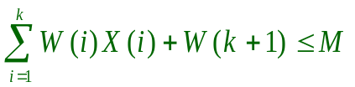
Back Tracking Algorithm for Subset-Sum
Sort W(i) in increasing order.
Bound function is: B(X(1),…, X(k))=true
iff and
SUMOFSUB
SUMOFSUB(s,k,r)
X(k)←1
if s+W(k)=M
then print(X(j),j←1 to k)
else if s+W(k)+W(k+1) ≤ M
then call SUMOFSUB(s+W(k),k+1,r-W(k))
if s+r-W(k) ≥ M and s+W(k+1) ≤ M
then X(k)←0
call SUMOFSUB(s,k+1,r-W(k))

Slide 76
Subset-sum problem
Given n+1 positive integers: w_{i} , 1≤i≤n, and M , Find all the subsets of W={w_{i}} , of which the summary equals to M.
  n＝4, (w₁，w₂，w₃，w₄)＝(11，13，24，7)，M＝31
    The expected subsets are (11，13，7) and (24，7).
The form of solution
  A solution of subset-sum problem is defined as an n-tuple (x₁，x₂，… ，x_{n}), where x_{i}∈{0，1}, 1 ≤ i ≤ n.
  If w_{i} is included in the subset, then x_{i}＝1, otherwise x_{i}＝0.
    The above answers can be defined as （1，1，0，1）and （0，0，1，1）.

Slide 77
Case study
(w₁, w₂, w₃, w₄ ) = ( 5, 10 , 15, 20 ) ; M = 25
SUMOFSUB(s,k,r)
X(k)←1
if s+W(k)=M
then print(X(j),j←1 to k)
else if s+W(k)+W(k+1) ≤ M
then call SUMOFSUB(s+W(k),k+1,r-W(k))
if s+r-W(k) ≥ M and s+W(k+1) ≤ M
then X(k)←0
call SUMOFSUB(s,k+1,r-W(k))
s,k,r
0,1,50
x₁=1
x₁=0
5,2,45
0,2,45
x₂=1
x₂=0
x₂=0
(1,0,0,1)
5,3,35
10,3,35
0,3,35
(0,1,1,0)
x₃=0
x₃=1
5,4,20
B
x₄=1
A
Notes:
r是剩余数字的和

