Slide 1
Chapter 8. NP-complete problems

Slide 2
The Reductions for NP-Complete Problems

Slide 3
Rudrata (s,t)-Path → Rudrata Cycle
Rudrata Cycle problem: given a graph, is there a
cycle that passes through each vertex exactly once?
We can also formulate the closely related Rudrata (s,t)-Path problem, in which two vertices s and t are speciﬁed, and we want a path starting at s and ending at t that goes through each vertex exactly once.
Is it possible that Rudrata Cycle is easier than Rudrata
(s,t)-Path?
We will show by a reduction that the answer is no.

Slide 4
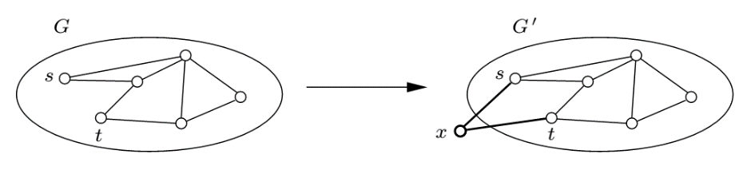
Rudrata (s,t)-Path → Rudrata Cycle, cont’d
The reduction maps an instance (G = (V,E), s, t) of
Rudrata (s,t)-Path into an instance G’ = (V’ ,E’ ) of Rudrata Cycle as follows: G’ is simply G with an additional vertex x and two new edges {s, x} and {x, t}.

Slide 5
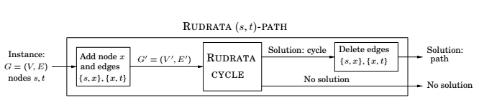

Slide 6
Sat → 3Sat
This is an interesting and common kind of reduction,
from a problem to a special case of itself.
Given an instance I of Sat, use exactly the same
instance for 3Sat, except that any clause with more than
three literals, (where the a_{i}’s are literals and k > 3),
is replaced by a set of clauses,
where the y_{i}’s are new variables.

Slide 7
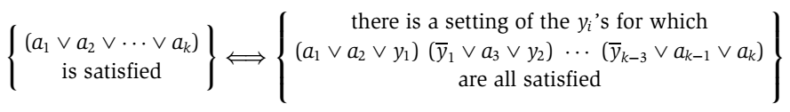
Sat → 3Sat
Call the resulting 3Sat instance I’ .
The conversion from I to I’ is clearly polynomial time.
I’ is equivalent to I in terms of satisﬁability,
because for any assignment to the a_{i}’s,

Slide 8
Sat → 3Sat (cont’d)
In fact, 3Sat remains hard even under the further restriction that no variable appears in more than three clauses.
Suppose that in the 3Sat instance, variable x appears in k > 3 clauses. Then replace its ﬁrst appearance by x1, its second appearance by x2, and so on, replacing each of its k appearances by a diﬀerent new variable. Finally, add the clauses
In the new formula no variable appears more than three times (and in fact, no literal appears more than twice).

Slide 9
3Sat → Independent Set
In 3Sat, the input is a set of clauses, each with three or fewer literals, for example
and the aim is to ﬁnd a satisfying truth assignment.
In independent set, the input is a graph and a number g, and the problem is to ﬁnd a set of g pairwise non-adjacent vertices.

Slide 10
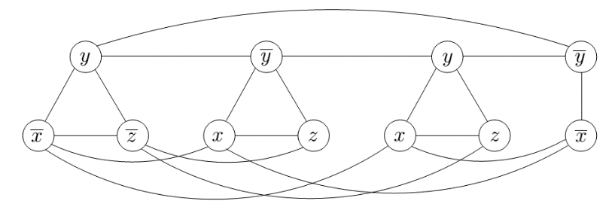
3Sat → Independent Set, cont’d
Given an instance I of 3Sat, we create an instance (G, g)
of independent set as follows.
Graph G has a triangle for each clause (or just an edge, if the clause has two literals), with vertices labeled by the clause’s literals, and has additional edges between any two vertices that represent opposite literals.
The goal g is set to the number of clauses.

Slide 11
Independent Set → Vertex Cover
To reduce Independent Set to Vertex Cover we just need to notice that a set of nodes S is a vertex cover of graph G = (V, E) (that is, S touches every edge in E) if and only if the remaining nodes, V − S, are an independent set of G.
Therefore, to solve an instance (G, g) of Independent Set, simply look for a vertex cover of G with |V| − g nodes.
If such a vertex cover exists, then take all nodes not in it.
If no such vertex cover exists, then G cannot possibly have
an independent set of size g.

Slide 12
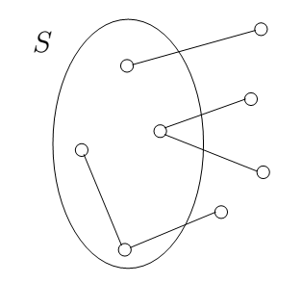

Slide 13
Special cases
3Sat is a special case of Sat, or, Sat is a generalization of 3Sat. By special case we mean that the instances of 3Sat are a subset of the instances of Sat (in particular, the ones with no long clauses), and the deﬁnition of solution is the same in both problems (an assignment satisfying all clauses).
Consequently, there is a reduction from 3Sat to Sat,
in which the input undergoes no transformation,
and the solution to the target instance is also kept
unchanged.

Slide 14
Special cases
In other words, functions f and h from the reduction diagram are both the identity.
It is a very useful and common way of establishing that a problem is NP-complete: Simply notice that it is a generalization of a known NP-complete problem.
For example, the Set Cover problem is NP-complete because it is a generalization of Vertex Cover.

Slide 15
Any problem in NP → Sat
Outline of the basic idea: First, we shall show that all problems in NP can be reduced to a generalization of Sat, i.e., Circuit Sat.
In Circuit Sat we are given a (Boolean) circuit, a dag whose vertices are gates of five different types:
1. AND gates and OR gates have indegree 2.
2. NOT gates have indegree 1.
3. Known input gates have no incoming edges and are labeled false or true.
4. Unknown input gates have no incoming edges and are labeled “?”.
One of the sinks of the dag is designated as the output gate.

Slide 16
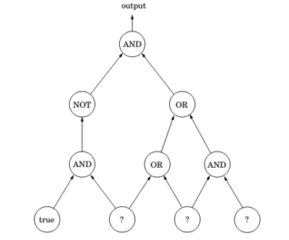
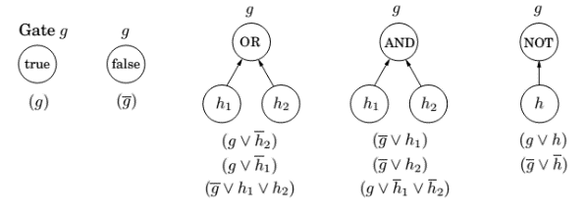
Any problem in NP → Sat (cont.)

Slide 17
Any problem in NP → Sat (cont.)
Any polynomial algorithm can be rendered as a circuit, whose input gates encode the input to the algorithm.
The satisfying truth assignments to the unknown inputs of the circuit are in one-to-one correspondence with the solutions of instance I of problem A.

Slide 18
Unsolvable Problems
At least an NP-complete problem can be solved by some algorithm—the trouble is that this algorithm will be exponential.
But it turns out there are perfectly decent computational problems for which no algorithms exist at all!
One famous problem of this sort is an arithmetical version of SAT. Given a polynomial equation in many variables, perhaps
x³yz + 2y⁴z² − 7xy⁵z = 6
are there integer values of x, y, z that satisfy it? There is no algorithm that solves this problem. Such problems are called unsolvable.

Slide 19
Chapter 9. Coping with NP-completeness

Slide 20
Intelligent exhaustive search

Slide 21
Backtracking: Abstract formulation
It is often possible to reject a solution by looking at just a small portion of it. A backtracking algorithm requires a test that looks at a subproblem and quickly declares one of three outcomes:
1. Failure: the subproblem has no solution.
2. Success: a solution to the subproblem is found.
3. Uncertainty.
For sat, this test declares failure if there is an
empty clause, success if there are no clauses,
and uncertainty otherwise.

Slide 22
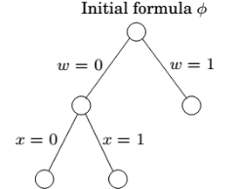
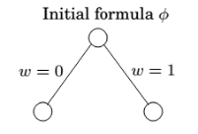
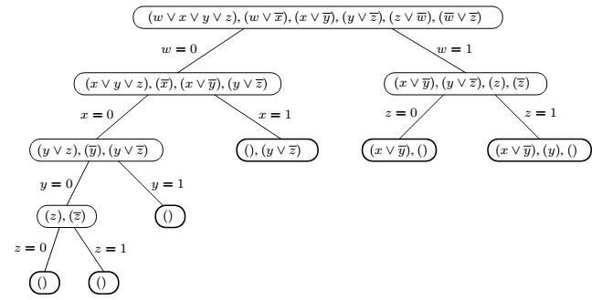
Backtracking: SAT

Slide 23
Abstract formulation (cont’d)
Start with some problem P0
Let S = {P0}, the set of active subproblems
Repeat while S is nonempty:
choose a subproblem P ∈ S and remove it from S
expand it into smaller subproblems P1,P2,...,Pk
for all Pi:
if test(Pi) succeeds then halt and announce this solution
if test(Pi) fails then discard Pi
else add Pi to S
announce that there is no solution.
For SAT, the choose procedure picks a clause, and expand picks
a variable within that clause.

Slide 24
Branch-and-bound
The same principle can be generalized from search problems such as sat to optimization problems.
For concreteness, let’s say we have a minimization problem; maximization will follow the same pattern.
We will deal with partial solutions, each represents a subproblem: what is the (cost of the) best way to complete this solution?

Slide 25
Branch-and-bound
And as before, we need a basis for eliminating partial solutions, since there is no other source of eﬃciency in our method.
To reject a subproblem, we must be certain that its cost exceeds that of some other solution we have already encountered. But its exact cost is unknown to us and is generally not eﬃciently computable.
So instead we use a quick lower bound on this cost.

Slide 26
Branch-and-bound: Abstract formulation
start with some problem P0
let S = {P0}, the set of active subproblems
bestSoFar = ∞
repeat while S is nonempty:
choose a subproblem (partial solution) P ∈ S
and remove it from S
expand it into smaller subproblems P1,P2,...,Pk
for all Pi:
if Pi is a complete solution then update best so far
else if lowerBound(Pi) < bestSoFar then add Pi to S
return bestSoFar.

Slide 27
Approximation algorithms

Slide 28
Optimization problems
In an optimization problem we are given an instance I and are asked to find the optimum solution, the one with the maximum gain if we have a maximization problem like independent set, or the minimum cost if we are dealing with a minimization problem such as the TSP.
For every instance I, OPT(I) denotes the value (beneﬁt or cost) of the optimum solution.
We always assume OPT(I) is a positive integer.

Slide 29
Approximation ratio
We have seen the greedy algorithm for set cover:
For any instance I of size n, this greedy algorithm
quickly ﬁnds a set cover of cardinality at most
OPT(I) · logn.
This logn factor is known as the approximation
guarantee of the algorithm. Suppose now that
we have an algorithm A for a minimization problem
which, given an instance I, returns a solution with
value A(I). The approximation ratio of A is deﬁned
to be
α_{A} = max A(I) / OPT(I)
I

Slide 30
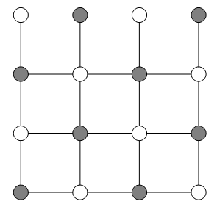
Vertex cover
We already know the vertex cover problem is NP-hard.
Input:
Output:
Goal:
An undirected graph G = (V, E).
A subset of the vertices S ⊆ V that touches
every edge.
Minimize |S|.

Slide 31
Matching vs. Vertex Cover
Deﬁnition
A matching is a subset of edges that have no vertices in common.
Deﬁnition
A matching is maximal if no more edges can be added to it.
Theorem
Any vertex cover of a graph G must be at least as large
as the number of edges in any matching in G.
Theorem
Let S be a set that contains both endpoints of each edge
in a maximal matching M. Then S must be a vertex cover.

Slide 32
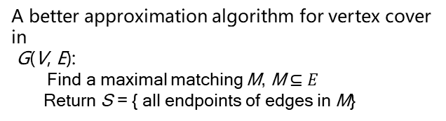
Matching vs. Vertex Cover
A better approximation algorithm for vertex cover in
G(V, E):
Find a maximal matching M, M$⊆E$
Return S = { all endpoints of edges in M}
Even through we have no way of finding the best
vertex cover, we can find another structure, a maximal
matching, with two key properties:
1. Its size gives us a low bound on the optimal
vertex cover.
2. It can be used to build a vertex cover, whose size
can be related to that of the optimal cover using
the above Property 1.
We have an approximation ratio α_{A} = max A(I) / OPT(I) ≤ 2

Slide 33
Local search heuristic

Slide 34
Evolution
By the incremental process of introducing small mutation, try them out, and keeping them if they work well. It is called local search and can be applied to any optimization tasks.
let s be any initial solution
while there is some solution s’ in the neighborhood of s
for which cost(s’) < cost(s): replace s by s’
return s
On each iteration, the current solution is replaced by a better one close to it, in its neighborhood. This neighborhood structure is imposed upon the problem, and is the central design decision in local search.

