Slide 1
Give the output to each stage of the compiler according to the input:
BMI float
II
BMI = Weight / (Height^2)
Weight float
Height float
Lexical Analyzer
Symbol table
A: (id, BMI), (=), (id, Weight), (/), ((), (id, Height), (^), (val, 2), ())
C: t1 = height * height
BMI = weight / t1
Syntax Analyzer
=
Intermedia Code
B:
(id, BMI)
/
(id, Weight)
^
(id, Height)
(val, 2)
Annotated Syntax Tree
Semantic Analyzer

Slide 2
A lexical analyzer implemented based on the lexical specification as below:
Let ∑ = { a, b, c },
L1 = ( a | b )* c ,
L2 = ab*a ,
L3 = ab(ab)* | ab(ab)*c ,
Please give the output of the lexical analyzer while the input of ‘ababcbacaabc’.
Let {a^{3n+1}b^{2m}|n>=0,m>=1} denote the set of all strings of a’s and b’s which start with 3n+1 a’s, followed by 2m b’s：
1)Please write the regular expression for these strings.
2)Convert this regular express into NFA.
3)Convert the NFA to DFA.

Slide 3
Use Regular Expression to describe additive expression of two integers, such as: 123 + 40, 7 + 5508 …. Draw the NFAs of these regular expressions.
digit = [0-9]
digit_No_Zero = [1-9]
add_expression = digit_No_Zero digit* + digit_No_Zero digit*
Draw NFA bases on the third regular expression above.
Consider the following grammar G[S]:
S Ac | aB
A ab
B bc
Is this grammar ambiguous ? if so, please give your reason.

Slide 4
Given a context free grammar G[S], construct the parsing table for LL(1) parsing.
G[S]:
S AB
B S |ε
A aC
C aC |ε
Please minizing the DFA shown in the following figure.

Slide 5
Given a context free grammar G[S]:
S S + S
S S * S
S (S)
S i
Is the G[S] an ambiguous grammar? Give your reason or proof.
Consider the following grammar :
G:
S S∨T | T
T T∧F | F
F ﹁F | p | q
Please write the rightmost derivation for the sentence form ‘﹁F∨﹁q∧p’ . And give the handle of this sentence form.

Slide 6
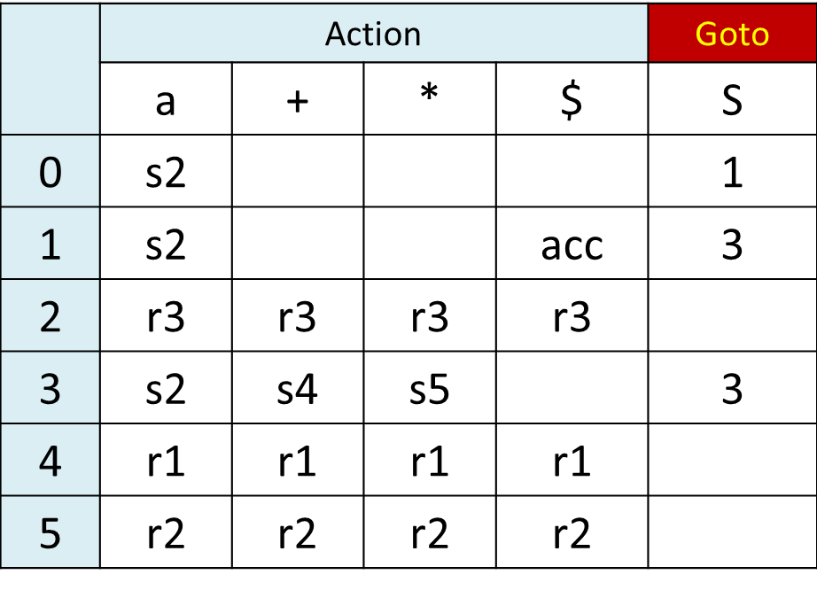
Consider the following grammar G[S]:
S (L)|aS|a
L L,S|S
Please rewrite this grammar to left factor and eliminate left recursion.
6.Consider the following augmented SLR(1) grammar G’[S’]:
(0) S’S (1) S SS+ (2) S SS* (3) S a
and its SLR(1) parsing table:
Show the parsing stack and the action of SLR(1) parser for the input string “aaa+*” .

Slide 7
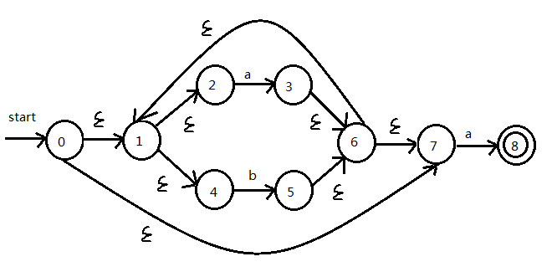
Given a context free grammar G[S], please write a rightmost derivation for string ‘abbcde’, and give the viable prefixes for the string.
G[S]:
S aAcBe
A b | Ab
B d
Construct the minimum-state DFA for the following NFA:
1)Convert this NFA into DFA by subset construction. Both the Transition table and the Transition graph of DFA are required.
2)Minimize the states of this DFA.

Slide 8
Is a context free grammar LL(1) grammar if the left recursion and left factor in the grammar are eliminated? Try to rewrite the grammar shown below. Judge the rewritten grammar is LL(1) or not, and give your reason.
G[A]:
A aABe | a
B Bb | d
Consider the following augmented grammar G’[E’]:
(1) E’E (2) E aTd (3) E ε
(4) T Eb (5) T ac (6) T ε
1Construct the DFA of LR(0) items for this augmented grammar.
2Is this grammar SLR(1) grammar ? Give your reason.
3Construct the SLR(1) parsing table.

Slide 9
Consider the grammar G[S] (“i”, “(”, “)”, “-” and “*” are terminals, the non-terminal “S” is the start symbol):
S i | ( E )
E SE’
E’ +SE’ | -SE’ | ε
1)Compute the First Set and Follow Set for the non-terminals.
2)Is the grammar is LL(1) grammar? Give your reason.
3)Construct the LL(1) parsing table.

Slide 10
Given a context free grammar G[A]:
A Ab | bBa
B aAc | a | aAb
1)Construct the LR(0) DFA for this grammar.
2)Judge whether the grammar is SLR(1)? Given you reason.
3)If the grammar is SLR(1) , construct its parsing table.
4)Give the analysis process for string ‘baabb’.

