Slide 1


Improving a Sentinel Benchmark
Smart home benchmark application
Hanyang University
Hanyang University
Janghoi (Simon) Koo
Dohyun (Alicia) Kim
Professor
Ph.D student
Master student
Brian Demsky
Rahmadi Trimananda
Ali
Notes:
Good morning every one.
I’m glad to be /here with you today.
I am Alicia Kim, and my partner Simon Koo.
We are working with professor Brian Demsky, and Ph.D student Rahmadi and Master student Ali.
Today I’m going to talk about our research, “how to make Smart home benchmark application”

Slide 2
Contents
1st challenge
2st challenge
Conclusion
and
future Research
purpose
how to safety use
the cloud server
how to show
the status of smart home
1
2
3
4
Notes:
We are going to talk in this order, purpose ___________ ___________ ____________

Slide 3
1
Purpose of our reasearch
Notes:
First, I will talk about the purpose.

Slide 4
Purpose
IoT
Notes:
Have you ever heard about IoT?

Slide 5

Purpose
Notes:
As you all know, The(디) IoT is an interconnection of devices with the Internet.and it makes our lives easier.

Slide 6

Purpose
Notes:
But these devices contain numerous vulnerabilities(보널어빌리티) and seriously impact home security and privacy(프라이브시).

Slide 7

Purpose
Notes:
Until now, smart home using IoT has not been universalized,

Slide 8

Purpose
Notes:
but in the near future, everyone will live in a smart home.

Slide 9

Purpose
Notes:
Thus, if we do not improve IoT's problem, smart home may threaten us (투렛디너스)/rather than make our lives more convenient.

Slide 10




Purpose
Notes:
Let’s imagine a situation. Suppose we leave / money in the house / and go to work.

Slide 11



Purpose
Notes:
What if somebody hack the computer and utilize the camera so they know you are not home and then steal your money.

Slide 12

Purpose
Sentinel
Notes:
Previously, professor Demski created the Sentinal system to reduce this type of problem. The Sentinal system is designed to protect an IoT system from security issues resulting from overprivileged(오붤프리블레지) network access.

Slide 13

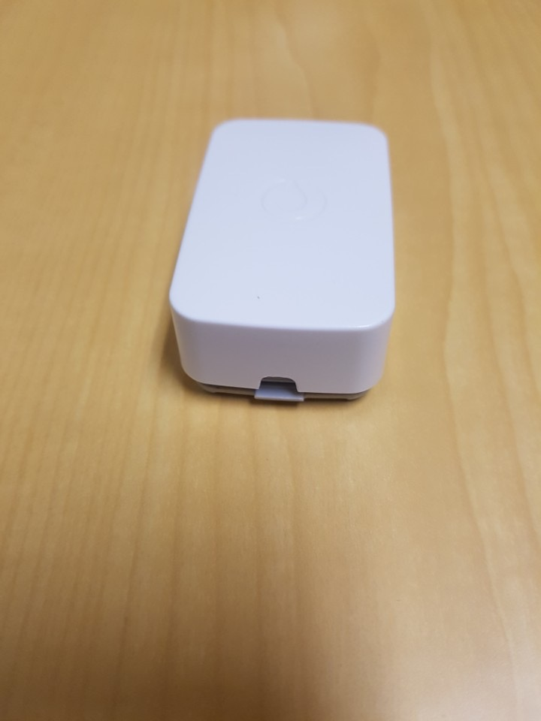
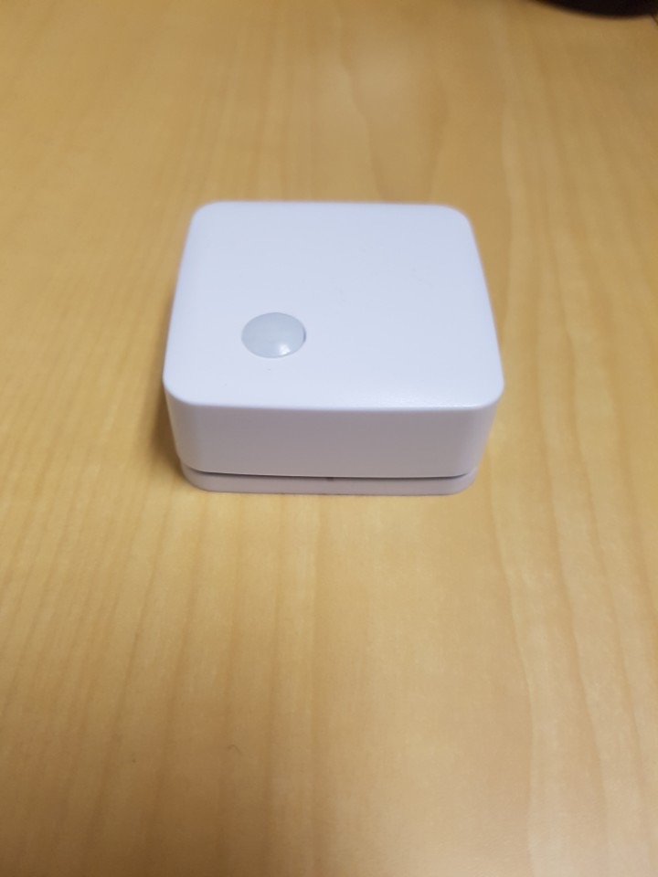
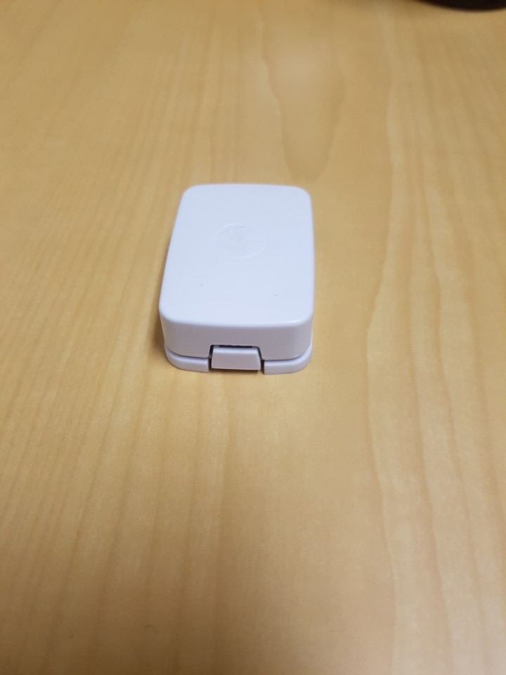
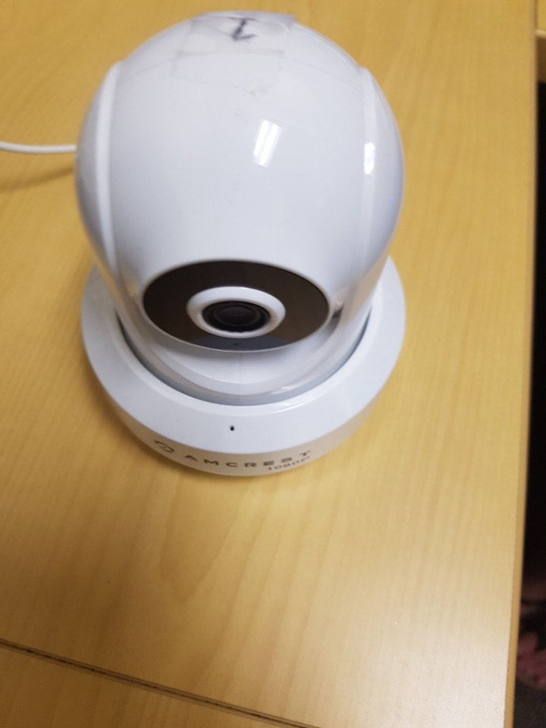
Purpose
alarm
alarm
Sensor #1
Camera#1
Room #1
Room #2
Sensor #3
Sensor #2
Notes:
Currently, the virtual house using the sentinel has sensors and a camera, and each room has an alarm. An alarm will ring when each sensor detects something.

Slide 14
Purpose
[ shortcomings ]
no way
to notify the
owner who is
outside the house
no way
to know
which alarm is ringing
or
which sensor is detected
no way
to disable
the sensor and alarm
Notes:
Although, it is a step in the right direction, there are a few shortcomings to the Sentinal system.
First, there was no way to notify the owner/ who is outside the house/ if the house is in danger.
Second, there wasn’t an option to disable the sensor when people are in the home.
Lastly,it was hard to know which alarm is ringing or which sensor is detected. This makes it hard to locate the problem.
So using with the cloud server, our team created an Android application to address these problems.

Slide 15
2
Our Fisrt Challange
How to saftly use the cloud server
Notes:
We had two things to consider when creating this app.
First thing is how to safely use the cloud server and Second is how to show and control the smart home. I am going to start with the first challenge.

Slide 16


The First Challange
How to saftly use the cloud server
Notes:
We have to use a cloud server because we need to make user available for controlling the state of the alarm from outside the home.

Slide 17
The First Challange
How to saftly use the cloud server
Notes:
At that point, we have a problem. The challenge is when someone sends command or receive control information, hackers can steal or tamper with it.

Slide 18
The First Challange
How to saftly use the cloud server
Fidelius
secured key - value system using block-chain algorithm

Slide 19
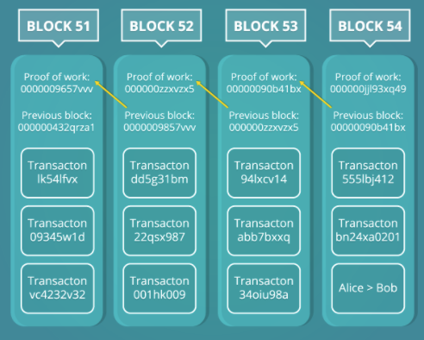
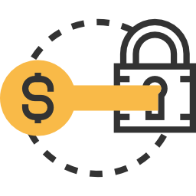
The First Challange
How to saftly use the cloud server
block- chain Algorithm
secret shared keys
Notes:
When we stores and delivers keys and values, we use a block-chained algorithm and uses validating system using secret shared keys to ensure valid sharing of information from cloud server.

Slide 20
The First Challange
How to saftly use the cloud server
Initializing entries in the cloud server
Notes:
We need the(디) initial settings to use this Fidelius method.
first we should clear the content of the cloud server/ to keep the initial status.

Slide 21
The First Challange
How to saftly use the cloud server
240
135
56
83
47
23
initializing the table and initializing the crypto stuff.
Notes:
Second the user have to run Setup file.
we should initialize the table by inserting a table status as the first entry and also initializes the crypto(크립토) key. setup file will help with this process.

Slide 22
The First Challange
How to saftly use the cloud server
new key
current key
240
135
56
83
47
23
124
31
48
5
30
27
getting the latest secret shared key from the server, and store
Notes:
third, user should launch the application to get secret shared key from the server, and store the secret shared key in the app.

Slide 23
The First Challange
How to saftly use the cloud server
new key
current key
240
135
56
83
47
23
240
135
56
83
47
23
If the stored key and the validation key match,
user can use the app.
Notes:
fourth, After relaunching application,
If the stored key and the validation key match, user can use the app.

Slide 24
The First Challange
How to saftly use the cloud server
vaildation
vaildation
key : value
Notes:
When we use the Android app can control the smart home by exchange key-value pairs. Each of these key value pairs must be validated.
At this point, They use Fidelius's block-chain algorithm to validate information.
through this process, the information can be guaranteed to be undamaged.

Slide 25

The First Challange
How to saftly use the cloud server
Safe
Notes:
Eventually, user can safely control smart home.
From now on, Simon will talk about the next challenge.

Slide 26
3
Our Second Challange
How to show and control the status of smart home

Slide 27
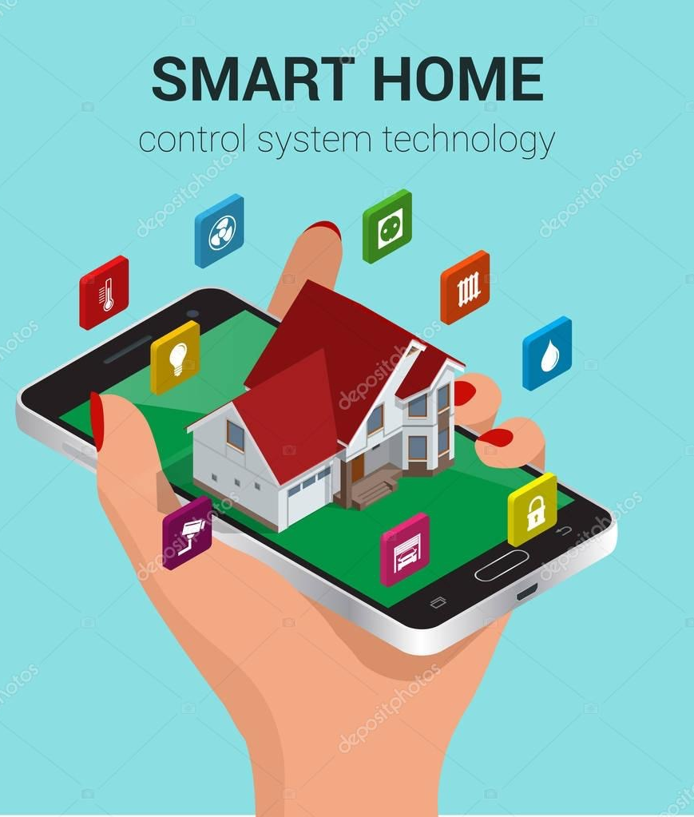
The Second Challange
How to show and control the status of smart home
How can the user understand
the condition of the house easily?
Notes:
Our second challenge is how to allow users to monitor and control the smart home.
We created an smartphone application that allows the user to easily grasp the overall status of smart home.

Slide 28
Simple design of Smart Home
The Second Challange
How to show and control the status of smart home
alarm
alarm
Sensor #1
Camera#1
Room #1
Room #2
Sensor #3
Sensor #2
Notes:
We assume a simple smart home like the slide.
There are three sensors and one camera in two rooms, and each room has an alarm.
If any device detects an abnormal situation, the alarm is triggered.
Now, I will explain more detail about smartphone application.
Please look at the slide.

Slide 29
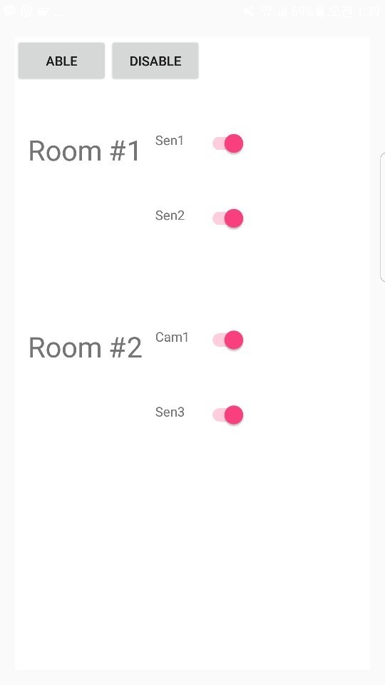
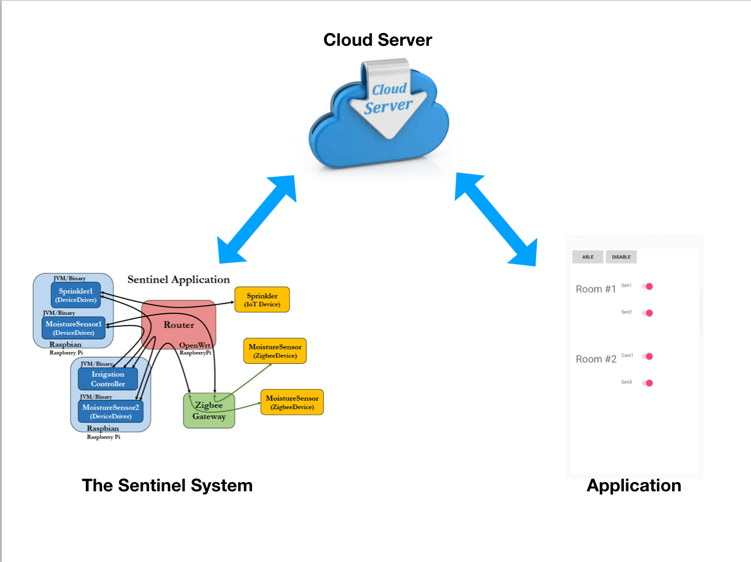
function #1
enable/disable entire alarm system
Application
Notes:
Left side is application screen and right side is overall structure.
As mentioned earlier, there are three components that communicate with each other.
The application has three main functions.
The first function is to enable or disable the entire alarm system via the button.
The user can disable the alarm system when the alarm is not needed.

Slide 30
function #1
enable/disable entire alarm system
Clicked!!
Change value of alarm system
enable -> disable
Application
Notes:
For example, if a party is held at home, user can deactivate whole alarm system.
If user click the disable button, application change the value of entire alarm system to disable and send it to cloud server.

Slide 31
function #1
enable/disable entire alarm system
validating changed value
and update key-value pairs
Application
Notes:
then in cloud server, After validating the changed values using Fidelius protocol, update the key-value table if there are no problems.

Slide 32
function #1
enable/disable entire alarm system
disable alarm system!
Application
Notes:
finally in sentinel system , the benchmark program continually checks the table and disable entire alarm system.
Conversely, user can activate the alarm system in same way

Slide 33

function #2
ignore specific IoT device
Change key-value pairs
enable -> disable
specific device
enable -> disable
Application
Notes:
And the second function is to ignore specific device through the switch.
There are some situation that user should ignore specific IoT device.
For example, If user cook at night, user need to disable certain sensors in the kitchen.
by simply checking switch, the certain sensor can be ignored.
Implementation detail is same as first function.

Slide 34
function #3
notification for alarm
Change key-value pairs
alarm off -> alarm on
Nofification
Application
Notes:
The third function is the notification for alarm
If an alarm is triggered, the user can see which sensor triggered alarm and where it was.
then, the application displays a red color in specific location.

Slide 35
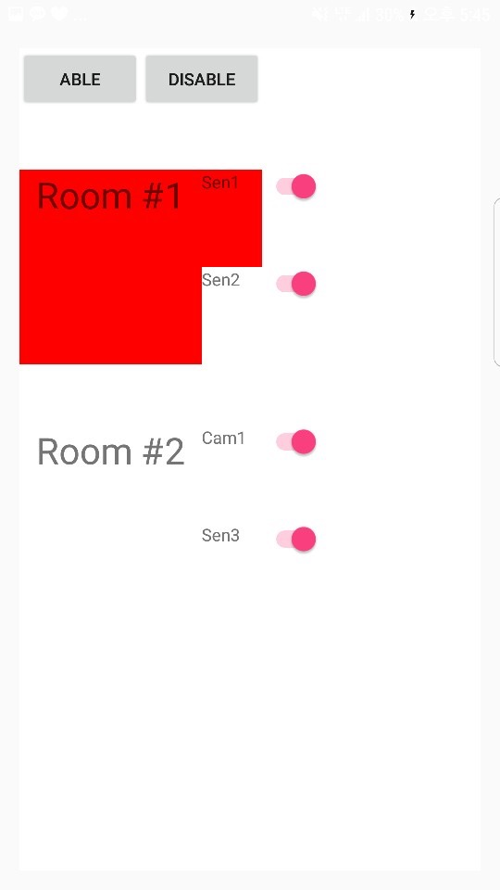
function #3
notification for alarm
Alarm is triggered
in Room #2
Nofification!!
Application
Notes:
For example, If sensor 2 in the first room detects a problem, the screen changes as this slide.
In other words, if the alarm is triggered, the Sentinel changes the value of the alarm in room #2 and sends it to the server.
And multiple thread in application check the table and send alert to users by displaying red color.

Slide 36
4
Conclusion and future Research

Slide 37
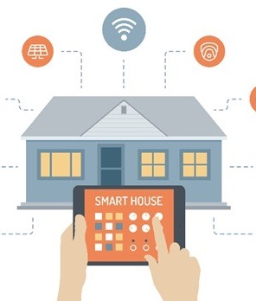
Conclusion
Smart Home is protected from network attack
User can remotely control the Smart Home.
Notes:
So far, we've explained what we've done.
We have created a remote control app
Specifically, we used Sentinel System and Fidelius protocol to protect smart home from network attacks.
and the Cloud server to remote control.
with our application, the user can remotely and safely monitor and control the smart home

Slide 38
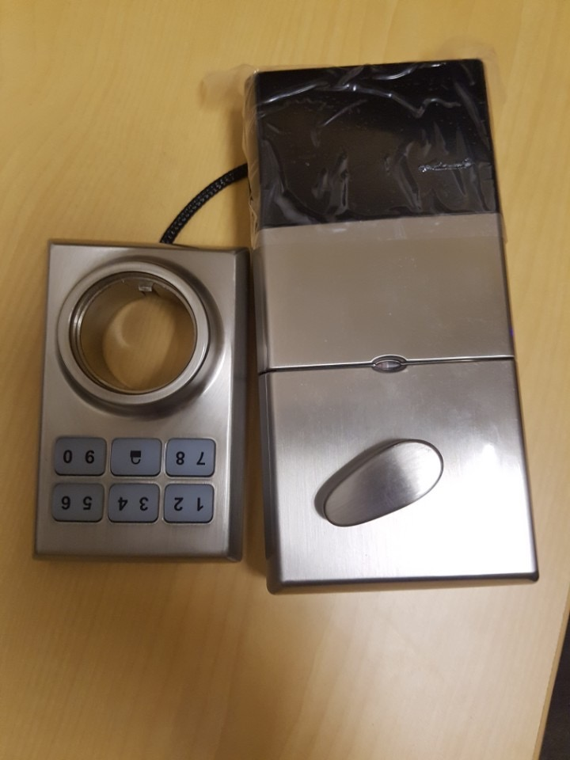
Future research
Improve The Sentinel System by adding other IoT devices
Notes:
And I’d like to finish presentation by telling future research
We used a few devices, but as you know, smart homes are consisted of lots of IoT devices in real life.
So, future research is about enhance security of smart home by adding another devices to Sentinel system.
In fact, We tried to increase the security of the sentinel by adding door locks, but we have not succeeded yet.

Slide 39
Q & A
Notes:
Thank you very much for your attention.
If you have any questions, I’d be pleased to answer them.

Slide 40
Thank you

