Slide 1
信用卡違約分析
統計碩一 107354020 柯百翼

Slide 2
01.變數介紹
目 录
02.程式分析
CONTENTS
03.資料來源

Slide 3
01.變數介紹

Slide 4





1.2 解釋變數介紹
教育程度
EDUCATION
信用額度 LIMIT
性別
SEX
年齡 AGE
.
婚姻狀況
MARRIAGE

Slide 5
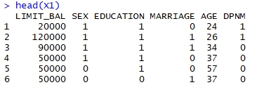
資料範例
SEX ( 0﹕male, 1﹕female )
EDUCATION( 0﹕graduate school, 1﹕university, 2﹕high school… )
MARRIAGE( 0﹕married, 1﹕single, 2﹕others )

Slide 6
02.程式分析

Slide 7
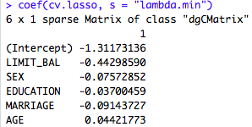
程式內容(R Lasso)
install.packages("readr")
library(readr)
install.packages("glmnet")
library(glmnet)
install.packages("aod")
library(aod)
X1<-read.csv("C:\\Users\\User\\Downloads\\default of credit card clients.csv", header=TRUE)
X1$LIMIT_BAL<-scale(X1$LIMIT_BAL,center=TRUE,scale=TRUE)
X1$SEX<-scale(X1$SEX,center=TRUE,scale=TRUE)
X1$EDUCATION<-scale(X1$EDUCATION,center=TRUE,scale=TRUE)
X1$MARRIAGE<-scale(X1$MARRIAGE,center=TRUE,scale=TRUE)
X1$AGE<-scale(X1$AGE,center=TRUE,scale=TRUE)
cv.lasso = cv.glmnet(x = as.matrix(X1[, -6]),
y = X1[, 6],
alpha = 1,
family = "binomial")
par(mfcol = c(1, 2))
plot(cv.lasso, xvar='lambda', main="Lasso")
best.lambda = cv.lasso$lambda.min
best.lambda
abline(v=log(best.lambda), col="blue", lty=5.5 )
coef(cv.lasso, s = "lambda.min")

Slide 8
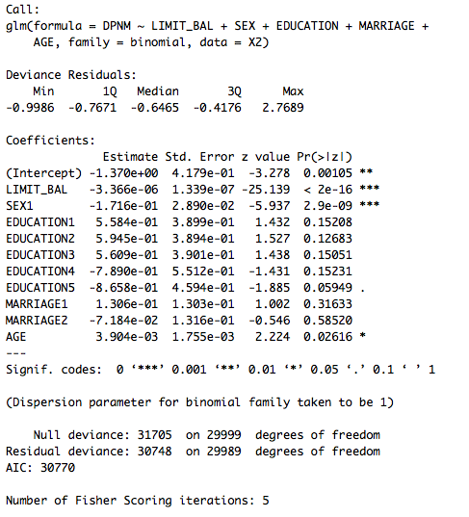
程式內容(R Logistic Regression)
X2<-read.csv("C:\\Users\\User\\Downloads\\default of credit card clients.csv", header=TRUE)
X2$SEX<-as.factor(X2$SEX)
X2$EDUCATION<-as.factor(X2$EDUCATION)
X2$MARRIAGE<-as.factor(X2$MARRIAGE)
contrasts(X2$EDUCATION)<-contr.treatment(6,base = 6)
contrasts(X2$MARRIAGE)<-contr.treatment(3,base=3)
mylogit<-glm(DPNM ~ LIMIT_BAL+SEX+EDUCATION+MARRIAGE+AGE , data = X2 ,family = binomial)
summary(mylogit)

Slide 9
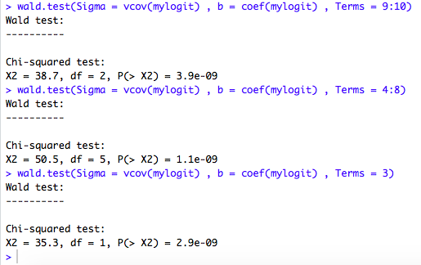
程式內容(R Wald Test)
wald.test(Sigma = vcov(mylogit) , b = coef(mylogit) , Terms = 9:10)
wald.test(Sigma = vcov(mylogit) , b = coef(mylogit) , Terms = 4:8)
wald.test(Sigma = vcov(mylogit) , b = coef(mylogit) , Terms = 3)

Slide 10
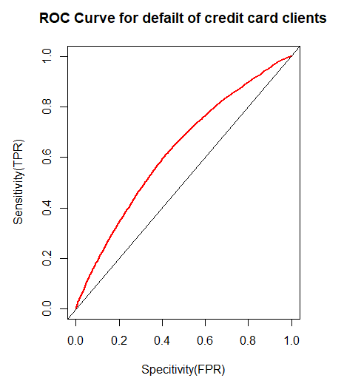
程式內容(R ROC curve)
X2$DPNM <- factor(X2$DPNM,
levels = c(0,1),
labels = c("NO","YES"))
result <- predict(mylogit , newdata = X2 , type = "response")
pred <- prediction(result ,X2$DPNM)
perf <- performance(pred , measure = "tpr" , x.measure = "fpr")
auc <- performance(pred , "auc")
plot(perf,col=2,lwd=2,main="ROC Curve for defailt of credit card clients" , xlab = "Specitivity(FPR)"
, ylab = "Sensitivity(TPR)")
abline(0,1)

Slide 11
04.資料來源

Slide 12
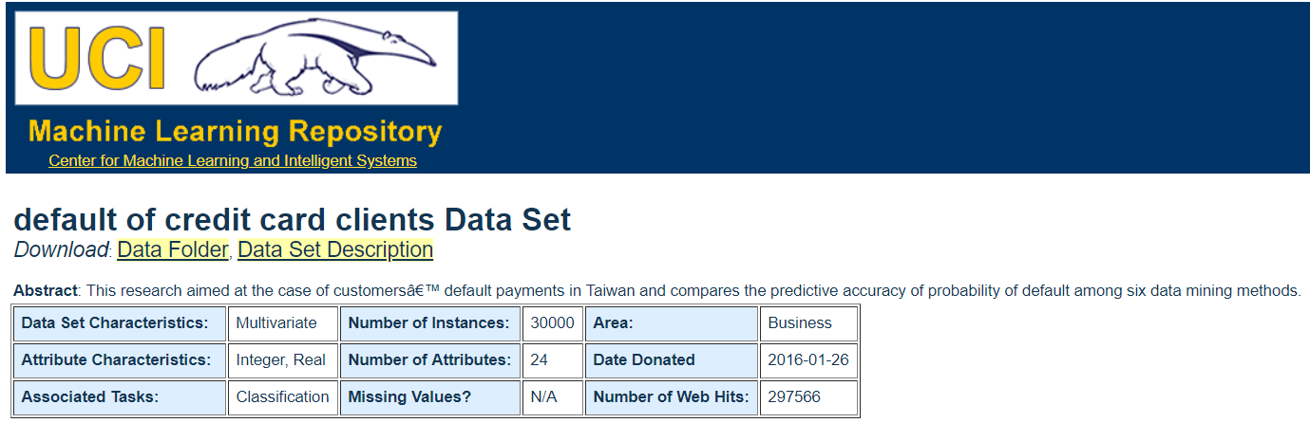
0.4資料來源 - UCI

Slide 13
Thank You For Watching

