Slide 1

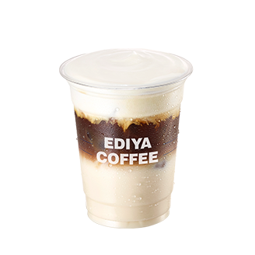
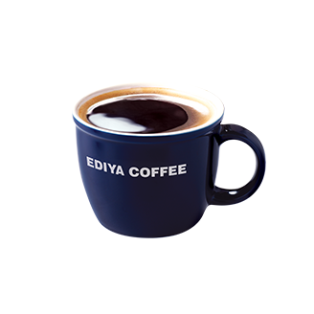
Developer
류동우,윤유비,강주현
EDIYA COFFEE CLONE
WEB DESIGN

Slide 2
HTML+CSS+JS
강주현

Slide 3
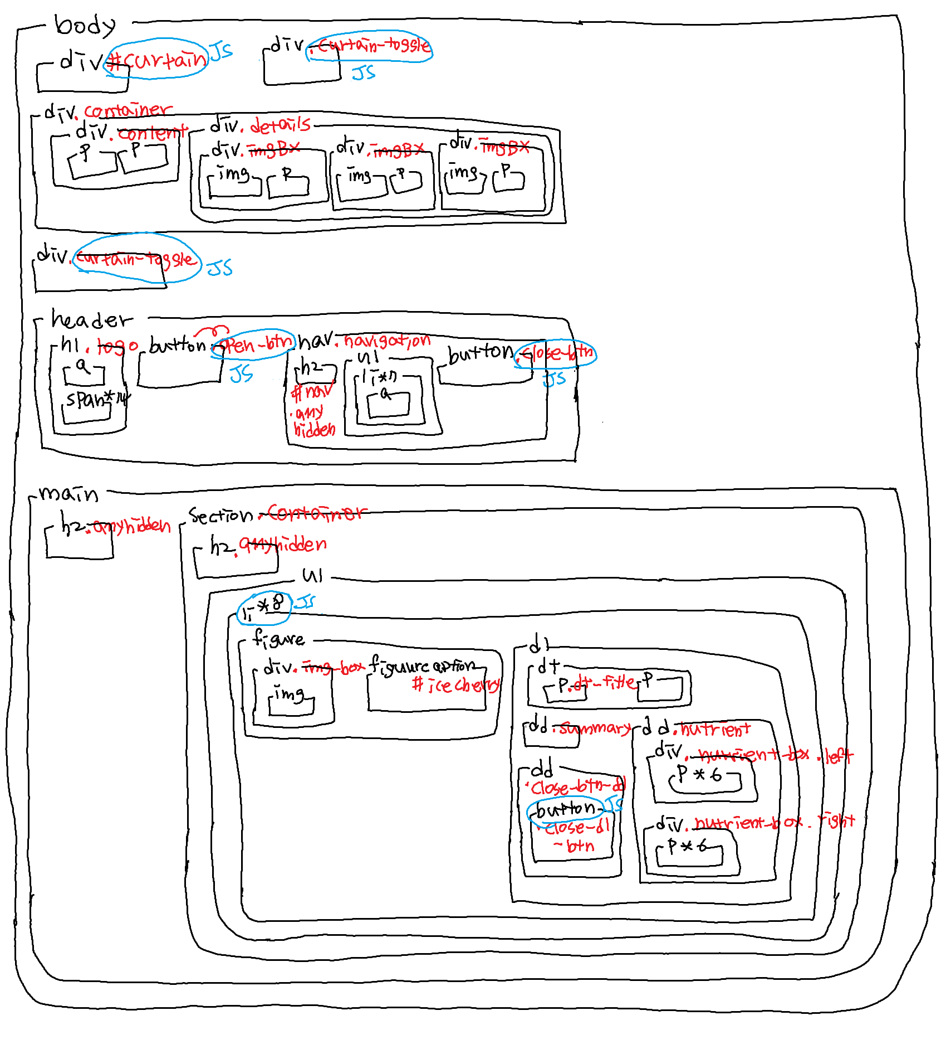

Slide 4
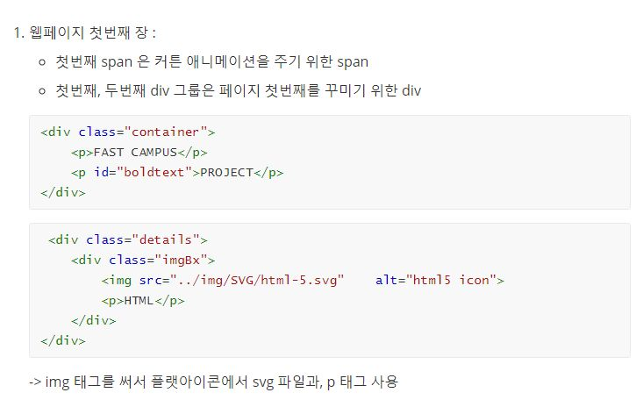
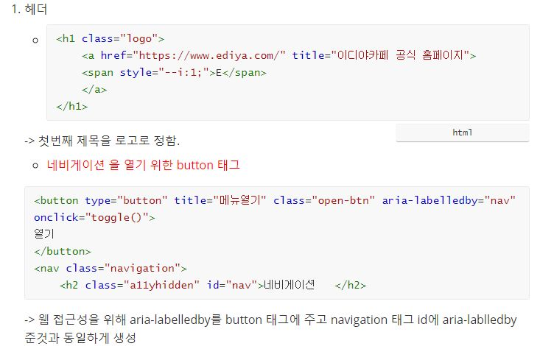

Slide 5
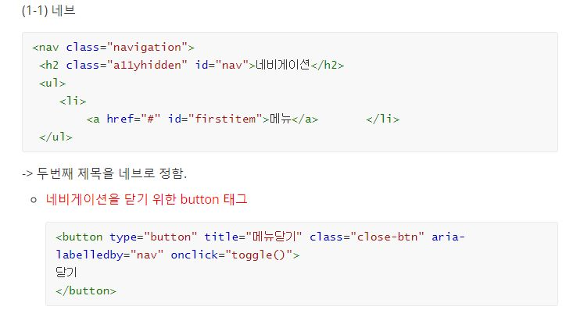
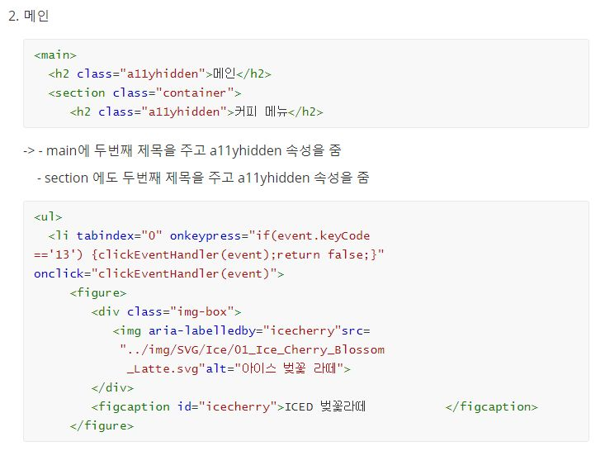

Slide 6
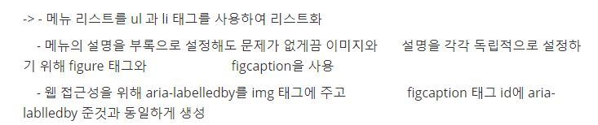
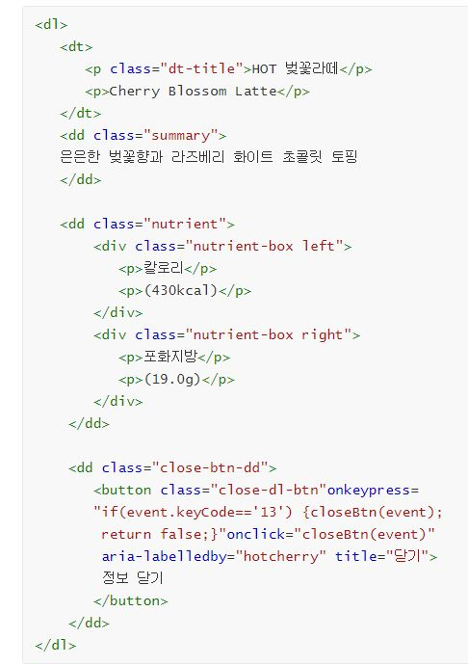
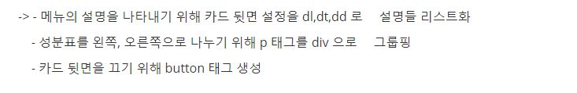

Slide 7
HTML+CSS+JS
류동우

Slide 9
HTML+CSS+JS
윤유비

Slide 10
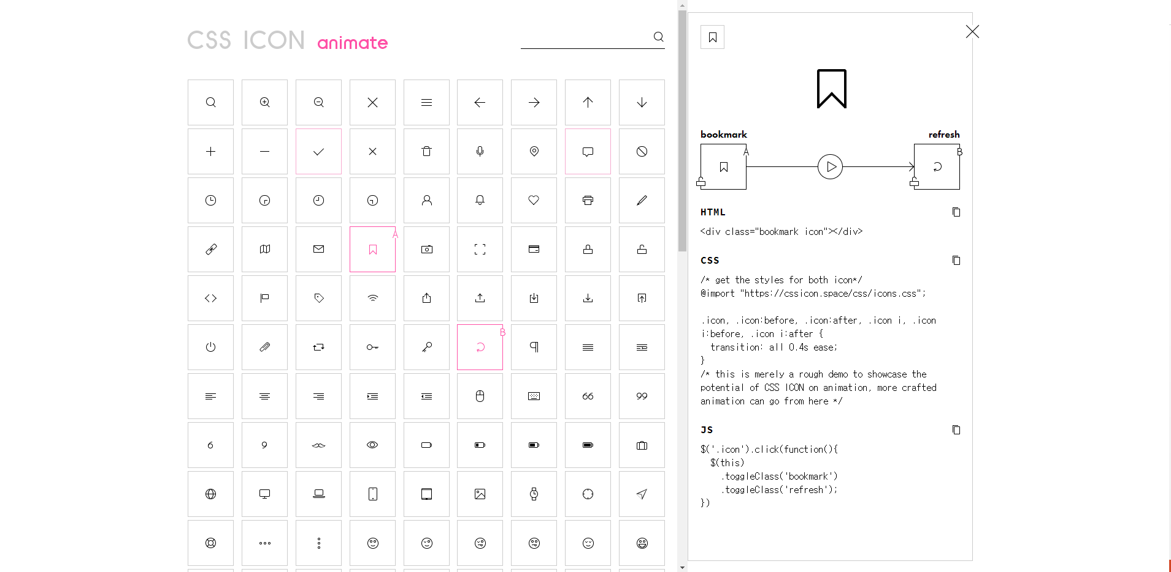
https://cssicon.space/#/animate/bookmark/to/refresh

Slide 11
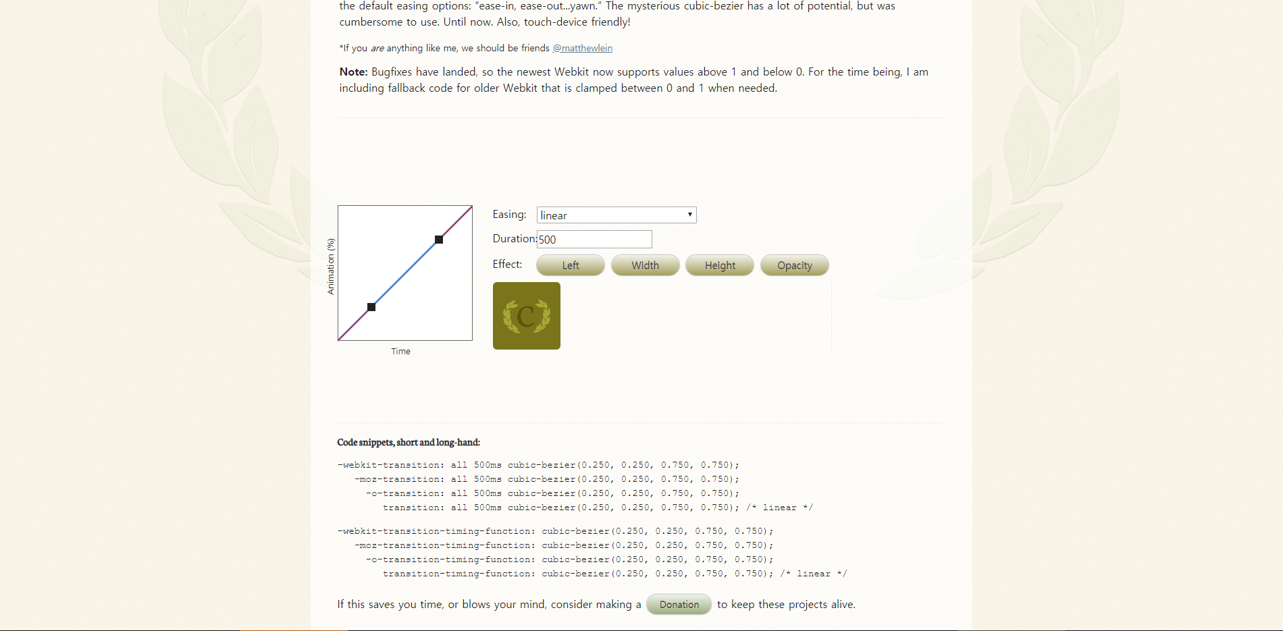
https://matthewlein.com/tools/ceaser

Slide 12
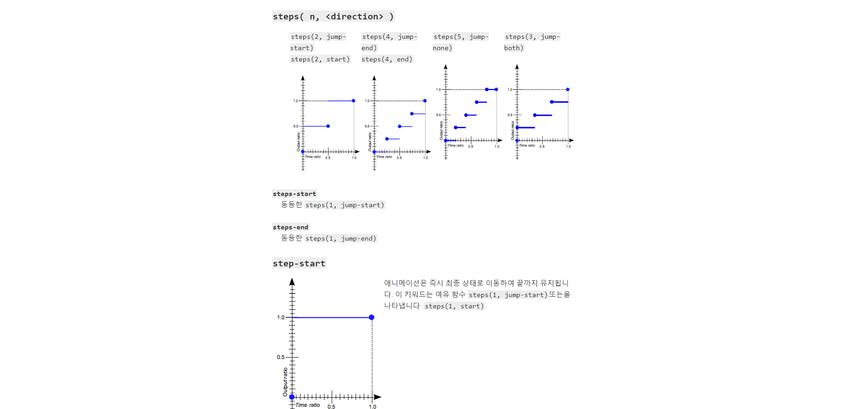
https://developer.mozilla.org/en-US/docs/Web/CSS/easing-function

