Slide 1

개발자
류동우,윤유비,강주현
EDIYA COFFEE CLONE
WEB DESIGN

Slide 2
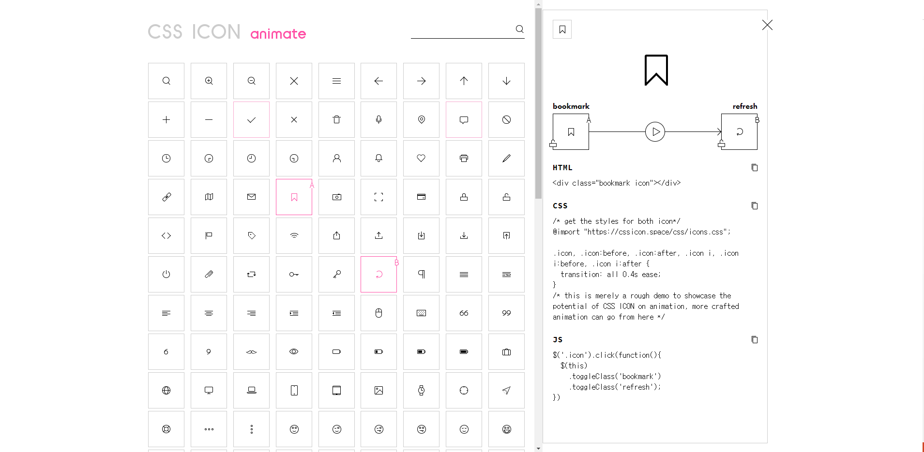
https://cssicon.space/#/animate/bookmark/to/refresh

Slide 3
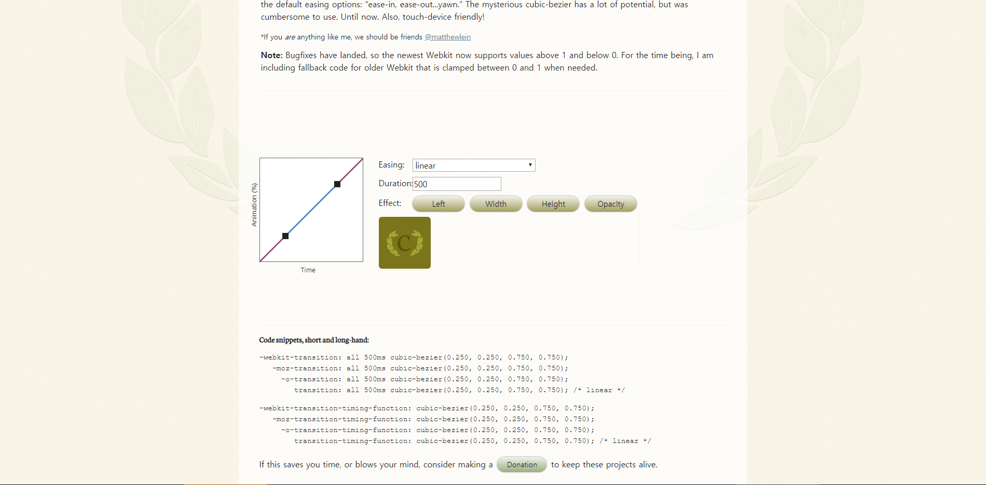
https://matthewlein.com/tools/ceaser

Slide 4
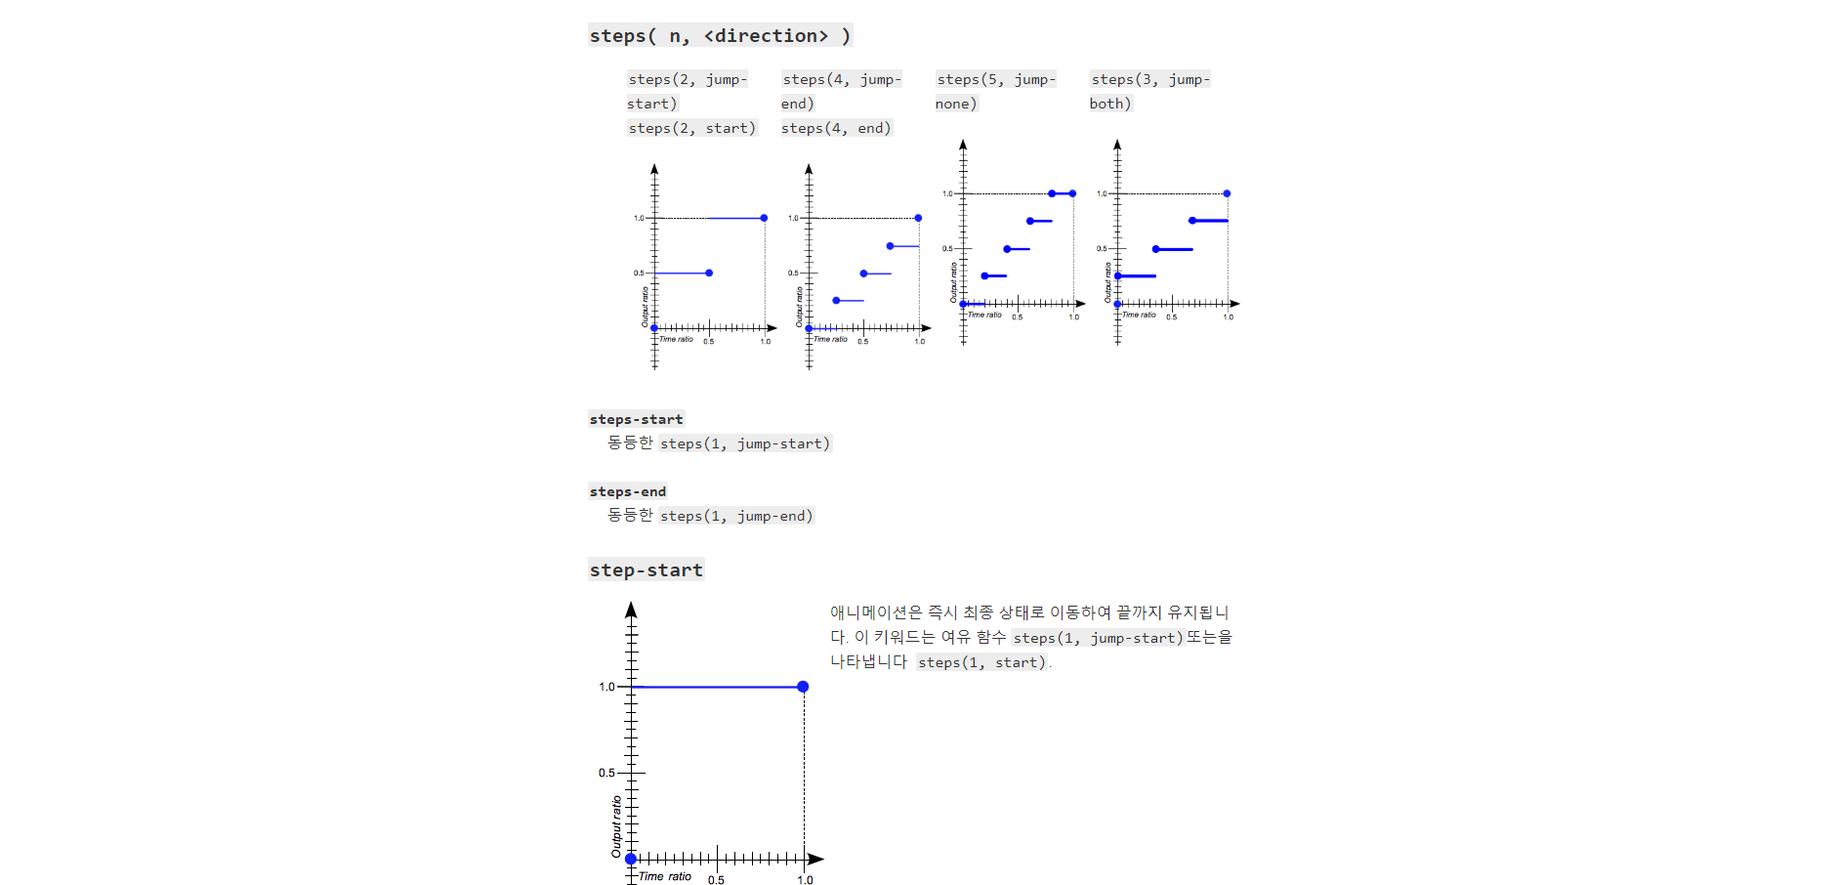
https://developer.mozilla.org/en-US/docs/Web/CSS/easing-function

