Slide 1

SeshadriRao Gudlavalleru Engineering College Department of Computer Science &Engineering Community Service Project on Fertilizer Usage Guide
By
K.Neha (24485A0511)
K.Sowmya (23481A0596)
K.Hemalatha (23481A05C4)
K.Bindhu (23481A05d2)
Under The Guidance Of
Dr. m.Babu Rao, M.Tech, Ph.D.
Professor And Head, Department Of Computer Science And Engineering.

Slide 2
Abstract
This project provides farmers with a simple and practical fertilizer usage guide to promote balanced fertilizer application, improve soil fertility, reduce costs, and enhance crop yield. The fertilizer usage guide is a community-focused web-based platform designed to educate farmers and gardeners on the correct and sustainable use of fertilizers.

Slide 3
Problem Statement
Many farmers struggle to identify the right type and amount of fertilizers for their crops. Overuse harms soil health and the environment, while underuse reduces crop yield. There is a need for an easy-to-use guide that provides accurate, crop-specific fertilizer recommendations to support sustainable farming.

Slide 4
Objectives
Provide crop-specific fertilizer recommendations.
To prevent overuse of chemical fertilizers
To educate farmers about the balanced and sustainable use of fertilizers.
To help reduce excess costs by avoiding overuse of fertilizers.
To design a user-friendly platform that is easy to access, even in low internet areas

Slide 5
Scope
Crop-specific recommendations:- Offers guidelines for fertilizer types and quantities based on specific crops.
Comprehensive fertilizer information:- Covers all major types of fertilizers, including chemical, organic, and bio-fertilizers, along with their benefits and risks.
Soil Health Tips:- Educates users on maintaining soil fertility and sustainable farming practices.
Educational Resources:-Includes FAQs, videos, and step-by-step guides on fertilizer application techniques.
Mobile-Friendly Platform:-Ensures that farmers can access information on smartphones and tablets, not just desktops.

Slide 6
Existing Systems & Limitations
Existing Systems
Fertilizer recommendations are provided by government agencies, agricultural universities, or private companies.
Limitations
No Focus on Sustainability – Existing systems often emphasize yield over soil health and environmental impact.
Lack of Personalization – Most resources provide general guidelines, not crop- or soil-specific recommendations.
Language Barriers – Many resources are only in English or Hindi, limiting regional reach.

Slide 7
Proposed System- Problems And Solutions
Limited Internet Access
problem: Farmers in rural areas may have slow or no internet connectivity.
Solution: Design a lightweight website that works on low bandwidth and offline-friendly features.
User Technical Skills
Problem: Non-tech-savvy farmers may struggle to use digital platforms.
Solution: Keep the interface simple, intuitive, and easy to navigate with clear instructions.
Language Coverage
Problem: Farmers may not understand guidance if their regional language isn’t supported.
Solution: Include multiple regional language options for better accessibility.

Slide 8
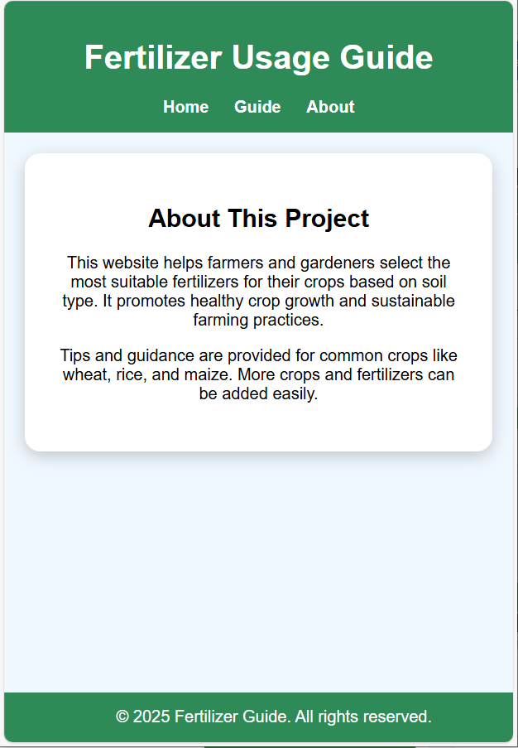
Action Plan For Implementation
Understand user needs (requirement analysis)
Identify the target crops and soil types.Gather information about the problems farmers face with fertilizer use.
Collect & verify data (data collection)
Gather accurate data on fertilizer types, dosages, and soil health practices.
Soil Health Guidance
The platform gives advice on soil improvement, organic alternatives, and eco-friendly practices.

Slide 9
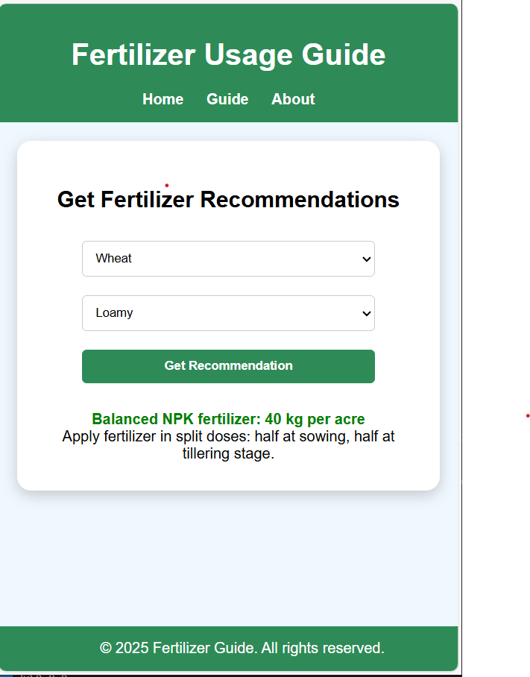
Input Crop & Soil Details Farmers enter the type of crop, soil type, and field information. Optionally, they can input soil test results if available.
Fertilizer recommendation engine
The system uses the input data to generate crop- and soil-specific fertilizer guidance. It provides dosage charts, application schedules, and seasonal recommendations.

Slide 10
Information Access And Testing
Information Access
To ensure farmers can easily get accurate, reliable, and actionable information about fertilizer use and soil health.
Including Tutorials, FAQs, videos, and Q&A sections . Access to government schemes and subsidies information.
Ensure the platform works on desktops, laptops, tablets, and smartphones.
Testing
Test thoroughly to make sure the website is accurate, fast, and user-friendly.
Check if farmers can navigate the website easily.
Collect feedback from farmers and experts to identify improvements or bugs.

Slide 11
Outcomes
Accurate fertilizer use
– crop- and soil-specific recommendations to reduce waste.
Higher crop yield & quality
– timely application enhances growth and produce.
Improved soil health
– balanced fertilization and eco-friendly practices.
Accessible information
– available to rural farmers with regional language support.

Slide 12
Challenges
Limited internet access
Challenge:-Farmers in remote or rural areas may have slow or no internet connectivity.
Mitigation Strategy:- make the platform lightweight and mobile-friendly.
Technical skills of users
Challenge:-Some farmers may not be tech-savvy, making navigation difficult.
Mitigation Strategy:- keep the interface simple and provide tutorials or guides.

Slide 13
Challenges
Language & Literacy Barriers
Challenge:- Farmers may not understand guidance if regional languages aren’t supported.
Mitigation Strategy:- Include multiple regional languages, simple instructions.
Adoption & Awareness
Challenge:- Farmers may be hesitant to use digital guidance.
Mitigation Strategy:- Conduct awareness programs, demonstrations, and provide local support.

Slide 14
Thank You

