Slide 1
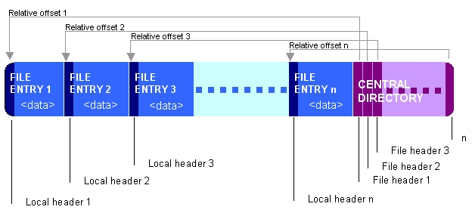

Slide 2
messageDigest MD5
content/ files & folder
header/ files & folder

