Slide 1


RealTime/FieldBased Project Internal1 Presentation On Real Time Object Prediction Using YOLO
22R21A6676 – B.GUNA SEKHAR
22R21A6678 – CH.RAKESH
22R21A6695 – K.HARSHA
Under the Guidance of
SK.GOUSE PASHA
ASSISSTANT PROFESSOR
Department of Computer Science & Engineering-Artificial Intelligence and Machine Learning
04/07/2024

Slide 2
Contents
Abstract
Introduction
Literature Survey
Existing System
Proposed System
Objectives
Architecture
Modules
UML Diagrams
References
Implementation
Result and future enhancement

Slide 3
ABSTRACT
This work presents a user-friendly web application for real-time object detection. It leverages the capabilities of Flask, a lightweight Python web framework, and YOLOv8, a state-of-the-art deep learning model. Users can upload images or select video sources, webcam, RTSP, and YouTube for object detection. The application employs the chosen YOLOv8 model to identify and localize objects within the selected source. A confidence threshold allows users to control detection accuracy. Detected objects are visualized with bounding boxes displayed on the image or video frame, providing clear results. This application offers a user-friendly and efficient solution for real-time object detection tasks across various media sources.

Slide 4
INTRODUCTION
Welcome to our presentation on simplifying real-time object detection using Flask and YOLOv8!
In the rapidly evolving field of computer vision, efficient and accessible tools for object detection are essential. Our project introduces a user-friendly web application designed to streamline real-time object detection tasks.
At the heart of our system is Flask, a popular Python web framework, combined with YOLOv8, a renowned deep learning model known for its speed and accuracy in object identification.
Our application caters to users seeking a straightforward approach to real-time object detection. Whether you're working with static images or exploring live webcam feeds and video streams (future work), our system offers a convenient and powerful solution.

Slide 5
LITERATURE SURVEY
YOLO (You Only Look Once): A swift and efficient object detection algorithm renowned for its real-time capabilities.
COCO (Common Objects in Context): A vast dataset offering comprehensive annotations for object detection tasks.
Strengths:
Speed: YOLO achieves real-time object detection with least latency possible.
Accuracy: Demonstrates robust accuracy on various detection tasks, facilitated by pre-trained models.
Limitations:
Small Object Detection: YOLO might struggle with very small objects.
Localization Accuracy: It may exhibit slightly lower precision compared to alternative algorithms.
Evaluation Metrics:
Mean Average Precision (mAP): Measures overall detection accuracy.
Intersection over Union (IoU): Evaluates the accuracy of bounding box predictions.
Future Directions:
YOLOvX: Ongoing advancements focus on enhancing accuracy, speed, and robustness.
Domain-specific Models: Exploration of tailored YOLO models for specialized tasks.

Slide 6
Exploring the Frontier of Object Detection: A Deep Dive into YOLOv8 and the COCO Dataset
Piyush Kumar, Vimal Kumar
DOI: 10.1109/CVMI59935.2023.10464837
YOLOv8-CAB: Improved YOLOv8 for Real-time object detection
Moahaimen Talib, A. Al-Noori, Jameelah Suad
DOI: 10.33640/2405-609x.3339
Object Detection Using Coco Dataset
Swasti Jain, S. Dash, Rajesh Deorari, Kavita
DOI: 10.1109/ICCR56254.2022.9995808

Slide 7
EXISTING SYSTEM
Commercial Solutions:
Amazon Recognition, Google Cloud Video Intelligence, and Microsoft Azure Cognitive Services offer cloud-based object detection with scalability.
They provide pre-trained models and advanced features but may incur costs and have a steeper learning curve.
Open-Source Frameworks:
TensorFlow Object Detection API, OpenCV, and Detectron2 are powerful but require more development expertise.
They offer flexibility but can be complex to implement compared to user-friendly web applications.
Comparison with Proposed System:
Strengths:
User-friendliness: Your Flask web app offers an intuitive interface for broader accessibility.
YOLOv8 Integration: Leveraging YOLOv8 emphasizes speed and accuracy.
Flexibility: Supporting diverse input options like image uploads and potential webcam and video streams (future work).
Differentiation Opportunities:
Deployment: Your on-premise deployment option provides data control to users.
Customization: Explore offering model selection or customization options in the future.

Slide 8
PROPOSED SYSTEM
Key Components:
Frontend: Easy-to-use interface for uploading images/videos and adjusting settings.
Backend: Powered by Flask and YOLOv8 for efficient object detection.
Real-time Detection: Detect objects in images, live webcam feeds, and videos.
Benefits:
Simple and efficient solution for real-time object detection tasks.
User-friendly interface for easy interaction and customization.
Supports detection in various media sources for flexibility.
Future Enhancements:
Integration of additional detection models for wider application.
Improvements in user interface for better interactivity.
Advanced features for enhanced detection accuracy and performance.

Slide 9
OBJECTIVES
Develop a User-Friendly Web Application for Real-time Object Detection:
Create an intuitive interface for users to interact with object detection features.
Ensure easy uploading of images and selection of video sources.
Provide straightforward controls for adjusting confidence thresholds.
Leverage YOLOv8 for Efficient and Accurate Object Detection:
Utilize the YOLOv8 deep learning model for fast and precise object identification.
Harness the power of YOLOv8 to achieve reliable detection results within images or video frames.
Enable Real-time Object Detection Across Various Media Sources:
Implement functionality to handle diverse input sources seamlessly.
Enable real-time object detection on static images, live webcam feeds, RTSP streams, and YouTube videos.
Ensure the application's versatility in processing different types of media for object detection tasks.

Slide 10
ARCHITECTURE
Image/Video/
Webcam
RTSP link/
YouTube link Insertion
Output
Output’s Description
Verification at back end

Slide 11
Frontend (Client-side)
HTML: Provides the user interface for selecting options and displaying results.
CSS: Styles the user interface for better presentation.
JavaScript: Handles user interactions, prepares data, and sends requests to the backend.
Backend (Server-side)
Flask: Python web framework that handles user requests and coordinates application logic.
YOLOv8 (via Ultralytics library): Pre-trained deep learning model for object detection.
Helper functions: Manage model loading, image/video processing, and response formatting.
Settings: Configuration file defining paths to models, resources, and default parameters.

Slide 12
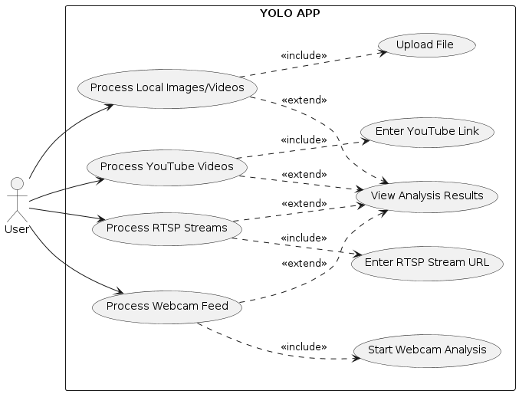
UML DIAGRAMS
Use Case Diagram

Slide 13
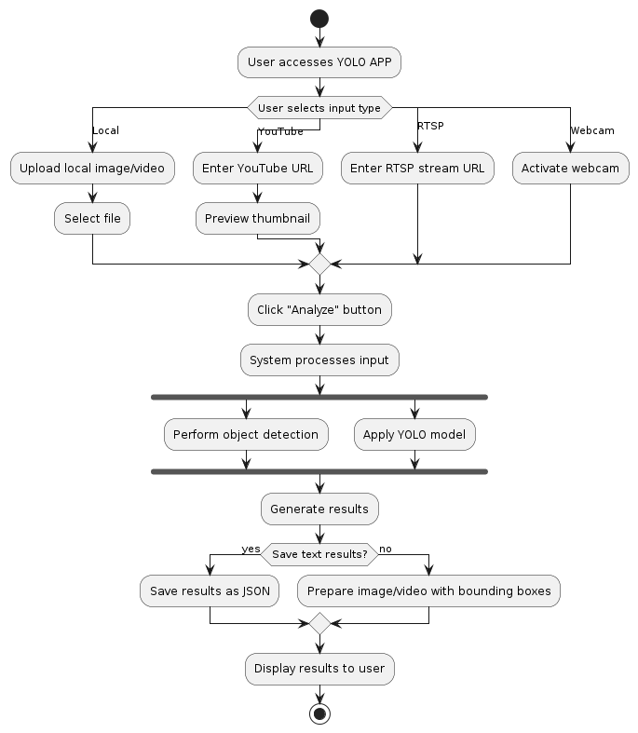
UML DIAGRAMS
Activity Diagram

Slide 14
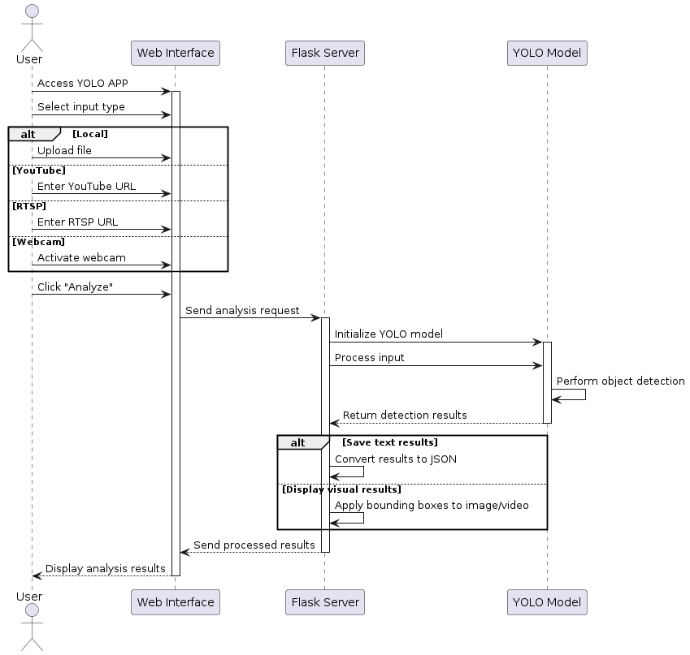
UML DIAGRAMS
Sequence Diagram

Slide 15
REFERENCES
Flask
Description: Python web framework for building web applications.
Official Website: https://flask.palletsprojects.com/
OpenCV
Description: Python library for computer vision tasks.
Official Website: https://opencv.org/
PyTorch
Description: Deep learning framework for building and deploying neural networks.
Official Website: https://pytorch.org/
Ultralytics
Description: Open-source implementation of YOLOv8 object detection model.
GitHub Repository: https://github.com/topics/yolov8

Slide 16
IMPLEMENTATION
from flask import Flask, render_template, Response, request
import json
import argparse
import os
import sys
from pathlib import Path
from ultralytics import YOLO
from ultralytics.utils.checks import cv2, print_args
from utils.general import update_options
app = Flask(__name__)
ROOT = Path(__file__).resolve().parents[0]
sys.path.append(str(ROOT))
def predict(opt):
results = model(**vars(opt), stream=True)

Slide 17
IMPLEMENTATION
for result in results:
if opt.save_txt:
result_json = json.loads(result.tojson())
yield json.dumps({'results': result_json})
else:
im0 = cv2.imencode('.jpg', result.plot())[1].tobytes()
yield (b'--frame\r\nContent-Type: image/jpeg\r\n\r\n' + im0 + b'\r\n')
@app.route('/')
def index():
return render_template('index.html')
@app.route('/<page>')
def load_page(page):
return render_template(f'{page}.html')

Slide 18
IMPLEMENTATION
@app.route('/predict', methods=['GET', 'POST'])
def video_feed():
if request.method == 'POST':
uploaded_file = request.files.get('myfile')
save_txt = request.form.get('save_txt', 'F')
if uploaded_file:
source = Path(__file__).parent / 'data/raw' / uploaded_file.filename
uploaded_file.save(source)
opt.source = source
else:
opt.source, _ = update_options(request)
opt.save_txt = True if save_txt == 'T' else False
elif request.method == 'GET':
opt.source, opt.save_txt = update_options(request)
return Response(predict(opt), mimetype='multipart/x-mixed-replace; boundary=frame')

Slide 19
IMPLEMENTATION
if __name__ == '__main__':
parser = argparse.ArgumentParser()
parser.add_argument('--model','--weights', type=str, default=ROOT / 'yolov8s.pt', help='model path or triton URL')
# Add other arguments here...
opt, unknown = parser.parse_known_args()
print_args(vars(opt))
raw_data = Path(opt.raw_data)
raw_data.mkdir(parents=True, exist_ok=True)
model = YOLO(str(opt.model))
app.run(port=opt.port, debug=False)

Slide 20
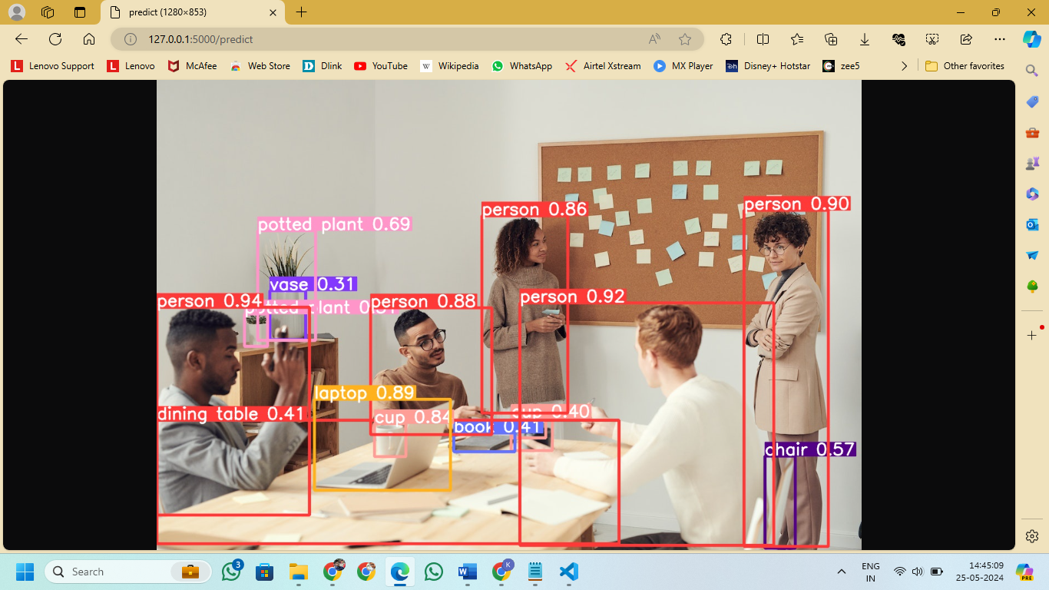
RESULT

Slide 21
FUTURE ENHANCEMENT
Future enhancements for the YOLOv8-based system include real-time processing to improve responsiveness, augmenting the training dataset for better accuracy and generalization, and integrating features like multi-camera support and advanced tracking algorithms.
Additionally, enhancing the model's ability to recognize complex object interactions will expand its functionality and applicability. These improvements aim to make the system more effective and versatile for various applications.

Slide 22


