Slide 1

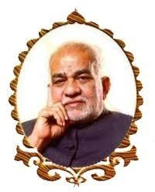
BVRIT HYDERABAD College of Engineering for Women
Nutrition Analysis Bot
Team No: 39
20WH1A1263 Udata Gayatri Lakshmi Srinija
20WH1A1279 Sumedha Ruddarraju
20WH1A12A6 Kothagadi Akhila
Medhanvesh 2023 ChatGPThon

Slide 2
Abstract: Nutrition is a critical part of health and development. Better nutrition is related to improved infant, child and maternal health, stronger immune systems, safer pregnancy and childbirth, lower risk of non-communicable diseases (such as diabetes and cardiovascular disease), and longevity. Poor nutrition can lead to reduced immunity, increased susceptibility to disease, impaired physical and mental development, and reduced productivity. A conversational agent can support people as a virtual coach i.e chatbot systems. We concentrated on giving the user-requested food item a precise nutrition analysis. Data was fetched from the trusted EDAMAM API which fetches the data from United States Department of Agriculture (USDA) National Nutrient Database, Nutritionix, Yummly.The user can enter the desired quantity, measurement unit, and food for nutrition analysis.It is a reliable and approachable bot.
Medhanvesh 2023 ChatGPThon

Slide 3
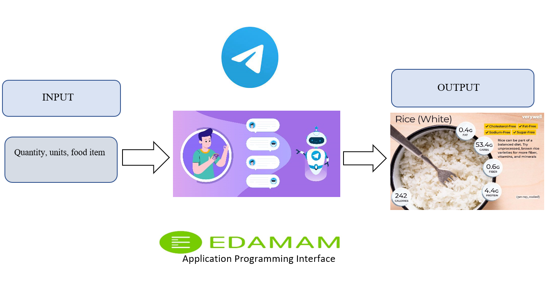
ARCHITECTURE
Medhanvesh 2023 ChatGPThon

Slide 4
TECH STACK
EDAMAM API
JAVASCRIPT
NODE JS
NODE-TELEGRAM-BOT-API package

Slide 5
SOCIETAL IMPACT
Building immunity depends heavily on nutrition from meals. Therefore, understanding the nutritional analysis of one's diet is crucial.
Malnutrition, in every form, presents significant threats to human health. Today the world faces a double burden of malnutrition that includes both undernutrition and overweight, especially in low- and middle-income countries. There are multiple forms of malnutrition, including undernutrition (wasting or stunting), inadequate vitamins or minerals, overweight, obesity, and resulting diet-related noncommunicable diseases.
The developmental, economic, social, and medical impacts of the global burden of malnutrition are serious and lasting for individuals and their families, for communities and for countries.
Those with weak immune systems were recently more susceptible to pandemic effects and took longer to recover.
Since Covid taught about the significance of nutrition, people have given it greater thought. Our Nutrition Analysis bot is quite useful to aid in this procedure.
Medhanvesh 2023 ChatGPThon

