Slide 1



PROJECT PRESENTATION
ON
SUDOKU GAME

Slide 2
Table of Contents
Introduction
Objective & Scope Of the Project
Application Tools
Project Design & Game flow and Logic
Flowchart
Testing And Validation
Challenges Faced
Conclusion
Limitations
References

Slide 3
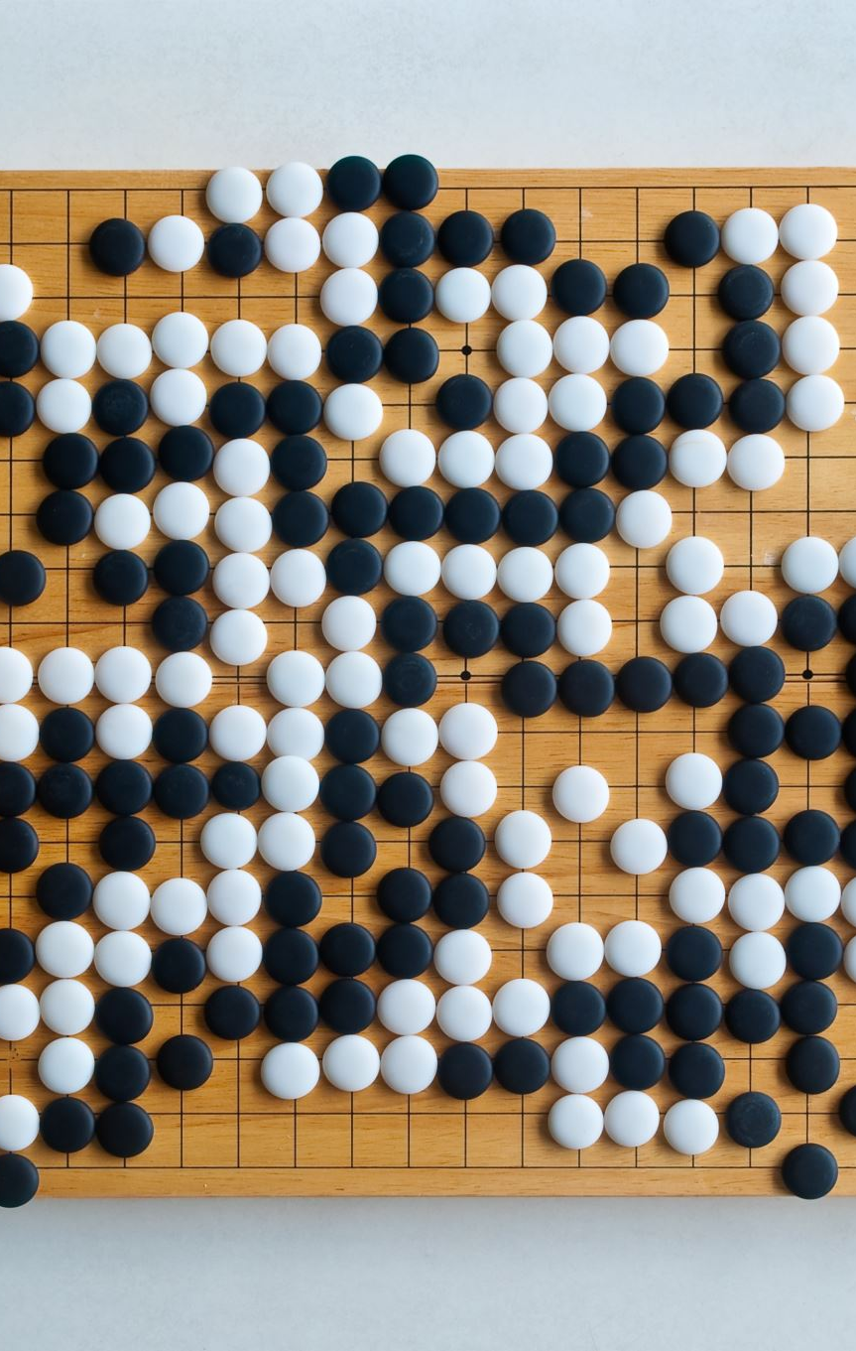
Introduction
This project is an interactive Sudoku game built using Pygame, designed to provide an engaging and intuitive puzzle-solving experience. The game begins with a welcome page and allows players to choose a difficulty level (Easy, Medium, Hard) by clicking on corresponding images. A visually appealing Sudoku board lets users interact with cells, highlight their selection with a transparent light blue color, and input numbers using the keyboard.
The game also features a randomly generated countdown timer (10 min, 5 min, 2 min), adding a layer of challenge. Players receive a congratulatory message upon solving the puzzle or a "Time’s up" message if the timer runs out. With smooth mouse and keyboard event handling, this project showcases dynamic UI design and responsive gameplay mechanics.

Slide 4
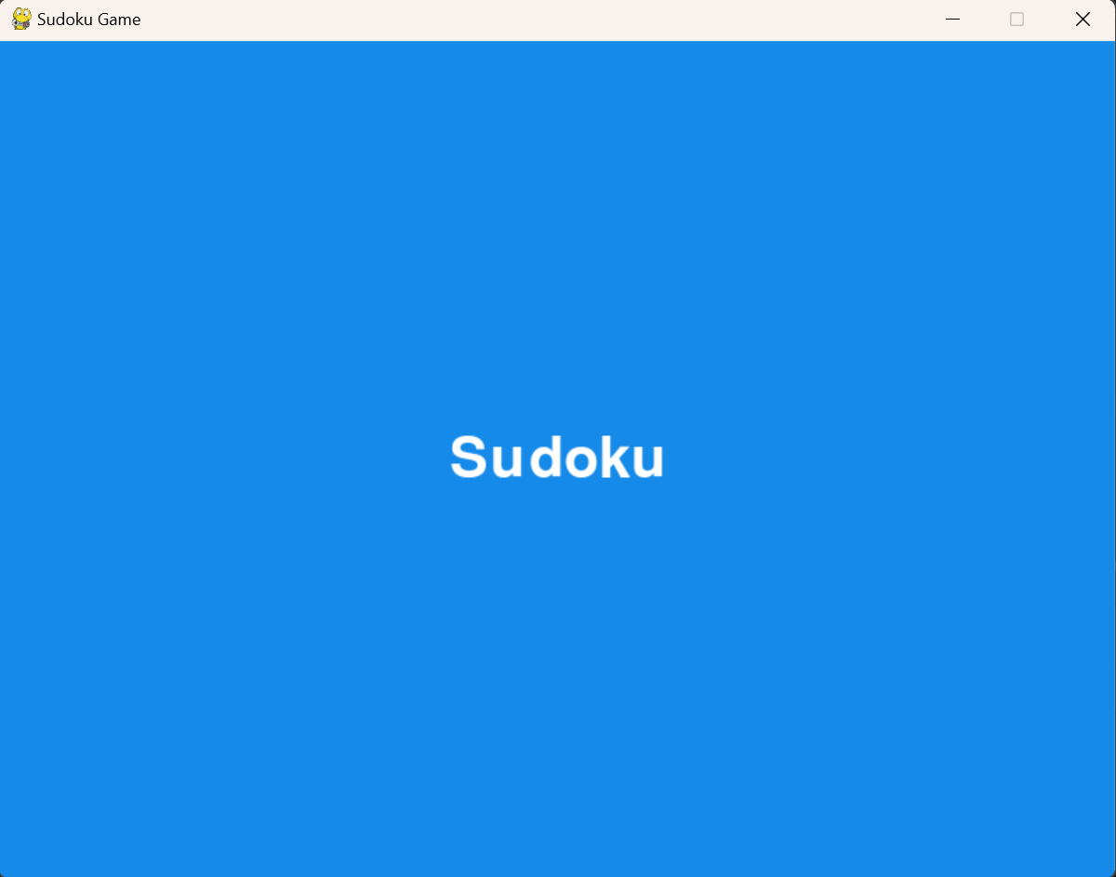
Objective
The objective of this project is to develop an intuitive and interactive Sudoku game that provides an engaging user experience.
The game will allow users to select difficulty levels and solve puzzles in a well-organized, timed environment.
It aims to enhance cognitive skills, including logical reasoning and strategic thinking, through gameplay.
Key features will include cell selection, number input, and timers, offering a dynamic and engaging experience for the user.
The project will focus on providing a seamless user interface, ensuring easy navigation and an efficient puzzle-solving experience.

Slide 5
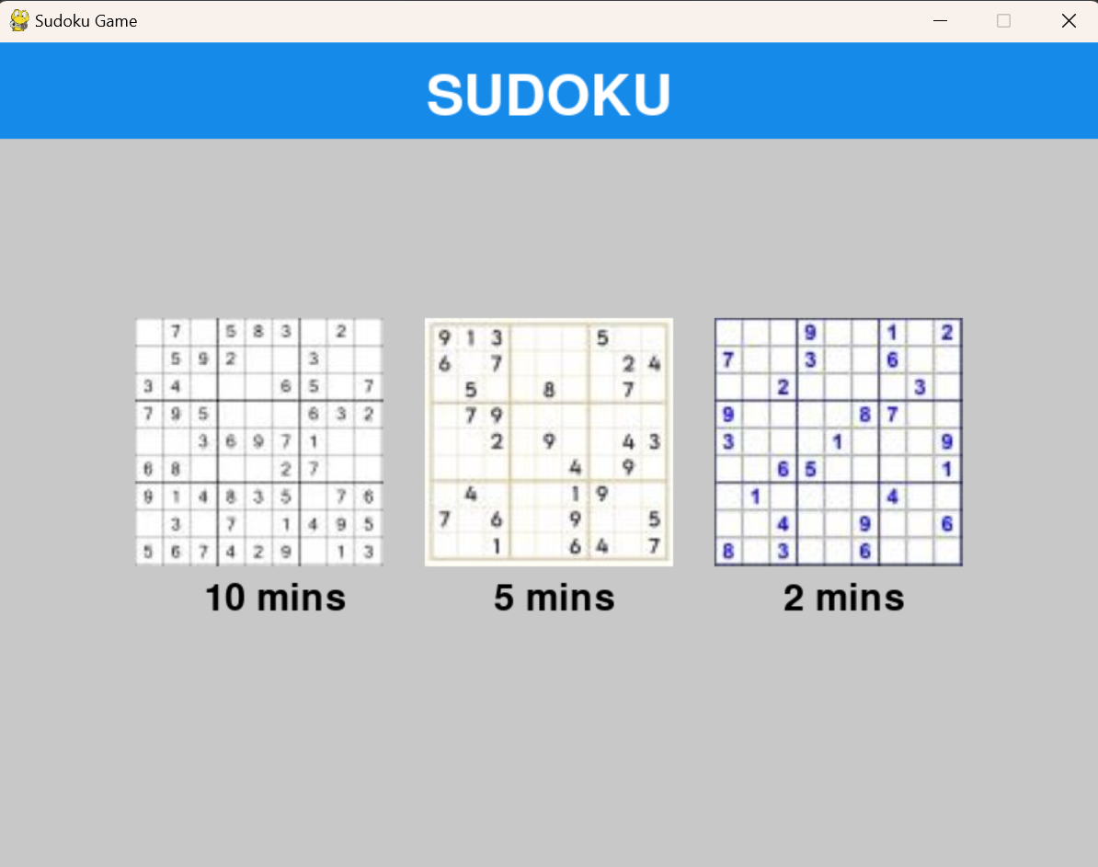
Scope
Core functionalities: Design and implement the basic features of a Sudoku game (grid, cell selection, number input).
User interface: Develop a clean, user-friendly interface with difficulty selection and game timer.
Game states: Handle different game scenarios such as win/lose conditions and time-outs.
Future enhancements: Explore advanced features like puzzle generation algorithms, adaptive difficulty, and multiplayer modes.
Applications: Relevant for education, cognitive training, and puzzle-solving communities.

Slide 6
Application Tools
Programming Language
Python:
Used for implementing the game's logic, handling animations, and managing game mechanics.
Sound Editing Software
Audacity:
For editing sound effects and background music, ensuring proper volume levels and format.
Libraries
Pygame:
Core library for game development, enabling sprite management, event handling, and rendering of graphics.
Testing Tools
Pygame Debugging Features:
For monitoring game states, detecting errors, and fine-tuning gameplay elements.
Development Tools
IDEs:
PyCharm: For coding, debugging, and managing project files.
Visual Studio Code: An alternative IDE for quick editing and testing.
Additional Tools
Button Module: Handles UI navigation and interactions. Sudoku Algorithm: Generates puzzles and validates solutions.

Slide 7
Project Design
Modular Design: Encapsulates core features into distinct classes and functions for better readability, maintainability, and scalability.
Game Initialization and Setup:
Main Settings: Configures screen dimensions, frame rate, assets, and difficulty levels.
Display & Clock: Manages game screen rendering and consistent frame rate.
Primary Classes:
Sudoku Grid: Handles puzzle generation, rendering, validation, and interactions.
Cell: Manages individual cell properties and rendering.
Timer: Tracks and displays elapsed game time.
Menu: Manages navigation, difficulty selection, and game start/exit.
Popup: Displays success or failure messages.

Slide 8
Game Flow and Logic
Game Logic Functions:
Grid Operations: Puzzle generation, win validation, and move validation.
Supporting Functions: Background rendering and game reset.
Main Game Loop:
Event Handling: Processes keyboard and menu inputs.
Logic Updates: Manages grid validation, timer, and game state.
Level Progression: Transitions between menus, gameplay, and outcomes.
Popups: Displays results ("Congratulations!" or "Time’s Up!").
Game Flow:
Start: Main menu to select difficulty and generate a new puzzle.
Gameplay: Player fills grid; timer tracks progress; optional health bar for mistakes.
End: Displays a success or failure popup; options to restart or exit.

Slide 9
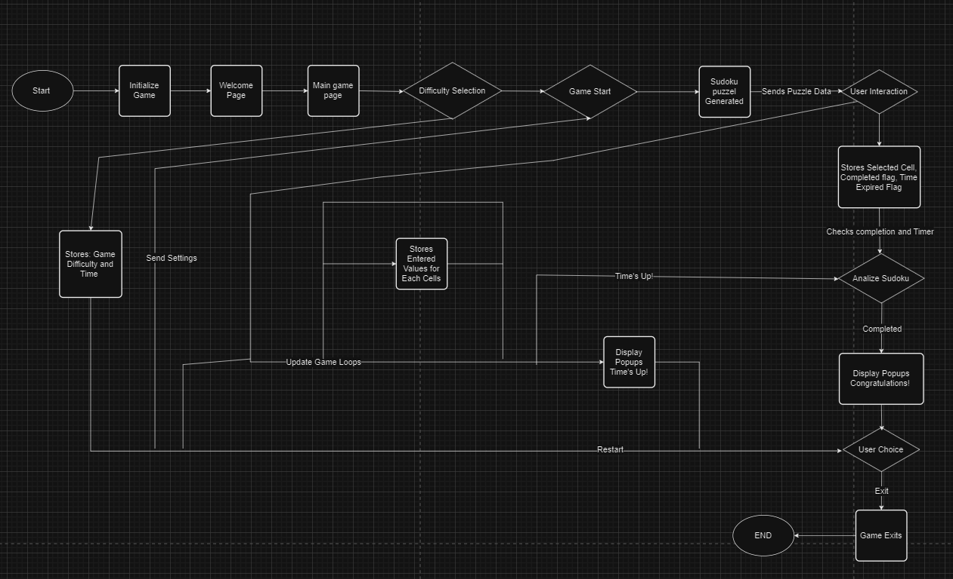
Flow Chart

Slide 10
Testing & Validation
1. Unit Testing Verifies the functionality of individual components or methods.
Key Areas Tested:
Grid generation for valid puzzles.
Timer operations (start, update, reset).
Cell operations (set value, clear value).
Popup behaviour (display messages, restart/exit actions).
3. System Testing Validates the entire game workflow to meet requirements.
Key Areas Tested:
Smooth transitions between menus and gameplay.
Proper rendering of UI elements (grid, timer, messages).
Validation of game logic (win condition, move correctness).
4. Manual Testing Played under various scenarios to identify issues.
Key Areas Tested:
Gameplay scenarios across different difficulty levels.
Handling of incorrect inputs or invalid moves.
Testing popups for "Congratulations!" and "Time's Up!" under varied conditions.
2. Integration Testing Ensures smooth interaction between components.
Key Areas Tested:
Player interactions with the Sudoku grid.
Timer integration with game progress.
Menu navigation and difficulty selection.
5. Performance Testing Ensures smooth and efficient game execution.
Key Areas Tested:
Stable frame rate and rendering efficiency.
Quick loading of assets (grid, menu, timer).
Smooth animations and cell highlighting effects.

Slide 11
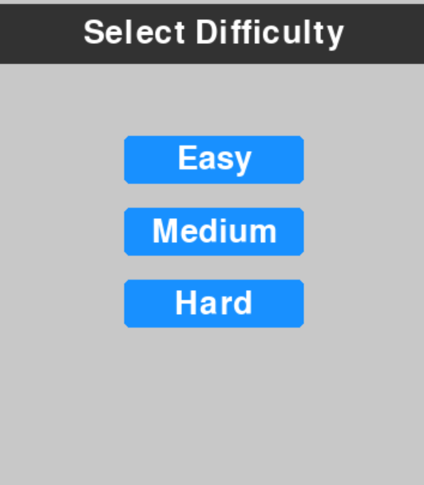
Challenges Faced
Handling User Input and Validation Solution: Implemented input validation in SudokuGrid and Cell classes to ensure only valid numbers (1-9) are entered and handle non-numeric inputs.
Rendering and Grid Updates Solution: Optimized rendering by updating only modified cells, reducing unnecessary redraws.
Game Timer Management Solution: Created a Timer class to track and update elapsed time, with reset and pause functionality.
Popup Handling and Transitions Solution: Developed a Popup class for smooth popup transitions and user interaction (restart or exit).

Slide 12
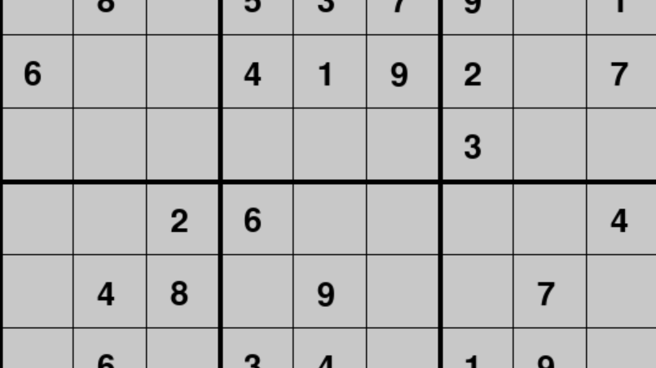
Conclusion
Functional Sudoku Game Development
Created a fully interactive game with dynamic grid, difficulty selection, and timers.
Implemented core mechanics like grid generation, number entry, validation, and progression.
Modular & Scalable Design
Used OOP principles for a modular codebase, easy extension (e.g., multiple difficulty levels, multiplayer).
Ensured clean logic separation (grid, timer, UI) for maintainability.
Immersive Gameplay
Integrated visual elements (grid, inputs, timer) for an engaging experience.
Included interactive popups for puzzle completion or time-out events.
Testing & Validation
Conducted thorough testing on key components: grid, number entry, validation, and UI.
Ensured smooth navigation, proper popup behavior, and responsive controls for a polished game.

Slide 13
Limitations
Game Logic Limitations
Uses a static grid with pre-generated puzzles; could benefit from dynamic puzzle generation and more varied difficulty.
Graphics and Visual Design
Basic visuals with limited customization (grid themes, backgrounds) and no animations for actions like entering numbers.
Limited Features
Lacks advanced features like hints, auto-solving, and scoring system. Could add multiple difficulty levels, customizable grids, and game modes.
No Multiplayer Option
Currently a single-player game. Adding multiplayer or challenge modes could increase engagement and appeal.

Slide 14
Reference
Pygame Documentation:
Comprehensive reference for Pygame features like sprite handling, collision detection, and sound integration.
https://www.pygame.org/docs/
Python Official Documentation:
Standard library references for os, random, and csv modules.
https://docs.python.org/
Online Resources:
Project GitHub Repository:
https://github.com/KOTHAPU/Sudoku-pygame
Pygame Documentation: pygame.org/docs (graphics, event management, sound)
Python Documentation: docs.python.org (standard library modules)
FreeCodeCamp, YouTube channels ("Tech with Tim", "Clear Code") for game logic and GUI tips.

Slide 15

THANK YOU

