Slide 1



📊 Exploratory Data Analysis (EDA) Project
🔍 on
🚚 SUPPLY CHAIN ANALYSIS
Presented By: Santosh Reddy K

Slide 2
Introduction
In this project, I performed an Exploratory Data Analysis (EDA) on a USA Sales dataset.
The dataset contains information related to various stages of the supply chain, such as procurement, ordering, shipping, and delivery.
The main aim of this project is to understand how products move through the supply chain and identify patterns, delays, and performance metrics.
The analysis helps in understanding operational efficiency and business performance.

Slide 3
Objectives
To clean and preprocess the supply chain dataset for analysis.
To study the flow of orders from procurement to delivery.
To calculate important KPIs such as Revenue, Cost, and Profit.
To identify delays in the supply chain process.
To analyze customer, product, and warehouse performance.
To generate meaningful visualizations to support insights.

Slide 4

Data Cleaning
Checked for missing values and handled them appropriately.
Converted all date-related columns to proper datetime format.
Removed invalid entries, such as negative values in Quantity, Price, or Discount.
Fixed formatting issues in numeric columns.
Created new calculated fields.
After cleaning, the dataset became ready for analysis.

Slide 5
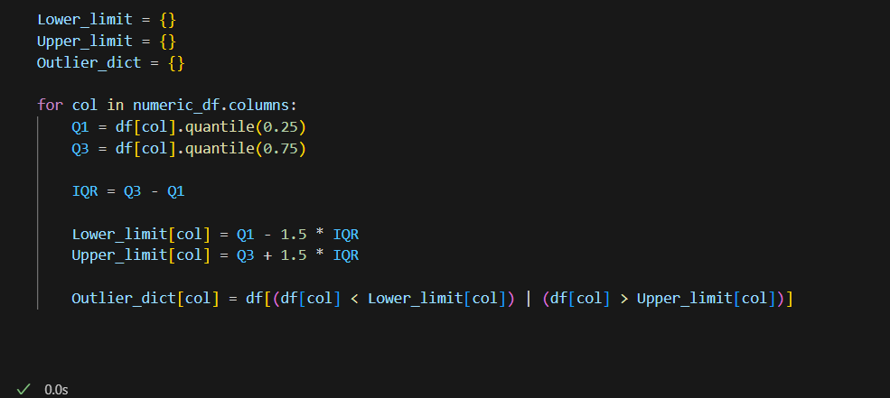
Outlier Treatment
Used boxplots and Z-score to find extreme values in speed and damage cost.
Applied IQR method to cap extreme outliers for balanced analysis

Slide 6
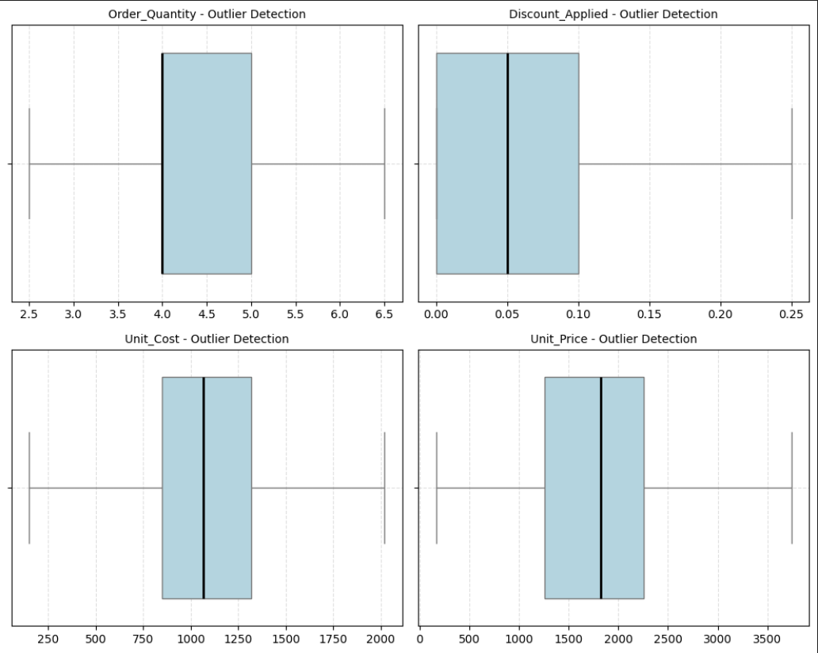
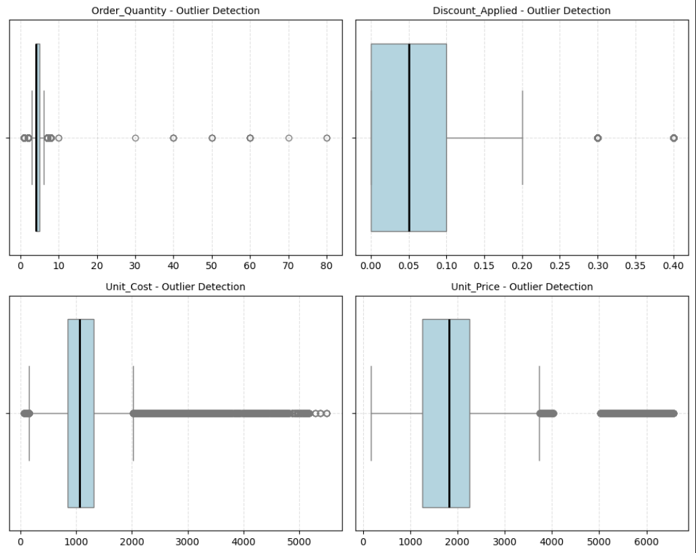
Before Capping
After Capping

Slide 7
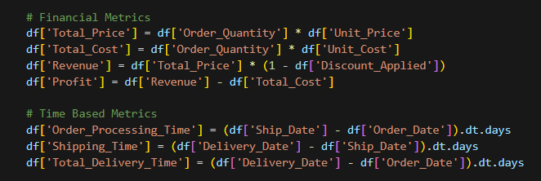
Feature Engineering
Financial & Time-Based Metrics:
Calculated key financial values like total price, cost, revenue (after discount), and profit for each order.
These financial metrics help understand earning, spending, and overall business performance.
Created lead-time metrics to measure how long each stage takes in the supply chain.
Measured delays such as order-to-ship time, ship-to-delivery time, and total delivery time.
These time metrics help find slow steps, improve speed, and reduce delays in the process.

Slide 8

Univariate Analysis
Studied individual variables to understand their distribution.
Examples of univariate findings:
Most orders were placed through a specific Sales Channel.
Some warehouses processed a higher number of orders compared to others.
Product demand distribution shows top-selling products.
Order Quantity varies widely depending on the product type.
Used histograms and bar charts to visualize patterns.

Slide 9
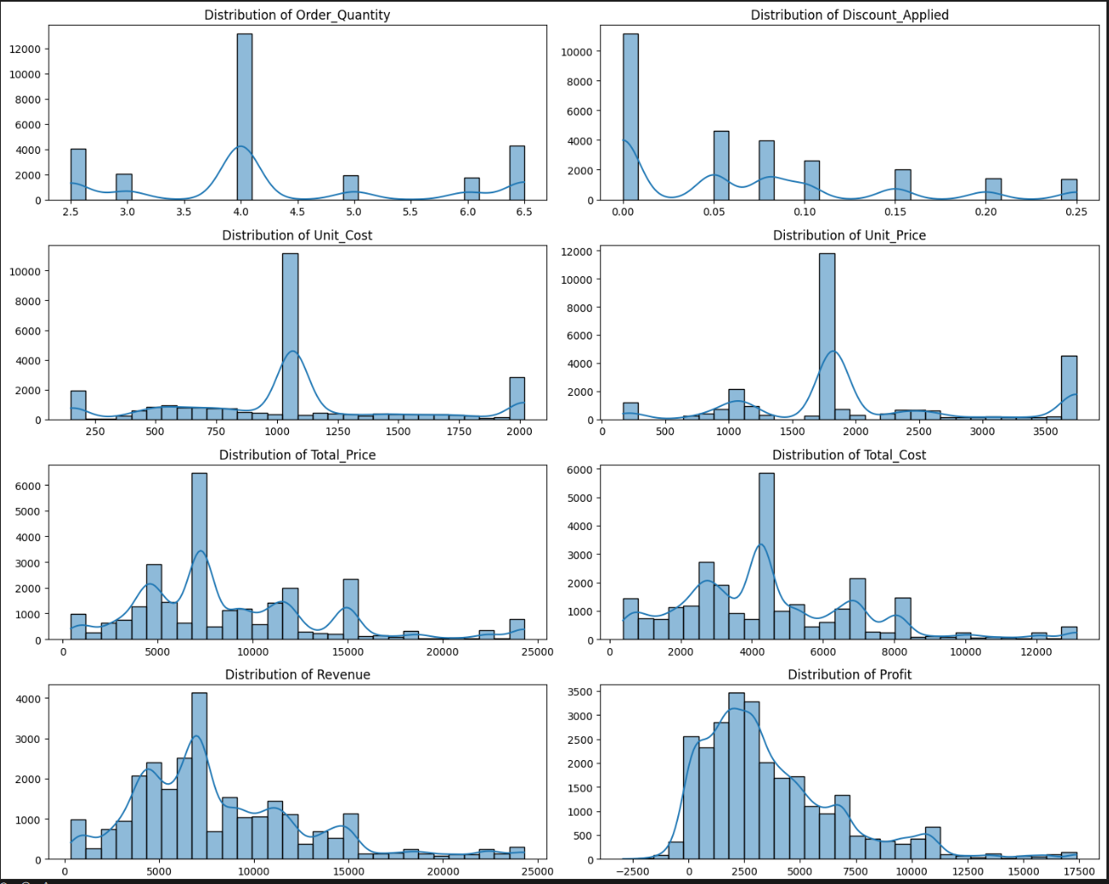
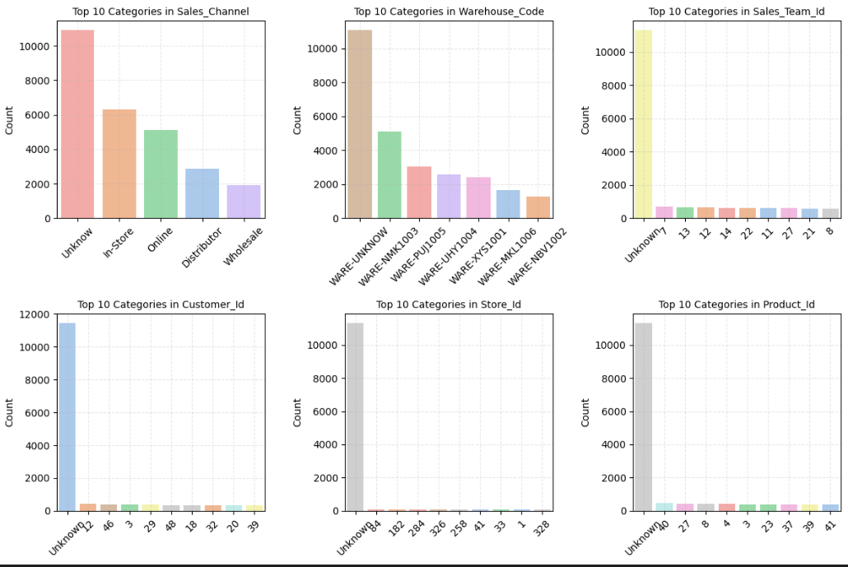
Category Columns
Numerical Columns

Slide 10
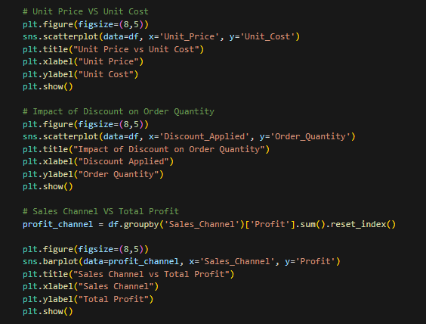
Bivariate Analysis
Explored relationships between two variables at a time.
Examples:
Relationship between Unit Price and Unit Cost to study margins.
Impact of Discount on Order Quantity.
Warehouse_Code vs Lead Time to identify delay-prone warehouses.
Sales_Channel vs Total_Profit to identify the most profitable channel.
Used scatter plots, boxplots, and bar charts for this part.

Slide 11
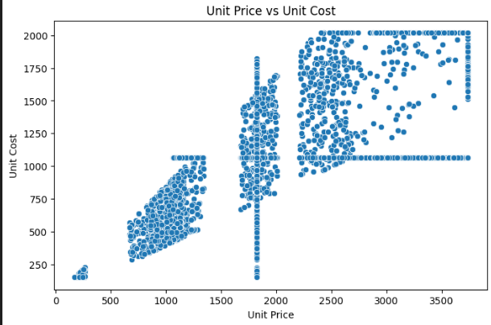
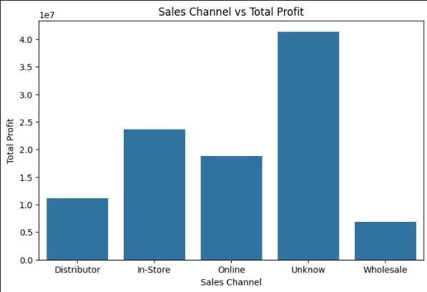
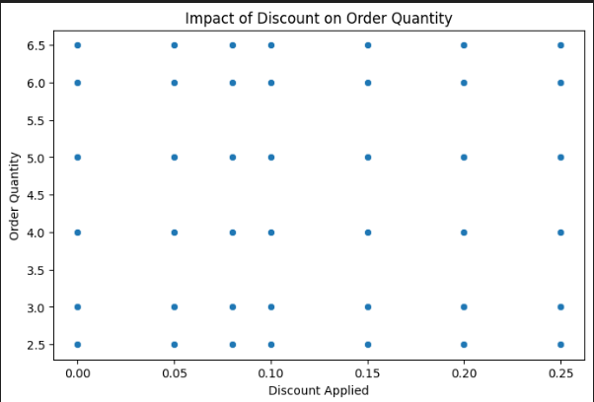

Slide 12
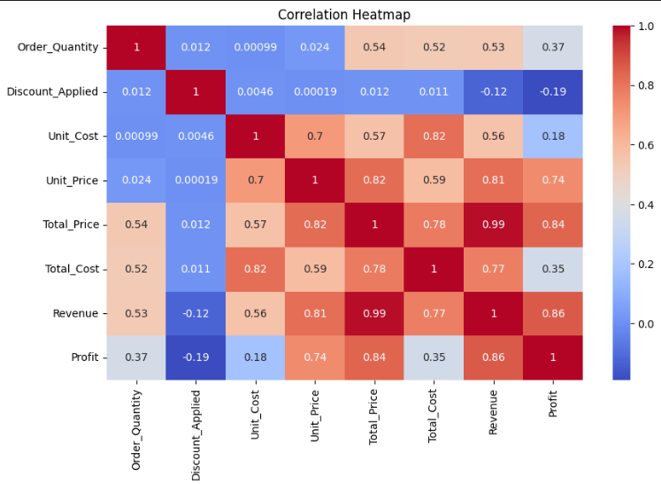
Correlation Heatmap

Slide 13
Key Business Insights (1–4)
1. The “Cost of Dust” – Inventory Aging
Products sold within 0–30 days generate the highest profit margins
Inventory held for 90+ days shows sharp margin decline
Indicates losses due to storage cost and clearance discounts
2. JIT Efficiency Gap (Procurement vs Sales)
Procurement spikes without matching sales demand
Results in overstocking and capital blockage
Weak alignment between demand planning and procurement
3. Warehouse Bottlenecks
Certain warehouses show high order processing time
Delay is internal (picking/packing), not shipping
Indicates operational inefficiencies at specific facilities
4. Performance Variance by Warehouse
Large differences in processing speed across warehouses
Some warehouses consistently outperform others
Lack of standardized operational practices

Slide 14
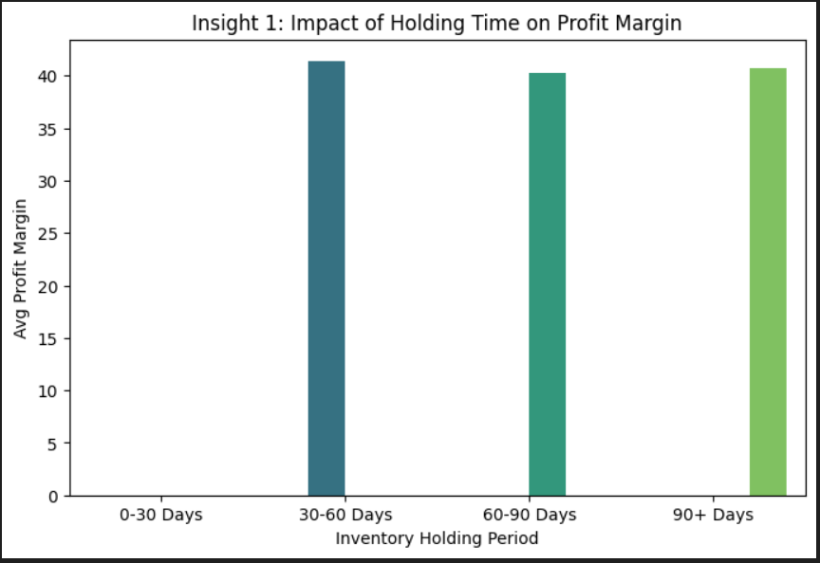
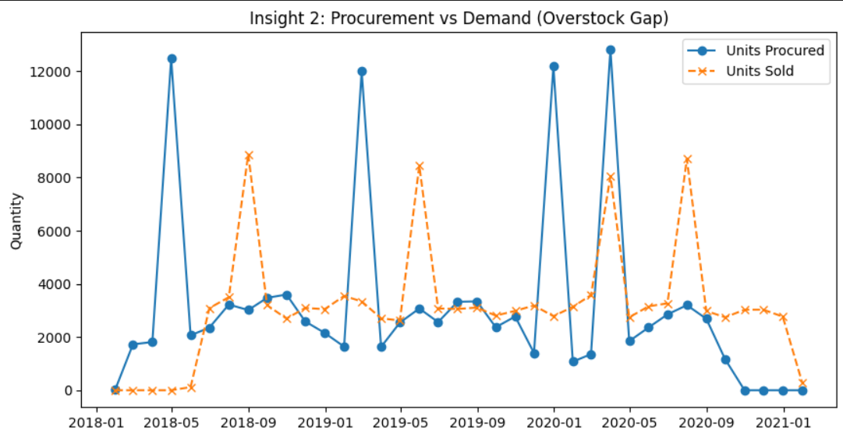
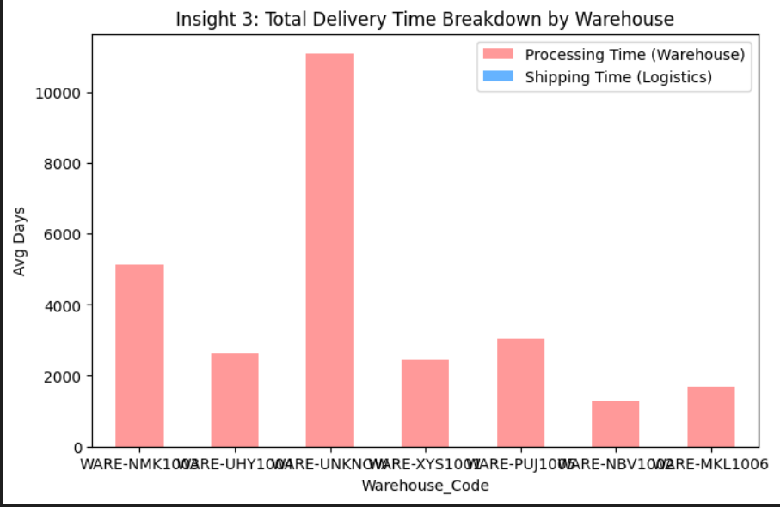
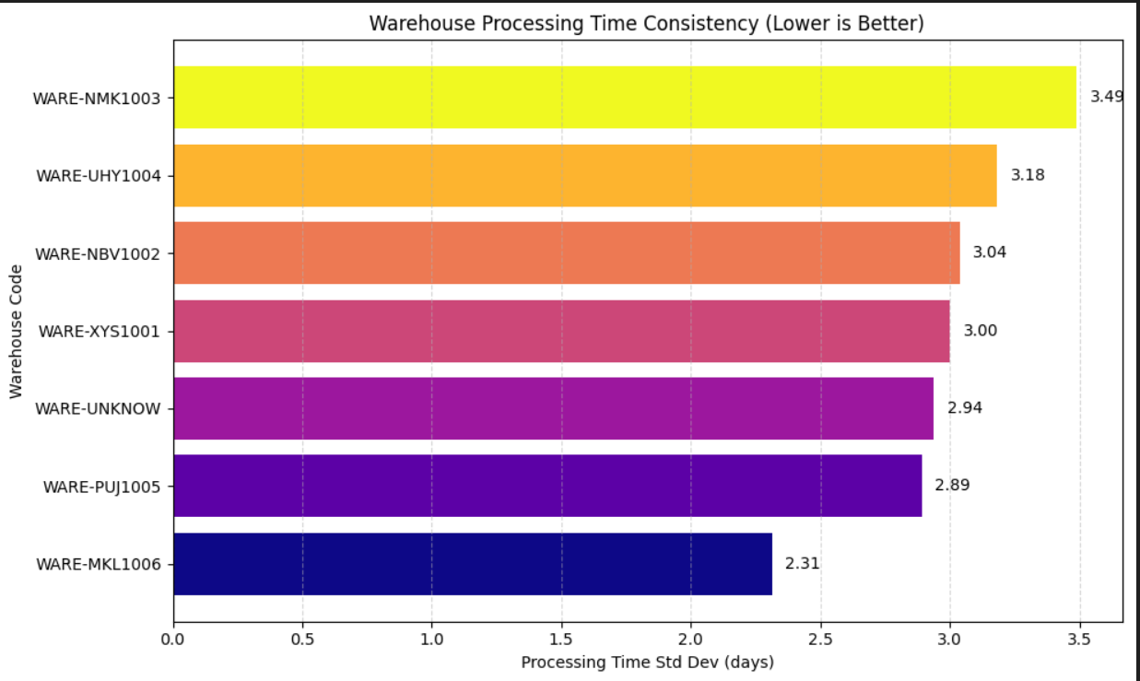

Slide 15
Key Business Insights (5–7)
5. The “Discount Trap” – Sales Team Impact
High discounts do not guarantee higher order volume
Some sales teams sacrifice profit for targets
Leads to margin erosion
6. Channel Profitability
High sales volume ≠ high profit
Certain channels generate better margins with lower discounts
Channel-wise strategy is required
7. Loss Leaders – Profit Leakage
Identified Top 10 products with negative profit
These products drain resources despite sales
Require price revision, cost renegotiation, or removal

Slide 16
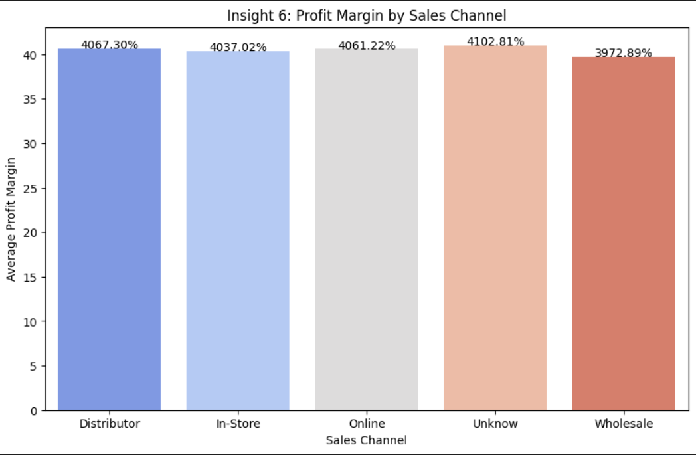
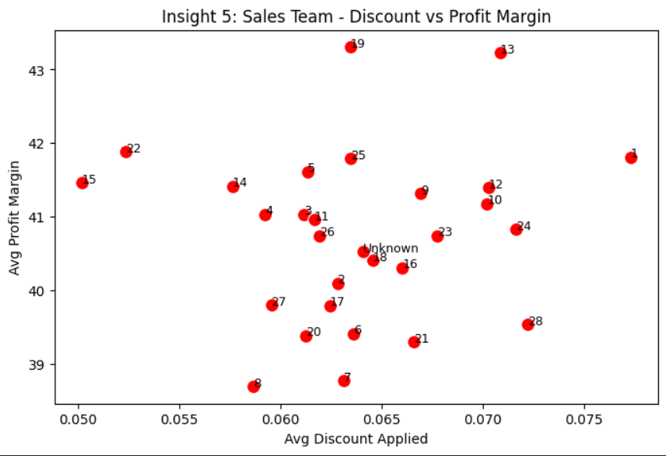
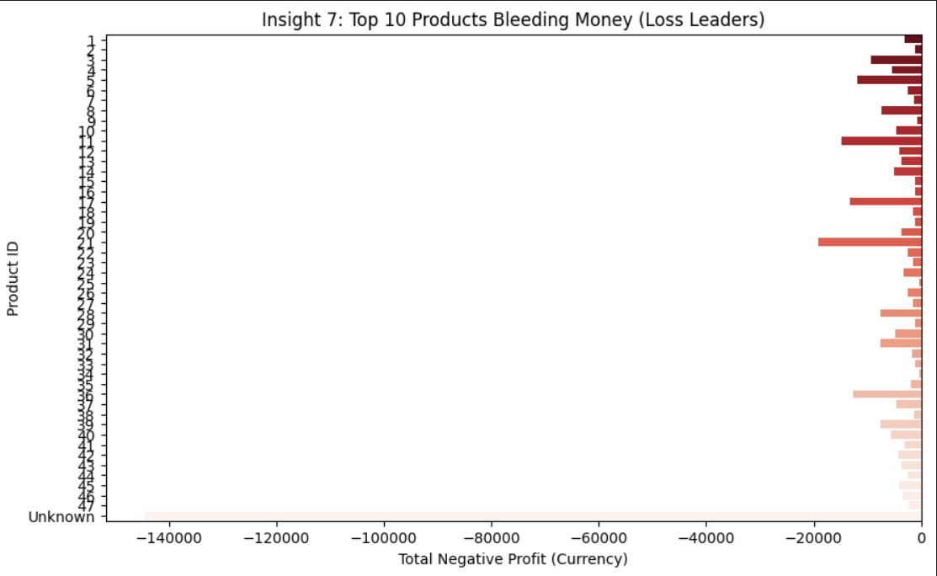

Slide 17
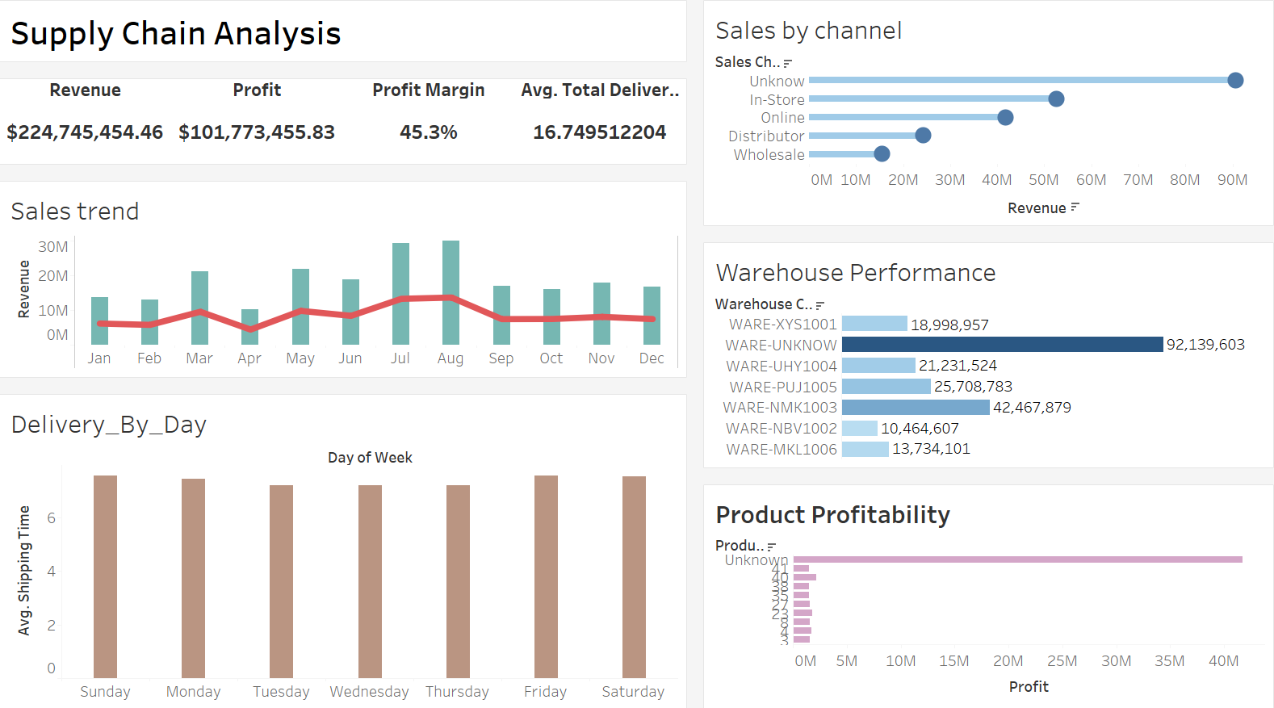
Data Visualization

Slide 18
Conclusion
The supply chain has areas with strong performance and some bottlenecks.
Delivery delays can be reduced by improving warehouse and shipping operations.
Profitability varies widely across products and sales channels.
The EDA helped identify patterns that can support better forecasting, planning, and decision-making.
Overall, the analysis provides a clear understanding of supply chain performance.

Slide 19

THANK YOU

