Slide 1



Memory management optimization strategies
Collaborative Work By:
V.Vaibav
R.Kotteeswaran
J. Seetharaman

Slide 2
Introduction
Memory management optimization is the efficient use of memory in a program.
It helps reduce memory wastage and improves performance.
It ensures proper allocation and deallocation of memory.
It prevents problems like memory leaks and fragmentation.
V. Vaibav & R.Kotteeswaran – CSA - SCSVMV

Slide 3
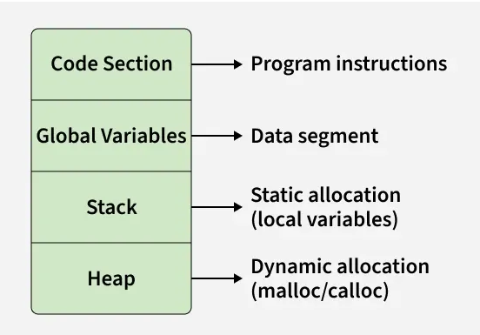
Memory Layout: C
V. Vaibav & R.Kotteeswaran – CSA - SCSVMV

Slide 4
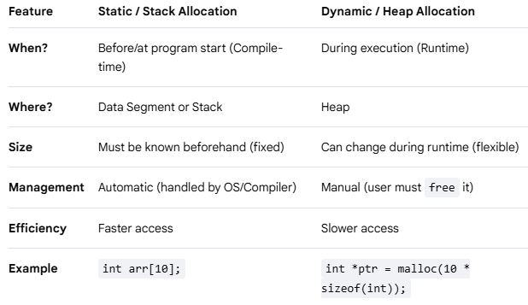
Memory Management: C
V. Vaibav & R.Kotteeswaran – CSA - SCSVMV

Slide 5
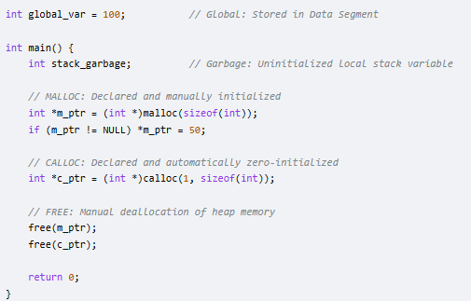
Garbage Value
- a variable contains random value because it is not initialized.
V. Vaibav & R.Kotteeswaran – CSA - SCSVMV

Slide 6
stdlib.h
:.
(.
malloc(): Allocates a single block of uninitialized "garbage" memory of the specified byte size
Ex Syntax : void* malloc(size _ t size);
size: total number of bytes to allocate, an unsigned integer.
calloc():Similar to malloc, but initializes all bytes to zero.
free(): Releases the allocated memory block back to the system.
V. Vaibav & R.Kotteeswaran – CSA - SCSVMV

Slide 7
Memory Management in Java
Automatic memory management.
Handled by JVM using Garbage Collection.
Memory divided into Stack, Heap, and Method Area.
Objects stored in Heap using new keyword.
Unused objects are automatically removed.
Improves program safety and reduces errors .
V. Vaibav & R.Kotteeswaran – CSA - SCSVMV

Slide 8
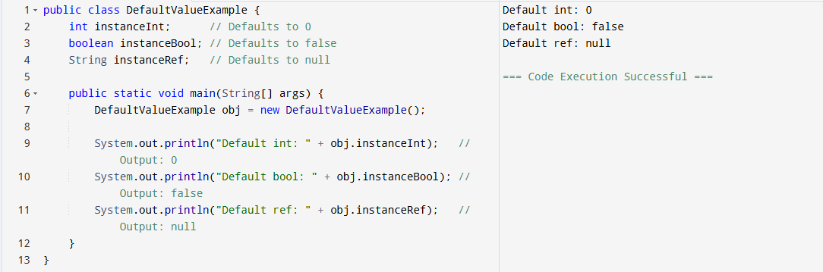
Garbage Value:
V. Vaibav & R.Kotteeswaran – CSA - SCSVMV

Slide 9
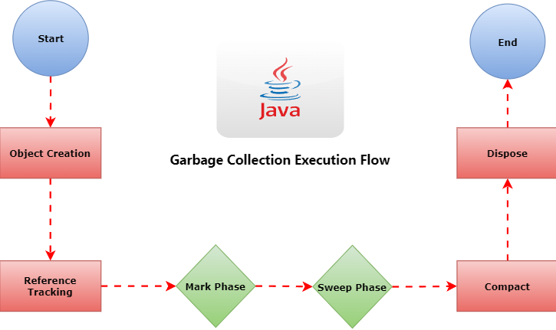

Java (GCE) Flow
V. Vaibav & R.Kotteeswaran – CSA - SCSVMV

Slide 10
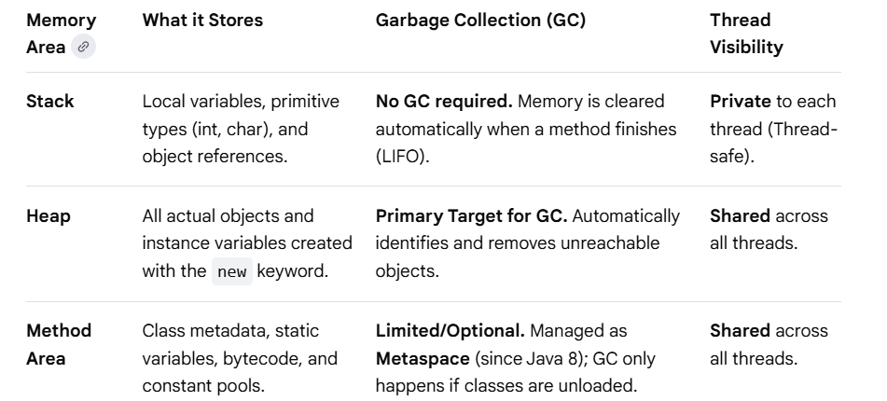
Applications of Java
1. Stack Memory
2. Heap Memory
3. Method Area
V. Vaibav & R.Kotteeswaran – CSA - SCSVMV

Slide 11
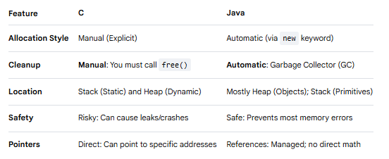
Comparison
V. Vaibav & R.Kotteeswaran – CSA - SCSVMV

Slide 12
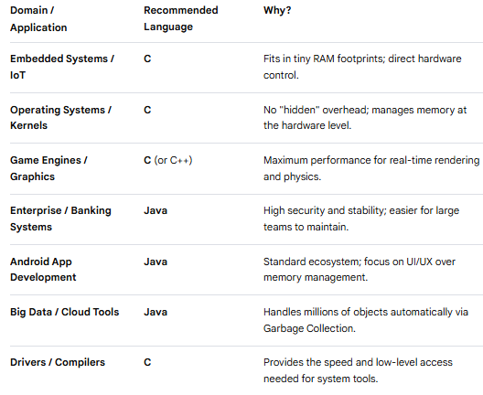
Apps that suits
V. Vaibav & R.Kotteeswaran – CSA - SCSVMV

Slide 13
Conclusion
Use C if you are building the foundation where efficiency is the top priority. Use Java if you are building the application where security, speed of coding, and memory safety are the top priorities.
V. Vaibav & R.Kotteeswaran – CSA - SCSVMV

Slide 14
Thank you

