Slide 1





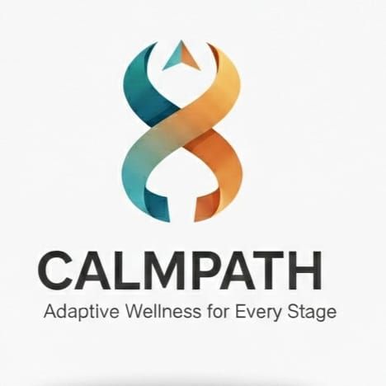
MENTIS 2026
Problem Statement ID : MENTIS0017
Problem Statement Title : Non-AI Technical Systems for Emotion Regulation in Anxiety & Depression
Theme : Non-AI Technology for Emotion Regulation in Anxiety & Depression
PS Category : Software
Team Name : CODAHOLICS

Slide 2
IDEA TITLE
Proposed Solution (Describe your Idea/Solution/Prototype)
Our system is a mobile/web application that helps users build emotional awareness and regulation through structured, non-AI tools.
Users log emotions along with daily situations and experiences to identify emotional patterns and triggers.
During moments of stress or emotional overload, the platform offers quick grounding and calming exercises for immediate relief.
A recovery-friendly emotion calendar and streak system encourages consistency without guilt, supporting emotional stability even during low-motivation days.

Slide 3
TECHNICAL APPROACH
Technologies used :
. Frontend : HTML , CSS, JS
. Backend : Node.js, Express.js (rest API’s)
. Database : MongoDB
. Tools : VS Code , Git & Git Hub
. Visualization : Dashboard
Methodology and process for implementation :
. Daily Check-In : Users log mood , intensity , sleep, screen time , activity and stress.
. Secure Storage : Data Saved with timestamps
. Rule-Based Logic : Transparent suggestions with no diagnosis.
. Trend Analysis : Weekly & monthly track of emotions.

Slide 4
FEASIBILITY AND VIABILITY
Feasibility : CalmPath is technically feasible using standard web technologies with rule-based logic, low development cost, and a scalable,privacy-first.
Potential Challenges & risks : Inconsistent user engagement, secure handling of sensitive emotional data, scalability with growing usage, and risk of misinterpreting emotional trends as medical conclusions.
Strategies to overcoming challenges : Simple daily check-ins with visual feedback, privacy-first data handling with user control, optimized data aggregation for scalability, and clear non-diagnostic suggestions to ensure ethical use.

Slide 5
IMPACT AND BENEFITS
Impacts on Target Audience :
Improves self-awareness and emotional regulation, encourages healthy routines, and empowers users to track mood trends safely without replacing professional care.
Benefits of the Solution:
Socially enhances mental well-being, economically offers a low-cost self-regulation tool, ethically ensures privacy and user control, and is scalable for broader adoption in wellness programs or educational institutions.

Slide 6
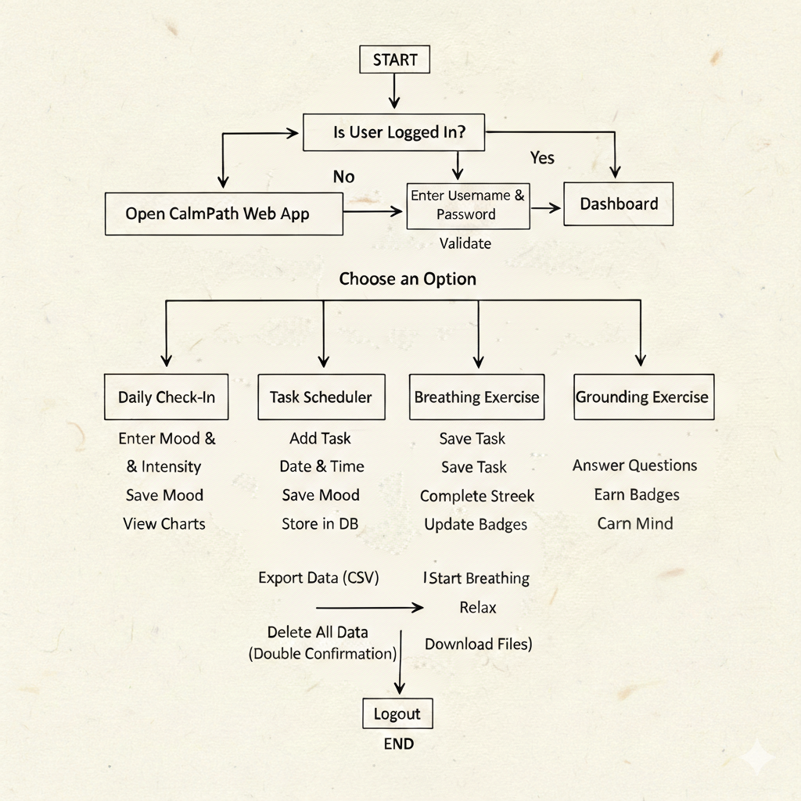
RESEARCH AND REFERENCES
WHO (2024–2025). World Mental Health Report & Fact Sheets
U.S. HHS (2023). Youth Mental Health & Social Media Advisory
. Links :
[https://www.who.int/news-room/fact-sheets/detail/mental-health-at-work]
[https://www.hhs.gov/sites/default/files/sg-youth-mental-health-social-media-advisory.pdf]

