Slide 2
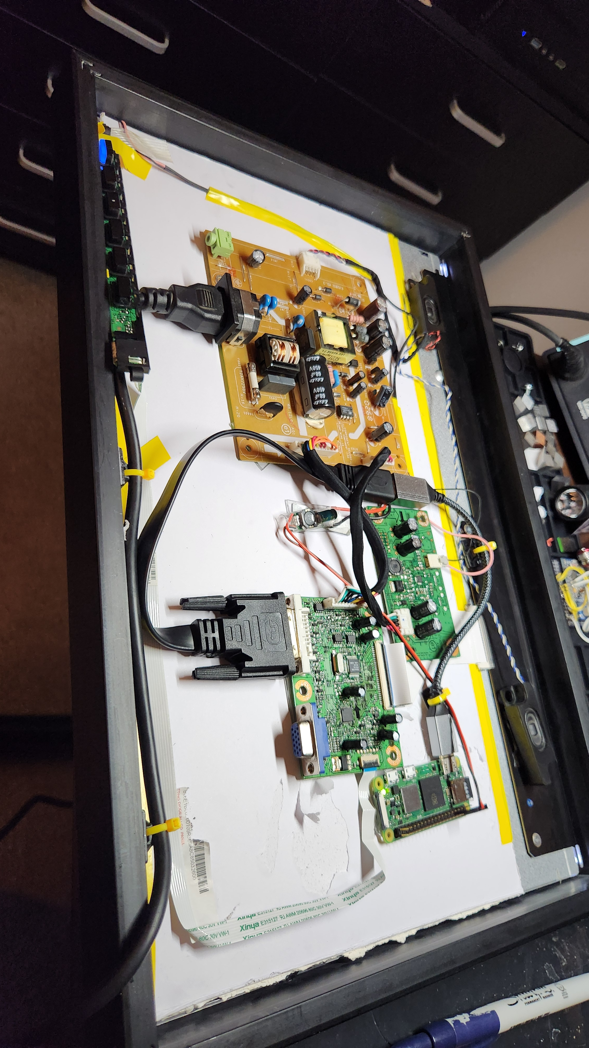
Monitor PCBs
Raspberry Pi
DC-DC Step Down to 5V
Frame

Slide 3
Text Color #FAFAFA
Primary Accent #64D5D2
DC-DC Step Down to 5V
Hover Background #2E4C5B
Highlight Accent #5BC0DE
Highlight Accent #5BC0DE

Slide 4
Journey to Drone Swarm Light Shows
Phase 1: Prototype Remote Control System
Build a wireless controller using a DualShock4, Arduino, XBee radio, and OLED screen.
Establish a standard protocol for sending commands and receiving telemetry.
Phase 2: Rover Teleoperation (DualShock4)
Test remote control on a simple rover using the new wireless system.
Verify reliable two-way communication and refine command handling.
Phase 3: Mesh Networking & Range Testing
Experiment with XBee mesh networking to extend control range.
Assess communication reliability with multiple nodes in real-world conditions.
Phase 4: Swarm Controller Development
Expand system to support controlling multiple vehicles.
Add synchronized command features and basic group coordination.
Phase 5: Integration with Flight Controllers (ArduPilot)
Upgrade to professional-grade flight controllers for advanced features.
Integrate command and telemetry protocol with ArduPilot systems.
Phase 6: Drone Swarm Simulation
Simulate swarm coordination and light show choreography in software.
Test and refine group commands and synchronization logic before live tests.
Phase 7: Live Swarm Light Show
Deploy multiple drones for a live, synchronized light show.
Showcase complete system integration with real-world choreography.

Slide 5
