Slide 1
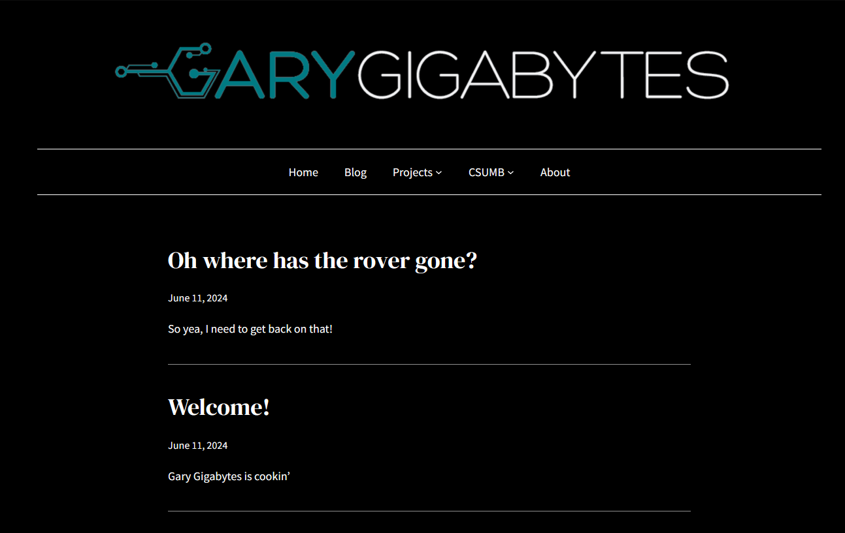

Slide 2
Rover
Smart Mirror
Drone
Drop Down Menu and Hover Highlight
Homepage has Updates

