Slide 1


COVID-19 Vaccination Progress:
How do Countries in the EU Compare with the UK?
By Konstantinos Orfanakis
https://github.com/KOrfanakis
https://twitter.com/korfanakis

Slide 2
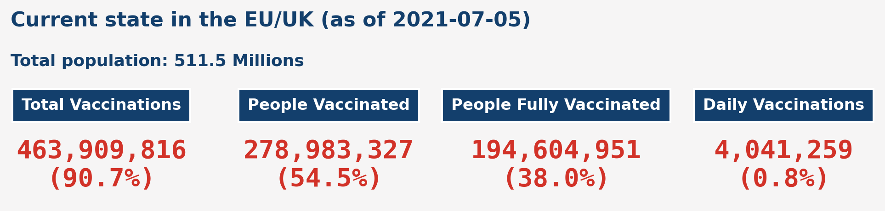
As of 2021-07-05:
The total number of vaccinations in the EU/UK exceeds 450 million.
More than 275 million people have received one dose of the vaccine, which amounts to almost 55% of the population.
Nearly 200 million people have been fully immunised (approximately 38% of the population).
The number of new vaccinations on this date exceeds 4 million.

Slide 3
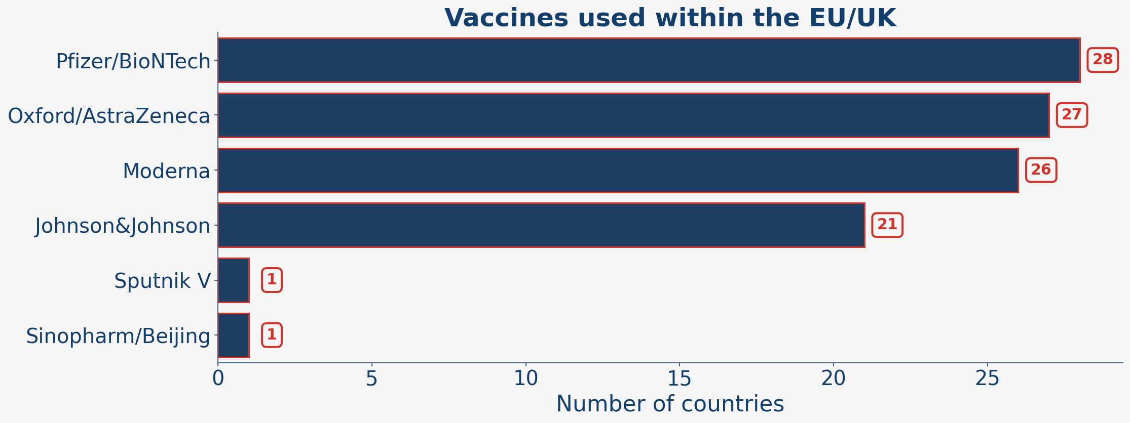
Six different vaccines have been used within the EU/UK. The most common vaccine is Pfizer/BioNTech, as it is in use in all 28 countries. The second and third most common vaccines are Oxford/AstraZeneca (27/28 countries) and Moderna (26/28 countries). Johnson&Johnson is in use in 21 countries. Interestingly, only one country (Hungary, as we will see later) uses the Chinese Sinopharm vaccine and the Russian Sputnik V vaccine.

Slide 4
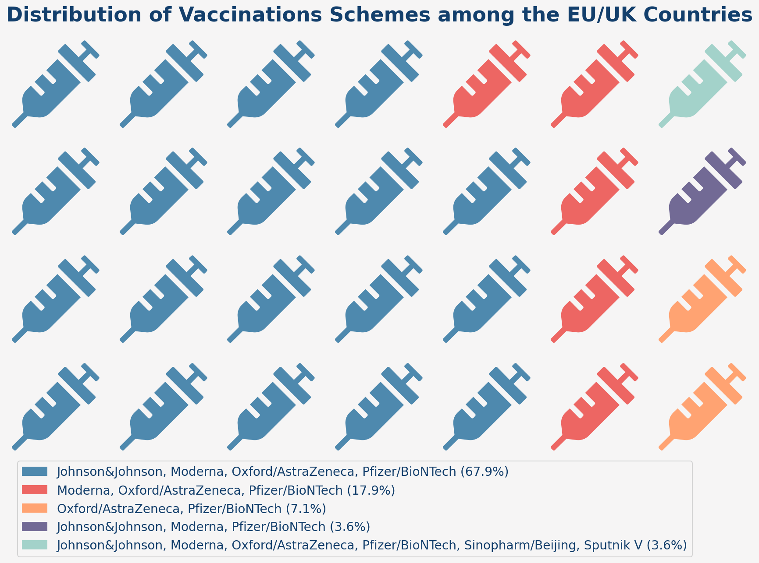
However, countries usually use a combination of different vaccines, which we refer to as 'vaccination schemes'.

Slide 5
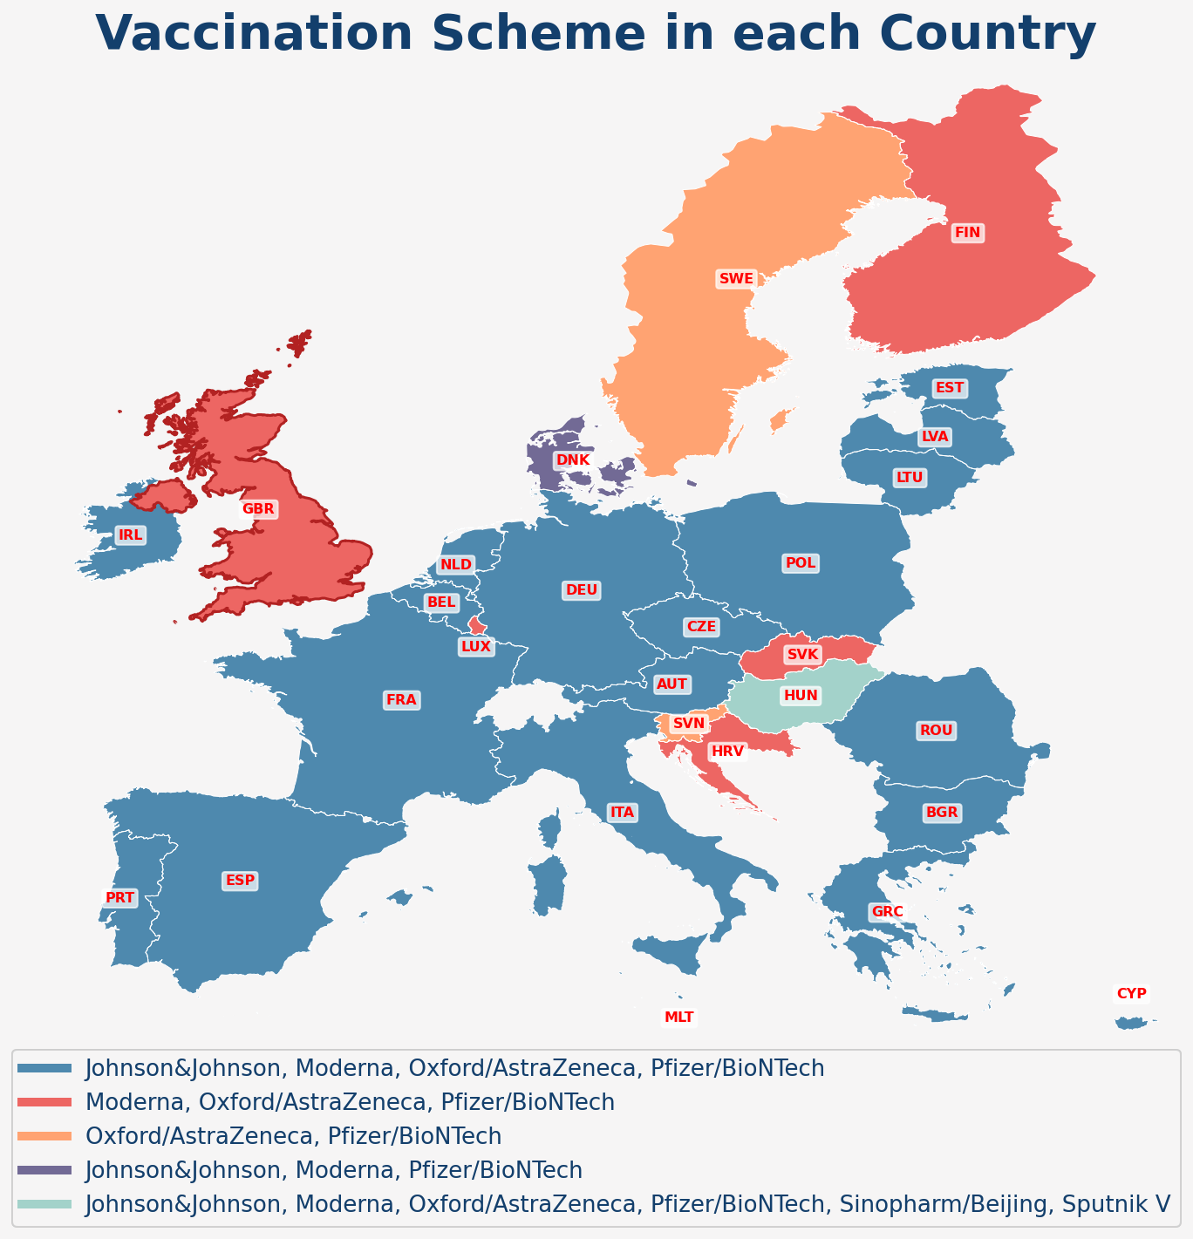
19 out of the 27 countries of the EU use a combination of four vaccines: Johnson&Johnson, Moderna, Oxford/AstraZeneca, and Pfizer/BioNTech.
The UK (along with Luxembourg, Croatia, Slovakia, and Finland) uses only Moderna, Oxford/AstraZeneca, and Pfizer/BioNTech.
Denmark is the only country that has not used Oxford/AstraZeneca.
As mentioned earlier, Hungary is the country with the highest diversity in vaccines since it uses all the previously mentioned ones, plus Sinopharm and Sputnik.

Slide 6
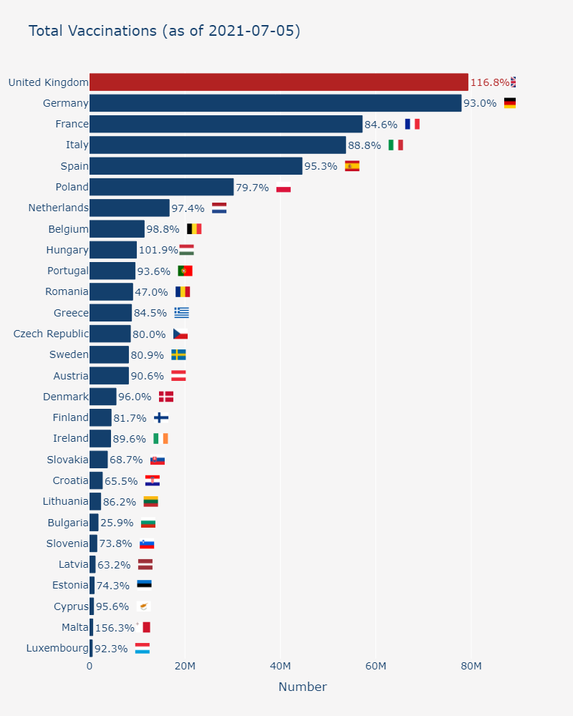
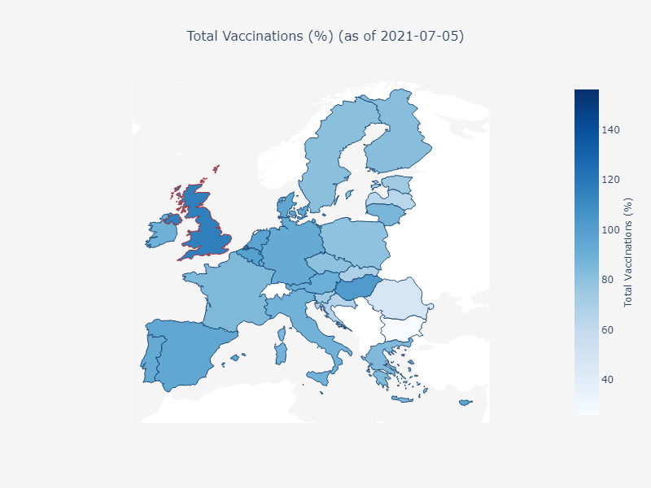
Considering countries with a high population (> 10M), the UK is leading the vaccination race. Since December, the total number of vaccinations in the UK exceeds 79 million. In comparison, Germany and France have administered almost 78 and 57 million vaccines, respectively.

Slide 7
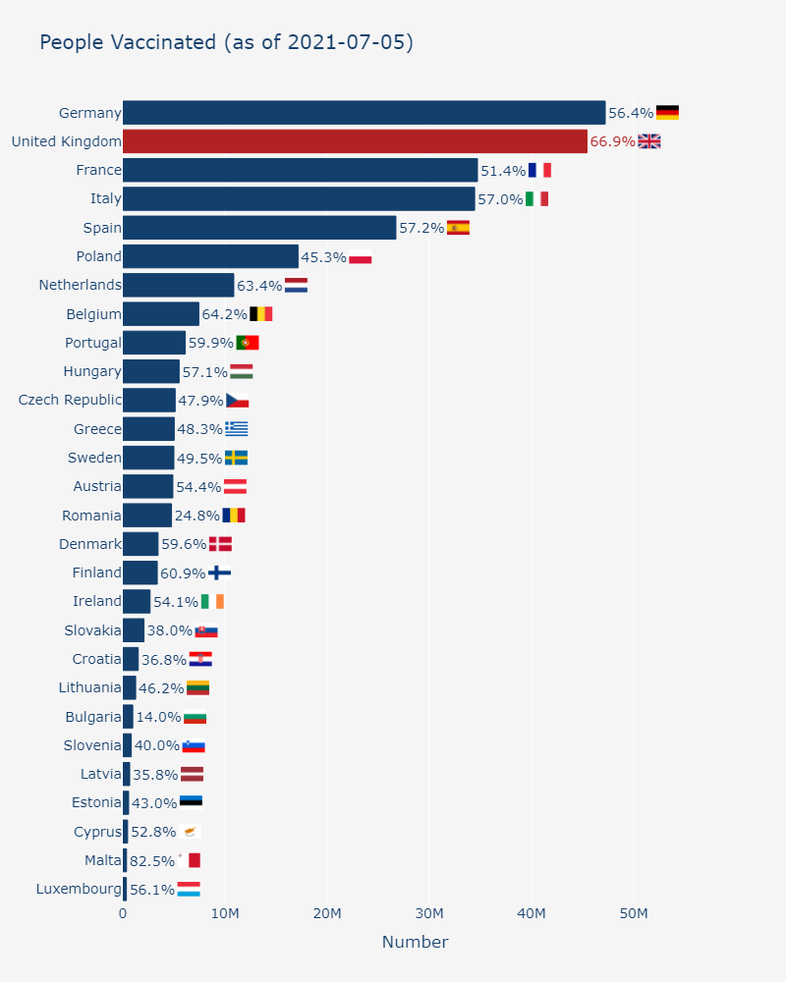
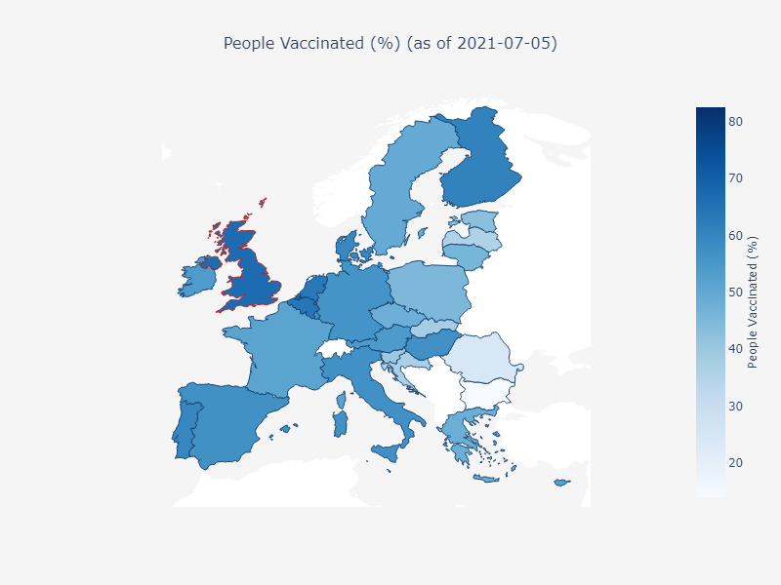
The UK also leads in terms of vaccinations per capita. Specifically, more than 45 million people have received one dose, which amounts to almost 67% of the UK's population. In comparison, Germany, the best-performing country in the EU, has immunised nearly 2 million more people than the UK, which amounts to approximately 56.5% of the country's population.

Slide 8
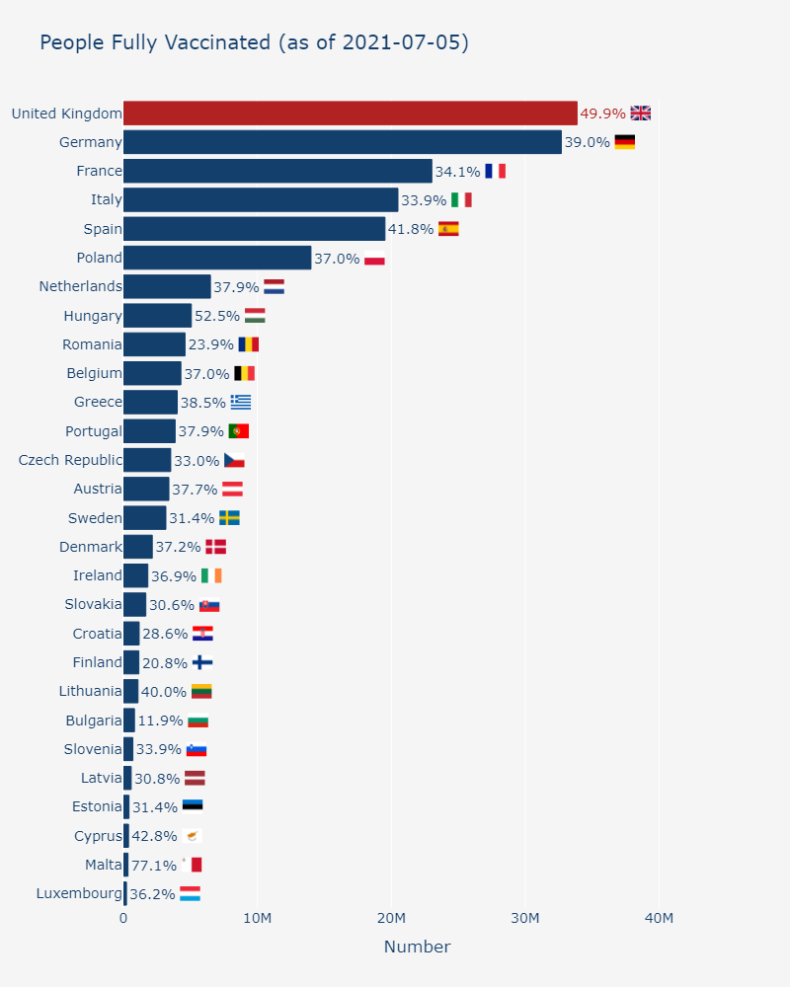
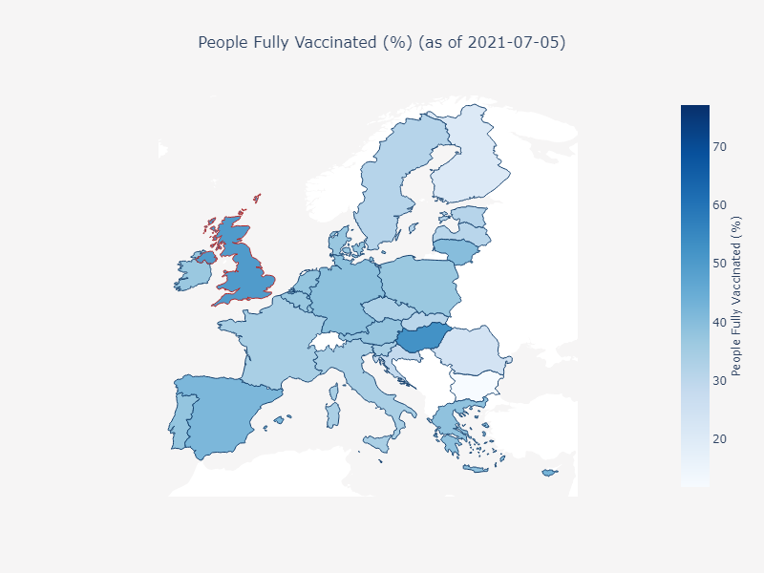
Almost one out of two people have been fully immunised in the UK. The same percentage is equal to 39% for Germany and 34% for France.

Slide 9
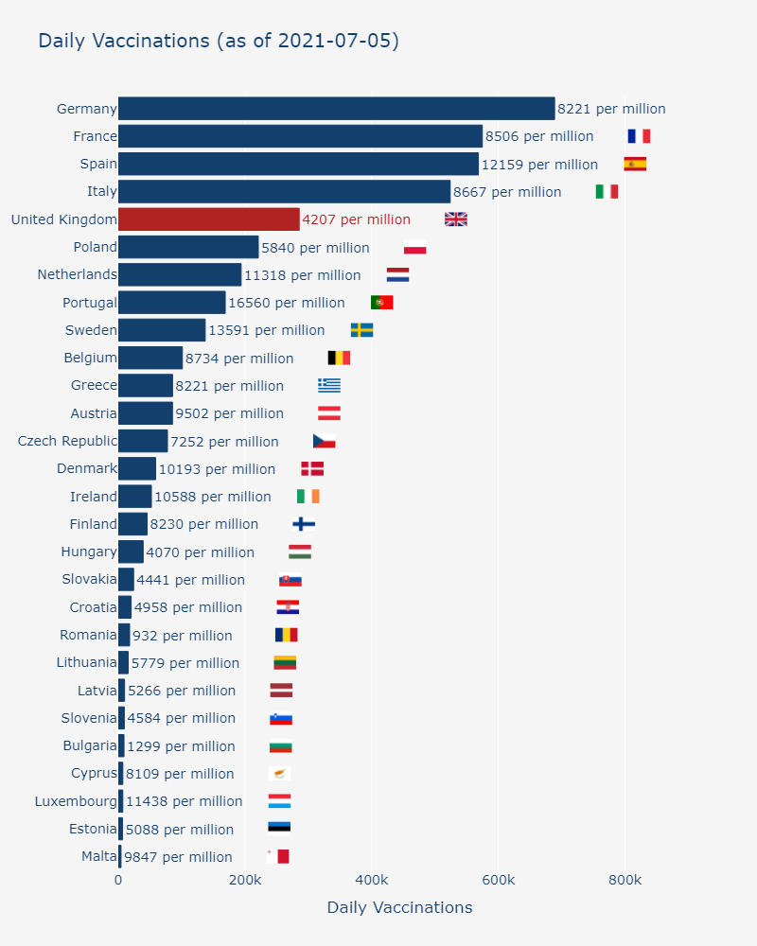
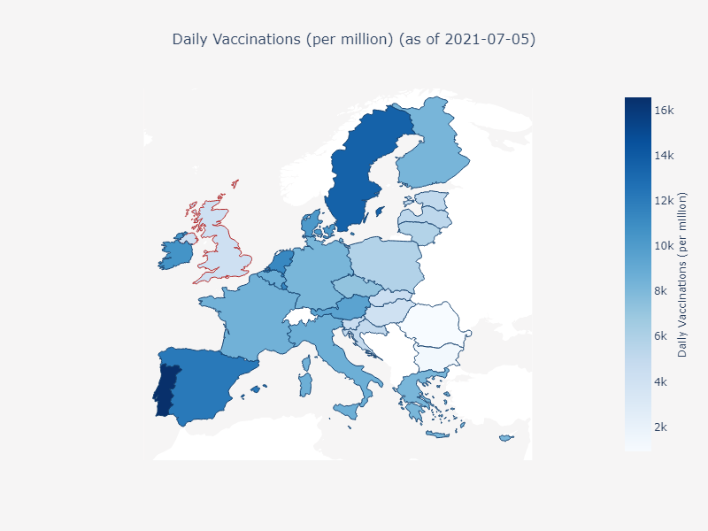
However, on 2021-07-05, the UK delivered 286,000 new vaccinations (almost 4,200 per million) while Germany delivered more than double that number (688,781 jabs or 8,221 per million). France also has a higher number with 574,717 jabs (or 8,506 per million). Portugal has the highest rate of daily new vaccinations, with 16,560 jabs per million.

Slide 10
We need to mention that Malta is currently the most successful country in terms of normalised numbers as it has the highest percentage of people having received both the first and second dose.

Slide 11
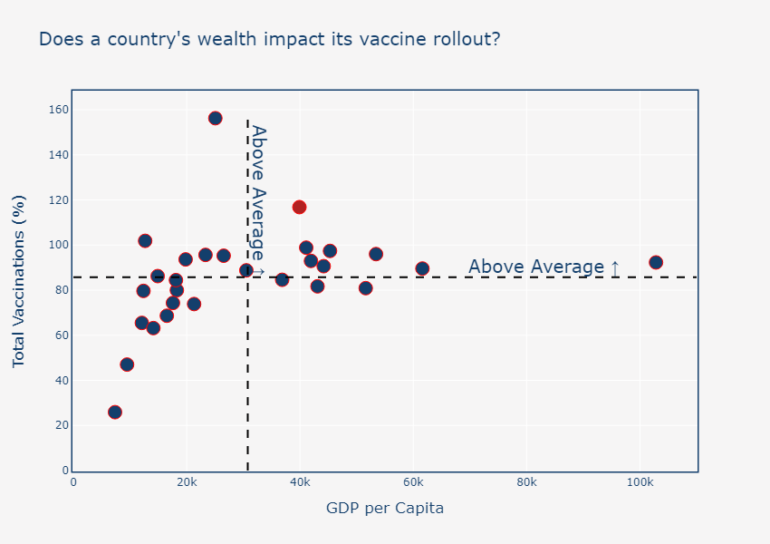
Does a country's wealth impact its vaccine rollout?
It appears that GDP is not a major factor as most countries are clustered around the mean percentage of total vaccinations. It’s interesting that Luxemburg, the richest of the countries featured, has a slightly above average percentage. As mentioned earlier, Malta has by far the highest vaccination rate even though its GDP is below the average value.

Slide 12
Caveat
The most significant caveat with our analysis is probably the fact that not every country began vaccinations at the same time.
For instance, the UK approved the Pfizer-BioNTech vaccine on the 2nd of December, and the first jab was administered six days later. Authorisation of the same vaccine in the EU came almost three weeks later (21st of December), with most countries starting vaccinations on the 27th of December.
We can mitigate this caveat by using the days since the first vaccination as the independent variable, instead of actual dates (Day-Month-Year).
I have chosen to compare the UK with the four EU countries with the highest population (Germany, France, Italy, and Spain). In this way, we will avoid cluttering the plot with 28 lines.

Slide 13
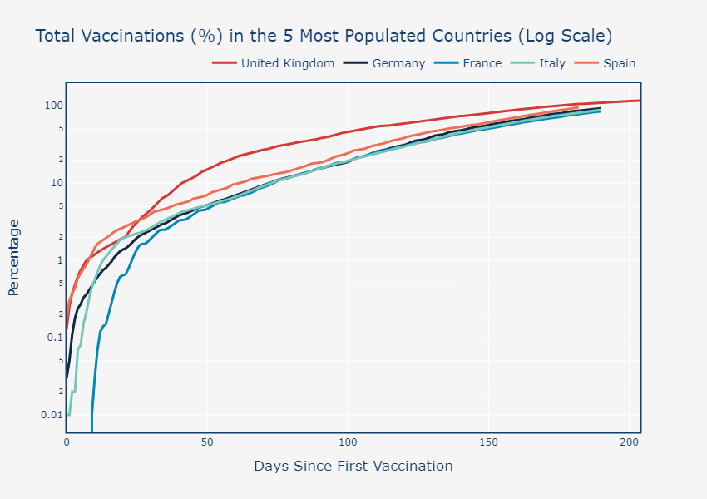
It appears that the UK has been the leading nation since the beginning of vaccinations; however, the four big EU countries have started catching up. Looking at the total number of vaccinations, after 190 days, Germany has administered vaccinations covering almost 93% of its population. The UK achieved the same vaccination percentage on day #165, i.e. more than three weeks faster than the best EU country. Interestingly, Spain is quickly approaching the UK.

Slide 14
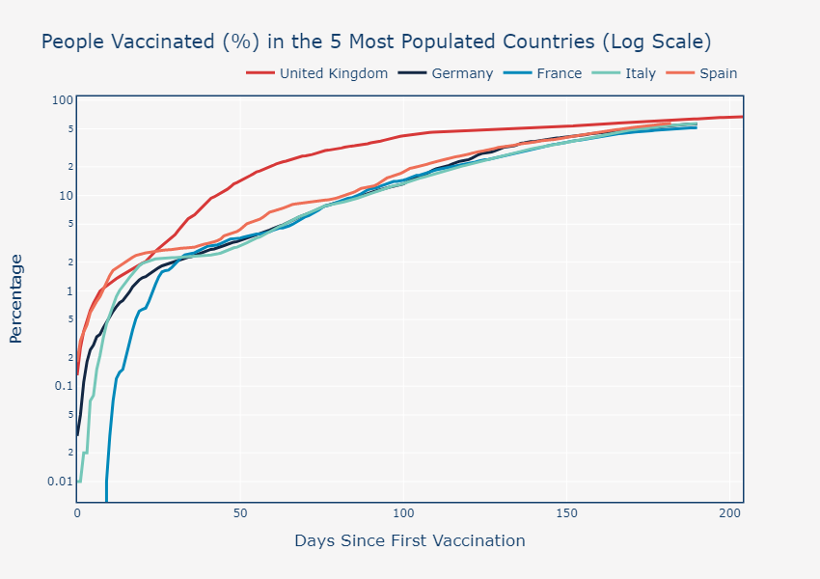
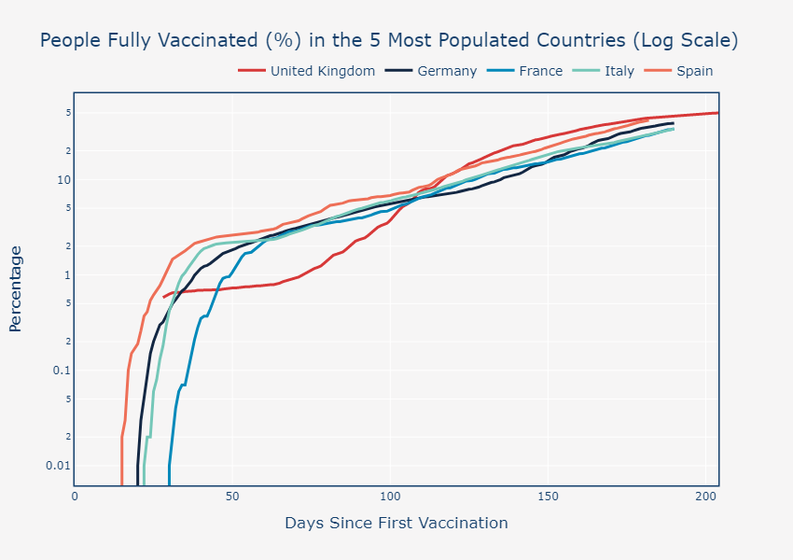
The UK is ahead in terms of the percentage of the population having received both the first and second dose of the vaccine.

Slide 15
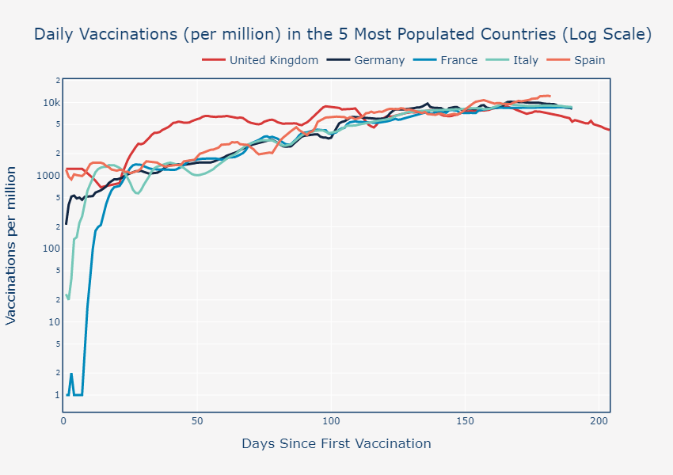
However, there is a significant decline in the number of daily new vaccinations in the UK starting from day #165.

