Slide 1


COVID-19 Pandemic in Greece: Cases, Deaths, and Vaccination Progress
By Konstantinos Orfanakis
https://github.com/KOrfanakis
https://twitter.com/korfanakis

Slide 2
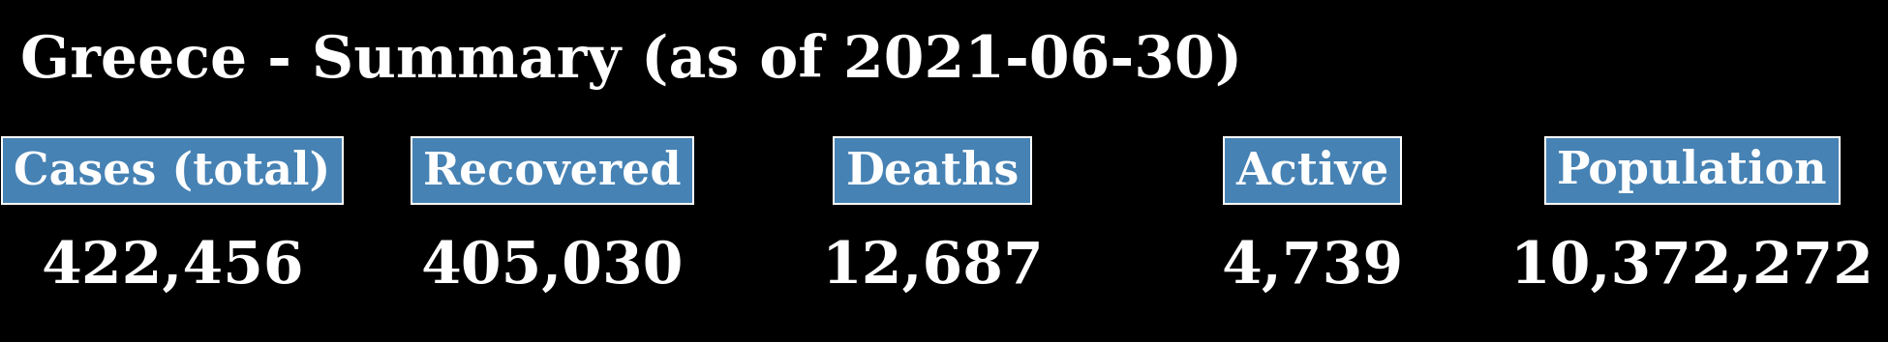
Since the beginning of the pandemic, more than 420 thousand cases have been recorded in Greece, which amounts to 4% of the population. 3% of COVID-19 patients passed away, however, the vast majority (> 95%) have recovered.

Slide 3
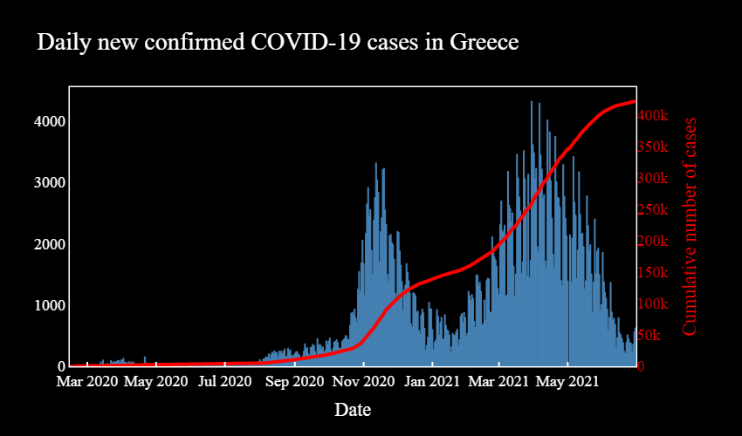
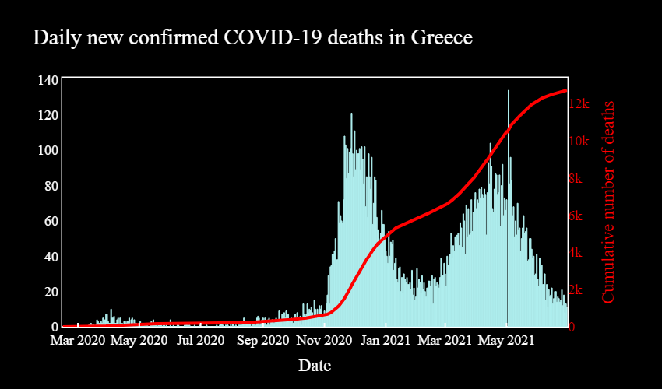
Greece has experienced two big waves of COVID-19:
During the first wave, which started around August 2020, cases peaked around mid-November.
During the second wave, which started in mid-January, cases peaked around late March.

Slide 4
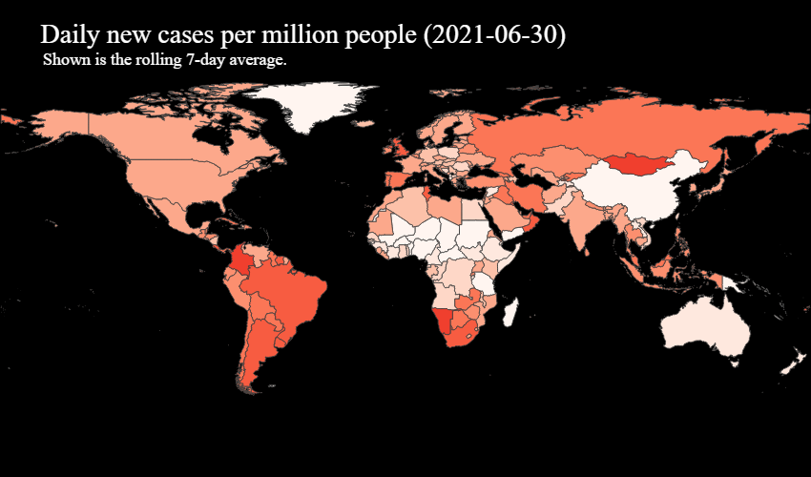
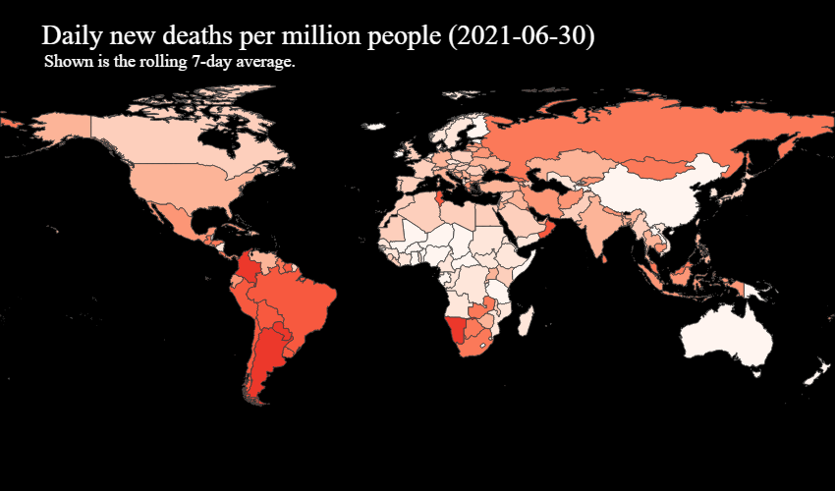
By normalising the latest figures per million people and calculating a 7-day rolling average, we can compare the number of cases and deaths with other countries.
It appears that Greece is faring similarly to most countries in Europe.

Slide 5
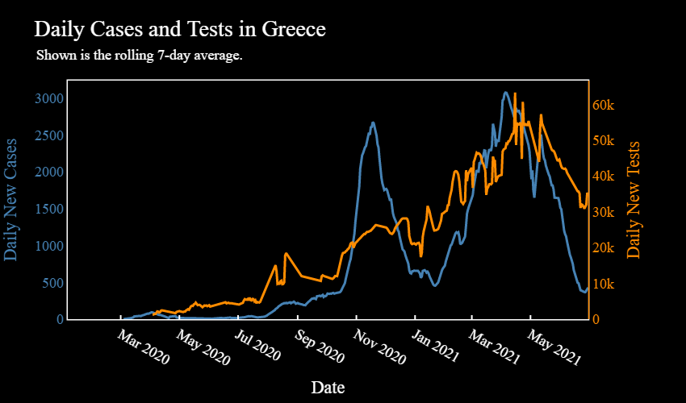
By looking at the number of tests, we can determine if big spikes in cases/deaths are real or just a result of changes in the number of tests.
It appears that the latest reduction in new cases coincides with a decline in the number of daily new tests.

Slide 6
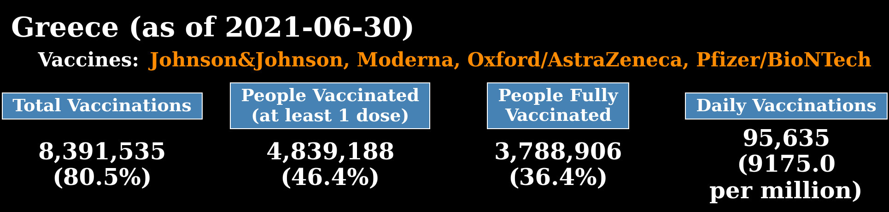
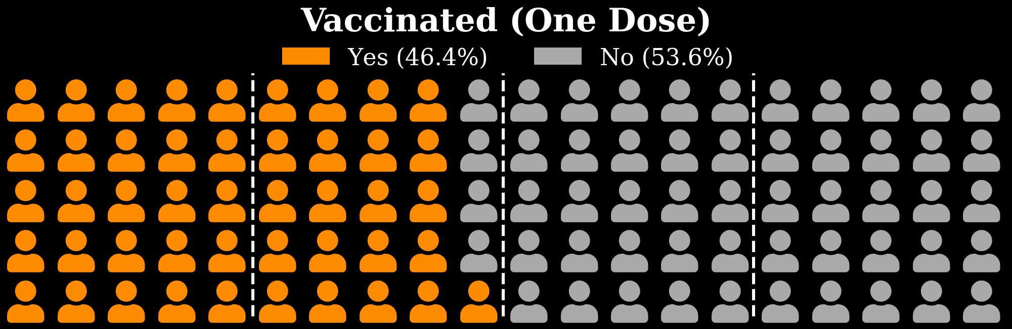
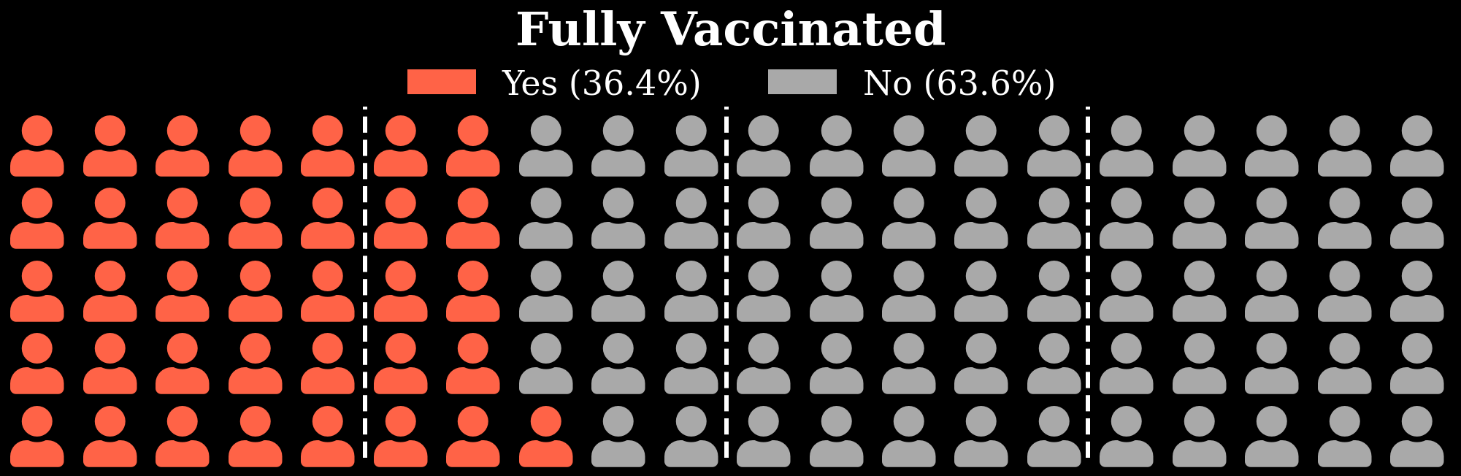
Four different vaccines are currently in use in Greece. Almost one out of two people has received the first dose of the vaccine, while one out of three people has been fully immunised.

Slide 7
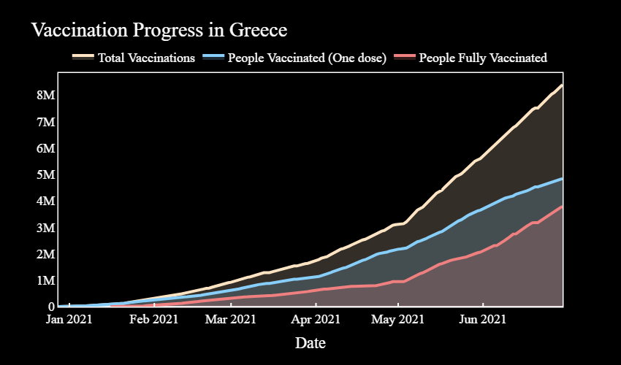

Slide 8
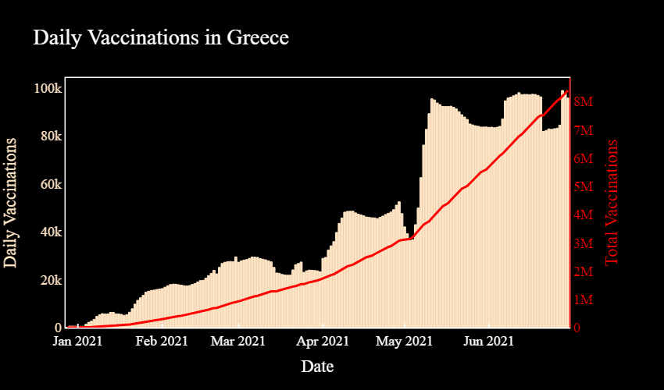
Starting at around the middle of May, Greece has achieved an almost constant vaccination rate of around 90K daily new vaccinations.

Slide 9
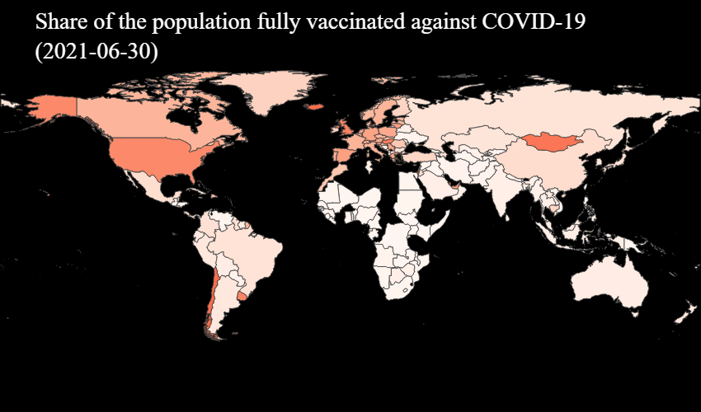
Greece has a similar proportion of the population fully vaccinated to most European countries.

Slide 10
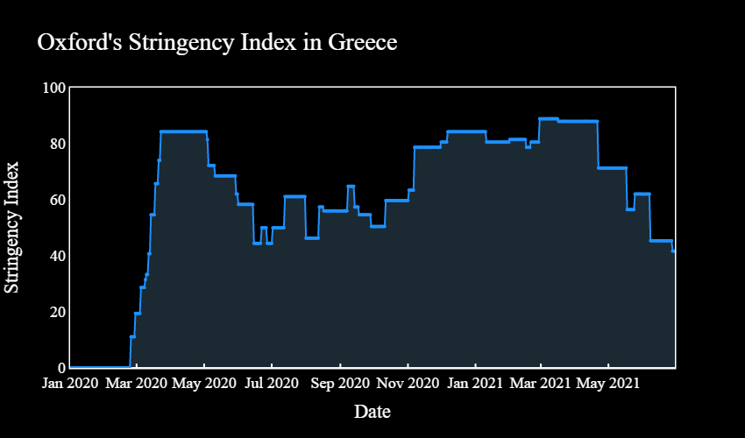
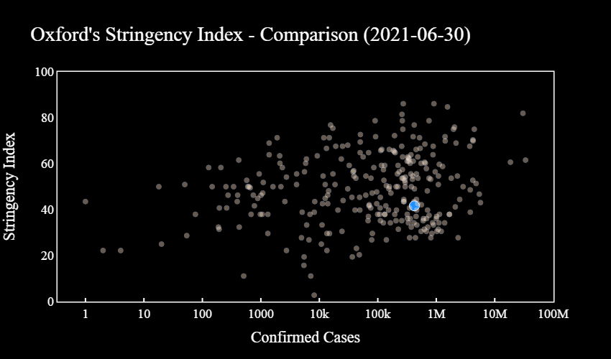
Starting from the 21st of April, Greece has been progressively relaxing lockdown measures. This is evidenced as a drop in stringency index from a value around 88 to one slightly above 40.
Greece has a smaller stringency index than most countries with the same number of confirmed cases (population is not considered though).

Slide 11
Summary
In Greece, as of 30-06-2021,
> 95% of confirmed cases have recovered.
Two big waves of COVID-19 have been observed.
Almost one out of two people has received the first dose of the vaccine, while one out of three people has been fully immunised.
Since mid-May, there has been (an almost) constant vaccination rate of around 90K daily new vaccinations.
A progressive relaxation of lockdown measures has started since mid/late April.

