Slide 1


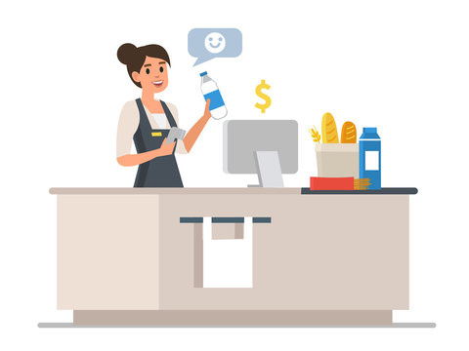
MTRACK
Presented by:- Kaushal Prajapat
Utkarsh

Slide 2





PROBLEM STATEMENT
TO KEEP A TRACK OF CREDITED MONEY THE THE SHOPKEEPER HAS GIVEN TO THE COSTUMER AGAINST THE PRODUCT THAT CUSTOMER HAS PURCHASED FROM HIS SHOP
FOR EG. IF A SHOPKEEPER GIVES A PRODUCT ON CREDIT AND ASKS THE CUSTOMER TO PAY AFTER A CERTAIN AMOUNT OF TIME. HE NEEDS TO KEEP TRACK OF HOW MUCH MONEY AND AFTER HOW MUCH TIME HE HAS TO COLLECT FROM WHAT CUSTOMERS

Slide 3



SOLUTION
We create a website where every shopkeeper can store data about every customer in a database which is linked through the shopkeepers account.
He can keep a track on how much money he has to recieve from the customer and the website can remind the customer on behalf of the shopkeeper about the deadline to return the credit. We can also impose some sort of penalty on the customer .
For e.g. he will be fined a fixed interest for each day he/she delays the payment.

Slide 4



TECHSTACK
HTML
CSS
PHP
MYSQL
XAMPP

Slide 5


Architecture
User interface
Back end
Shopkeeper’s account created
Home Page
Customer is added by shopkeeper
Sign up / Login
Add new customer
Data entry of the customer
View or edit customer data
Send
Reminder
Send remainder
Impose penalty if
payment delayed
Delete customer if payment recieved

Slide 6
HOW YOUR IDEA IS UNIQUE
Our idea is really helpful to remind the sho[keepers about their credit. As the shopkeeper’s credit and number of customers increases it gets harder for them to just write it in a notebook and keep checking everyone’s credit and as the reminder is automatic it reduces one of the shopkeeper’s job and reduces their work load

Slide 7
Thank
Thank
you!
you!

