Slide 1
JVM vs JRE vs JDK

Slide 2
If you're in a hurry ...
JDK contains JRE plus more items.
JRE contains JVM plus additional items.
In other words, JDK is the superset of JRE and JRE is the superset of JVM. Conversely, JVM is the subset of JRE and JRE, in turn, is a subset of JDK.
Java programmers/developers must have the JDK.
But, users / consumers of pre-compiled java programs only need JRE.
JVM, JRE and JDK are platform dependent because configuration of each OS differs. But, Java is platform independent.

Slide 3
JVM (Java Virtual Machine)
JVM (Java Virtual Machine) is an abstract computing machine which works on top of an operating system and provides runtime environment for executing java bytecode.
Three notions of JVM – specification, implementation & instance.
JVMs are available for many hardware and software platforms. So, these are essentially, different JVM implementations but with the same JVM specification. Even on a single platform, there can be different implementations of JVM.
JVM performs following main tasks: Loads code, Verifies code, Executes code, Provides runtime environment

Slide 4
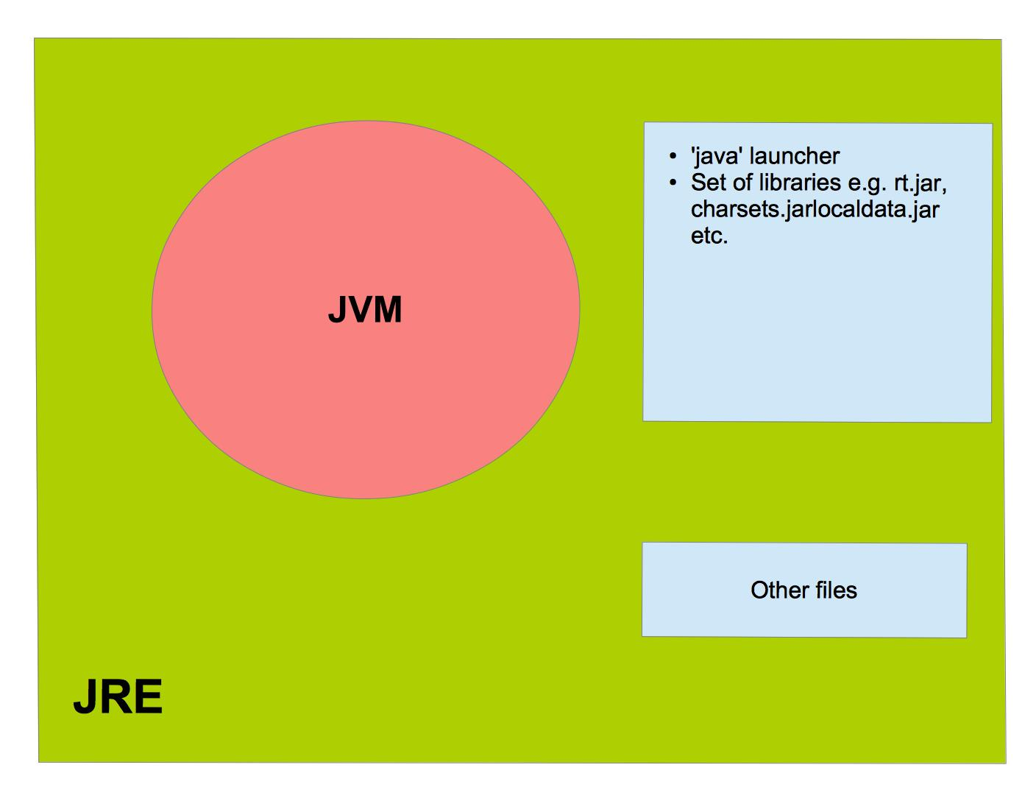
JRE (Java Runtime Environment)
Well, JRE is a software package that is used to provide runtime environment to execute Java programs. It physically exists and contains everything required to run already compiled Java programs. In other words, it contains an implementation of JVM together with a set of libraries + other files that JVM uses at runtime. JRE doesn’t contain any development tools like java compiler, debugger etc. But, it does contain the ‘java’ launcher (in order to start the execution of the java program) and various other files including the libraries.

Slide 5
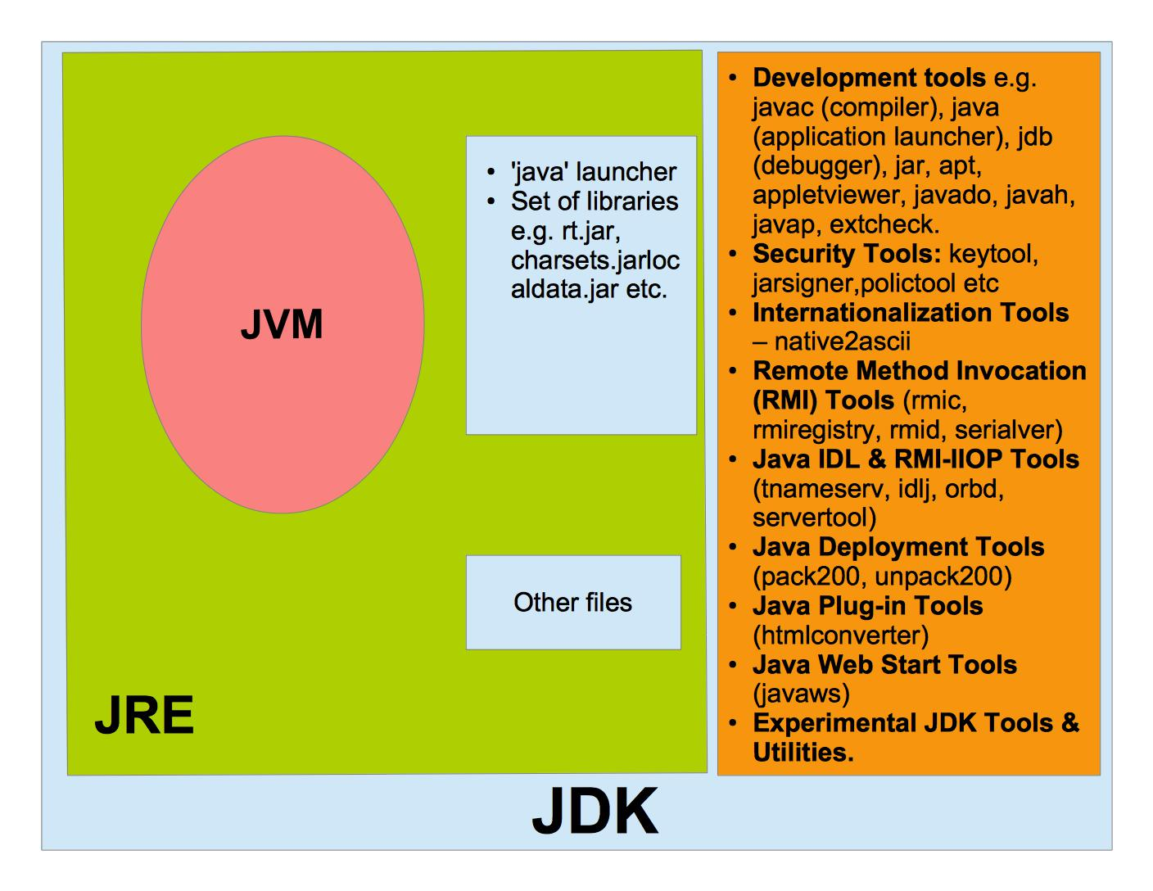
JDK (Java Development Kit)
It is something that physically exists and it contains everything that is required to develop and run Java programs. In other words, it contains JRE + various development and other tools. As you can see from the diagram that I am showing here, JDK is a superset of JRE or JRE is a subset of JDK. In addition to the JRE, the JDK contains the development tools such as the Java compiler ‘javac’, java program launcher ‘java’ & ‘jar’, java debugger ‘jdb’ etc. It also contains various sets of tools such as that for security, internationalization, java deployment etc.

Slide 6

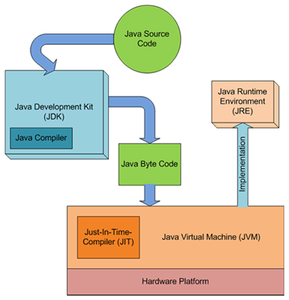
Summary
To summarize, if you want to write and build your own java programs, you must have the JDK, but if you only want to run already built Java programs, you will need only JRE. And, please remember that both contain an implementation of JVM.

