Slide 1
Hospital Waiting Lists
Kevin Breslin

Slide 2
Intro
This project looks at examining trends and behaviours across the wide range of hospitals in Northern Ireland. Healthcare waiting lists, like all aspects of national public sector healthcare policy are deeply sensitive issues.
The problem of Northern Ireland’s waiting lists is difficult, and there are no easy or obvious answers.

Slide 3
Intro
According to Professor Deirdre Heenan, when compared to the Merseyside and Wirral region. Northern Ireland’s statistics on long term waiting lists are poor.
"Merseyside and Wirral has a population of two million and has 10 people on its waiting lists for more than a year," she said. "The equivalent here - where there is a population of 1.8m - is 120,000.”
(cite Newspaper)

Slide 4
In response to this challenge, Professor Heenan, co-wrote a report with Mark Dayan, a Nuffield Trust policy analyst, called the “Change or Collapse: Lessons from the drive to reform health and social care in Northern Ireland” https://www.nuffieldtrust.org.uk/files/2019-07/nuffield-trust-change-or-collapse-web-final.pdf
One of the main methods of addressing the crisis looks at community care and centralisation, highlighted in the opening section.
“The health and social care system in Northern Ireland has seen seven fundamental reviews setting out major changes of direction in the last 20 years. Each has delivered a similar verdict: the country needs to reduce its reliance on hospitals, centralise some services for a critical mass at a smaller number of sites, and focus more on prevention and keeping people healthy.”

Slide 5
The report looks at what is helping and hindering the system from delivering four broad goals indicated in the Bengoa review and set out in detail in “Delivering together” a Northern Ireland Executive paper that focuses on Health reform.
It suggests:
Shifting care out of hospital, so that greater use is made of services that treat people in their neighbourhoods or their own home.
Greater focus on prevention rather than curative services, and a focus on the health of the population as the essential task of health and social care.
Increasing public trust in the system by reducing waiting times to an acceptable level
The centralisation of hospital services where this improves quality or safety by concentrating key staff.

Slide 6
What isn’t explored in this report, and what I believe is a good challenge for a data scientist, is the relationship between waiting times and the positioning of hospitals. Data on the waiting lists from Open NI, and vocational data for the hospitals involved can offer new insights into the scale of this issue.
It is my belief that clustering tools looking at waiting times in the context of regional performance can provide a useful metric in identifying where the scale of the problem exists in terms of either a trust.

Slide 7
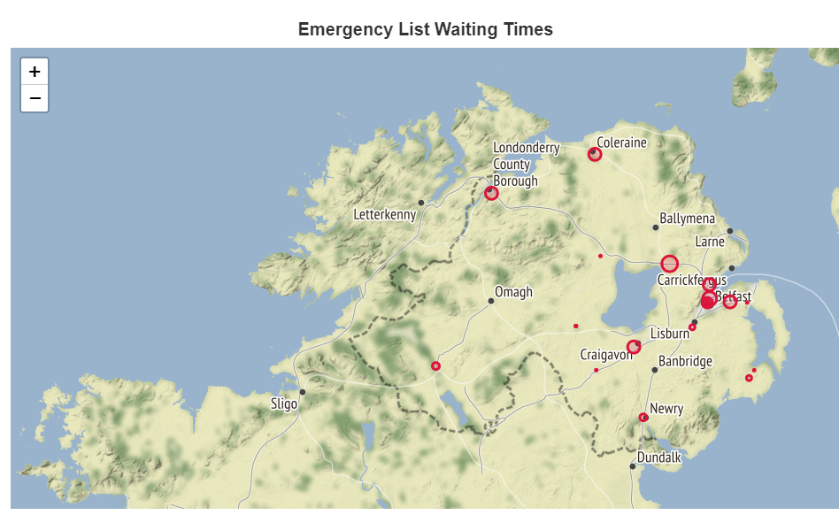
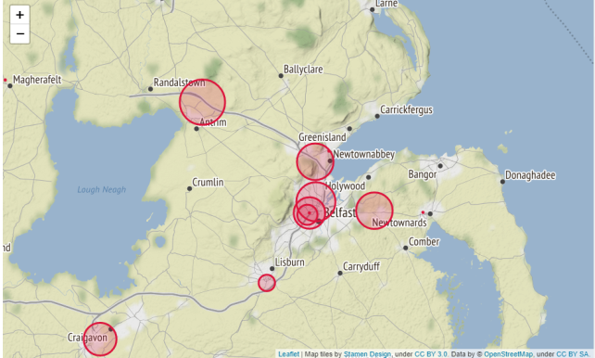
Emergency Waiting Lists

Slide 8
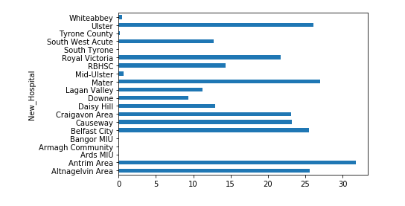
Emergency Waiting Lists

Slide 9
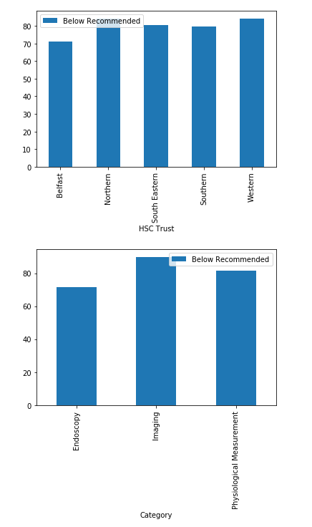
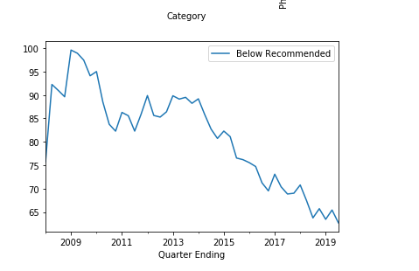
Emergency Waiting List Times Performance

Slide 10
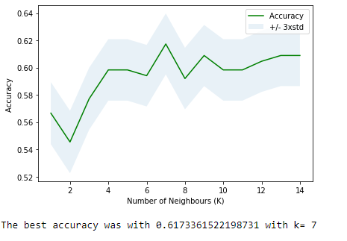
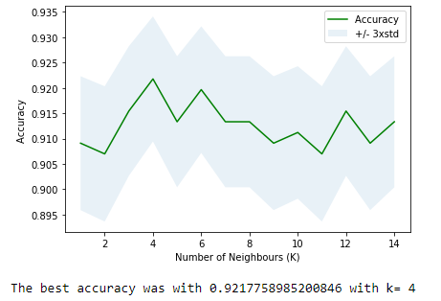
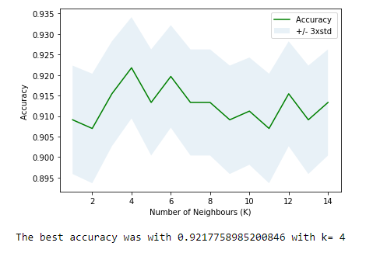
K-means clustering tests

Slide 11
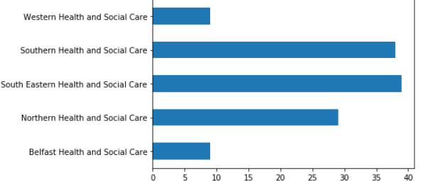
Trust Performance Graph (Emergency)

Slide 12
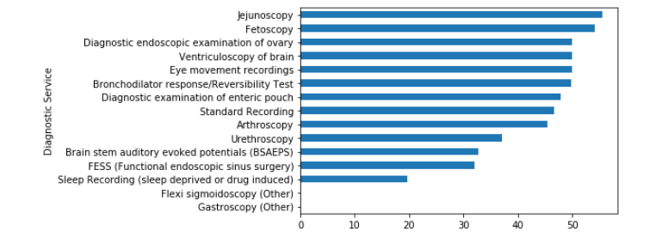
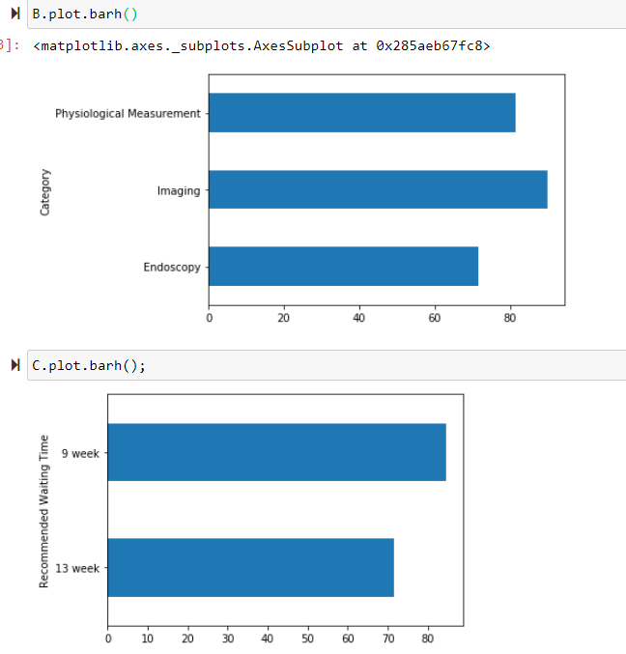
Diagnostic Waiting Time Performance

Slide 13
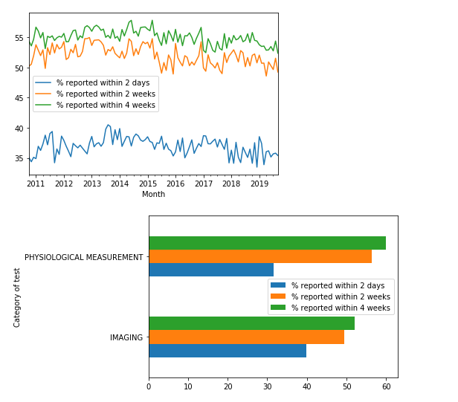
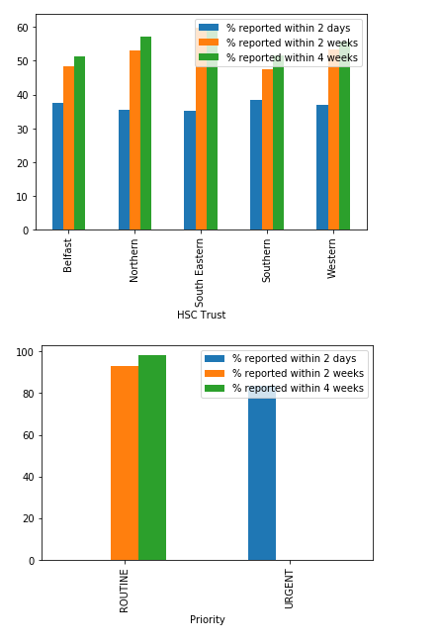
Diagnostic Waiting Time Performance

Slide 14
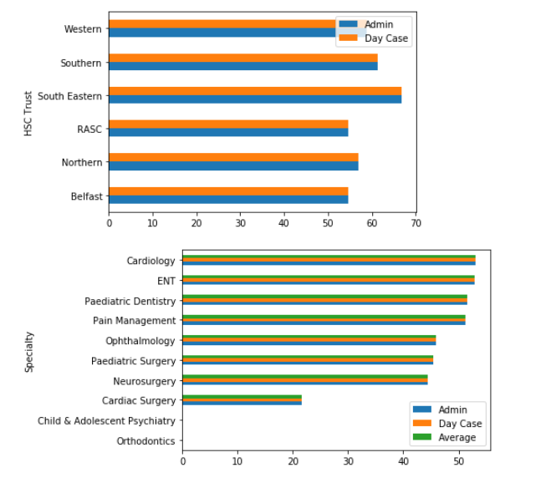
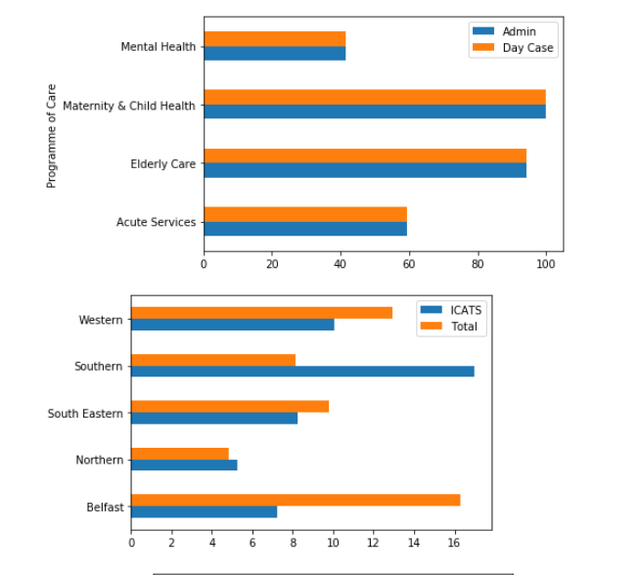
Admin and Day Care Waiting Lists (Comparison)

Slide 15
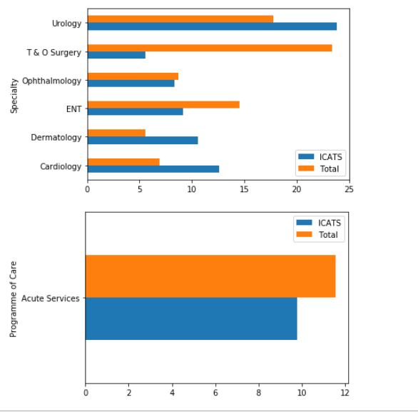
ICATS vs. Total Waiting List Performance (Comparison)

Slide 16
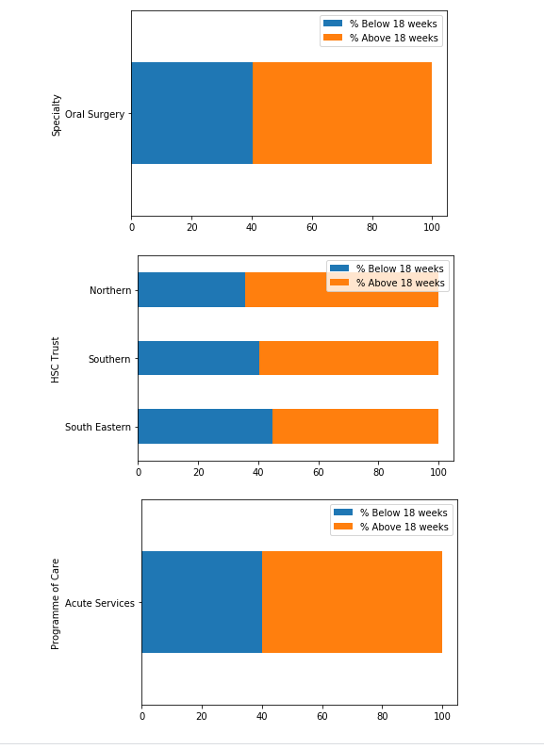
Outpatient (Central) Performance

Slide 17
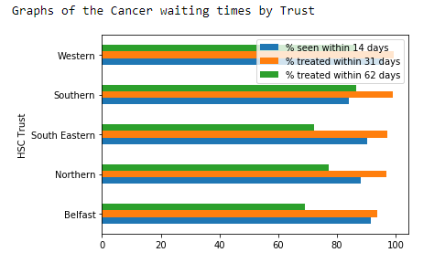
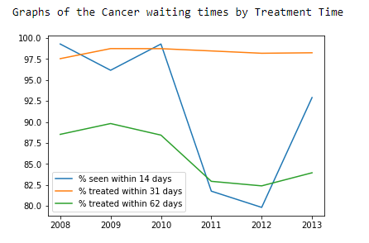
Cancer Waiting Times Performance

Slide 18
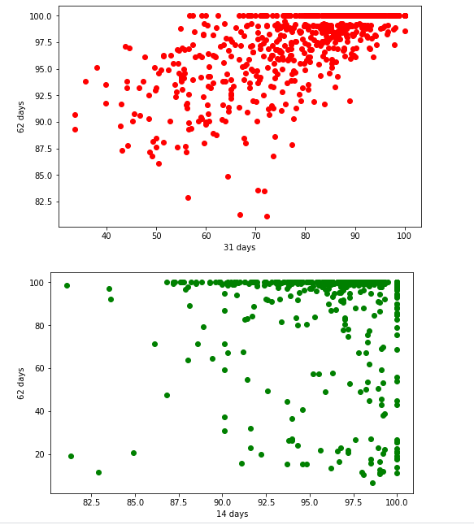
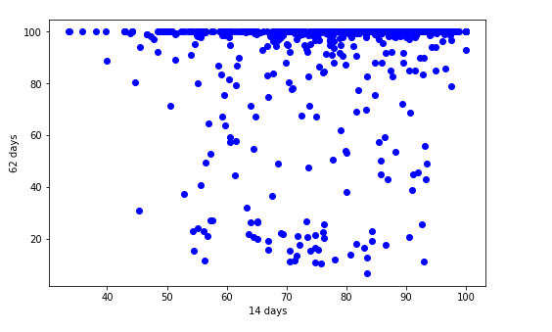
Cancer Waiting Time Patterns

Slide 19
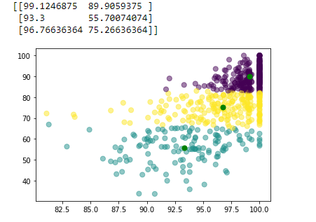
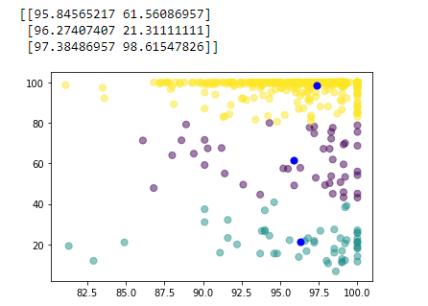
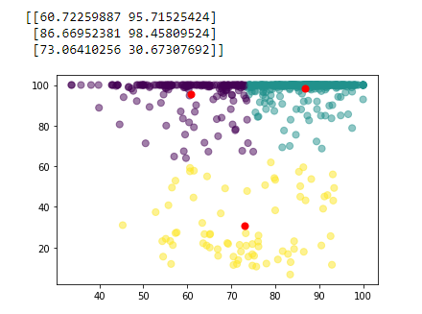
Cancer Waiting Times Patterns

Slide 20
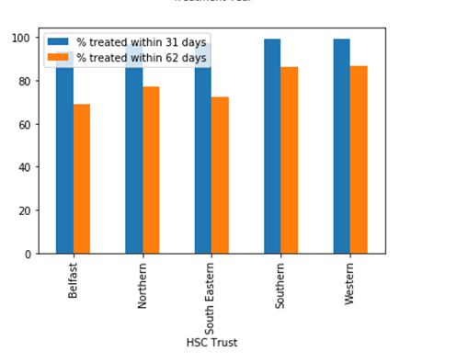
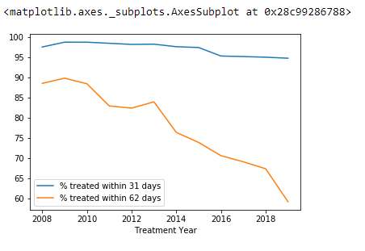
Cancer Treatment Time Performance

Slide 21
Discussion
Much of the numerical and temporal data from the raw sources are alphanumeric instead of pure numeric and datetime, so data-cleaning is necessary
Performance metrics for waiting times are readily available for data analysis.
Comparative measures are needed to weigh up how a combined score for diagnostic, emergency, inpatient, outpatient and cancer results.

Slide 22
Conclusion
This investigation was a time limited proof of concept look at trying to apply a data science methodology onto the Hospital waiting times of Northern Ireland.
Aspects such as performance metrics can be brought to light with sound application of these techniques.
A through analysis of this problem however will require a more holistic approach taking account the constraints placed on trusts in terms of both human and material resources, as well as the geographic change in demand.

