Slide 1
Machine Learning Testing
Convergytics Solutions

Slide 2

Agenda
What is Testing?
Need to Test?
Software testing vs ML Testing
Model Testing vs Model Evaluation
Types of Testing
Testing Philosophy

Slide 3
What is Testing?
In general, testing is finding out how well something works.
Software testing is the process of evaluating and verifying that a software product or application does what it is supposed to do.

Slide 4
Need to Test?
Checking product and documentation in order to determine how far the needs or requirements are met
To find and prevent defects.
To measure quality and risk
Speeds up data science work raises data scientist confidence levels and assures quality of delivery – just like in software development.
To sum up - Making our systems bug-free & robust and our lives' easy.

Slide 5
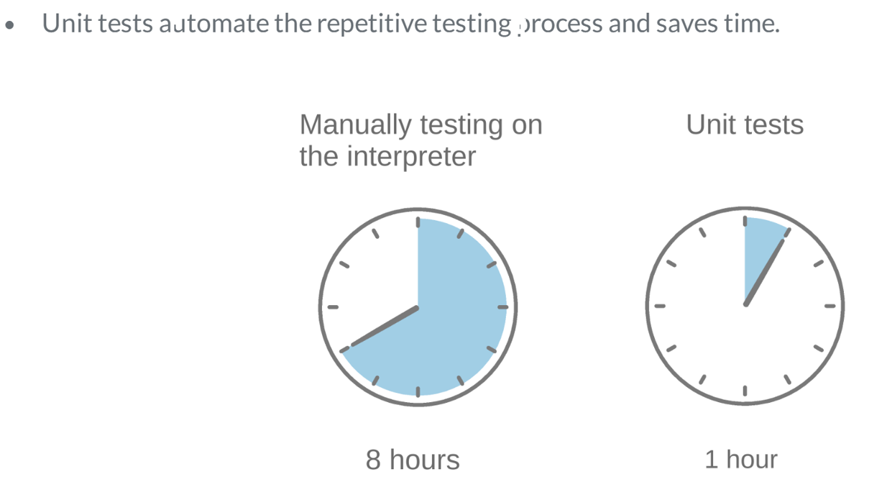
Test Time Benefit
This shows the amount of time we can save it we have unit test cases written as part of the existing development process.

Slide 6
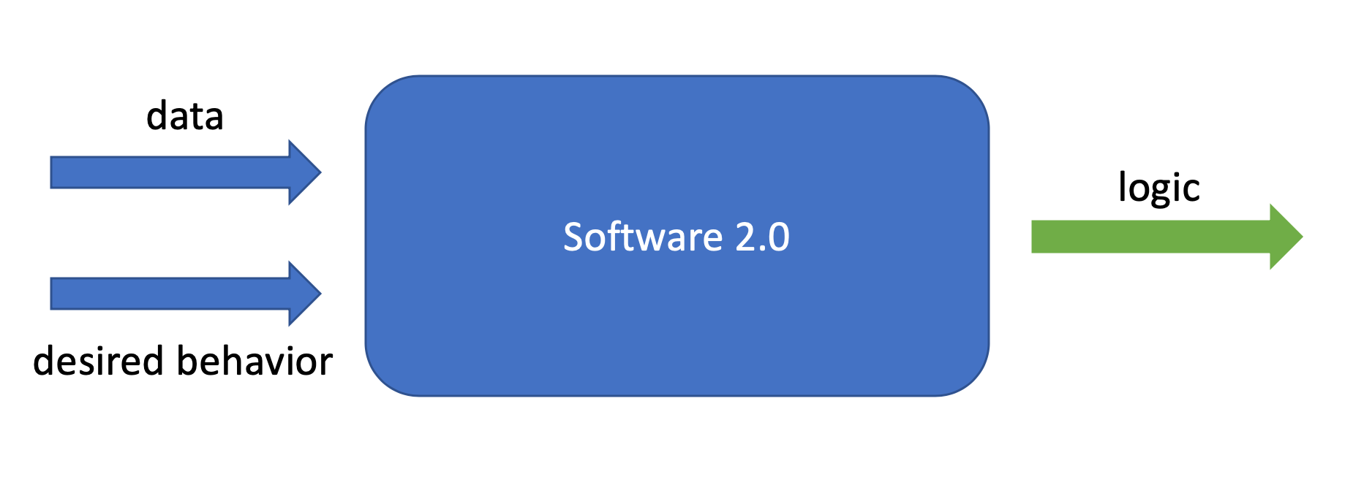
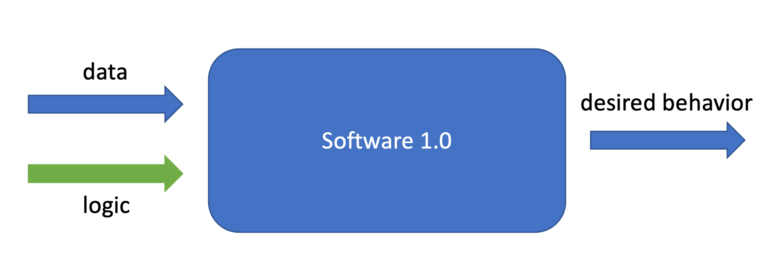
Software testing vs ML Testing
Software tests ensure that logic with data produces a desired behavior (white box testing)
In ML tests - desired behavior and data are used for optimization by a model to produce the logic (black box testing)

Slide 7
Model Evaluation vs Model Testing
Model evaluation covers model metrics/business metrics that show performance on a dataset.
And it does not tell us a lot about the reasons behind the failures and the specific model behaviors.
Model testing is the explicit behavior that the model should follow.
It helps us to narrow down the reasons and mechanisms behind behavior change and track behavioral degradation for specific failure modes.

Slide 8
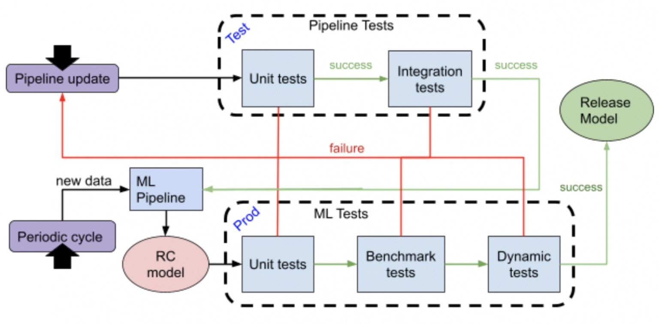
ML Test Flow
This is the schematic representation of how and where testing needs to be incorporated to have models ready for deployment.

Slide 9
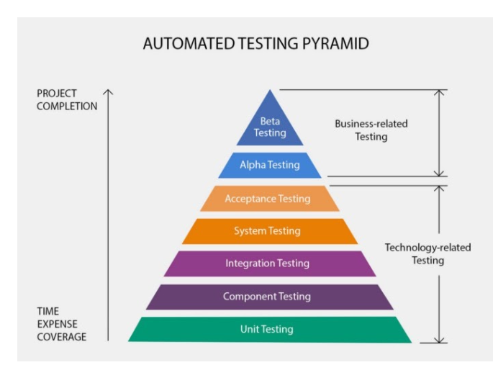
Test Pyramid
The most granular is unit testing and is a must to have test.

Slide 10
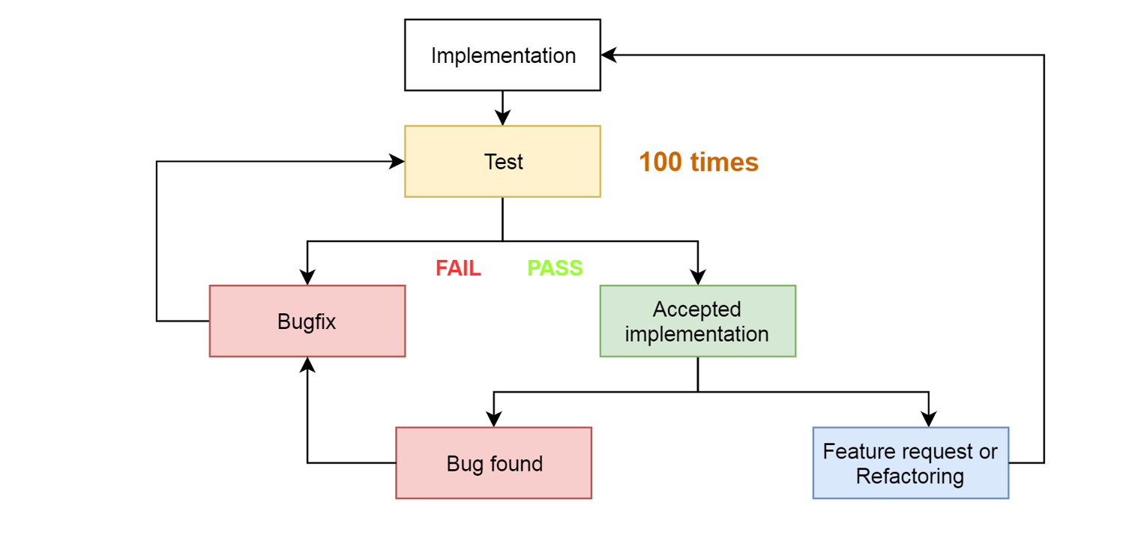
Life Cycle of a function
Iteration to detect, fix and test case to prevent bug in future.

Slide 11

Types of Testing
In ML space, we divide the tests into two main types:
- Pipeline tests
ML tests
Test flow should trigger by any one of the two events:
- A periodic model creation: if the only thing that changes is the data, run only ML tests.
- Pipeline update: any change to the data, model hyperparameters, etc., run pipeline tests and ml tests.

Slide 12
Contd…
ML Pipeline Tests
Unit test: Check the correctness of individual model components.
Regression test: Check whether our model breaks and test for previously encountered bugs.
Integration test: Check whether the different components work with each other within our machine learning pipeline.

Slide 13
Unit Test
ML Pipeline unit tests
unit testing is just a function calling another function (or a unit) and checking if the values returned match the expected output.
3 parts – AAA

Slide 14
Integration tests
It is a terminology we usually use for machine learning pipelines, in a machine learning pipeline changes in one component can cause errors in other components, therefore it is important to include integration tests to ensure the components work together seamlessly.
e.g., testing dags as whole
Differential test - A differential test compares outputs from a version that is under test with outputs from a released version.

Slide 15
Types of model testing
- Pre-train tests - prevent bugs early on during training.
- Post-train tests - check for model behavior on pre-defined scenarios.
- Production tests - monitoring models for prediction drift.

Slide 16
Pre-train tests
Assert output shapes of models should be same as the shape of the labels.
1
Assert range of outputs are within expectations.
2
Check for data leakage.
3
Ensure that the model can overfit a single batch.
4

Slide 17
Post-train tests
Invariant test
Minimum functionality test
Directional test

Slide 18
Testing Philosophy
Tests should test one functionality only
Tests should not depend on external data
Test should reflect what is used in production
Tests to avoid recognized bugs in the future
100% test coverage does not mean no errors

Slide 19
Runners/Frameworks
Unittest
Pytest
nose

Slide 20
Pytest
Pytest is a most popular test framework used to perform unit tests with ease.
Features:
- Identifying/Discovering test files
- Run tests selectively
- Markers
- Fixtures
- Parametrization
- Parallel execution & HTML report generation

Slide 21

Thank You

