Slide 1
Leveraging Azure Cloud Solutions for Enhanced Business Performance
ΟΜΑΔΑ 3
ΕΥΑΓΓΕΛΙΑ ΜΙΖΙΟΥ
ΚΩΝΣΤΑΝΤΙΝΟΣ ΠΙΣΤΟΛΑΣ
ΔΗΜΗΤΡΙΟΣ ΙΑΤΡΟΥ
ΧΡΗΣΤΟΣ ΓΑΛΛΟΣ
ΑΝΑΣΤΑΣΙΑ ΜΑΡΜΑΡΟΥ
Notes:
<number>

Slide 2
DIAGRAM OF THE CLOUD ARCHITECTURE
Notes:
<number>

Slide 3
Detailed configuration for each of the services used
WEB APP
SQL DATABASE SERVER
STORAGE ACCOUNT
RULES
FUNCTION APP
FIREWALL
SUBNETS
DIAGNOSTIC SETTINGS
KEY VAULT
IDENTITY PROVIDER
Notes:
<number>

Slide 4
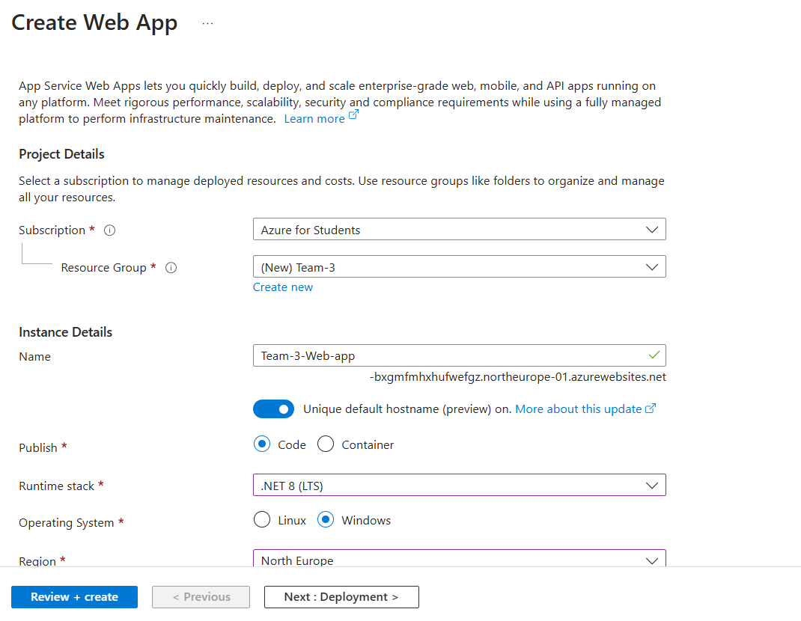
WEB APP
INFO :
Notes:
<number>

Slide 5
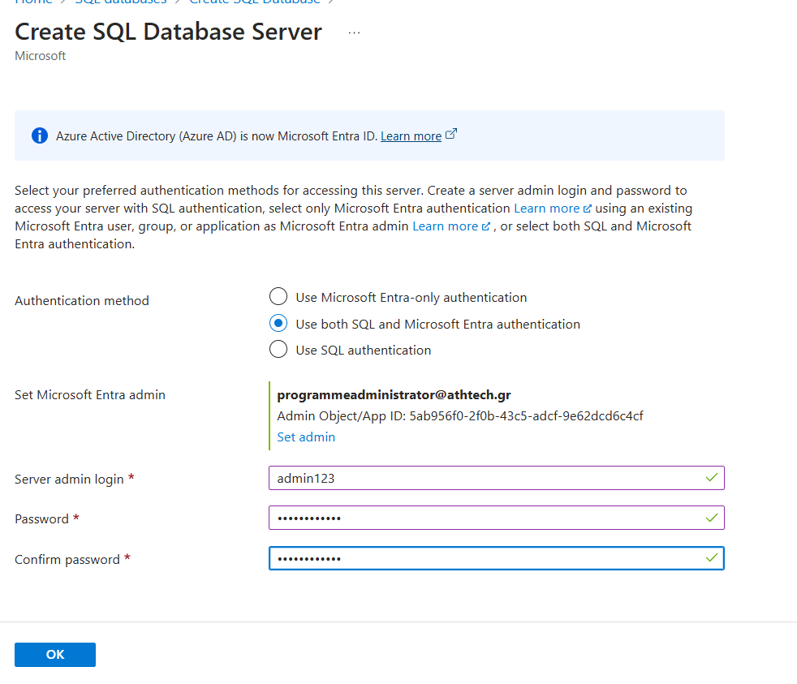
SQL DATABASE SERVER
INFO :
Notes:
<number>

Slide 6
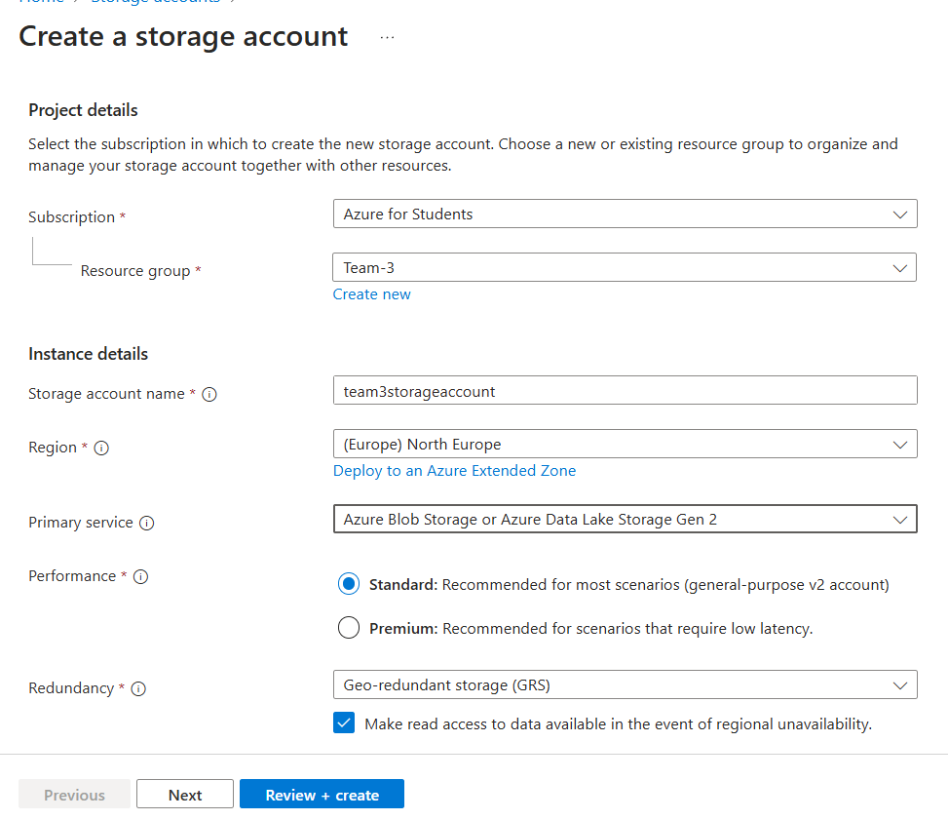
STORAGE ACCOUNT
INFO :
Notes:
<number>

Slide 7
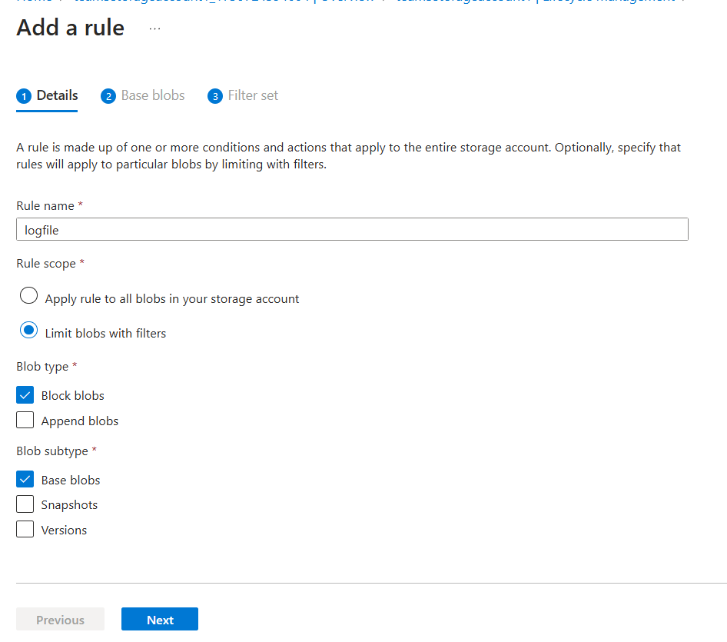
RULES
INFO :
Notes:
<number>

Slide 8
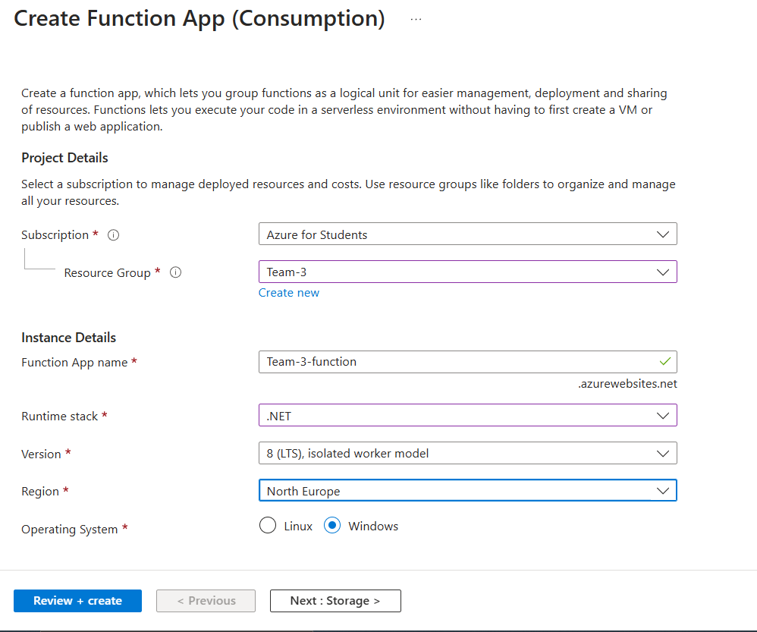
FUNCTION APP
INFO :
Notes:
<number>

Slide 9
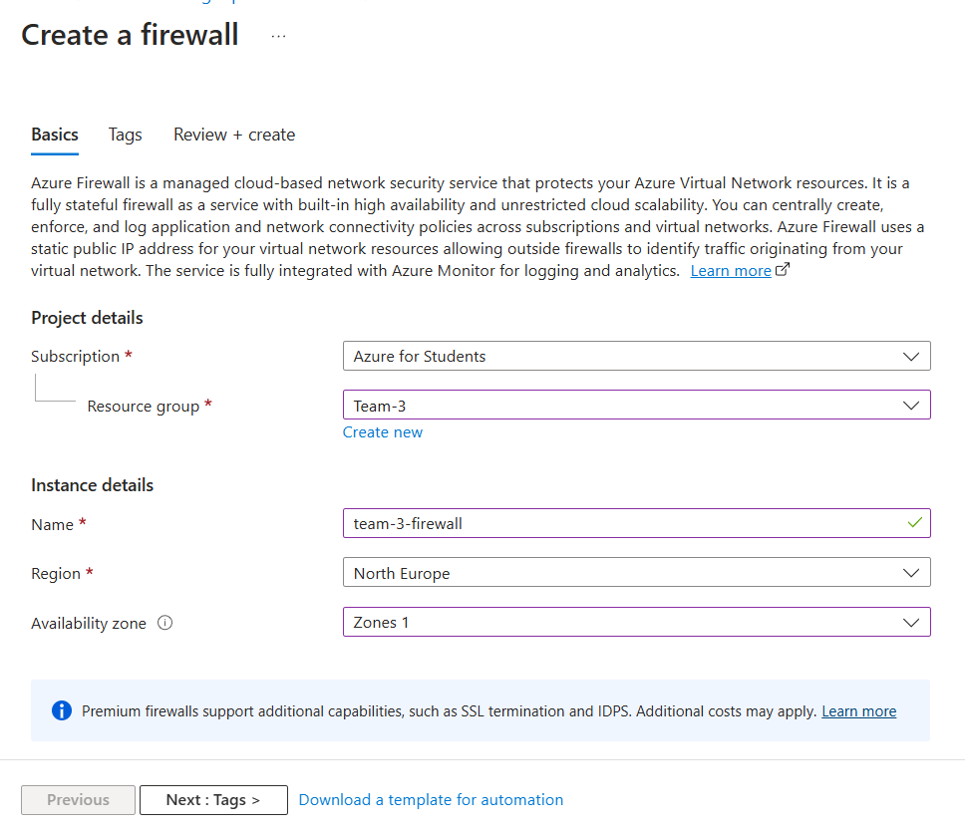
FIREWALL
INFO :
Notes:
<number>

Slide 10
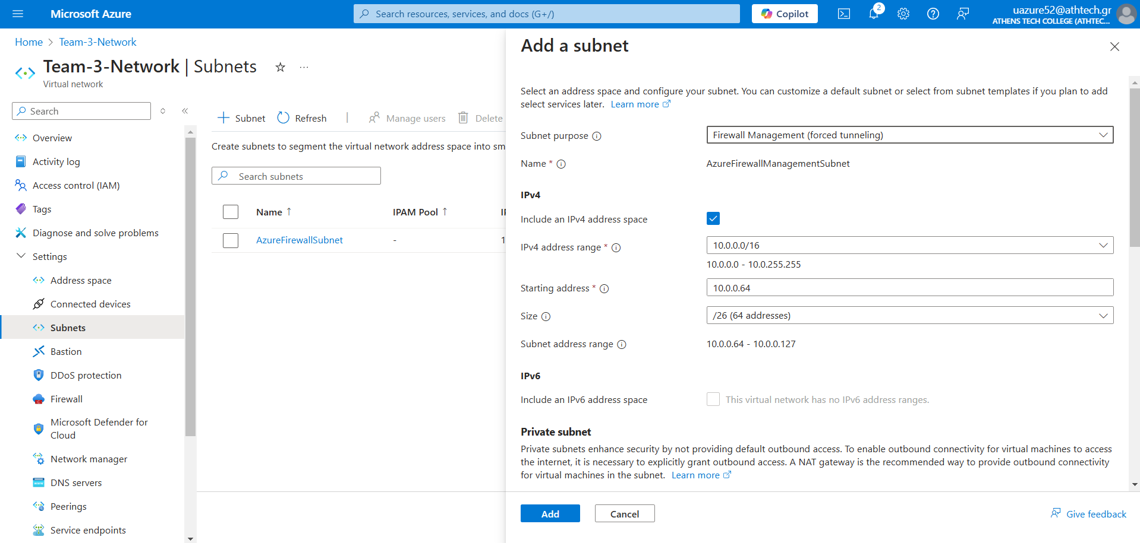
SUBNETS
INFO :
Notes:
<number>

Slide 11
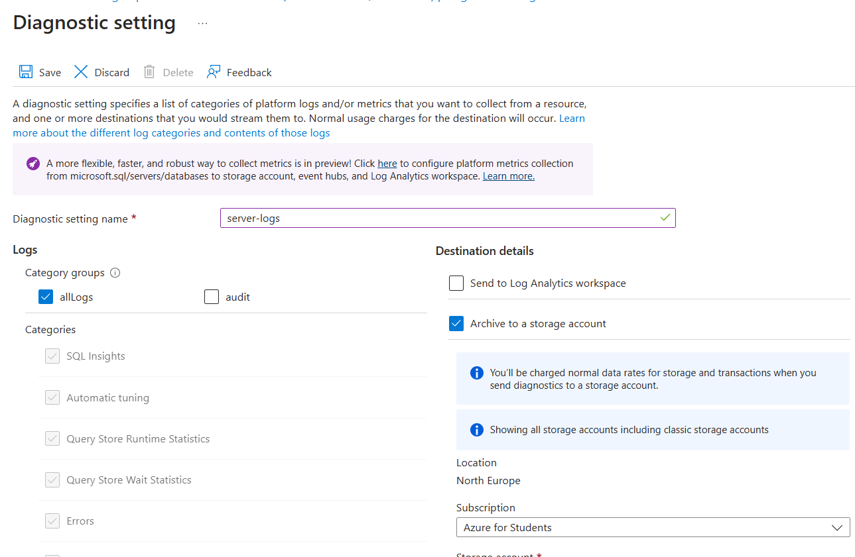
DIAGNOSTIC SETTINGS
INFO :
Notes:
<number>

Slide 12
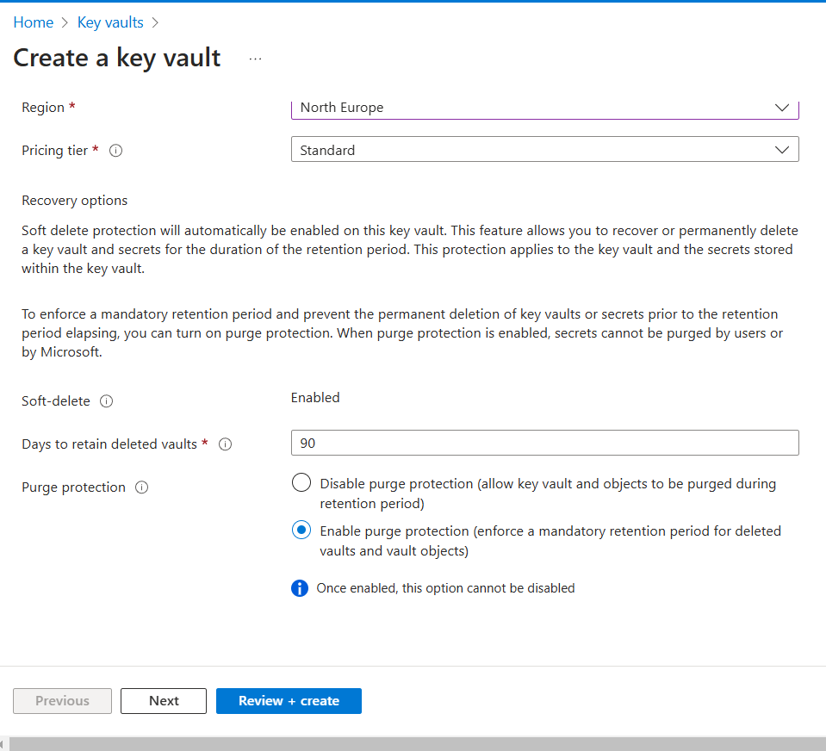
KEY VAULT
INFO :
Notes:
<number>

Slide 13
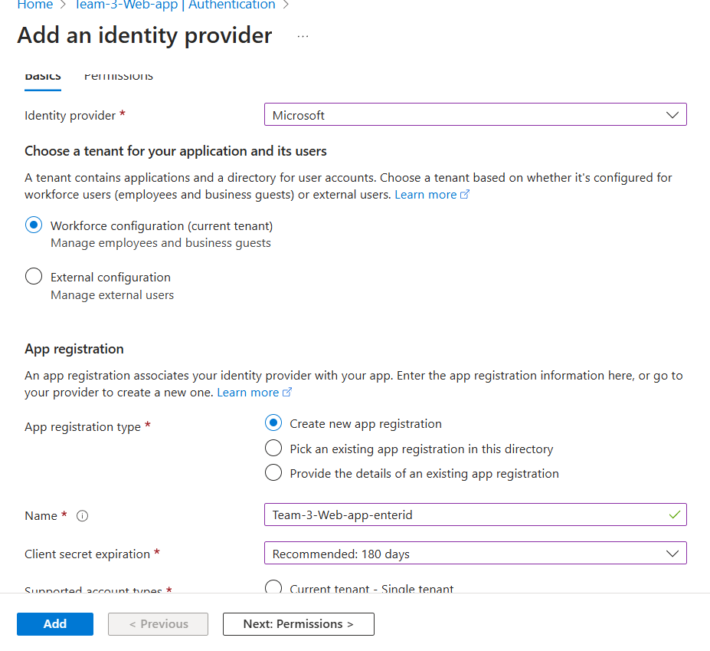
IDENTITY PROVIDER
INFO :
Notes:
<number>

Slide 14

Estimated billing
Notes:
<number>

Slide 15
Financial snapshot
Service category | Service type | Region | Estimated monthly cost
Compute | App Service | North Europe | $122,02
Compute | Azure Functions | North Europe | $0,00
Databases | Azure SQL Database | North Europe | $385,04
Storage | Storage Accounts | North Europe | $255,70
Security | Key Vault | North Europe | $30,18
Networking | Azure Firewall | North Europe | $300,38
Identity | Microsoft Entra ID (formerly Azure AD) | North Europe | $2.220,60
Cash reserves |  |  | $3.313,92
Notes:
<number>

Slide 16
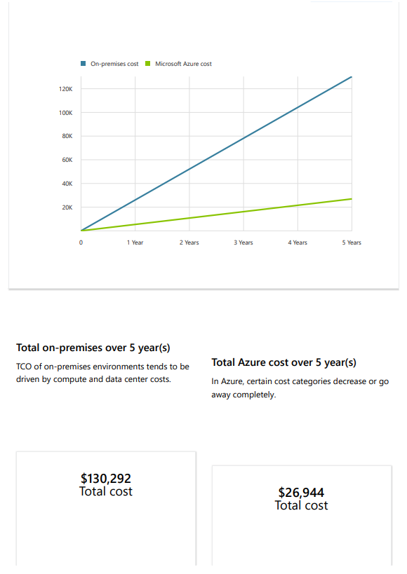
Over 5 year(s) with Microsoft Azure, your estimated cost savings could be as much as $103,348
Notes:
<number>

Slide 17
Thank You
Notes:
<number>

Slide 18

Marketing strategies
Implement personalized engagement strategies
Tailor campaigns to resonate with specific demographics, fostering a sense of relevance and connection
Collaborate with influencers and thought leaders to amplify our brand message
Notes:
<number>

Slide 19
Innovative decisions
Notes:
<number>

Slide 20
Quarterly targets
Quarter | Revenue growth (%) | Market share increase (%) | Customer acquisition
Q1 | 12 | 2 | 500
Q2 | 15 | 3 | 600
Q3 | 18 | 4 | 700
Q4 | 20 | 5 | 800
Market expansion
Product innovation
Customer retention
Operational efficiency
Notes:
<number>

Slide 21
Innovative solutions
Notes:
<number>

Slide 22
Future initiatives
Green supply chain
Reduced carbon footprint
Waste reduction
Water conservation
Product enhancement.
Introduce regular updates and features to enhance product offerings.
Technology integration.
Explore emerging technologies for potential integration into our operations.
Collaborative partnerships.
Foster collaborations with tech innovators and industry leaders to drive innovation.
Notes:
<number>

